Slide 1

EY Techathon 6.0 Executive Summary
Date of submission: 09-10-25
TEAM-RUVA

Slide 2


"Empowering Smarter Vehicle Maintenance with Intelligent Agentic AI."
Introduction
This project is about using Agentic AI to make vehicle maintenance smarter. It predicts problems before they happen, books service automatically, talks to customers through a voice agent, and sends feedback to the manufacturing team. The goal is to reduce breakdowns, improve customer satisfaction, and enhance product quality using real-time vehicle data.
introduction
Team- RUVA

Slide 3
Team Name: RUVA
Shaik Abdul Razak (Team Lead) Leads the project development and coordination. Skilled in AI integration, Python, Java, and problem solving.
01#
03#
Amogh Works on backend and API development. Good at API design, database management, and cloud integration.
05#
Ramya Responsible for research and documentation. Strong in presentation, report writing, and RCA/CAPA analysis.
02#
Umesh Handles data and analytics. Expert in data preprocessing, machine learning, and visualization.
04#
Vinod Focuses on frontend and UI/UX design. Skilled in React, HTML, CSS, and interface design.

Slide 4
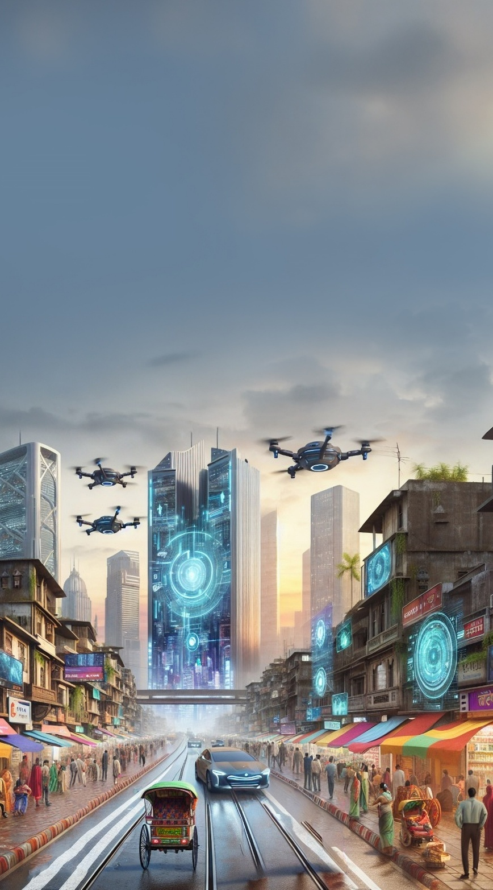
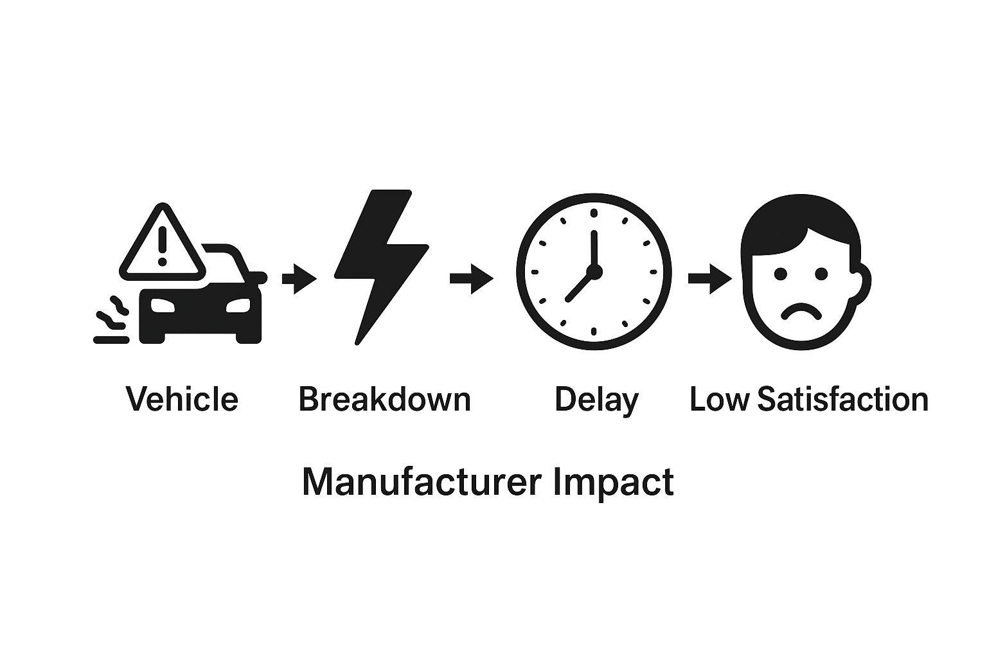
Problem:
Vehicles often face unexpected breakdowns due to lack of real-time predictive maintenance. Customers wait long for repairs, causing delays and low satisfaction. Service centers get overloaded, and manufacturers get limited feedback to fix recurring issues.
Why it matters:
Increases downtime and maintenance cost
Reduces customer trust
Slows down product quality
improvement
Problem statement you wish to address and why (Provide detailed explanation)

Slide 5
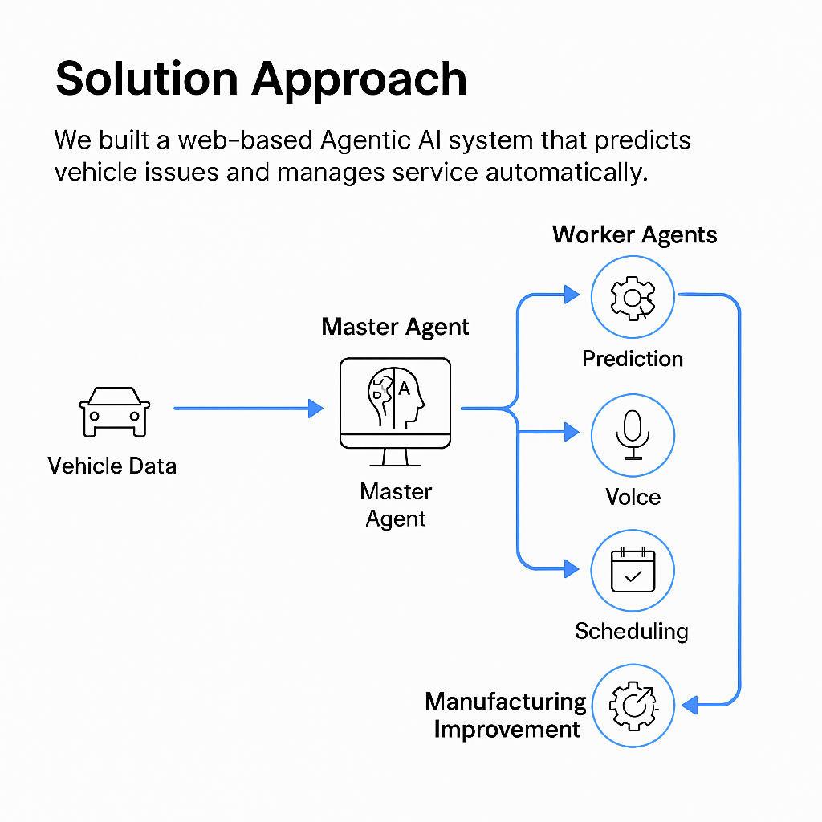
Solution Approach
We built a web-based Agentic AI system that predicts vehicle issues and manages service automatically.
How it works:
Master Agent controls all Worker Agents for data analysis, prediction, and scheduling.
Voice Agent talks to customers
and confirms service bookings.
Dashboard shows vehicle health,
upcoming issues, and service
status.
UEBA Security monitors all
Agents to prevent abnormal or
risky actions.
Describe your approach to solving the problem
(Describing Output Form Factor [Mobile App/Web App/Faceless Agent Execution/Chat Bot/Voice Bot Etc], Key User Group, User Journey.

Slide 6

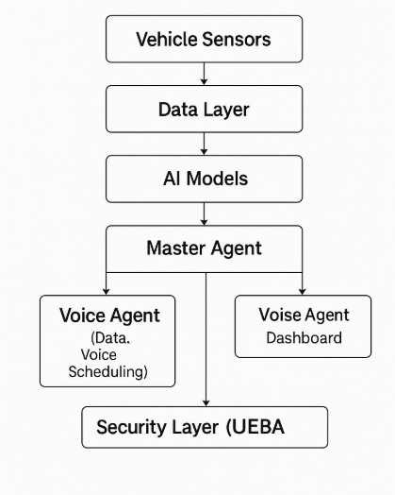
Planned Solution Design
Our system uses Agentic AI with a Master Agent and multiple Worker Agents to handle prediction, service, and feedback.
Main Parts:
Vehicle Data Layer: Collects real-time sensor data.
AI Layer: Predicts failures and service needs.
Agent Layer:
Master Agent (controls flow)
Worker Agents (Data, Voice, Scheduling,
Feedback).
Customer Side: Voice agent + web dashboard.
Manufacturing Feedback: Sends RCA/CAPA
insights to improve quality.
Security: UEBA monitors agent activity.
Planned solution design
(Diagram and Key Technology components planned for use)
Tech Used: Python | React | AI/ML | MongoDB | APIs |
UEBA Security

Slide 7
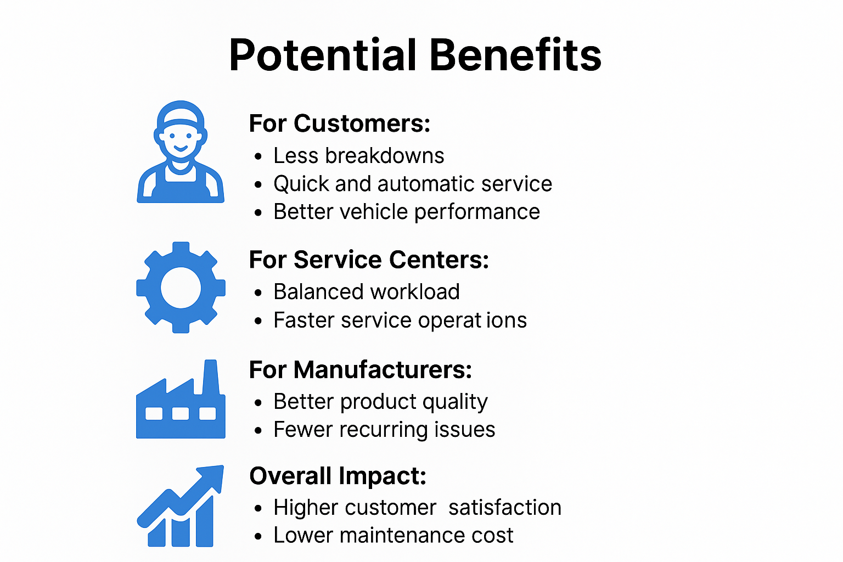
Potential Benefit from your proposed solution
Potential Benefits
For Customers:
Less breakdowns
Quick and automatic service
Better vehicle performance
For Service Centers:
Balanced workload
Faster service operations
For Manufacturers:
Better product quality
Fewer recurring issues
Overall Impact:
Higher customer satisfaction
Lower maintenance cost
Improved ROI
(Describe in detail the kind of benefit can be planned through your solution, Explain key Matrix, Potential Return on Investment)

