Slide 1
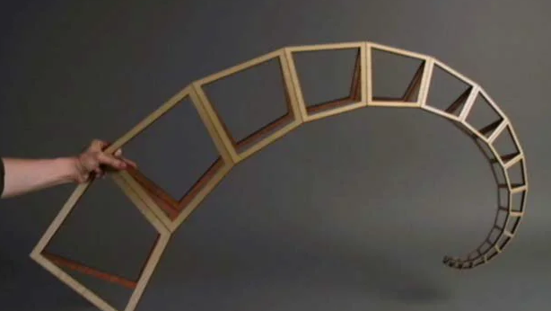

Curling Spiral (Outer Spine)
Weekly Tasks summary
Project folder on Github

Slide 2
Week 1
DOF Analysis and Literature review on Spiral Mechanism
Project folder on Github

Slide 3
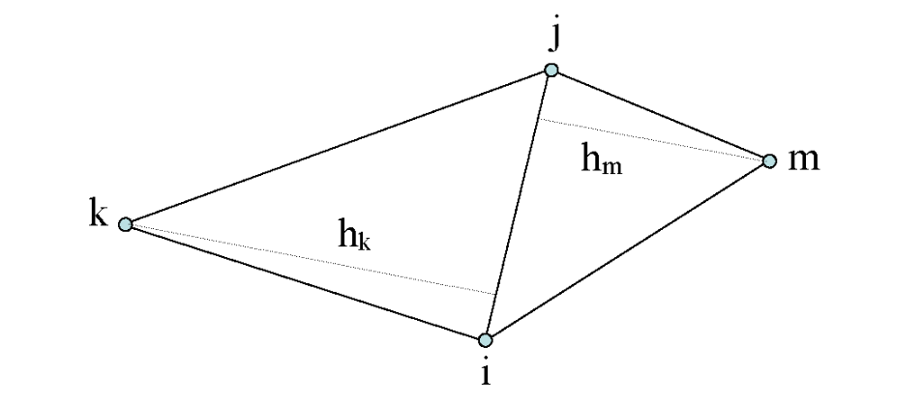
Geometric Definition & Parametric Requirements
Calculated 5 DOF by subtracting translational and rotational constraints from the total coordinate set (8 - 3 = 5).
Triangulation Method: Verified the result by decomposing the geometry into two adjacent triangles (3 + 2 parameters).
The shape is fully defined by specific combinations of the 5 DOF, such as:
4 Sides and 1 Angle
3 Sides and 2 Angles
2 Adjacent Sides and 3 Angles

Slide 4
Design Logic (Focus on parameters)
DOF Reduction: Simplified the available 5 degrees of freedom by fixing internal angles and applying a strict geometric reduction ratio.
Geometric Consistency: Achieved a self-similar logarithmic spiral by maintaining constant internal angles (alpha, beta = 80.41deg) while scaling dimensions from 50mm down to 11.88mm.

Slide 5
Design assembly
CAD Implementation: Modeled the calculated geometry in SolidWorks, extruding each quadrilateral segment to a uniform thickness of 2mm.
Constructed the primary chain by joining six quadrilaterals at their common edges to establish the base structure.
Symmetric Integration: Completed the profile by assembling a mirrored copy, replicating the motion dynamics of the John Edmark Curling Spiral (Outer Spine) framework.

Slide 6
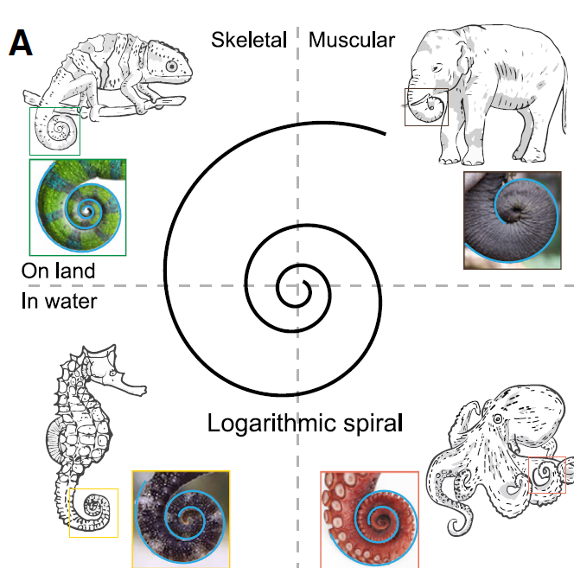
SpiRobs: Logarithmic spiral-shaped robots
The mechanism’s profile follows the polar equation
r = a.e^{(b.θ)}
Scale Factor (a): Defines the initial geometric size, correlating directly to the first quadrilateral dimension (50mm).
Expansion (b): A constant parameter that dictates the rate of expansion and the "tightness" of the spiral wrap.

Slide 7


Skill Acquisition
3D structural FEA in Abaqus CAE to capture the continuous behavior of the spiral assembly.
Learned datum planes and cell partitioning to define seperate geometries.
Workflow and techniques adapted from A-Star Education and Ahmed Elkady tutorials.

Slide 8
Week 2
Simulation in Abaqus
Project folder on Github

Slide 9
Geometry & Boundary condition
Unified Body Approach: Modeled the assembly as a single continuum body rather than separate parts, eliminating complex contact interactions.
Utilized cell partitioning and section assignments to distinctively define the plywood and tape regions within the spiral.
Geometry and dimensions align with the previously developed SolidWorks model.

Slide 10
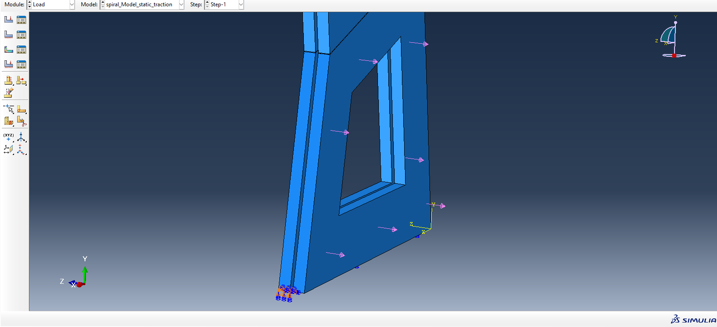
Geometry & Boundary condition
Fixed constraint to the left base quadrilateral, while subjecting the opposing side to varying loads (body force, traction, pressure) across different simulation trials.
Adopted standard SI units to ensure consistency within the Abaqus environment.

Slide 11
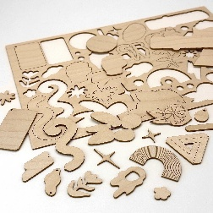
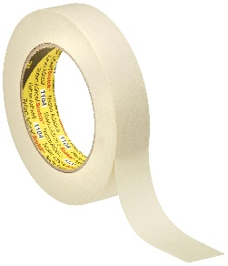
Material Properties
Constitutive Behavior: Materials defined as Linear Elastic. Properties are derived from literature to serve as a representative baseline for static and dynamic analysis.
Data Sources: Plywood data sourced from Chudoba et al. (2012); Tape data approximated from 3M Technical Data Sheets and Baum et al.
Property Summary:
Material | Young's Modulus (E) | Poisson's Ratio (ν) | Density (ρ)
Baltic Birch Plywood | 7 GPa | 0.13 | 680 kg/m³
Masking Tape | 0.5 GPa | 0.34 | 880 kg/m³

Slide 12
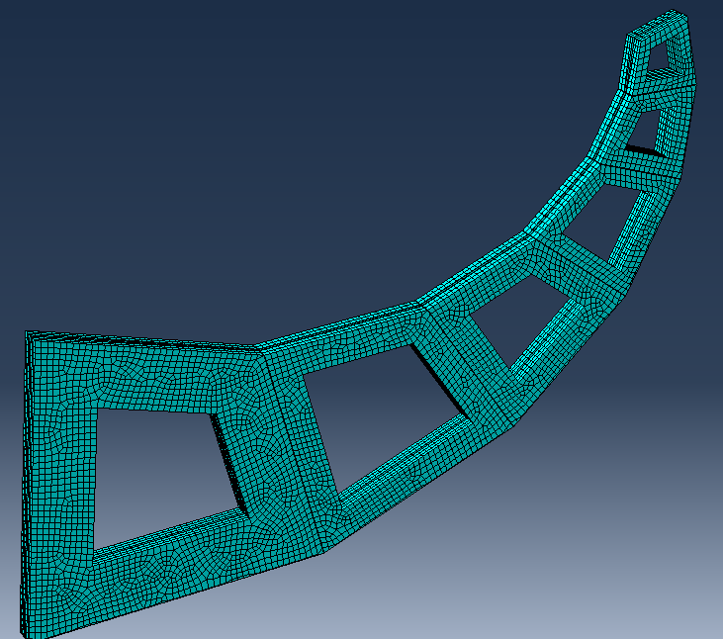
Meshing
Element Type: utilized C3D8R (8-node linear brick, reduced integration with hourglass control) to balance accuracy with computational cost.
Discretization Strategy: Applied Hexahedral (Hex) meshing with a global seed size of 0.005, refined to 0.001 in critical regions.
Model Density: Resulting mesh comprises approximately 20,000 elements for the complete assembly.

Slide 13
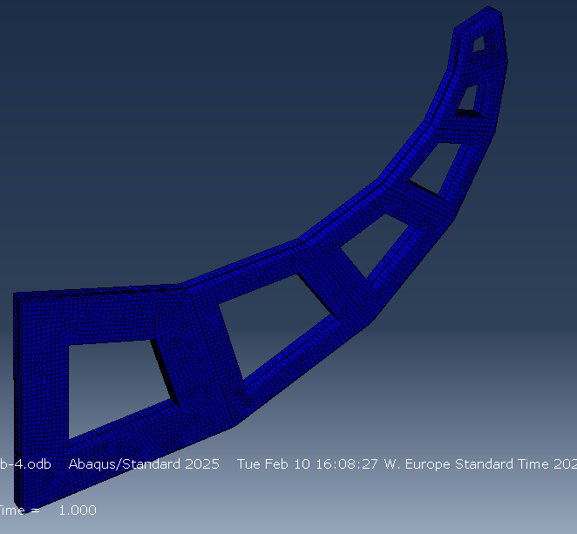
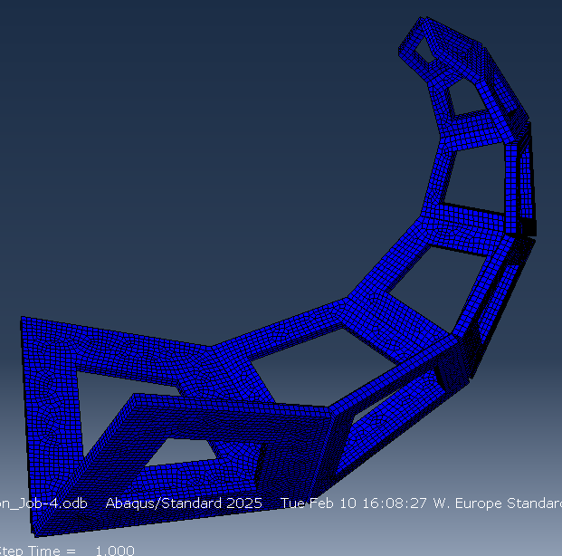
Result Visualization
Undeformed: Deformed:

Slide 14
Result Visualization
Video:

Slide 15
Week 3
Abaqus scripting with foundational vector mathematics
Project folder on Github

Slide 16
Translation and Rotation (2D)
The Local Coordinates (x and y): These are the coordinates of the point measured strictly within the local coordinate system.
The Local Origin (Xo and Yo): These represent the exact location of the local origin, measured from the global origin.
The Angle (theta): represents the rotation of the entire local coordinate system relative to the global one. Specifically, it is the angle between the global X-axis and the local x-axis.
$$\left[\begin{matrix}X \\ Y\end{matrix}\right]=\left[\begin{matrix}cosθ & −sinθ \\ sinθ & cosθ\end{matrix}\right]\left[\begin{matrix}x \\ y\end{matrix}\right]+\left[\begin{matrix}Xo \\ Yo\end{matrix}\right]$$

Slide 17

Trigonometric Projection & Local-to-Global Mapping
Sequential Geometry: Continuous quadrilateral segments require the start of each new shape to anchor perfectly to the end of the previous one.
Dynamic Coordinate Calculation: Global coordinates are projected dynamically using the base edge length (L) and the relative angle (theta_base) combined with local design angles (alpha, beta, gamma).
Trigonometric Mapping: The exact spatial location of new vertices is mapped into the global Abaqus coordinate system using standard functions:
Parametric Stability: This ensures vertices are always placed correctly in 3D space, regardless of how the initial base angles or widths are altered.
$$\begin{matrix}X_new = X_base + L cos(θ_base+ α) \\ Y_new = Y_base + L sin(θ_base+ α)\end{matrix}$$

Slide 18

Linear Intersection for Vertex Determination
Closing Geometric Loops: Identifies the exact global coordinates where converging quadrilateral edges the top and right bounds) naturally intersect.
Determinant-Based Solution: Utilizes a mathematical intersection method relying on the determinant of the direction vectors:
Trajectory Calculation: Solves for the scalar distance along the first line's trajectory to pinpoint the exact crossing point.
Automated Accuracy: Crucial for mathematically sealing the geometry without relying on manual sketching or visual approximations.
$$|\cos\left(θ1\right)∗\sin\left(θ2\right)−\cos\left(θ2\right)sin\left(θ1\right)|$$

Slide 19
Vector Normalization & Geometric Offsetting
Defining Internal Thicknesses: Generates uniform wall dimensions and precision gap cuts by mathematically offsetting the outer perimeter lines inward.
Segment Length Calculation: Computes the overall length of any given edge using the Pythagorean theorem:
Orthogonal Direction: Determines the exact perpendicular direction of the line by calculating unit normal vector components.
Parallel Mapping: Multiplies these normal vectors by the desired parametric thickness (like gap width) and adds them to the original coordinates to map a perfectly parallel inner profile.
$$L=\sqrt{{dx}^{2}+{dy}^{2}}$$

Slide 20
Orthogonal Distance for Material Assignment
Automated Region Tagging: Differentiates between "Tape" and "Plywood" regions computationally, eliminating the need for manual cell selection in Abaqus.
Centroid Projection: Calculates the shortest orthogonal distance from the geometric centroid of an generated Abaqus cell to the dividing line of the next cell.
Vector Dot Product & Clamping: Uses the dot product to project the centroid onto the line, applying a clamping function to ensure the distance is measured only within the physical start and end of that segment.
Tolerance-Based Identification: If the computed shortest distance falls within a tightly defined tolerance, the script automatically assigns that specific cell to the Tape material group.

Slide 21
Input Variables: Global Scaling and Base Geometry
Unit Conversion & Baseline: The scale parameter automates the conversion from millimeters to standard SI units (meters) for Abaqus, while Wo_mm sets the foundational starting width for the entire model.
Shape & Trajectory Control: Internal angles (alpha_deg, beta_deg, gamma_deg) dictate the specific curvature, tightness, and geometric path of the repeating quadrilateral segments.
Customizable Length & Tapering: num_quads defines the total number of wrapping turns. The thicknesses_mm array allows for custom tapering, such as creating robust central walls that thin out toward the edges.
3D Extrusion: extrude_depth determines the final overall thickness when the 2D planar sketch is pulled into a 3D solid body.

Slide 22
Input Variables: Cut and Hinge Geometry
Layer Separation: gap_thickness_mm establishes the vertical slit that physically separates the top and bottom layers of the structure.
Mechanical Hinge Stiffness: The web_thickness_mm defines the thin, continuous strip of material connecting adjacent segments. Modifying this directly impacts how easily the hinge bends or yields.
Kinematic Direction: The web_side toggle (Left/Right) determines which side of the perimeter acts as the continuous hinge, driving the folding kinematics of the final part.
Collision Prevention: divider_cut_width and depth control the physical gaps routed between faces, ensuring they do not intersect or collide during large rotational deformations in the simulation.

Slide 23
Input Variables: Material and Mesh Properties
Layer Separation: Rapid Material Testing: Centralized variables for Density, Young's Modulus (E), and Poisson's ratio (nu) allow for quick iterations between different physical materials for the "Tape" and "Plywood" regions.
Global Element Sizing: mesh_size_mm defines the target edge length for the finite elements across the entire generated structure.
Resolution vs. Speed Trade-off: Increasing the mesh size produces a coarse mesh ideal for fast, draft iterations. Decreasing the size generates a highly dense mesh necessary for capturing high-stress concentrations at the hinges.

Slide 24
Week 4 & 5
pyScript update,
Data collection & Logarithmic spiral fitting
Project folder on Github

Slide 25
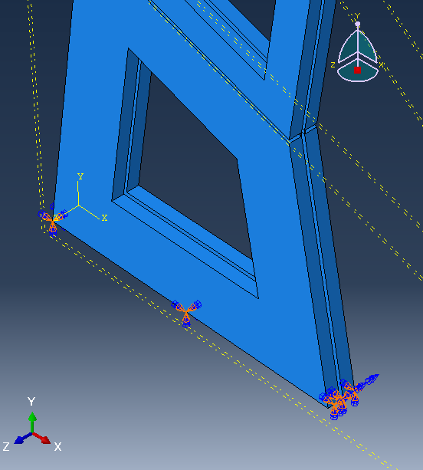
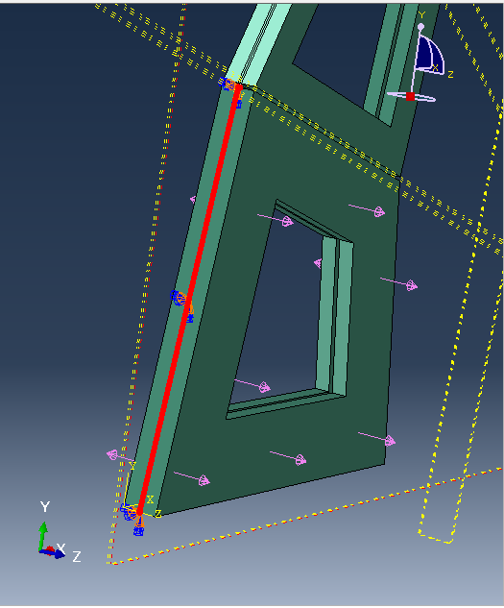
Script (modifications)
Before
Encastre (fixed) boundary on the largest quadrilateral induced unwanted 3D out-of-plane deformation at the spiral tip. I relocated the fixed constraint to the interface between the two largest quadrilaterals.
Introduced datum planes for strategic partitioning to enforce precise mesh boundaries and stabilize element quality.
Replaced displacement constraints with Surface Traction, correctly accounting for the lack of rotational degrees of freedom in 3D solid elements.
After

Slide 26
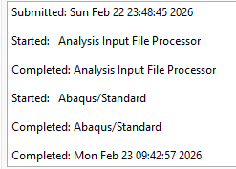
Script (modifications)
Reduce solve time by applying a coarse mesh to the non-deforming quadrilateral and a fine mesh to the masking tape caused convergence Challenge. Variable mesh sizes caused the simulation to fail. Transition between coarse and fine regions cause severe element distortion, leading to numerical instability in the solver.
Implemented a uniform global mesh across the entire geometry to maintain element quality and ensure solver stability.
Trade-off: While ensuring convergence, the uniform mesh significantly increased the simulation job time to approximately 10 hours.
Final Validated Parameters:
Global Mesh Size: 0.0005
Surface Traction: 7300
Outcome: The simulation ran successfully without aborting, generating a sufficient opening of the spiral to observe and analyze the curl.

Slide 27
Script CAE Visualization

Slide 28
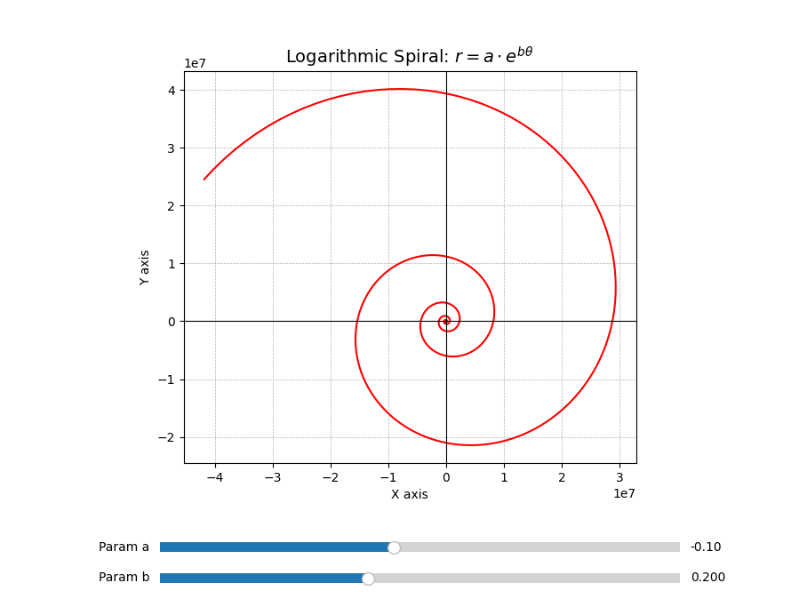
Spiral Fitting py code
Instead of a static image, a user interface directly into the graph window. It creates two dedicated rectangular areas at the bottom of the screen and places interactive sliders inside them:
Slider A: Allows user to drag the value of a between -1.0 and 1.0.
Slider B: Allows user to drag the value of b. The code intentionally restricts this range from 0 to 0.5 because higher values would cause the exp to plot a shape too large to display cleanly.
Dynamic way to visualize how manipulating the constants of an exponential function actively changes its physical geometry in real-time.

Slide 29
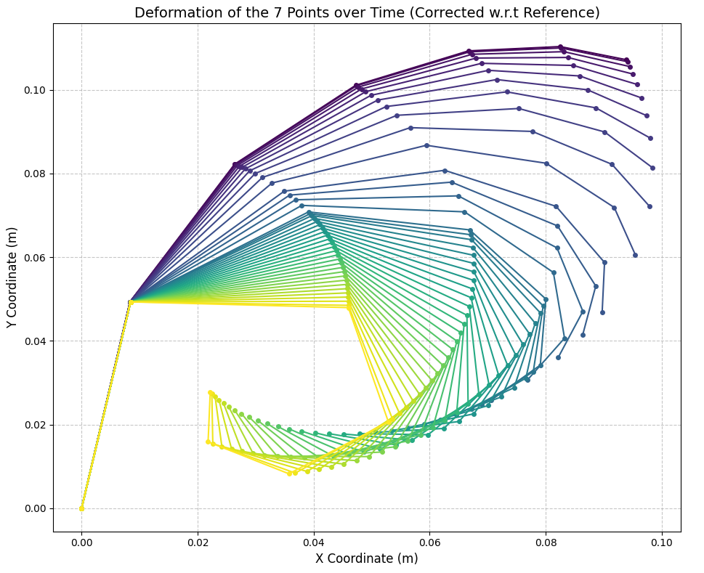
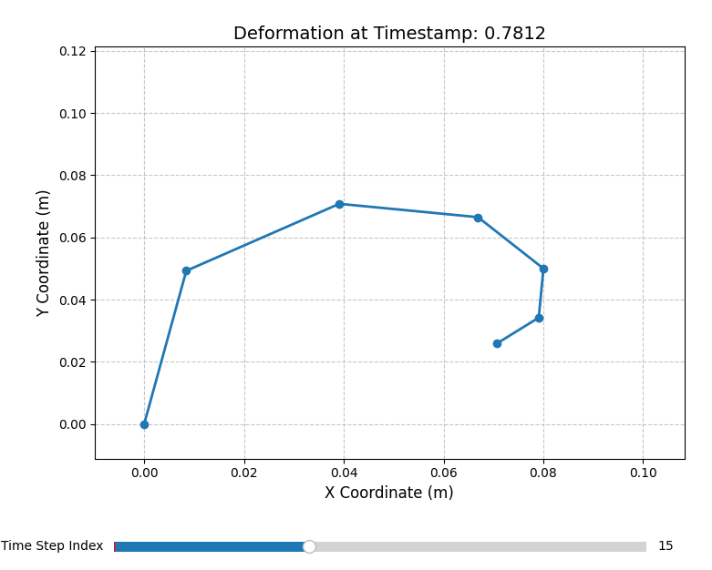
Plotting Spiral Deformation
Data Integration: Exported 7-node displacement data from Abaqus and processed it via Python to visualize structural movement over time.
Coordinate Correction: Applied hardcoded initial positions (Time = 0) to relative displacement values to map nodes accurately into a global coordinate system.
Static Overview: Utilized a color-gradient plot to display the full motion path and bending progression in a single comprehensive view.
Dynamic plot: Developed an interactive slider tool to allow frame-by-frame inspection of the seven-point deformation at specific time steps.

Slide 30
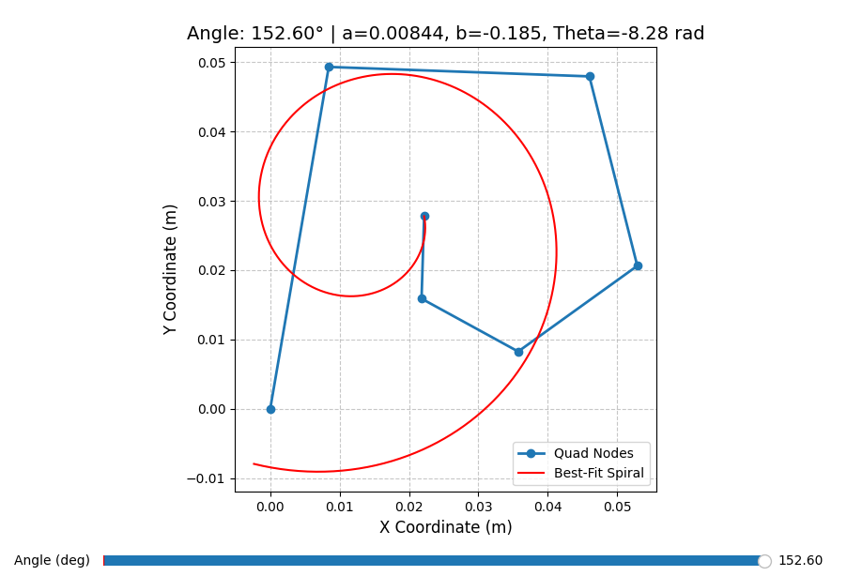
Mapping Spiral issue
This is an issue with unconstrained numerical optimization. The Nelder-Mead algorithm does not inherently understand the physical reality of the mechanism. It only looks for the lowest mathematical error based on the provided initial guesses.
The solver gets trapped in a local minimum were flipping the parameters utilizing a negative growth rate (b = -0.185) and a negative angular domain (theta = -8.28$) yields a mathematically fit that satisfies the Q6 anchor and the Q1 tail constraint, but completely ignores the correct geometric path of the intermediate nodes.

Slide 31
Mapping Spiral Deformation
For this analysis, the actuation angle is defined as the angle between the two largest quadrilaterals at the base of the structure, which drives the entire inward curling motion.
In each of the plots below, the blue markers represent the discrete physical nodes of the mechanism extracted directly from the Abaqus simulation. The solid red line represents the continuous logarithmic spiral generated by our optimization script.
We can visually verify how the mathematical model adapts to the physical bending. It shows the spiral tightening as the structural angle increases, and also clearly illustrates the specific point of failure at the maximum bending angle, where the numerical best-fit solver snaps to a mirrored, physically inaccurate curve.

Slide 32
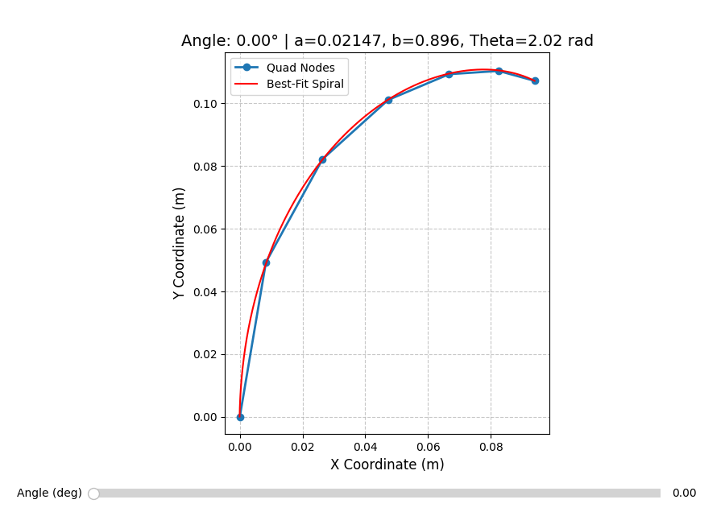
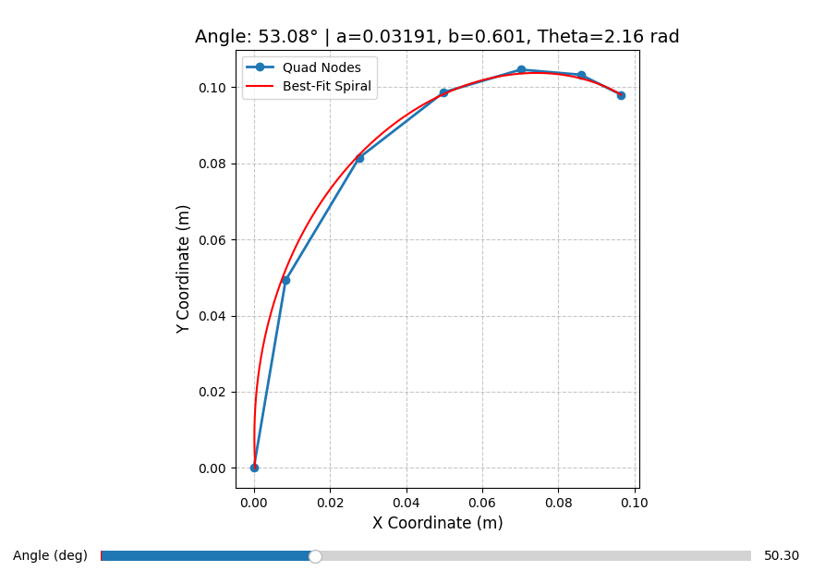
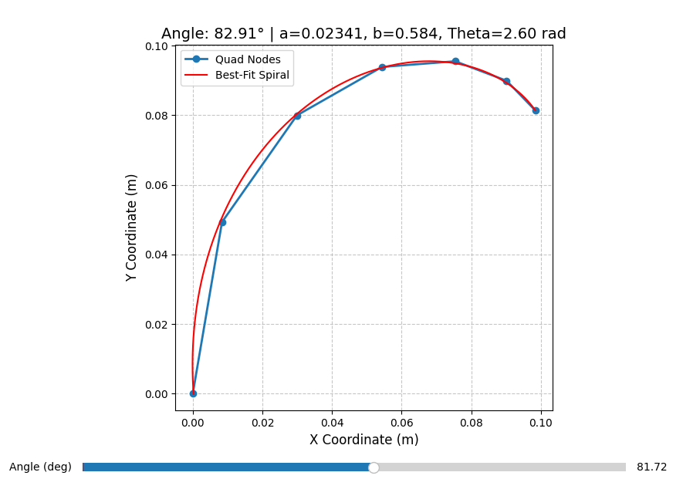
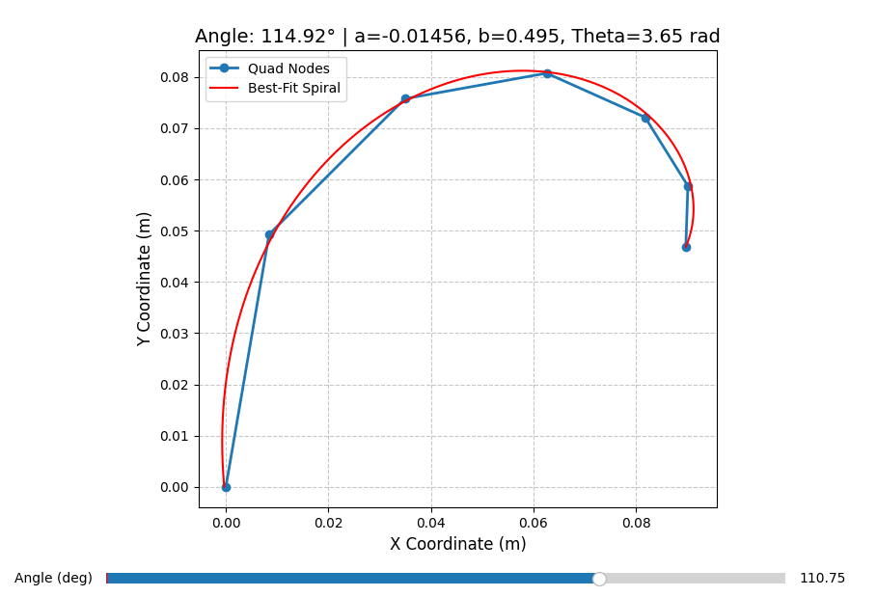
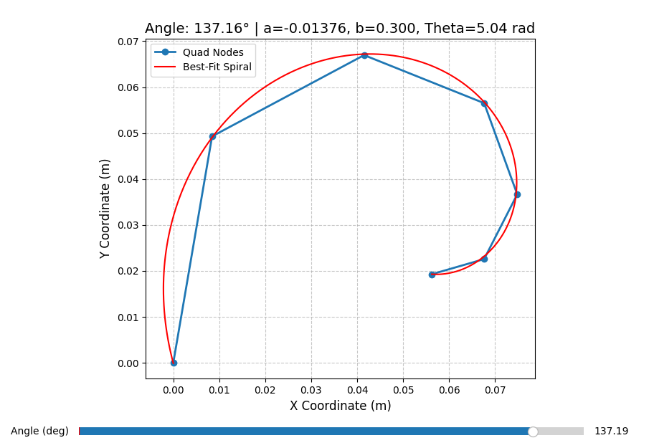
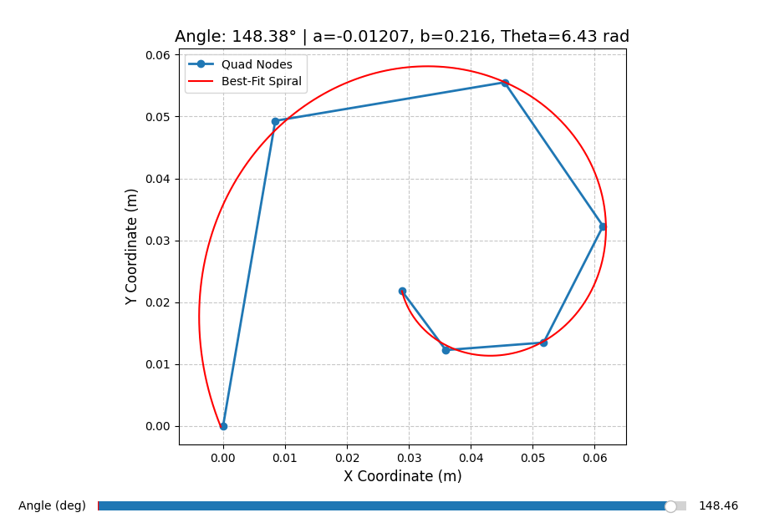
Mapping Spiral Deformation plot

Slide 33
Fin
Curling Spiral Simulation Study
Project folder on Github

