Slide 1
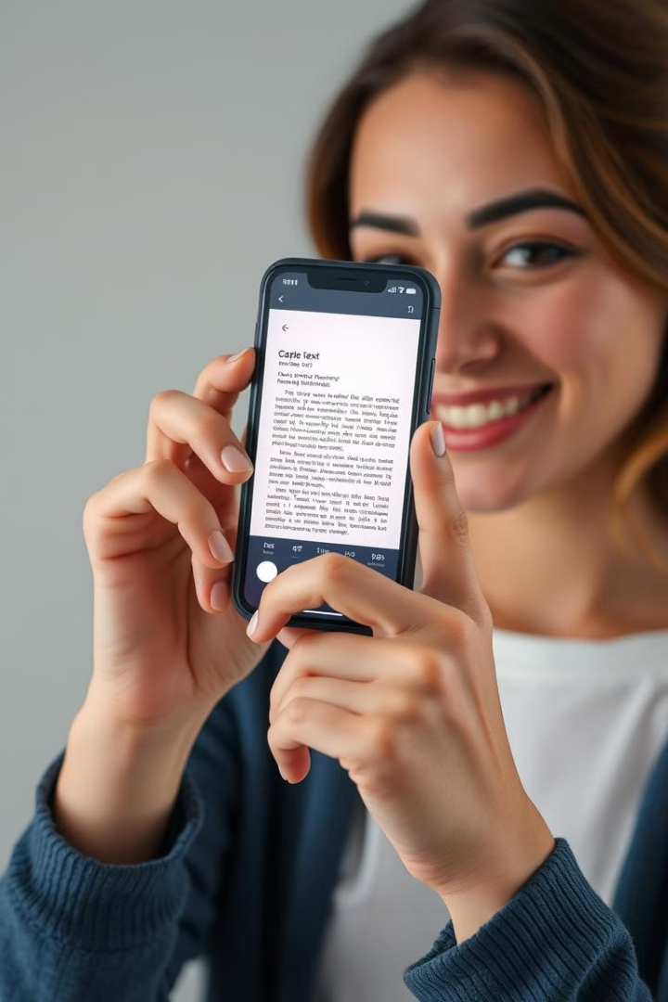
Vocal Eyes: Empowering the Visually Impaired
Welcome! Vocal Eyes is a revolutionary app designed to empower visually impaired individuals, helping them access and understand the written world. Let's explore how this game-changing technology works!
Abdul Rehman (2022-CS-79) Abdul Sabur (2022-CS-98)

Slide 2
The Challenges of Visual Impairment
Navigating a World of Text
Unlocking New Opportunities
For individuals with visual impairments, accessing and understanding written information can be a significant challenge, limiting their ability to participate fully in society. Everyday tasks like reading books, menus, or even personal mail can be difficult or impossible.
Vocal Eyes aims to bridge this gap, providing a simple and powerful solution to empower individuals with visual impairments to read and understand the world around them with confidence and independence.

Slide 3
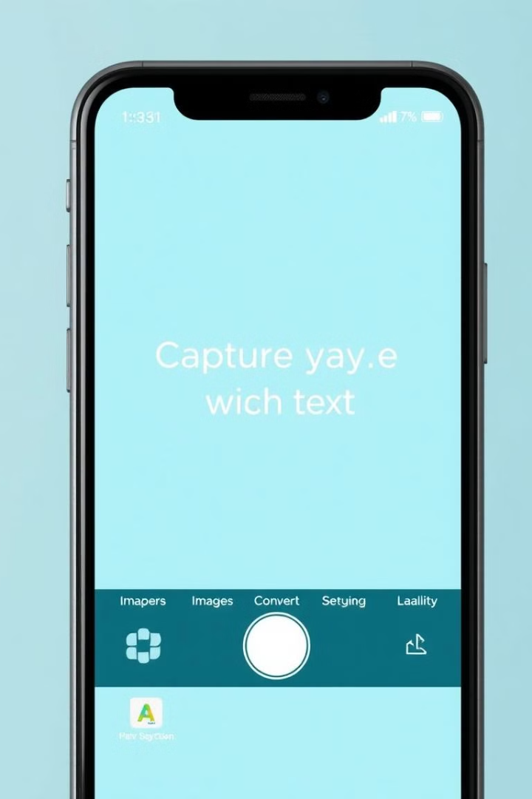
How Vocal Eyes Works
1
First, users capture an image of any written text using their smartphone camera. The app is simple and easy to use, even for individuals with limited tech experience.
2
Next, our advanced Optical Character Recognition (OCR) technology analyzes the captured image, accurately converting the text into digital form.
3
Finally, the text is seamlessly converted to speech using high-quality speech synthesis, allowing users to listen to the content at their own pace. This ensures accessibility for everyone, regardless of literacy level.

Slide 4



Optical Character Recognition (OCR) Technology
Image Analysis
1
The first step is to analyze the captured image to identify the individual characters within the text.
Character Recognition
2
Each character is then compared to a vast database of known characters to determine its identity, recognizing letters, numbers, and punctuation marks.
Text Reconstruction
3
The recognized characters are then assembled into words and sentences, forming the complete digital text output.

Slide 5
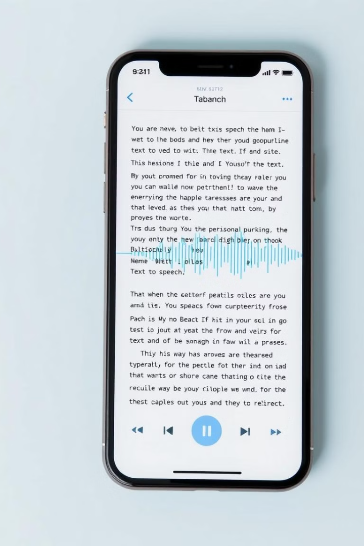


Seamless Text-to-Speech Conversion
Natural Voices
Adjustable Speed
Vocal Eyes utilizes high-quality speech synthesis, creating a natural and pleasant listening experience. Users can choose from a variety of voices to match their preferences.
Users can adjust the playback speed to suit their individual needs and preferences, ensuring optimal comprehension and ease of use.

Slide 6
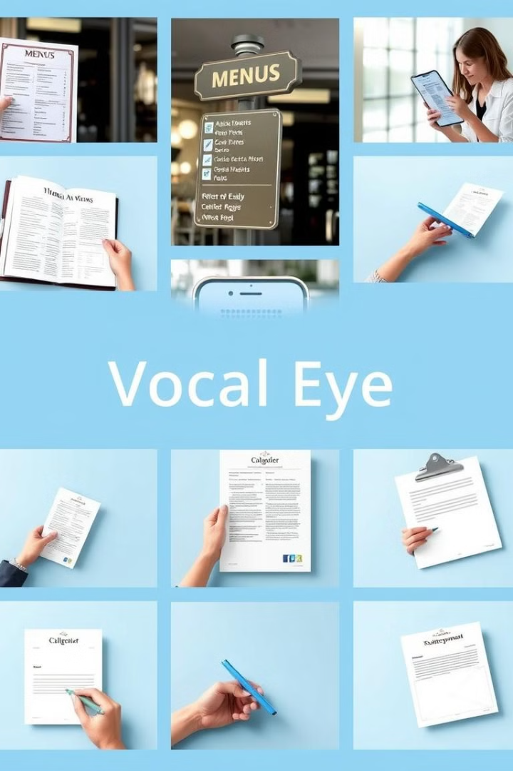
Real-World Applications and Use Cases
Education
Employment
Students with visual impairments can access textbooks, assignments, and other educational materials, enabling them to participate fully in their learning process.
Individuals can read job descriptions, company policies, and training materials, paving the way for greater employment opportunities.
Personal Life
From reading mail and grocery lists to navigating public transportation, Vocal Eyes empowers individuals to manage their daily lives with ease and independence.

Slide 7
The Future of Assistive Technology
Advanced Handwriting Recognition
Real-Time Translation
Improved OCR Accuracy
Enable real-time translation of recognized text into different languages.
Further improve OCR accuracy with advanced AI.
Enhance OCR to recognize cursive and complex handwriting styles.
Smart Home Integration
Multilingual Accessibility
Integrate with smart home devices for a seamless experience.
Develop real-time translation features for multilingual accessibility.

