Slide 1
Lecture # 1
By Majid

Slide 2
Lecture Targets….
Graphics Definition
History
Application Areas

Slide 3
Computer Graphics
Computer: Accept, process, transform and present information
Computer Graphics: involves technology to accept, transform and present information in a visual form

Slide 4
Computer Graphics
Computer graphics are largely interactive
The user control the contents, structure and appearance of the objects and displayed images by using input devices such as mouse keyboard etc.
The handling of such devices also part of computer graphics

Slide 5
Text Book
Title: Introduction to computer graphics using open GL (3rd Edition)
Author: Donald Hearn
M.Pauline Baker
Publisher: Prentice Hall

Slide 6
History
The term “Computer Graphics” was coined in 1960 by William Fetter
The use computer graphics popularized in late 1980 because of the low cost of hardware

Slide 7
History
Bitmap Graphics started for user-computer interaction
A bitmap is a ones and zeros representation of the rectangular array(matrix) of points(pixels or pels, short for picture elements) on screen

Slide 8
Ingredients of Computer Graphics
Graphic Application: is designed to produce graphics – visual representation in the form of pictures,slides etc
The User: The user runs the application, direct its sequence of action to accomplish some specific task
Display devices Presents the text and picture to user Classified as hardcopy(printer, pen plotter etc.) and softcopy(CRT displays)
Host Computer: The host computer is a processor on which the application runs

Slide 9
Applications
Graphs and Charts
User interfaces
Computer aided design
Scientific visualization and analysis
Art and design
Medicine and virtual Surgery
Architectural simulation
Entertainment
Games

Slide 10
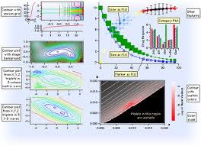
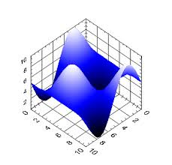
Graphs and Charts
Graphs are used to summarize financial, mathematical, scientific, engineering and economic data

Slide 11
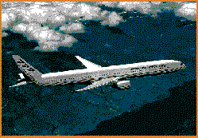
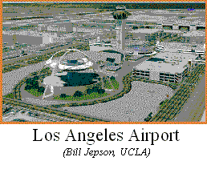
Computer aided design
Graphic software are used for design purposes
Applications are used to design automobiles and aircrafts Computer Aided Manufacturing (CAM)
Also used for architectural designs

Slide 12
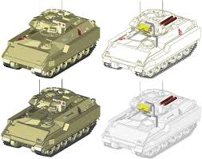
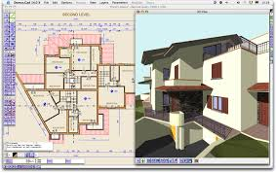
Computer Aided Design

Slide 13
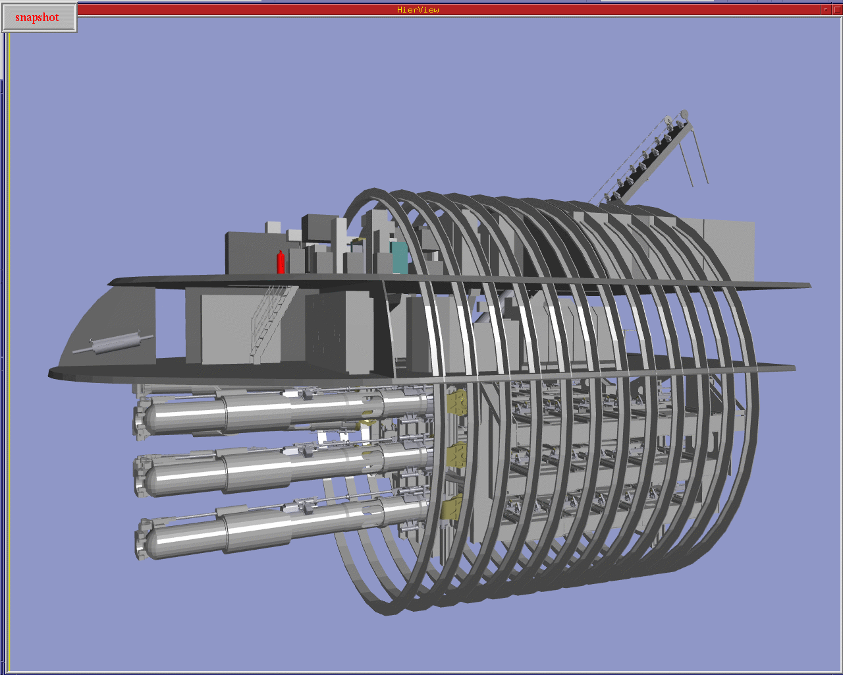

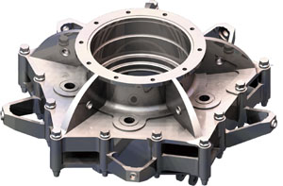
Computer Aided Manufacturing

Slide 14
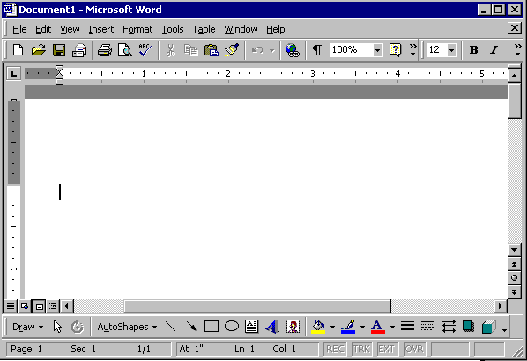
Graphical User Interfaces
We shift on command-line to visual interface
Almost all application provide GUI with there package
Revolutionized the software industry

Slide 15
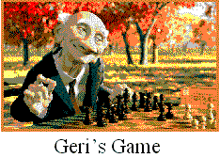
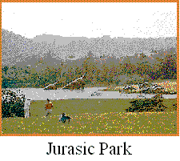
Entertainment
Perhaps the biggest areas of graphics applications
Computer Games
Animated Movies
Almost all movies use computer generated graphics
Lot of animated movies

Slide 16
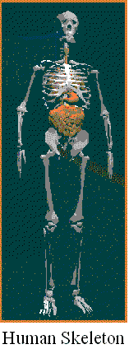
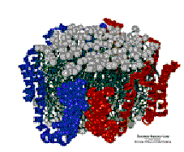
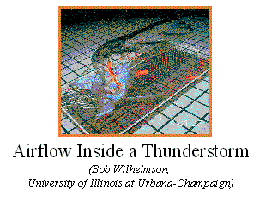
Scientific Visualization

Slide 17
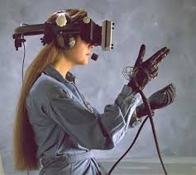
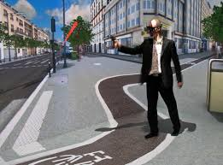
Virtual Reality Environments
In VR environments user can interact with the objects in a three dimensional scene
Augmented Reality

Slide 18
Related Disciplines
Computer Graphics: relates to the creation and structuring of different objects in visual form
Image Processing: also known as image enhancement, concerned with visual clarity of an image
Computer vision: is the capability of understanding of an image

Slide 19
Helping Areas
Science
Physics: light, color, appearance behavior
Mathematics: curves, surfaces, geometry etc
Engineering
Hardware: Processors and input and output devices
Software: Graphic libraries, window systems
Art, perception and Aesthetics
Color composition
lighting

