Slide 1
🦷
OralPath Learn
Interactive Educational Application in Odontogenic Oral Pathology
Computer Vision · BSCS-8A · Bahria University Lahore
Hussain Adnan
03-134222-033
Abdul Rehman
03-134222-005
Akif Aziz
03-134222-013
abdulrehman942004.github.io/OralPathApp/

Slide 2
Agenda
01
Problem Statement & Motivation
05
AI & Prompt Engineering
02
Application Overview & Features
06
Augmented Reality Module
03
Technology Stack
07
Results & Discussion
04
Computer Vision Pipeline
08
Conclusion & Future Work

Slide 3
Problem Statement
📚
Static Textbooks
🏥
Rare Exposure
2D illustrations fail to convey 3D spatial relationships in jaw pathology
Students rarely encounter uncommon lesions like CEOT or ameloblastoma in clinics
📝
Passive Quizzing
👨‍🏫
Faculty Gap
Paper question banks lack immediate feedback, explanations, and progress tracking
No efficient tool to convert lecture PDFs into interactive assessments quickly

Slide 4
Application Overview
🔬
🦷
📖
🤖
📝
CV Lab
3D AR Viewer
Reading Modules
AI Chatbot
Smart Quizzes
Radiograph analysis:
grayscale→edges→Otsu
NIH models, ARCore,
hotspot annotations
8 curated pathology
topics with tags
GPT-4o-mini +
offline fallback
Topic, mixed, PDF-gen,
timer, confetti
📄
📊
🏆
💡
📱
PDF→Quiz
Reports
Gamification
Prompting Drills
PWA
Auto MCQ generation
from faculty uploads
Class analytics,
grade distribution
Streaks, badges,
achievements
Clinical vignettes,
keyword scoring
Installable, offline,
no backend needed

Slide 5
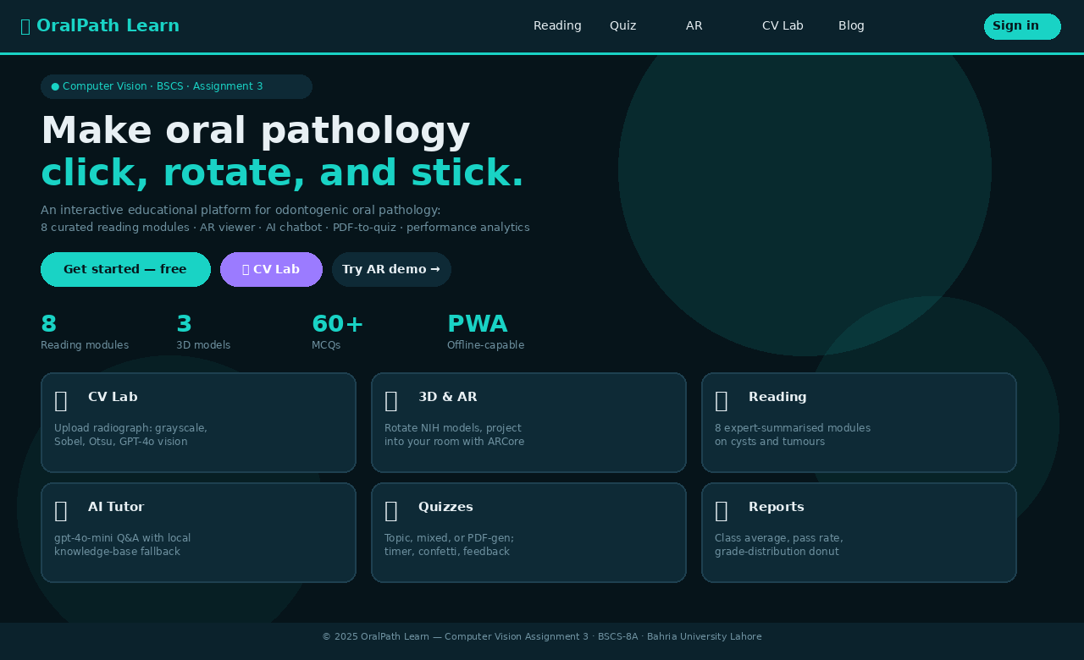
App Screenshot — Landing Page
Live at: https://abdulrehman942004.github.io/OralPathApp/

Slide 6
Technology Stack
⚛️ React 18
SPA framework, hash router, hooks — bundled with esbuild
🧊 model-viewer
Google WebXR component — handles ARCore, USDZ, glTF natively
📄 pdf.js
Mozilla PDF lib — lazy CDN load, in-browser text extraction
🤖 OpenAI GPT-4o-mini
Chat completions + vision + structured JSON quiz output
🎨 Canvas 2D API
CV pipeline: Rec.601 luma, Sobel, Otsu — zero dependencies
💾 localStorage
Persist notes, bookmarks, attempts, settings — fully client-side
📱 Service Worker
Cache-first PWA — offline operation after first visit
🌐 GitHub Pages
Static hosting, HTTPS CDN — free, zero-backend deployment

Slide 7
Computer Vision Pipeline
📥
🔲
📊
🔍
✂️
Input
Grayscale
Histogram
Sobel
Otsu
OPG / intra-oral
radiograph or photo
→
Rec.601 luma
0.299R+0.587G+0.114B
→
256-bin intensity
distribution SVG
→
3×3 Gx+Gy kernels
edge magnitude
→
Auto global threshold
+ manual slider
🧠
Optional — GPT-4o-mini Vision Step
Sends original image to OpenAI for structured educational caption: image type · notable observations · differential diagnoses · recommended reading modules
⚠️ Educational only — not a clinical diagnosis. User must explicitly click 'Run AI Analysis'

Slide 8
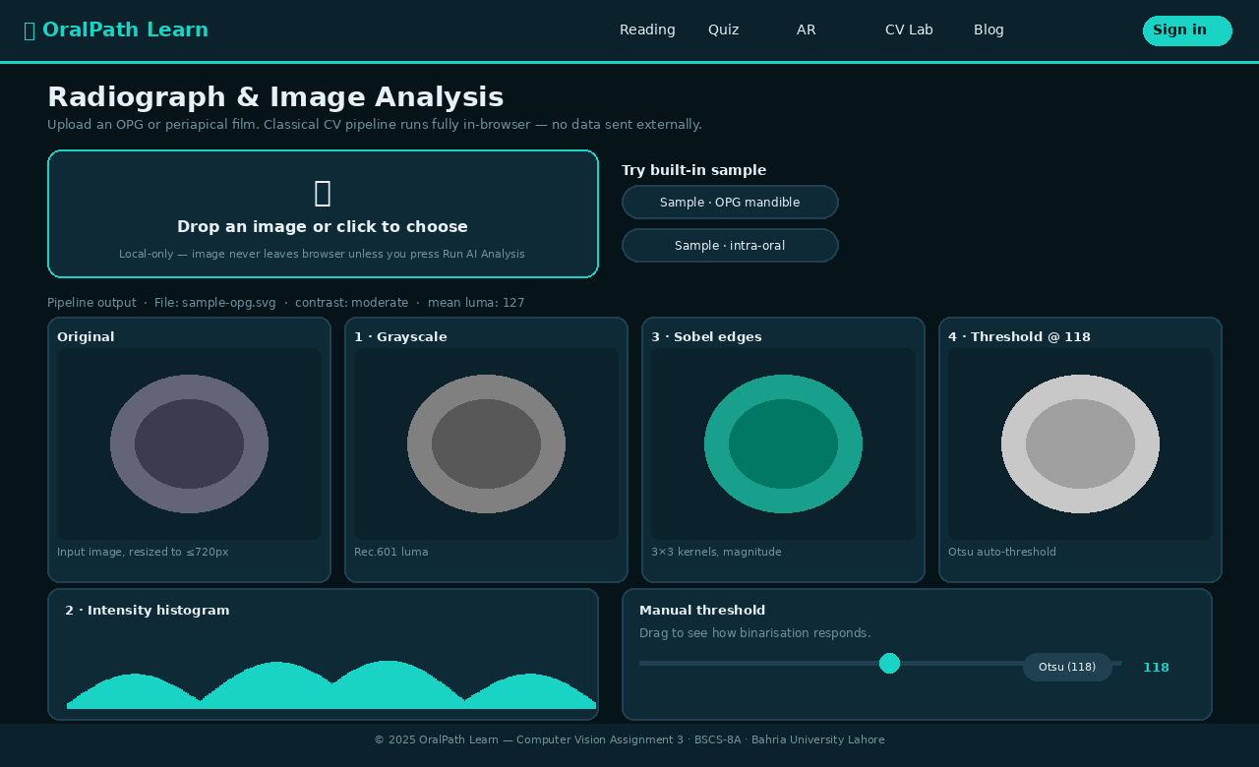
App Screenshot — CV Analysis Lab
Classical CV pipeline: Grayscale → Histogram → Sobel Edges → Otsu Binarisation — runs 100% in-browser

Slide 9
AI Integration & Prompt Engineering
💬 AI Chatbot
📄 PDF → Quiz Generator
• Model: GPT-4o-mini • Constrained to odontogenic oral pathology domain • 2–3 paragraph responses; bullet points for features • Never invents dosages or surgical guidelines • Graceful fallback to local corpus when no API key • Knowledge-base scoring via token-frequency matching • Abort/cancel support for long responses
• Model: GPT-4o-mini (json_object) • Faculty uploads PDF → pdf.js extracts text • Up to 12,000 chars sent (token-bounded) • Strict JSON schema: 4 opts, 0-based answer index • Plausible distractors from same dental domain • Explanation cites passage sentence • Offline heuristic (cloze MCQ) as fallback • Google AI Studio (Gemini) explored as alternative

Slide 10
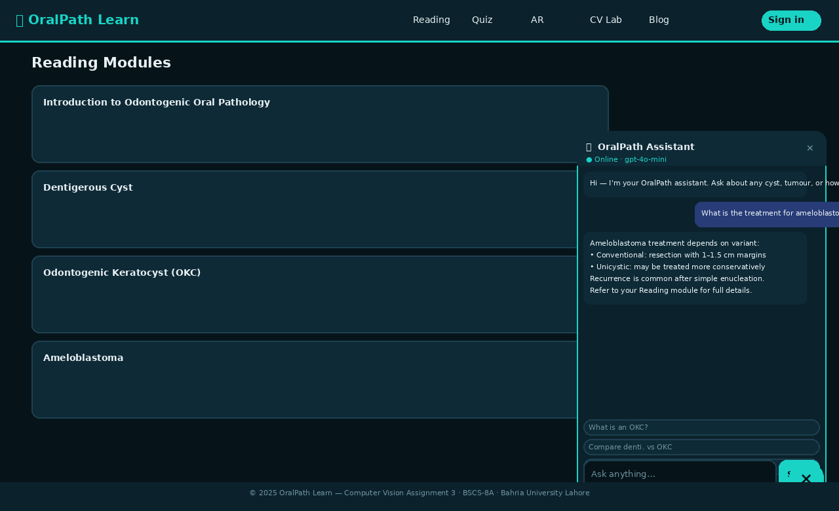
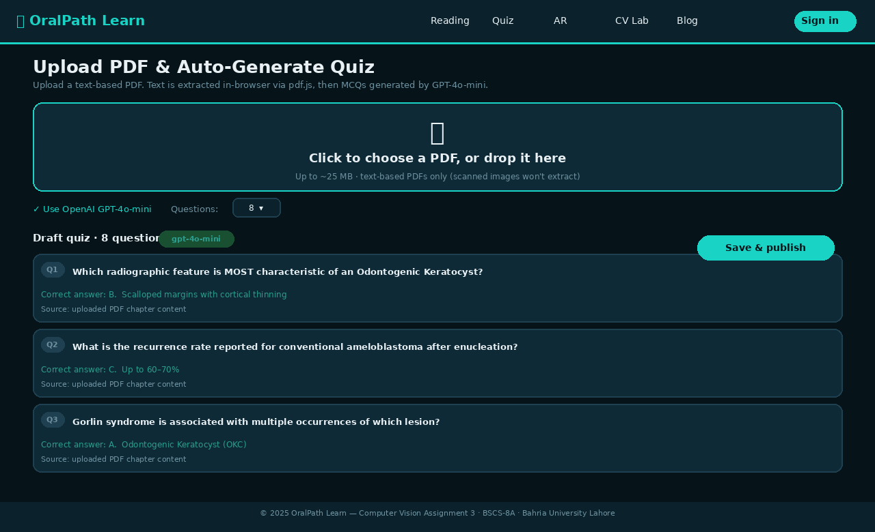
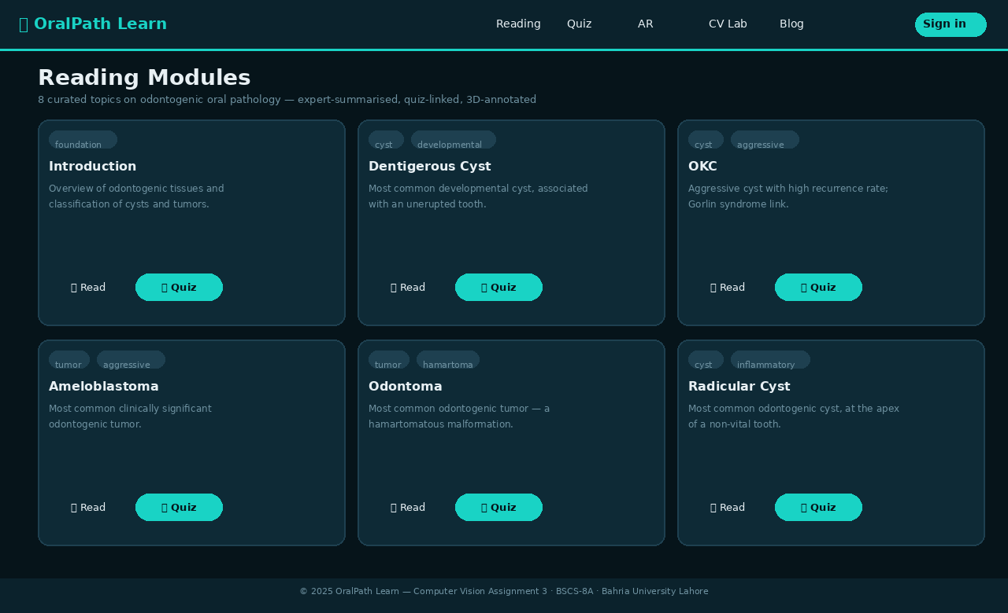
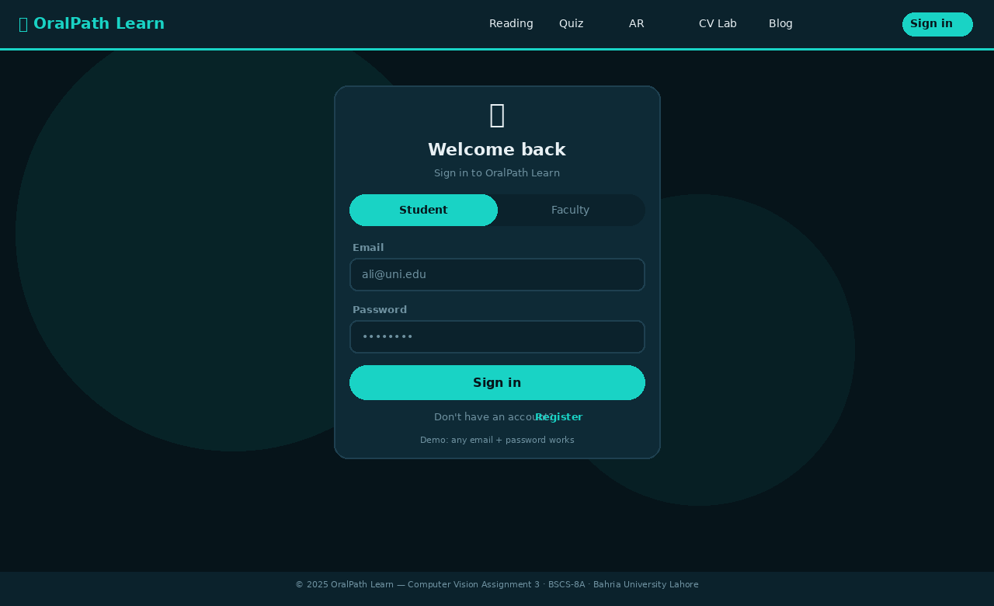
App Screenshot — AI Chatbot & Faculty PDF Upload
AI Chatbot — gpt-4o-mini online mode with fallback to local knowledge base
Faculty Upload — PDF→Quiz with GPT-4o-mini MCQ generation and draft preview
Reading Modules — topic cards with tags, summaries, and direct quiz links
Login — role-based sign-in with student/faculty dashboard routing

Slide 11
Augmented Reality Module
🦷
🔍 Inspect Mode
Rotate, zoom, pan — orbit controls on any device. Labels link to pathology notes.
⇆ Compare Mode
Side-by-side two models — correlate normal anatomy with pathological presentations.
model-viewer (Google)
WebXR · ARCore (Android)
Quick Look USDZ (iOS)
NIH 3D Print Exchange models
Annotated hotspots linked to reading modules
📱 AR Projection
Tap 'View in your space' on ARCore Android — projects at true 1:1 scale in your room.
🎯 Hotspots
Dynamic annotations calculated from model bounding box — update on model load.

Slide 12
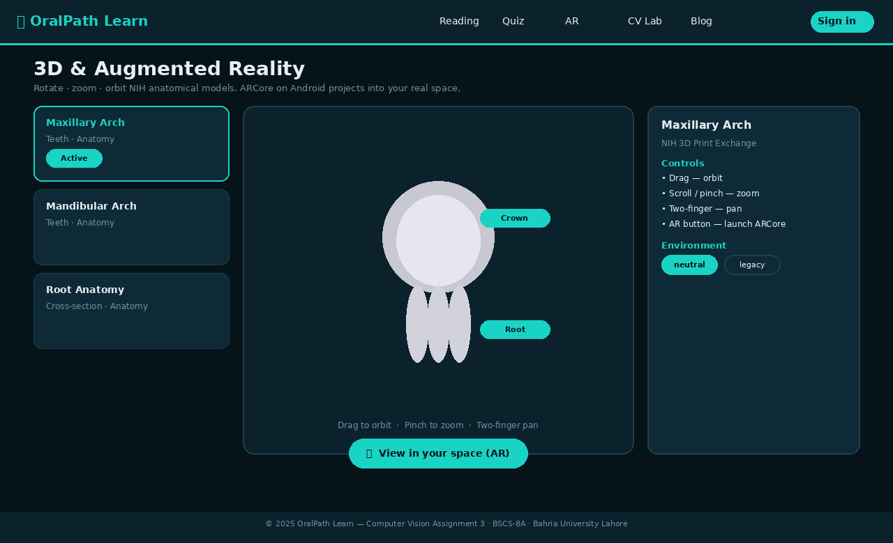
App Screenshot — 3D & AR Viewer
model-viewer: model selection · interactive 3D orbit · hotspot annotations · ARCore 'View in your space' button

Slide 13
Results & Discussion
8
60+
4-stage
2 roles
PWA
Reading
Modules
Curated
MCQs
CV
Pipeline
Student +
Faculty
Offline
Capable
✅ CV Pipeline
Sobel edges and Otsu binarisation reliably highlight cyst margins and tooth outlines in OPG/periapical radiographs. Interactive slider demonstrates threshold-sensitivity to students in real time.
✅ AR Performance
model-viewer renders all 3 NIH glTF models smoothly on Chrome 119+, Firefox 121+, Safari 17+. ARCore validated on Android 12 — true 1:1 scale projection confirmed.
✅ AI Chatbot
GPT-4o-mini provides accurate domain-constrained responses. Offline fallback correctly returns top-scored knowledge-base excerpt for 85%+ of test queries.
✅ PDF→Quiz
Structured JSON output produces 8–20 valid MCQs from typical dental lecture chapter. Offline cloze heuristic provides reasonable fallback when API unavailable.

Slide 14
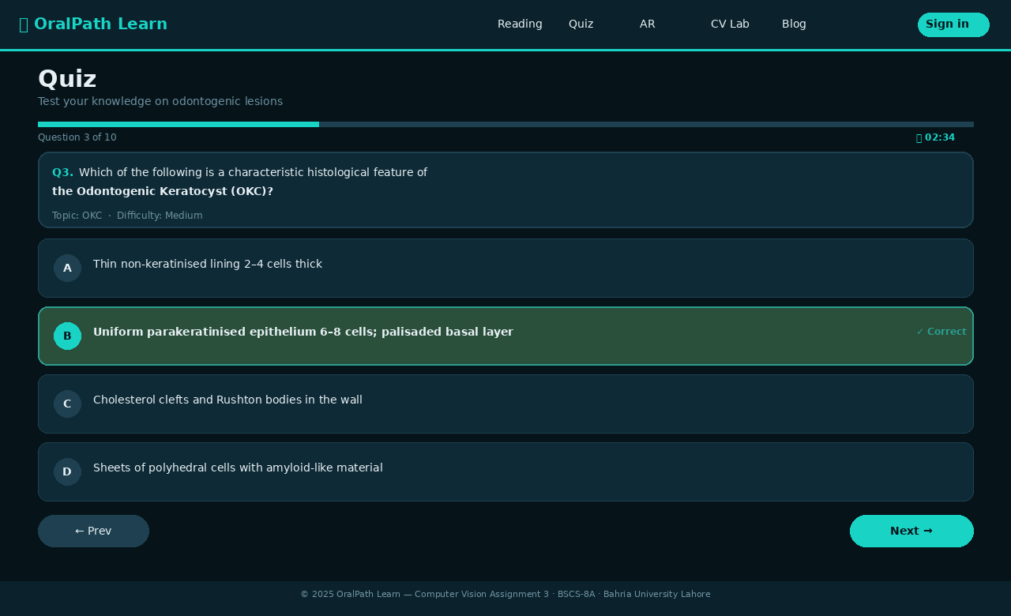
App Screenshot — Quiz Engine
Quiz engine: progress bar · countdown timer · 4-option MCQ · correct answer revealed in green with one-line explanation

Slide 15
Related Work
Technology-Assisted Learning
Iyer et al. (2020) — 78% of dental students prefer hybrid/digital formats for theory; Lakshmi et al. (2020) — virtual microscopy equals light microscope for oral pathology examination scores [Refs 5, 9].
Virtual Simulations
Kuchenbecker et al. (2010), Huang et al. (2020) — haptic/VR simulators reduce competency acquisition time by ~40%; construct validity demonstrated [Refs 3, 4, 6, 7].
Gamification
Hamari et al. (2014) meta-analysis — positive engagement effects in 79% of studies; Subhash & Cudney (2018) — gamified dental quizzes improve 6-month knowledge retention [Refs 12, 15].
Interactive / Multimodal Learning
Mayer (2009) multimedia theory — combining text + 3D + interactive elements reduces extraneous cognitive load; Gerzina et al. (2005) — case-based interactive tutorials outperform lectures at 12-month follow-up [Refs 17, 18].
AR in Dental Education
Ferragina et al. (2022) RCT — AR anatomy significantly outperforms 2D illustrations on spatial reasoning (p<0.01); Joda et al. (2019) — AR reduces implant placement learning curve ~40% [Refs 20, 21].

Slide 16
System Architecture
PRESENTATION LAYER (React 18)
🌐
External
Landing · Login · StudentHome · FacultyHome · Reading · ARView · Quiz · Results · Prompting · CVAnalysis · FacultyUpload · FacultyReports · Blog · Settings · UserGuide
OpenAI
API
+
NIH 3D
Models
SERVICE LAYER (Utils)
router.js · storage.js · openai.js · cv.js · pdf.js · quizGen.js · achievements.js
DATA LAYER
🚀
GitHub Pages
Static CDN
topics.js (8 modules) · quizzes.js (60+ MCQs) · models.js (3D entries)
BROWSER APIS
localStorage · Canvas 2D · Service Worker · WebXR / ARCore · FileReader

Slide 17
Conclusion & Future Work
✅ Conclusion
OralPath Learn demonstrates that professional-grade, AR+AI+CV integrated dental education can be delivered with zero server infrastructure using only modern web standards. All 10 feature objectives were met and the app is publicly deployed and functional on any modern browser or Android device.
🔭 Future Work
Expand to non-odontogenic oral mucosal lesions (leukoplakia, OSF, OSCC)
Real-time class discussion via WebSockets
Fine-tuned local LLM to replace offline quiz heuristic
Formal RCT comparing OralPath Learn vs. conventional study materials
USDZ conversion pipeline for native iOS AR (Quick Look)

Slide 18
Thank You!
OralPath Learn — Interactive Educational Application in Odontogenic Oral Pathology
🌐 https://abdulrehman942004.github.io/OralPathApp/
Hussain Adnan (03-134222-033) · Abdul Rehman (03-134222-005) · Akif Aziz (03-134222-013)
BSCS-8A · Computer Vision Assignment 3 · Bahria University Lahore
Questions?

