Slide 1

Machine learning course
Presented by Abdel Rahman AlSabbagh
Lecture #2 – Sat - 13.5.2023

Slide 2


Tech Requirements
In the name of Allah, the most gracious, the most merciful, we start :)
Machine Learning Course
Abdel Rahman AlSabbagh

Slide 3
Tech Requirements
Today’s Quote
“You don’t have to see the whole staircase,
just take the first step.”
- Martin Luther King Jr.
Machine Learning Course
Abdel Rahman AlSabbagh
Notes:
When most people hear “Machine Learning,” they picture a robot: a dependable butler
or a deadly Terminator depending on who you ask. But Machine Learning is not
just a futuristic fantasy, it’s already here. In fact, it has been around for decades in
some specialized applications, such as Optical Character Recognition (OCR). But the
first ML application that really became mainstream, improving the lives of hundreds
of millions of people, took over the world back in the 1990s: it was the spam filter.
Not exactly a self-aware Skynet, but it does technically qualify as Machine Learning
(it has actually learned so well that you seldom need to flag an email as spam anymore).
It was followed by hundreds of ML applications that now quietly power hundreds
of products and features that you use regularly, from better recommendations
to voice search.
Where does Machine Learning start and where does it end? What exactly does it
mean for a machine to learn something? If I download a copy of Wikipedia, has my
computer really “learned” something? Is it suddenly smarter? In this chapter we will
start by clarifying what Machine Learning is and why you may want to use it.
Then, before we set out to explore the Machine Learning continent, we will take a
look at the map and learn about the main regions and the most notable landmarks:
supervised versus unsupervised learning, online versus batch learning, instance-based
versus model-based learning. Then we will look at the workflow of a typical ML
project, discuss the main challenges you may face, and cover how to evaluate and
fine-tune a Machine Learning system.

Slide 4
Tech Requirements
So, What is Machine Learning in a sentence?
It's the science of getting computers to learn without being explicitly programmed.
Machine Learning Course
Abdel Rahman AlSabbagh

Slide 5
Tech Requirements
Course Outline
Machine Learning Overview
The Machine Learning Process
Introduction to Classification
Machine Learning Model Training
Support Vector Machines
Decision Trees
Ensemble Learning and Random Forests
Unsupervised Learning Techniques
Artificial Neural Networks
Resources used:
Hands-on Machine Learning with Scikit-Learn, Keras, and TensorFlow by Aurélien Géron
Machine Learning Specialization by Andrew Ng and Stanford Online
Machine Learning Course
Abdel Rahman AlSabbagh

Slide 6
Tech Requirements
Machine Learning Overview
Topics covered in this section include:
What Is Machine Learning.
Why Use Machine Learning?.
Types of Machine Learning Systems.
Main Challenges of Machine Learning.
Testing and Validating.
Exercises.
Machine Learning Course
Abdel Rahman AlSabbagh

Slide 7
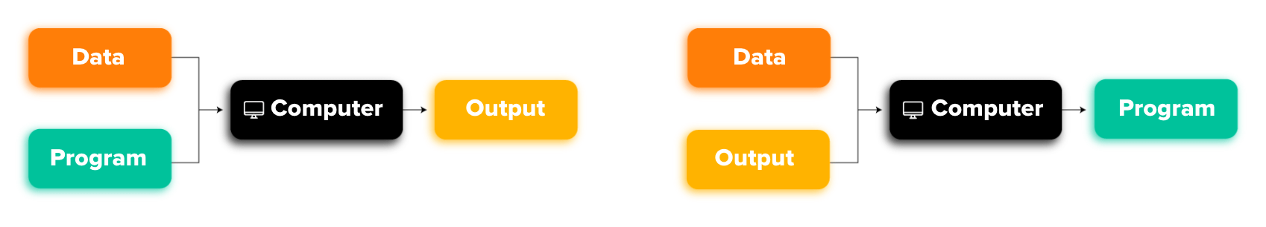
Tech Requirements
Why Use Machine Learning?
Traditional approach
Machine Learning approach
Machine Learning Course
Abdel Rahman AlSabbagh
Notes:
In contrast, a spam filter based on Machine Learning techniques automatically learns
which words and phrases are good predictors of spam by detecting unusually frequent
patterns of words in the spam examples compared to the ham examples.
The program is much shorter, easier to maintain, and most likely more
accurate.
Moreover, if spammers notice that all their emails containing “4U” are blocked, they
might start writing “For U” instead. A spam filter using traditional programming
techniques would need to be updated to flag “For U” emails. If spammers keep working
around your spam filter, you will need to keep writing new rules forever.

Slide 8
Tech Requirements
Types of Machine Learning Systems
Types of Machine Learning Systems
Supervised/Unsupervised Learning
Batch and Online Learning
Instance-Based Versus Model-Based Learning
Supervised learning
Unsupervised learning
Semisupervised learning
Reinforcement Learning
Machine Learning Course
Abdel Rahman AlSabbagh

Slide 9
Tech Requirements
Instance-Based Versus Model-Based Learning
One more way to categorize Machine Learning systems is by how they generalize.
Most Machine Learning tasks are about making predictions. This means that given a number of training examples, the system needs to be able to generalize to examples it has never seen before.
Having a good performance measure on the training data is good, but insufficient; the true goal is to perform well on new instances.
There are two main approaches to generalization: instance-based learning and model-based learning.
Machine Learning Course
Abdel Rahman AlSabbagh

Slide 10
Tech Requirements
Instance-Based Versus Model-Based Learning
One more way to categorize Machine Learning systems is by how they generalize.
Most Machine Learning tasks are about making predictions. This means that given a number of training examples, the system needs to be able to generalize to examples it has never seen before.
Having a good performance measure on the training data is good, but insufficient; the true goal is to perform well on new instances.
There are two main approaches to generalization: instance-based learning and model-based learning.
Machine Learning Course
Abdel Rahman AlSabbagh

Slide 11
Tech Requirements
Instance-Based Learning
The system learns the examples by heart, then generalizes to new cases by comparing them to the learned examples (or a subset of them), using a similarity measure.
Machine Learning Course
Abdel Rahman AlSabbagh
Notes:
Possibly the most trivial form of learning is simply to learn by heart. If you were to
create a spam filter this way, it would just flag all emails that are identical to emails
that have already been flagged by users—not the worst solution, but certainly not the
best.
Instead of just flagging emails that are identical to known spam emails, your spam
filter could be programmed to also flag emails that are very similar to known spam
emails. This requires a measure of similarity between two emails. A (very basic) similarity
measure between two emails could be to count the number of words they have
in common. The system would flag an email as spam if it has many words in common
with a known spam email.

Slide 12
Tech Requirements
Model-Based Learning
Another way to generalize from a set of examples is to build a model of these examples, then use that model to make predictions. This is called model-based learning.
A model is the output of a machine learning algorithm run on data. A model represents what was learned by a machine learning algorithm.
Machine Learning Course
Abdel Rahman AlSabbagh
Notes:
For example, suppose you want to know if money makes people happy, so you download
the Better Life Index data from the OECD’s website as well as stats about GDP
per capita from the IMF’s website. Then you join the tables and sort by GDP per capita.

Slide 13
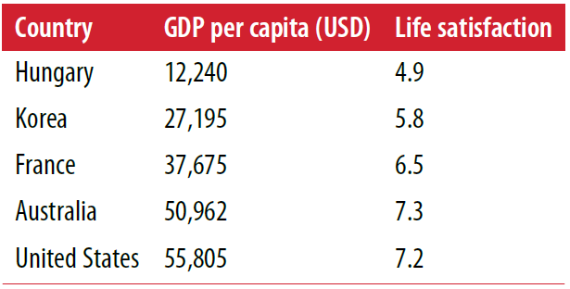
Tech Requirements
Model-Based Learning - Example
Machine Learning Course
Abdel Rahman AlSabbagh
Notes:
For example, suppose you want to know if money makes people happy, so you download
the Better Life Index data from the OECD’s website as well as stats about GDP
per capita from the IMF’s website. Then you join the tables and sort by GDP per capita.

Slide 14
Tech Requirements
Model-Based Learning - Example
There does seem to be a trend here! Although the data is noisy (i.e., partly random), it looks like life satisfaction goes up more or less linearly as the country’s GDP per capita increases.
So you decide to model life satisfaction as a linear function of GDP per capita.
Machine Learning Course
Abdel Rahman AlSabbagh

Slide 15
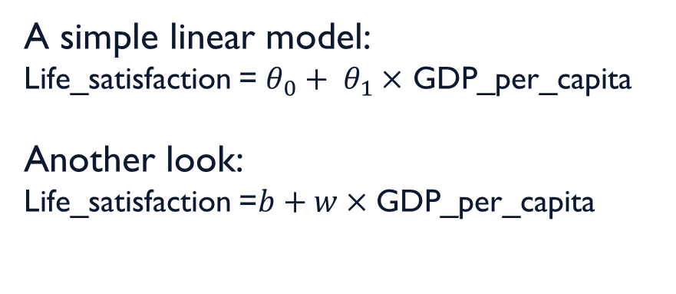
Tech Requirements
Model-Based Learning - Example
This step is called model selection: you selected a linear model of life satisfaction
with just one attribute, GDP per capita.
A simple linear model:
Life_satisfaction = ${θ_{0}+ θ}_{1}×$ GDP_per_capita
Another look:
Life_satisfaction =$b+w×$ GDP_per_capita
Machine Learning Course
Abdel Rahman AlSabbagh

Slide 16
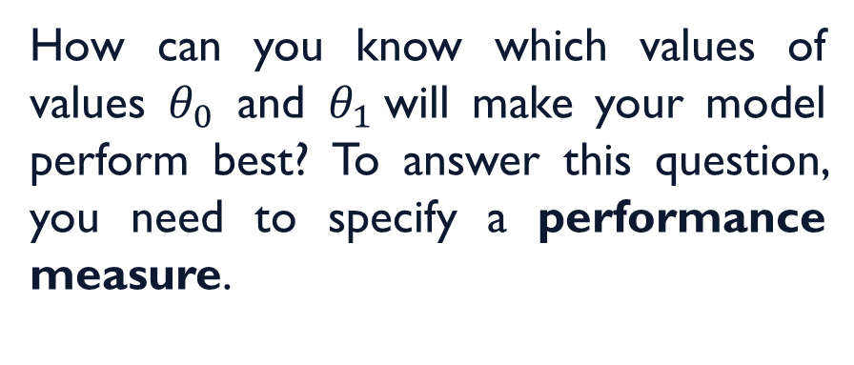
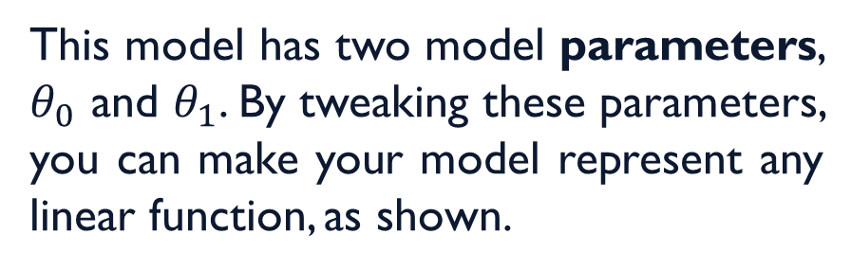
Tech Requirements
Model-Based Learning - Example
This model has two model parameters, $θ_{0}$ and $θ_{1}$. By tweaking these parameters, you can make your model represent any linear function, as shown.
How can you know which values of values $θ_{0}$ and $θ_{1}$will make your model perform best? To answer this question, you need to specify a performance measure.
Machine Learning Course
Abdel Rahman AlSabbagh

Slide 17
Tech Requirements
Model-Based Learning - Performance Measure
You can either define a utility function (or fitness function) that measures how good your model is.
Or you can define a cost function that measures how bad it is.
Machine Learning Course
Abdel Rahman AlSabbagh

Slide 18
Tech Requirements
Model-Based Learning - Performance Measure
For linear regression problems, people typically use a cost function that measures the distance between the linear model’s predictions and the training examples; the objective is to minimize this distance.
Machine Learning Course
Abdel Rahman AlSabbagh

Slide 19
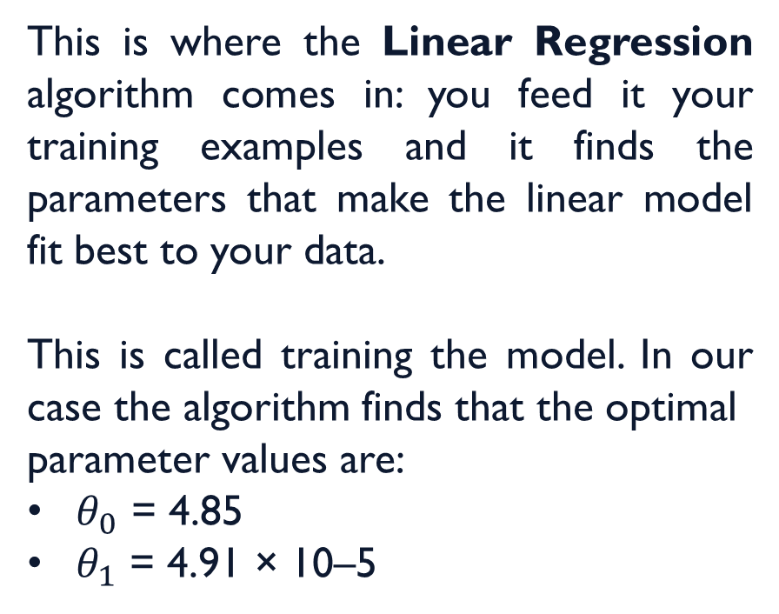
Tech Requirements
Model-Based Learning - Linear Regression
This is where the Linear Regression algorithm comes in: you feed it your training examples and it finds the parameters that make the linear model fit best to your data.
This is called training the model. In our case the algorithm finds that the optimal
parameter values are:
$θ_{0}$ = 4.85
$θ_{1}$ = 4.91 × 10–5
Machine Learning Course
Abdel Rahman AlSabbagh

Slide 20
Tech Requirements
Model-Based Learning - Linear Regression
Say you want to know how happy Cypriots are, and the OECD data does not have the answer.
Fortunately, you can use your model to make a good prediction: you look up Cyprus’s GDP per capita, find $22,587, and then apply your model and find that life satisfaction is likely to be somewhere around:
4.85 + 22,587 × 4.91 × 10-5 = 5.96.
Machine Learning Course
Abdel Rahman AlSabbagh

Slide 21
Tech Requirements
Model-Based Learning
If all went well, your model will make good predictions. If not, you may need to use more attributes (employment rate, health, air pollution, etc.), get more or better quality training data, or perhaps select a more powerful model (e.g., a Polynomial Regression model).
In summary:
You studied the data.
You selected a model.
You trained it on the training data (i.e., the learning algorithm searched for the model parameter values that minimize a cost function).
Finally, you applied the model to make predictions on new cases (this is called inference), hoping that this model will generalize well.
Machine Learning Course
Abdel Rahman AlSabbagh
Notes:
This is what a typical Machine Learning project looks like. Next lecture you will
experience this first-hand by going through an end-to-end project.

Slide 22
Tech Requirements
Recap
Types of Machine Learning Systems
Supervised/Unsupervised Learning
Batch and Online Learning
Instance-Based Versus Model-Based Learning
Supervised learning
Unsupervised learning
Semisupervised learning
Reinforcement Learning
Machine Learning Course
Abdel Rahman AlSabbagh
Notes:
We have covered a lot of ground so far: you now know what Machine Learning is
really about, why it is useful, what some of the most common categories of ML systems
are, and what a typical project workflow looks like. Now let’s look at what can go
wrong in learning and prevent you from making accurate predictions.

Slide 23
Tech Requirements
Main Challenges of Machine Learning
In short, since your main task is to select a learning algorithm and train it on some data, the two things that can go wrong are “bad algorithm” and “bad data.”
Bad algorithm:
Overfitting the Training Data.
Underfitting the Training Data.
Bad data:
Insufficient Quantity of Training Data.
Nonrepresentative Training Data.
Poor-Quality Data.
Irrelevant Features.
Machine Learning Course
Abdel Rahman AlSabbagh
Notes:
This is what a typical Machine Learning project looks like. Next lecture you will
experience this first-hand by going through an end-to-end project.

Slide 24
Tech Requirements
Insufficient Quantity of Training Data
It takes a lot of data for most Machine Learning algorithms to work properly. Even for very simple problems you typically need thousands of examples, and for complex problems such as image or speech recognition you may need millions of examples (unless you can reuse parts of an existing model).
Microsoft researchers showed that very different ML algorithms, including fairly simple ones, performed almost identically well on a complex problem once they were given enough data.
Machine Learning Course
Abdel Rahman AlSabbagh
Notes:
For a toddler to learn what an apple is, all it takes is for you to point to an apple and
say “apple” (possibly repeating this procedure a few times). Now the child is able to
recognize apples in all sorts of colors and shapes. Genius.
Machine Learning is not quite there yet;

Slide 25
Tech Requirements
Nonrepresentative Training Data
In order to generalize well, it is crucial that your training data be representative of the new cases you want to generalize to. This is true whether you use instance-based learning or model-based learning.
Machine Learning Course
Abdel Rahman AlSabbagh
Notes:
For example, the set of countries we used earlier for training the linear model was not
perfectly representative; a few countries were missing. Figure shows what the
data looks like when you add the missing countries.
If you train a linear model on this data, you get the solid line, while the old model is
represented by the dotted line. As you can see, not only does adding a few missing
countries significantly alter the model, but it makes it clear that such a simple linear
model is probably never going to work well. It seems that very rich countries are not
happier than moderately rich countries (in fact they seem unhappier), and conversely
some poor countries seem happier than many rich countries.
By using a nonrepresentative training set, we trained a model that is unlikely to make
accurate predictions, especially for very poor and very rich countries.
It is crucial to use a training set that is representative of the cases you want to generalize
to. This is often harder than it sounds: if the sample is too small, you will have
sampling noise (i.e., nonrepresentative data as a result of chance), but even very large
samples can be nonrepresentative if the sampling method is flawed. This is called
sampling bias.
Perhaps the most famous example of sampling bias happened during the US presidential
election in 1936, which pitted Landon against Roosevelt: the Literary Digest
conducted a very large poll, sending mail to about 10 million people. It got 2.4 million
answers, and predicted with high confidence that Landon would get 57% of the votes.
Instead, Roosevelt won with 62% of the votes. The flaw was in the Literary Digest’s
sampling method
Here is another example: say you want to build a system to recognize funk music videos.
One way to build your training set is to search “funk music” on YouTube and use
the resulting videos. But this assumes that YouTube’s search engine returns a set of
videos that are representative of all the funk music videos on YouTube. In reality, the
search results are likely to be biased toward popular artists (and if you live in Brazil
you will get a lot of “funk carioca” videos, which sound nothing like James Brown).
On the other hand, how else can you get a large training set?

Slide 26
Tech Requirements
Poor-Quality Data
Obviously, if your training data is full of errors, outliers, and noise (e.g., due to poor quality measurements), it will make it harder for the system to detect the underlying patterns, so your system is less likely to perform well.
It is often well worth the effort to spend time cleaning up your training data.
The truth is, most data scientists spend a significant part of their time doing just that.
Machine Learning Course
Abdel Rahman AlSabbagh
Notes:
For example:
If some instances are clearly outliers, it may help to simply discard them or try to fix the errors manually.
If some instances are missing a few features (e.g., 5% of your customers did not specify their age), you must decide whether you want to ignore this attribute altogether, ignore these instances, fill in the missing values (e.g., with the median age), or train one model with the feature and one model without it, and so on.

Slide 27
Tech Requirements
Irrelevant Features
As the saying goes: garbage in, garbage out.
Your system will only be capable of learning if the training data contains enough relevant features and not too many irrelevant ones. A critical part of the success of a Machine Learning project is coming up with a good set of features to train on. This process, called feature engineering, involves:
Feature selection: selecting the most useful features to train on among existing features.
Feature extraction: combining existing features to produce a more useful one (as we saw earlier, dimensionality reduction algorithms can help).
Creating new features by gathering new data.
Machine Learning Course
Abdel Rahman AlSabbagh
Notes:
Now that we have looked at many examples of bad data, let’s look at a couple of examples
of bad algorithms.

Slide 28
Tech Requirements
Overfitting the Training Data
The model performs well on the training data, but it does not generalize well.
Complex models can detect subtle patterns in the data, but if the training set is noisy, or if it is too small (which introduces sampling noise), then the model is likely to detect patterns in the noise itself. Obviously these patterns will not generalize to new instances.
Machine Learning Course
Abdel Rahman AlSabbagh
Notes:
For example, say you feed your life satisfaction
model many more attributes, including uninformative ones such as the country’s
name. In that case, a complex model may detect patterns like the fact that all countries
in the training data with a w in their name have a life satisfaction greater than 7:
New Zealand (7.3), Norway (7.4), Sweden (7.2), and Switzerland (7.5). How confident
are you that the W-satisfaction rule generalizes to Rwanda or Zimbabwe? Obviously
this pattern occurred in the training data by pure chance, but the model has no way
to tell whether a pattern is real or simply the result of noise in the data.

Slide 29
Tech Requirements
Overfitting the Training Data
Overfitting happens when the model is too complex relative to the amount and noisiness of the training data.
The possible solutions are:
To simplify the model by selecting one with fewer parameters (e.g., a linear model rather than a high-degree polynomial model), by reducing the number of attributes in the training data or by constraining the model.
To gather more training data.
To reduce the noise in the training data (e.g., fix data errors and remove outliers).
Constraining a model to make it simpler and reduce the risk of overfitting is called regularization.
Machine Learning Course
Abdel Rahman AlSabbagh
Notes:
For example, the linear model we defined earlier has two parameters,
θ0 and θ1. This gives the learning algorithm two degrees of freedom to adapt the model
to the training data: it can tweak both the height (θ0) and the slope (θ1) of the line. If
we forced θ1 = 0, the algorithm would have only one degree of freedom and would
have a much harder time fitting the data properly: all it could do is move the line up
or down to get as close as possible to the training instances, so it would end up
around the mean. A very simple model indeed! If we allow the algorithm to modify θ1
but we force it to keep it small, then the learning algorithm will effectively have somewhere
in between one and two degrees of freedom. It will produce a simpler model
than with two degrees of freedom, but more complex than with just one. You want to
find the right balance between fitting the training data perfectly and keeping the
model simple enough to ensure that it will generalize well.

Slide 30
Tech Requirements
Overfitting the Training Data
Machine Learning Course
Abdel Rahman AlSabbagh
Notes:
The dotted line represents the original model that
was trained with a few countries missing, the dashed line is our second model trained
with all countries, and the solid line is a linear model trained with the same data as
the first model but with a regularization constraint. You can see that regularization
forced the model to have a smaller slope, which fits a bit less the training data that the
model was trained on, but actually allows it to generalize better to new examples.

Slide 31
Tech Requirements
Overfitting the Training Data
The amount of regularization to apply during learning can be controlled by a hyperparameter. A hyperparameter is a parameter of a learning algorithm (not of the model). As such, it is not affected by the learning algorithm itself; it must be set prior to training and remains constant during training.
If you set the regularization hyperparameter to a very large value, you will get an almost flat model (a slope close to zero); the learning algorithm will almost certainly not overfit the training data, but it will be less likely to find a good solution.
Tuning hyperparameters is an important part of building a Machine Learning system.
Machine Learning Course
Abdel Rahman AlSabbagh
Notes:
For example, the linear model we defined earlier has two parameters,
θ0 and θ1. This gives the learning algorithm two degrees of freedom to adapt the model
to the training data: it can tweak both the height (θ0) and the slope (θ1) of the line. If
we forced θ1 = 0, the algorithm would have only one degree of freedom and would
have a much harder time fitting the data properly: all it could do is move the line up
or down to get as close as possible to the training instances, so it would end up
around the mean. A very simple model indeed! If we allow the algorithm to modify θ1
but we force it to keep it small, then the learning algorithm will effectively have somewhere
in between one and two degrees of freedom. It will produce a simpler model
than with two degrees of freedom, but more complex than with just one. You want to
find the right balance between fitting the training data perfectly and keeping the
model simple enough to ensure that it will generalize well.

Slide 32
Tech Requirements
Underfitting the Training Data
As you might guess, underfitting is the opposite of overfitting: it occurs when your model is too simple to learn the underlying structure of the data.
The main options to fix this problem are:
• Selecting a more powerful model, with more parameters.
• Feeding better features to the learning algorithm (feature engineering).
• Reducing the constraints on the model (e.g. reducing the regularization hyperparameter).
Machine Learning Course
Abdel Rahman AlSabbagh
Notes:
For example, a linear model of life satisfaction is prone to underfit; reality is just more complex than
the model, so its predictions are bound to be inaccurate, even on the training examples.

Slide 33
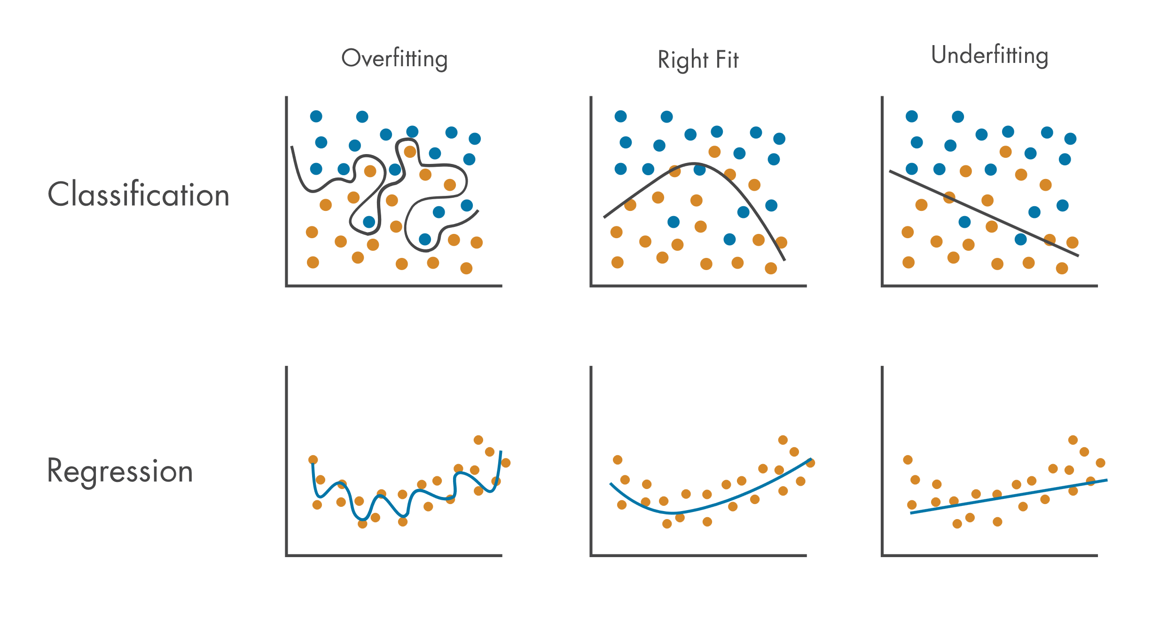
Tech Requirements
Recap
Image source: MathWorks
Machine Learning Course
Abdel Rahman AlSabbagh

Slide 34
Tech Requirements
Stepping Back
By now you already know a lot about Machine Learning.
However, we went through so many concepts that you may be feeling a little lost, so let’s step back and look at the big picture:
Machine Learning is about making machines get better at some task by learning from data, instead of having to explicitly code rules.
There are many different types of ML systems: supervised or not, batch or online, instance-based or model-based, and so on.
Machine Learning Course
Abdel Rahman AlSabbagh

Slide 35
Tech Requirements
Stepping Back
In a ML project you gather data in a training set, and you feed the training set to a learning algorithm. If the algorithm is model-based it tunes some parameters to fit the model to the training set (i.e., to make good predictions on the training set itself), and then hopefully it will be able to make good predictions on new cases as well. If the algorithm is instance-based, it just learns the examples by heart and generalizes to new instances by comparing them to the learned instances using a similarity measure.
The system will not perform well if your training set is too small, or if the data is not representative, noisy, or polluted with irrelevant features (garbage in, garbage out). Lastly, your model needs to be neither too simple (in which case it will underfit) nor too complex (in which case it will overfit).
Machine Learning Course
Abdel Rahman AlSabbagh
Notes:
There’s just one last important topic to cover: once you have trained a model, you
don’t want to just “hope” it generalizes to new cases. You want to evaluate it, and finetune
it if necessary. Let’s see how.

Slide 36
Tech Requirements
Testing and Validating
There’s just one last important topic to cover:
Once you have trained a model, you don’t want to just “hope” it generalizes to new cases.
You want to evaluate it, and fine-tune it if necessary.
Let’s see how.
Machine Learning Course
Abdel Rahman AlSabbagh
Notes:
There’s just one last important topic to cover: once you have trained a model, you
don’t want to just “hope” it generalizes to new cases. You want to evaluate it, and finetune
it if necessary. Let’s see how.

Slide 37
Tech Requirements
Testing and Validating
The only way to know how well a model will generalize to new cases is to actually try it out on new cases. Not the best idea.
A better option is to split your data into two sets:
The training set.
The test set.
As these names imply, you train your model using the training set, and you test it using the test set.
Machine Learning Course
Abdel Rahman AlSabbagh
Notes:
The only way to know how well a model will generalize to new cases is to actually try
it out on new cases. One way to do that is to put your model in production and monitor
how well it performs. This works well, but if your model is horribly bad, your
users will complain—not the best idea.

Slide 38
Tech Requirements
Testing and Validating
The error rate on new cases is called the generalization error (or out-of-sample error), and by evaluating your model on the test set, you get an estimate of this error.
This value tells you how well your model will perform on instances it has never seen before.
If the training error is low (i.e., your model makes few mistakes on the training set) but the generalization error is high, it means that your model is overfitting the training data.
Machine Learning Course
Abdel Rahman AlSabbagh

Slide 39
Tech Requirements
Testing and Validating
Machine Learning Course
Abdel Rahman AlSabbagh
Notes:
The only way to know how well a model will generalize to new cases is to actually try
it out on new cases. One way to do that is to put your model in production and monitor
how well it performs. This works well, but if your model is horribly bad, your
users will complain—not the best idea.

Slide 40
Tech Requirements
Hyperparameter Tuning and Model Selection
So evaluating a model is simple enough: just use a test set.
Now suppose you are hesitating between two models (say a linear model and a polynomial model): how can you decide? One option is to train both and compare how well they generalize using the test set.
Now suppose that the linear model generalizes better, but you want to apply some regularization to avoid overfitting. The question is: how do you choose the value of the regularization hyperparameter?
Machine Learning Course
Abdel Rahman AlSabbagh

Slide 41
Tech Requirements
Hyperparameter Tuning and Model Selection
One option is to train 100 different models using 100 different values for this hyperparameter. Suppose you find the best hyperparameter value that produces a model with the lowest generalization error, say just 5% error.
So you launch this model into production, but unfortunately it does not perform as well as expected and produces 15% errors. What just happened?
The problem is that you measured the generalization error multiple times on the test set, and you adapted the model and hyperparameters to produce the best model for that particular set. This means that the model is unlikely to perform as well on new data.
Machine Learning Course
Abdel Rahman AlSabbagh

Slide 42
Tech Requirements
Hyperparameter Tuning and Model Selection
Machine Learning Course
Abdel Rahman AlSabbagh
Notes:
A common solution to this problem is called holdout validation: you simply hold out
part of the training set to evaluate several candidate models and select the best one.
The new heldout set is called the validation set (or sometimes the development set, or
dev set). More specifically, you train multiple models with various hyperparameters
on the reduced training set (i.e., the full training set minus the validation set), and
you select the model that performs best on the validation set. After this holdout validation
process, you train the best model on the full training set (including the validation
set), and this gives you the final model. Lastly, you evaluate this final model on
the test set to get an estimate of the generalization error.

Slide 43
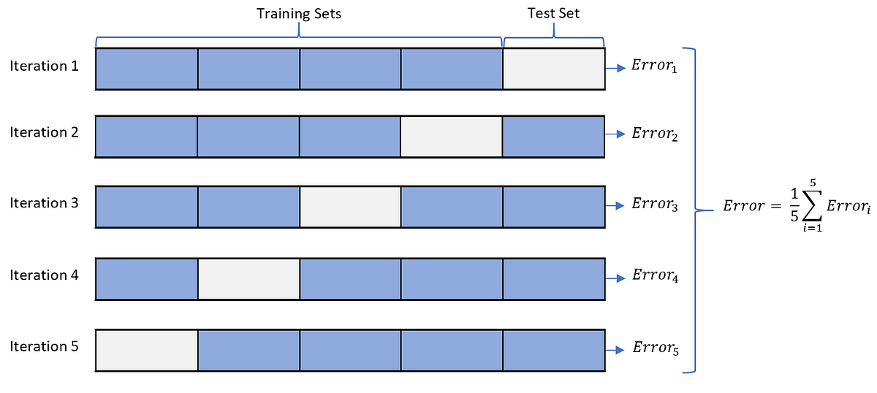
Tech Requirements
Hyperparameter Tuning and Model Selection
Machine Learning Course
Abdel Rahman AlSabbagh
Notes:
This solution usually works quite well. However, if the validation set is too small, then
model evaluations will be imprecise: you may end up selecting a suboptimal model by
mistake. Conversely, if the validation set is too large, then the remaining training set
will be much smaller than the full training set. Why is this bad? Well, since the final
model will be trained on the full training set, it is not ideal to compare candidate
models trained on a much smaller training set. It would be like selecting the fastest
sprinter to participate in a marathon. One way to solve this problem is to perform
repeated cross-validation, using many small validation sets. Each model is evaluated
once per validation set, after it is trained on the rest of the data. By averaging out all
the evaluations of a model, we get a much more accurate measure of its performance.
However, there is a drawback: the training time is multiplied by the number of validation
sets.

Slide 44
Tech Requirements
Data Mismatch
In some cases, it is easy to get a large amount of data for training, but it is not perfectly representative of the data that will be used in production.
The most important rule to remember is that the validation and the test set must be as representative as possible of the data you expect to use in production.
Machine Learning Course
Abdel Rahman AlSabbagh
Notes:
You can easily download millions of pictures of flowers on the
web, but they won’t be perfectly representative of the pictures that will actually be
taken using the app on a mobile device. Perhaps you only have 10,000 representative
pictures (i.e., actually taken with the app). In this case, the most important rule to
remember is that the validation set and the test must be as representative as possible
of the data you expect to use in production, so they should be composed exclusively
of representative pictures: you can shuffle them and put half in the validation set, and
half in the test set (making sure that no duplicates or near-duplicates end up in both
sets).
After training your model on the web pictures, if you observe that the performance
of your model on the validation set is disappointing, you will not know
whether this is because your model has overfit the training set, or whether this is just
due to the mismatch between the web pictures and the mobile app pictures.

Slide 45
Tech Requirements
Data Mismatch
Machine Learning Course
Abdel Rahman AlSabbagh
Notes:
One solution is to hold out part of the training pictures (from the web) in yet another set that
Andrew Ng calls the train-dev set. After the model is trained (on the training set, not
on the train-dev set), you can evaluate it on the train-dev set: if it performs well, then
the model is not overfitting the training set, so if performs poorly on the validation
set, the problem must come from the data mismatch. You can try to tackle this problem
by preprocessing the web images to make them look more like the pictures that
will be taken by the mobile app, and then retraining the model. Conversely, if the
model performs poorly on the train-dev set, then the model must have overfit the
training set, so you should try to simplify or regularize the model, get more training
data and clean up the training data, as discussed earlier.
No Free

Slide 46
Tech Requirements
Recap
Main Challenges of Machine Learning
Bad Data
Bad Algorithm
Insufficient Quantity of Training Data
Nonrepresentative Training Data
Poor-Quality Data
Irrelevant Features
Overfitting the Training Data
Underfitting the Training Data
Machine Learning Course
Abdel Rahman AlSabbagh
Notes:
One solution is to hold out part of the training pictures (from the web) in yet another set that
Andrew Ng calls the train-dev set. After the model is trained (on the training set, not
on the train-dev set), you can evaluate it on the train-dev set: if it performs well, then
the model is not overfitting the training set, so if performs poorly on the validation
set, the problem must come from the data mismatch. You can try to tackle this problem
by preprocessing the web images to make them look more like the pictures that
will be taken by the mobile app, and then retraining the model. Conversely, if the
model performs poorly on the train-dev set, then the model must have overfit the
training set, so you should try to simplify or regularize the model, get more training
data and clean up the training data, as discussed earlier.
No Free

Slide 47
Tech Requirements
Recap
Testing and Validating
Hyperparameter Tuning and Model Selection
Data Mismatch
Machine Learning Course
Abdel Rahman AlSabbagh
Notes:
One solution is to hold out part of the training pictures (from the web) in yet another set that
Andrew Ng calls the train-dev set. After the model is trained (on the training set, not
on the train-dev set), you can evaluate it on the train-dev set: if it performs well, then
the model is not overfitting the training set, so if performs poorly on the validation
set, the problem must come from the data mismatch. You can try to tackle this problem
by preprocessing the web images to make them look more like the pictures that
will be taken by the mobile app, and then retraining the model. Conversely, if the
model performs poorly on the train-dev set, then the model must have overfit the
training set, so you should try to simplify or regularize the model, get more training
data and clean up the training data, as discussed earlier.
No Free

Slide 48
Tech Requirements
Finally
Let’s write some code!
Want to get better at coding?
Try LeetCode (https://leetcode.com/studyplan/)
On another note, there’s a CV workshop with an HR from the prestigious company RealSoft.
This Tuesday, 16.5, 12:30, KASIT Lab #107. Join us!
Machine Learning Course
Abdel Rahman AlSabbagh
Notes:
One solution is to hold out part of the training pictures (from the web) in yet another set that
Andrew Ng calls the train-dev set. After the model is trained (on the training set, not
on the train-dev set), you can evaluate it on the train-dev set: if it performs well, then
the model is not overfitting the training set, so if performs poorly on the validation
set, the problem must come from the data mismatch. You can try to tackle this problem
by preprocessing the web images to make them look more like the pictures that
will be taken by the mobile app, and then retraining the model. Conversely, if the
model performs poorly on the train-dev set, then the model must have overfit the
training set, so you should try to simplify or regularize the model, get more training
data and clean up the training data, as discussed earlier.
No Free

Slide 49

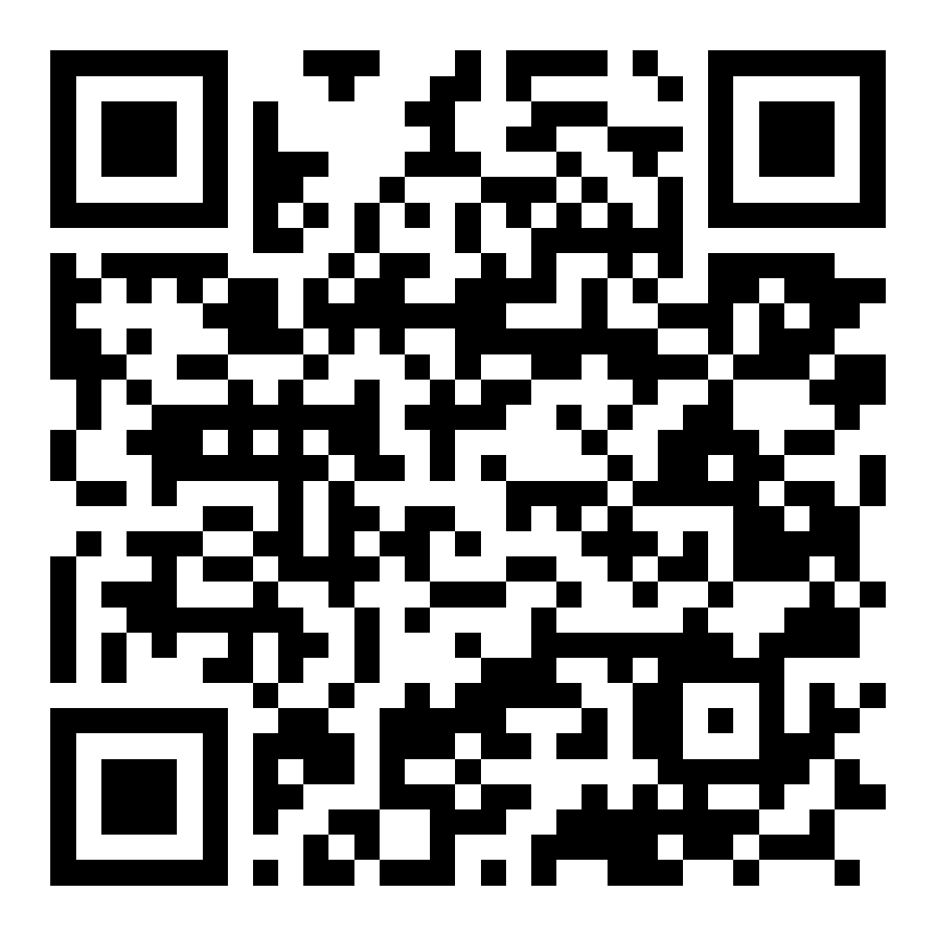
Thank You
Next lecture will be online on Mon, 15.5.2023, In Shaa allah!
sabbagh@ieee.org
Connect on Linkedin

