Slide 1

Machine learning course
Presented by Abdel Rahman AlSabbagh
Lecture #4 – Sat - 20.5.2023

Slide 2


Tech Requirements
In the name of Allah, the most gracious, the most merciful, we start :)
Machine Learning Course
Abdel Rahman AlSabbagh

Slide 3
Tech Requirements
Today’s Quote
“You are responsible for the pursuit, not the outcome”
- Bryant McGill
Machine Learning Course
Abdel Rahman AlSabbagh

Slide 4
Tech Requirements
Introduction to Classification
Logistic regression.
Decision boundary.
Cost function for logistic regression.
Gradient descent implementation.
Overfitting.
Addressing overfitting.
Cost function with regularization.
Regularized gradient descent.
Source: Machine Learning Specialization by Andrew Ng and Stanford Online.
Machine Learning Course
Abdel Rahman AlSabbagh

Slide 5
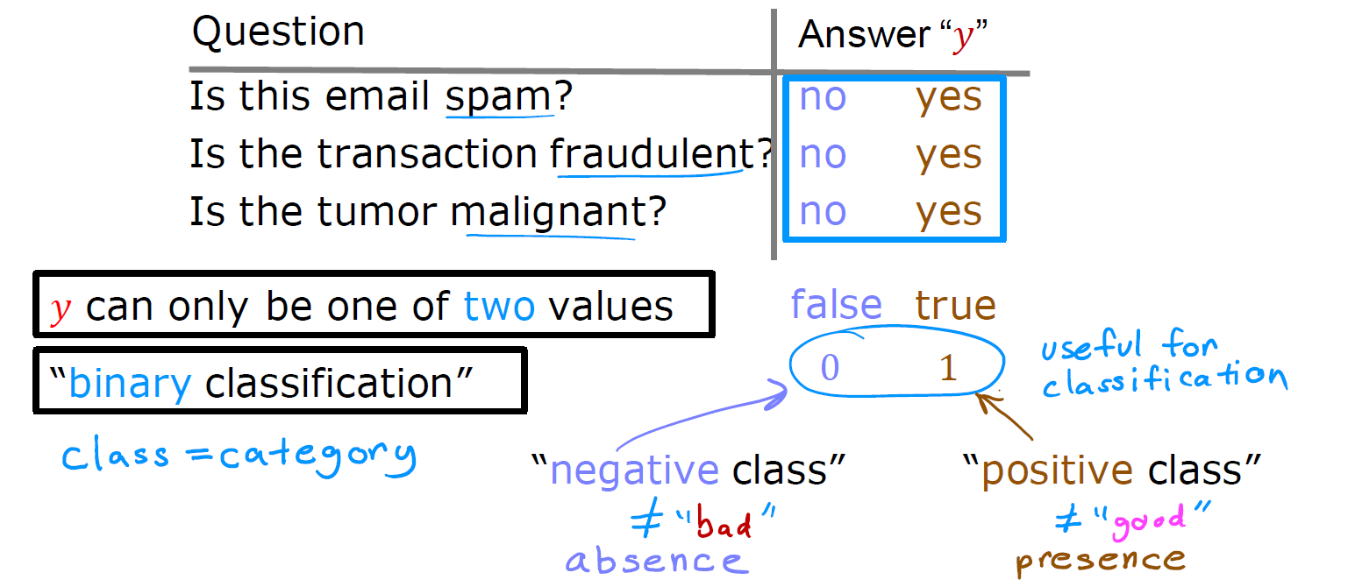
Tech Requirements
Classification
Machine Learning Course
Abdel Rahman AlSabbagh

Slide 6
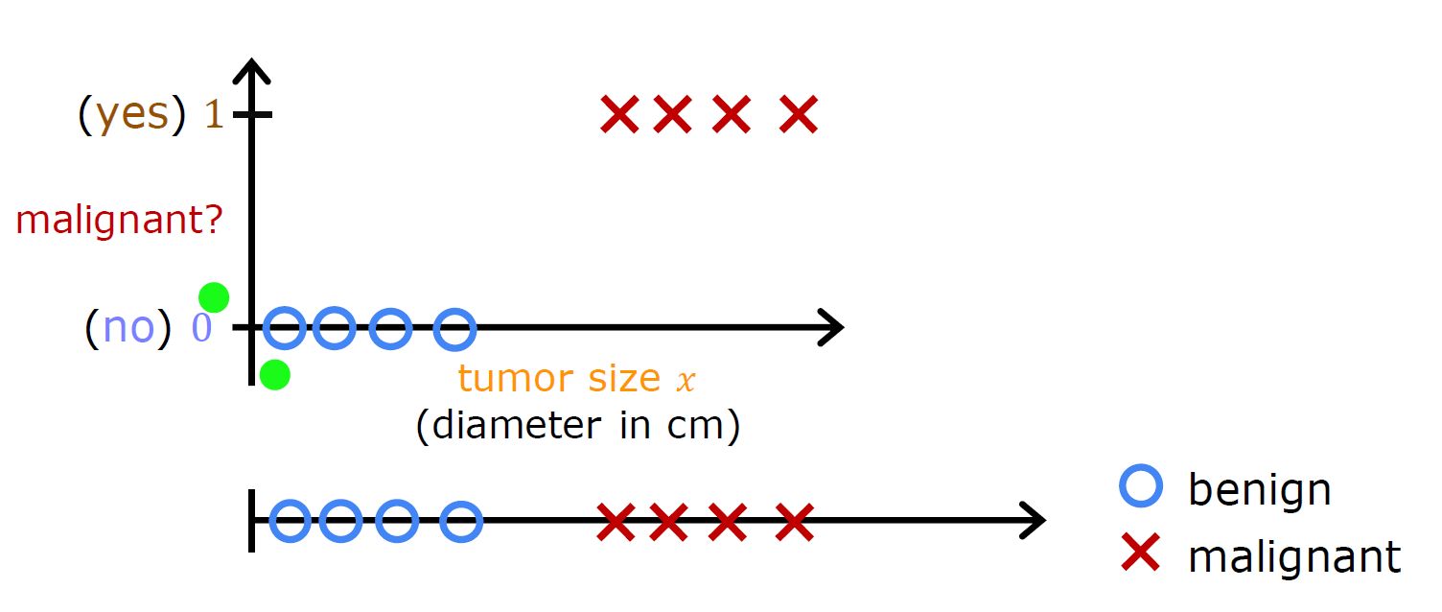
Tech Requirements
Classification
Machine Learning Course
Abdel Rahman AlSabbagh

Slide 7
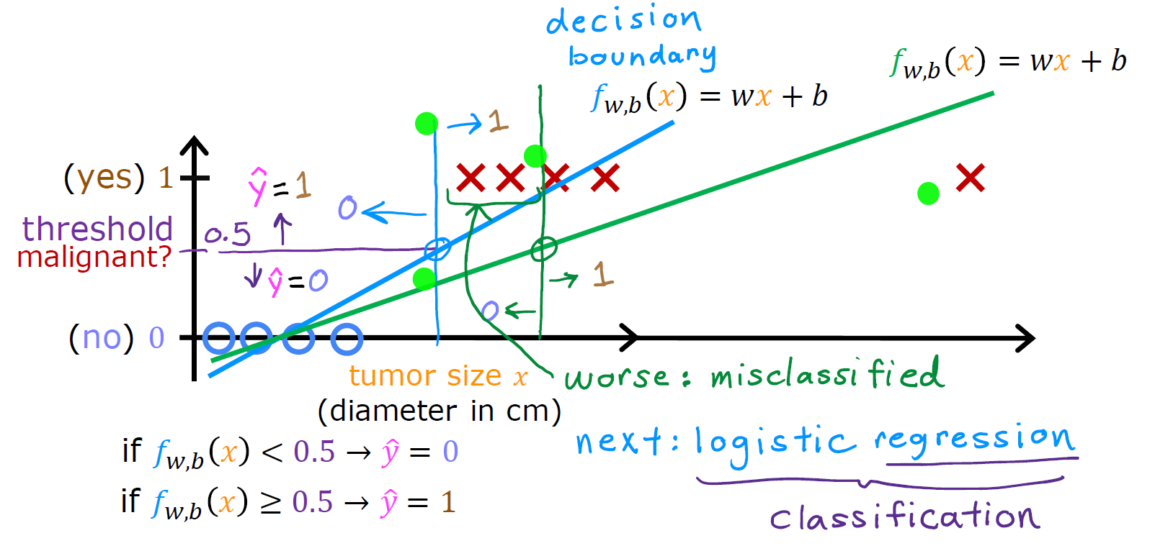
Tech Requirements
Classification
Machine Learning Course
Abdel Rahman AlSabbagh

Slide 8
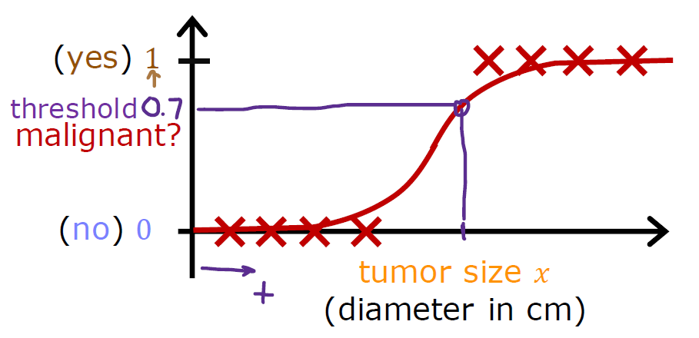
Tech Requirements
Logistic Regression
Machine Learning Course
Abdel Rahman AlSabbagh

Slide 9
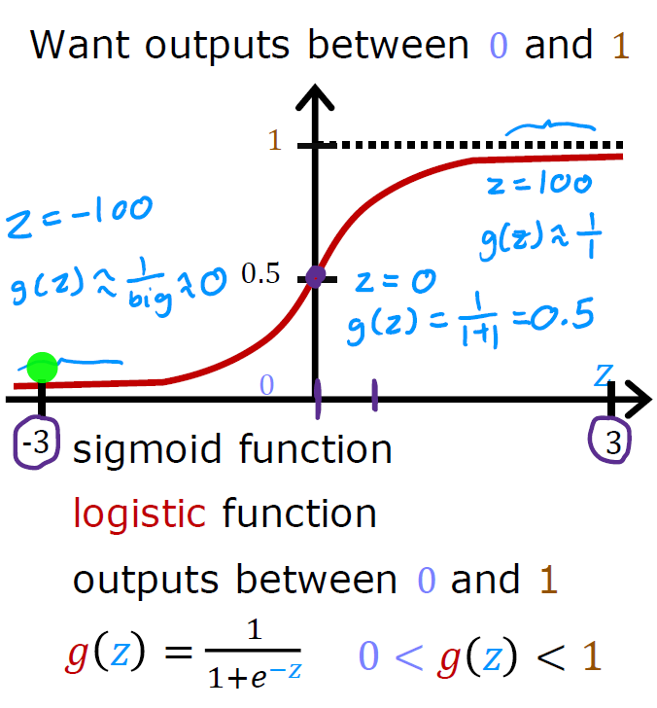
Tech Requirements
Logistic Regression
Machine Learning Course
Abdel Rahman AlSabbagh

Slide 10
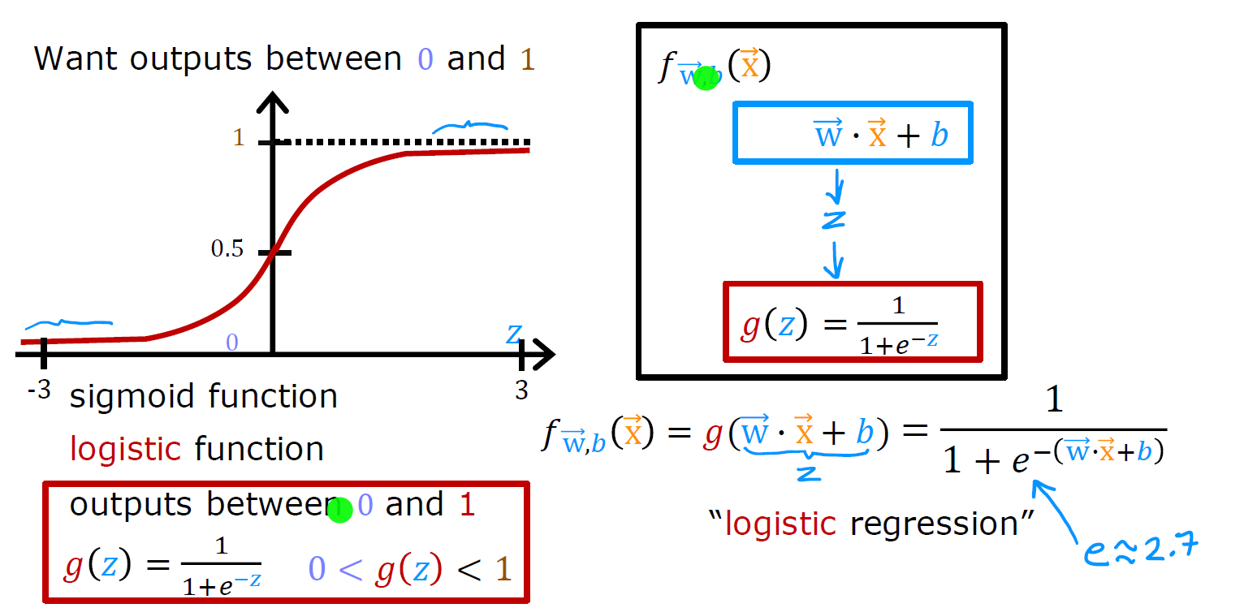
Tech Requirements
Logistic Regression
Machine Learning Course
Abdel Rahman AlSabbagh

Slide 11
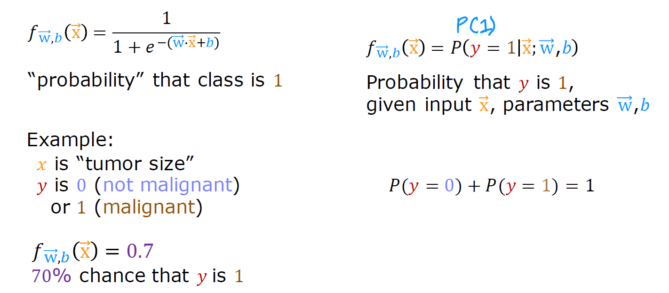
Tech Requirements
Logistic Regression
Machine Learning Course
Abdel Rahman AlSabbagh

Slide 12
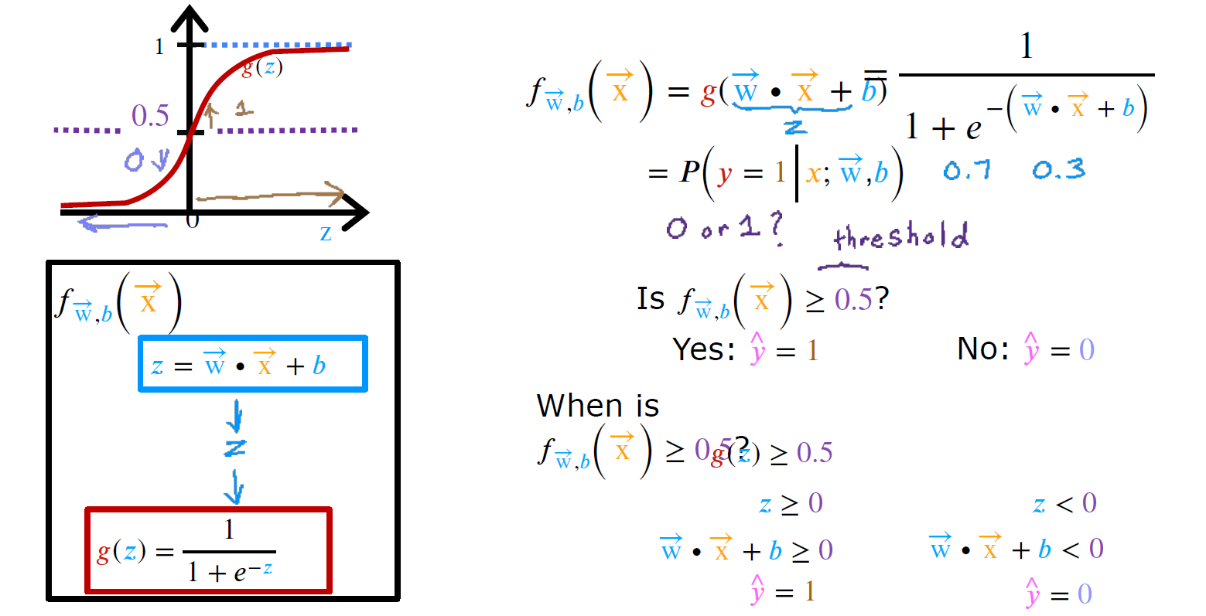
Tech Requirements
Decision Boundary
Machine Learning Course
Abdel Rahman AlSabbagh

Slide 13
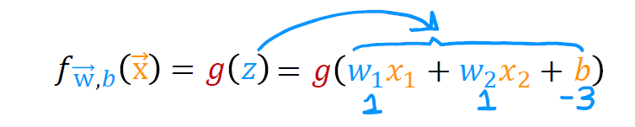
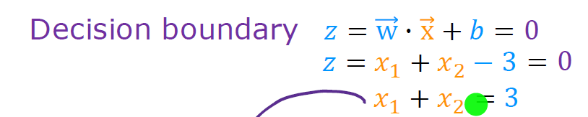
Tech Requirements
Decision Boundary
Machine Learning Course
Abdel Rahman AlSabbagh

Slide 14
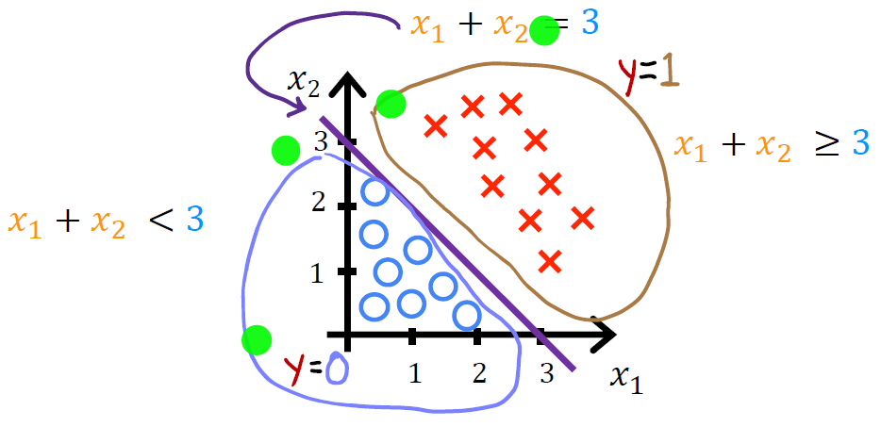
Tech Requireents
Decision Boundary
Machine Learning Course
Abdel Rahman AlSabbagh

Slide 15
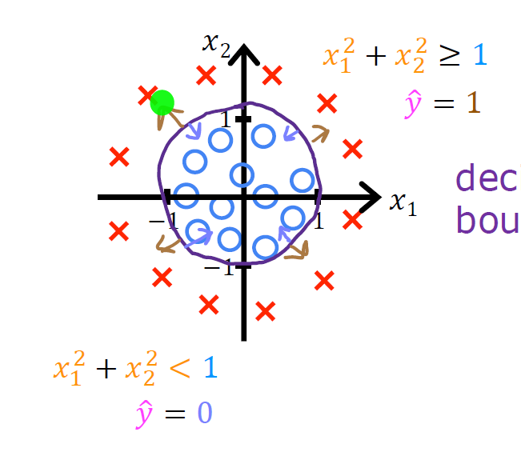
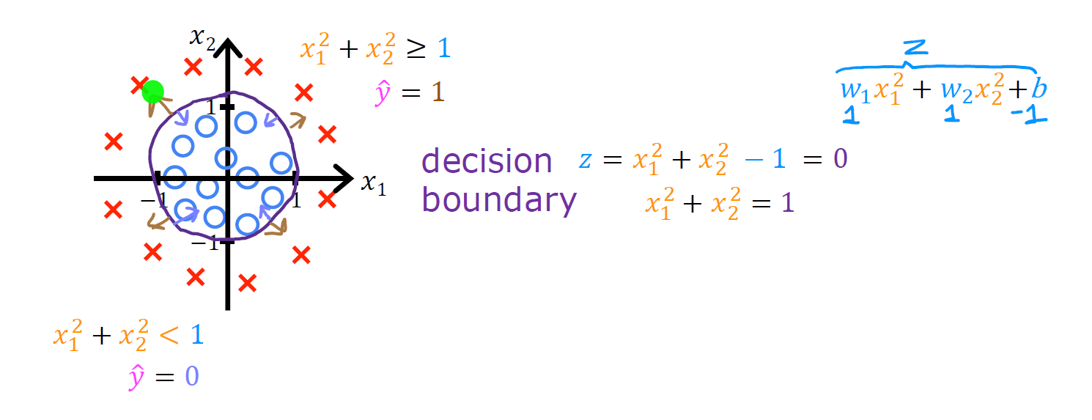
Tech Requireents
Non-linear Decision Boundaries
Machine Learning Course
Abdel Rahman AlSabbagh

Slide 16
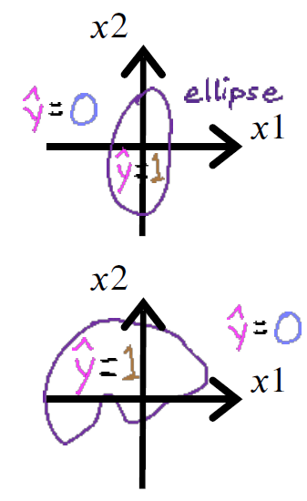
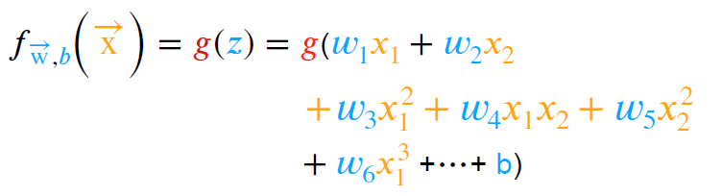
Tech Requireents
Non-linear Decision Boundaries
Machine Learning Course
Abdel Rahman AlSabbagh

Slide 17
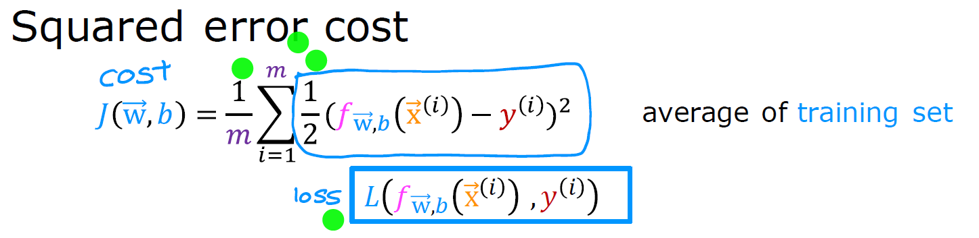
Tech Requireents
Cost Function for Logistic Regression
Machine Learning Course
Abdel Rahman AlSabbagh

Slide 18
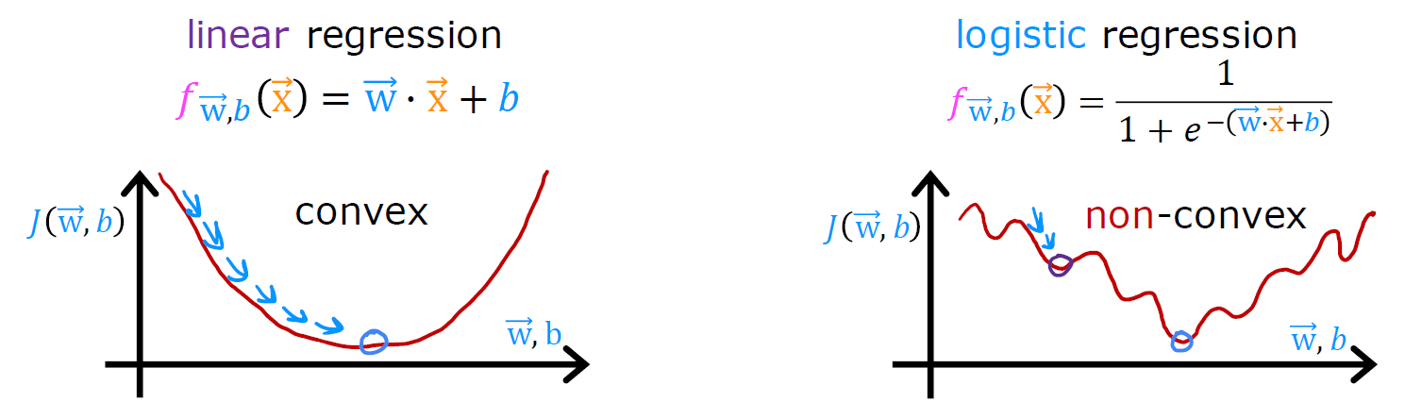
Tech Requireents
Cost Function for Logistic Regression
Machine Learning Course
Abdel Rahman AlSabbagh

Slide 19
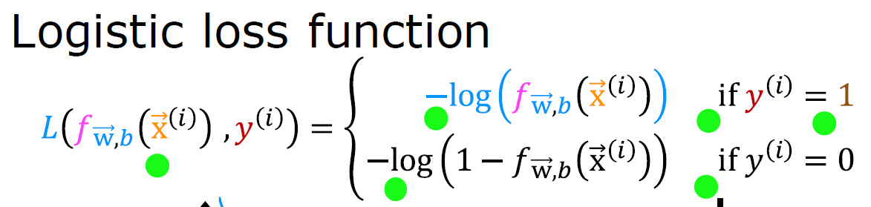
Tech Requireents
Cost Function for Logistic Regression
Machine Learning Course
Abdel Rahman AlSabbagh

Slide 20
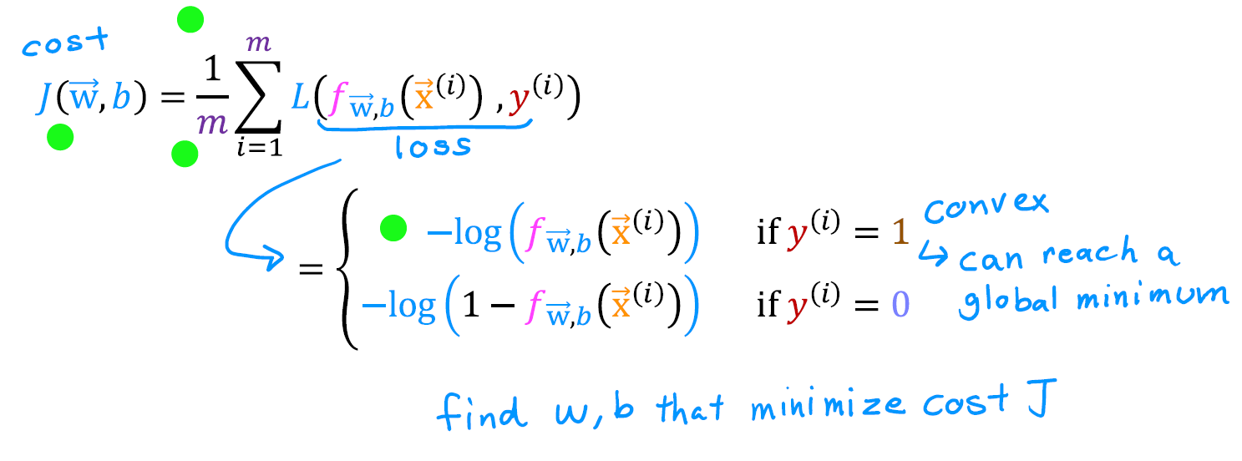
Tech Requireents
Cost Function for Logistic Regression
Machine Learning Course
Abdel Rahman AlSabbagh

Slide 21
Tech Requireents
Cost Function for Logistic Regression
Machine Learning Course
Abdel Rahman AlSabbagh

Slide 22
Tech Requireents
Simplified Cost Function for Logistic Regression
Machine Learning Course
Abdel Rahman AlSabbagh

Slide 23
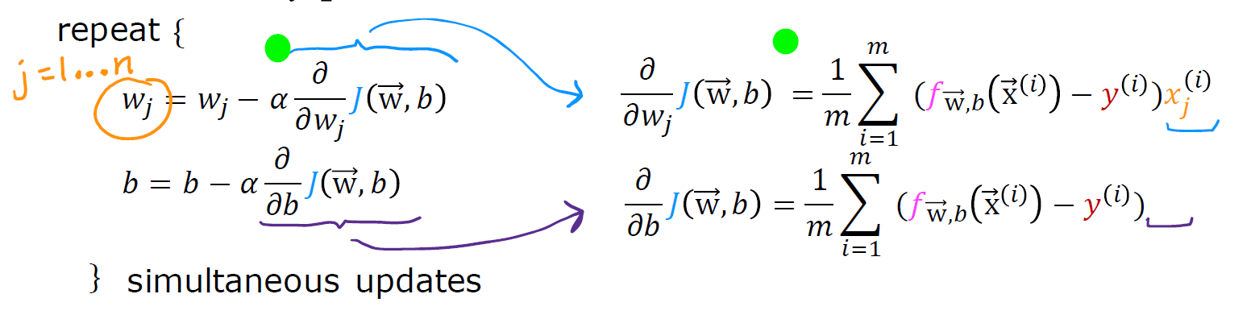
Tech Requireents
Gradient Descent for Logistic Regression
Machine Learning Course
Abdel Rahman AlSabbagh

Slide 24
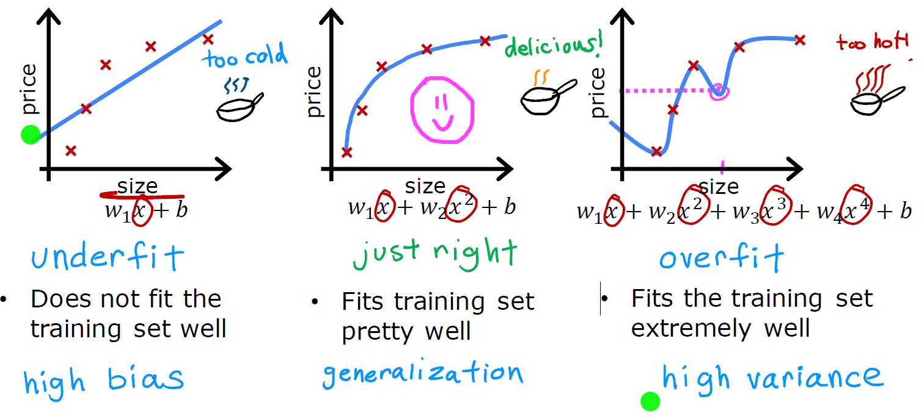
The Problem of Overfitting
Machine Learning Course
Abdel Rahman AlSabbagh

Slide 25
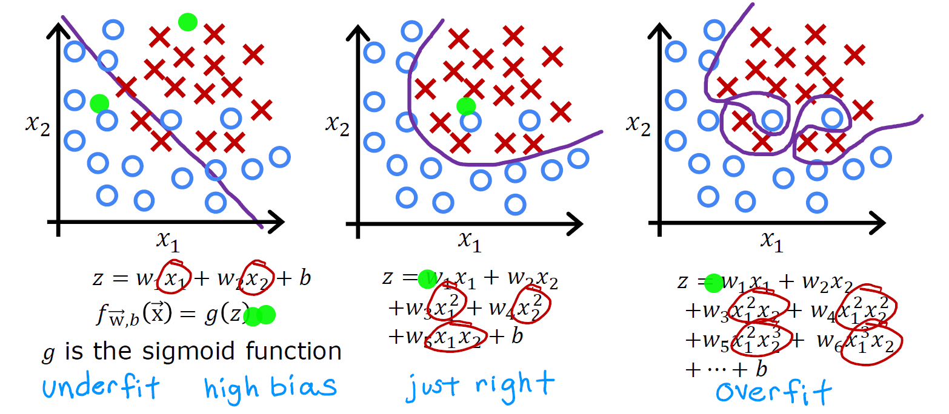
The Problem of Overfitting
Machine Learning Course
Abdel Rahman AlSabbagh

Slide 26
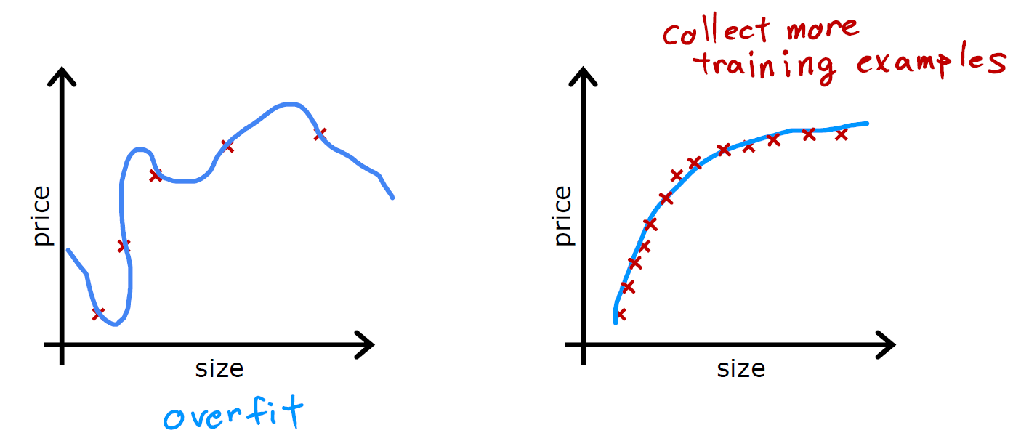
Addressing Overfitting
Machine Learning Course
Abdel Rahman AlSabbagh

Slide 27
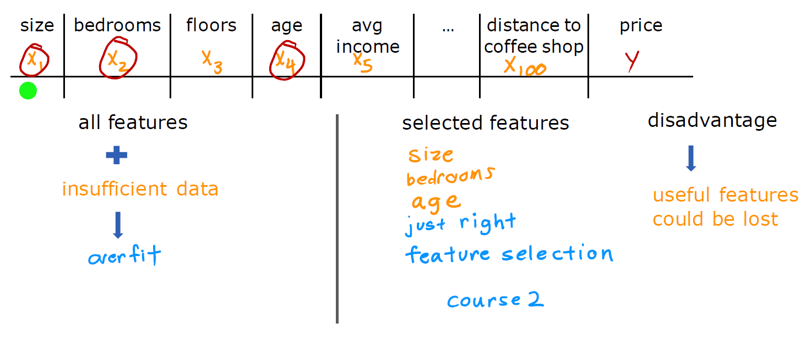
Addressing Overfitting
Machine Learning Course
Abdel Rahman AlSabbagh

Slide 28
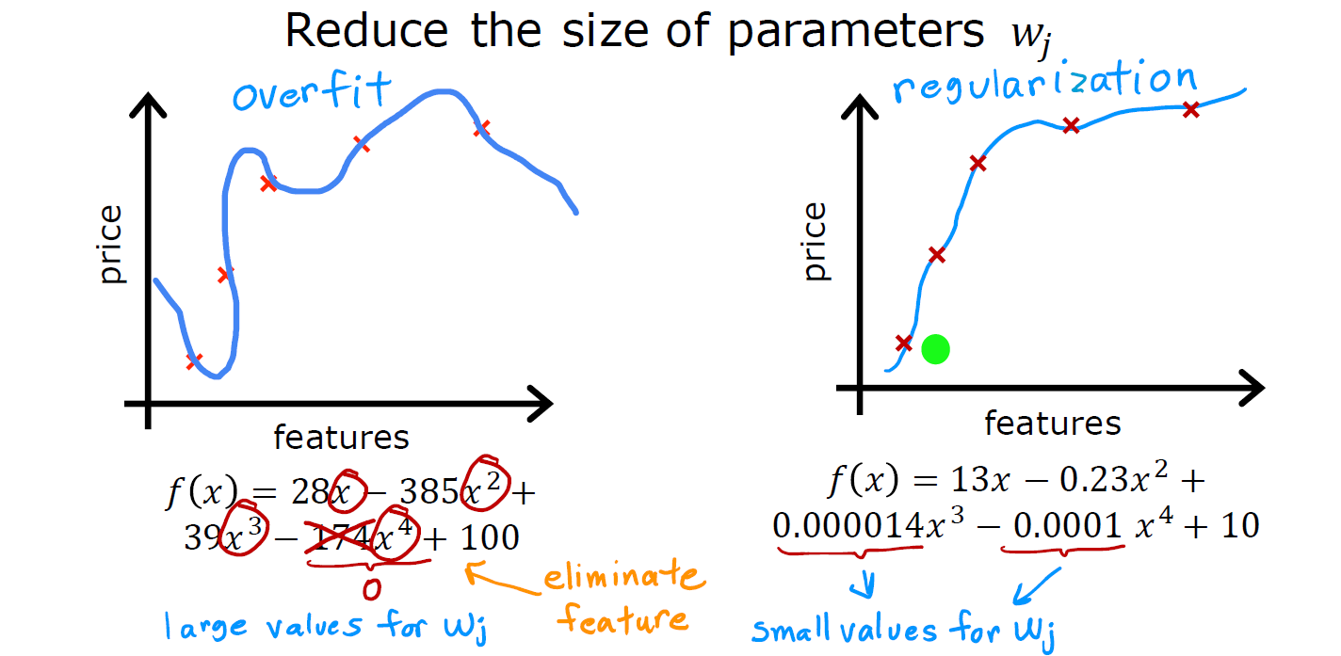
Addressing Overfitting
Machine Learning Course
Abdel Rahman AlSabbagh

Slide 29
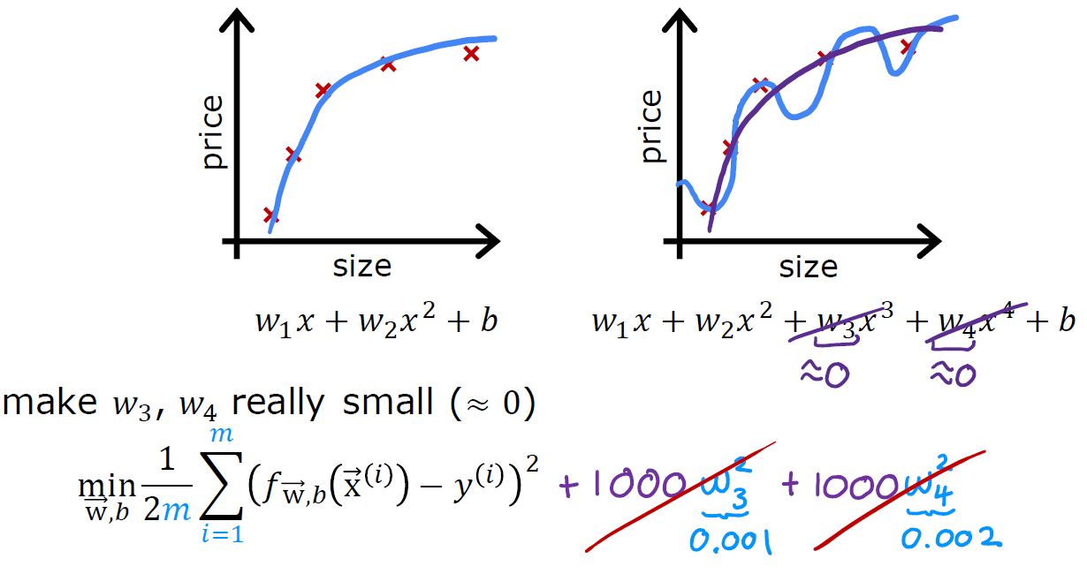
Cost Function with Regularization
Machine Learning Course
Abdel Rahman AlSabbagh

Slide 30
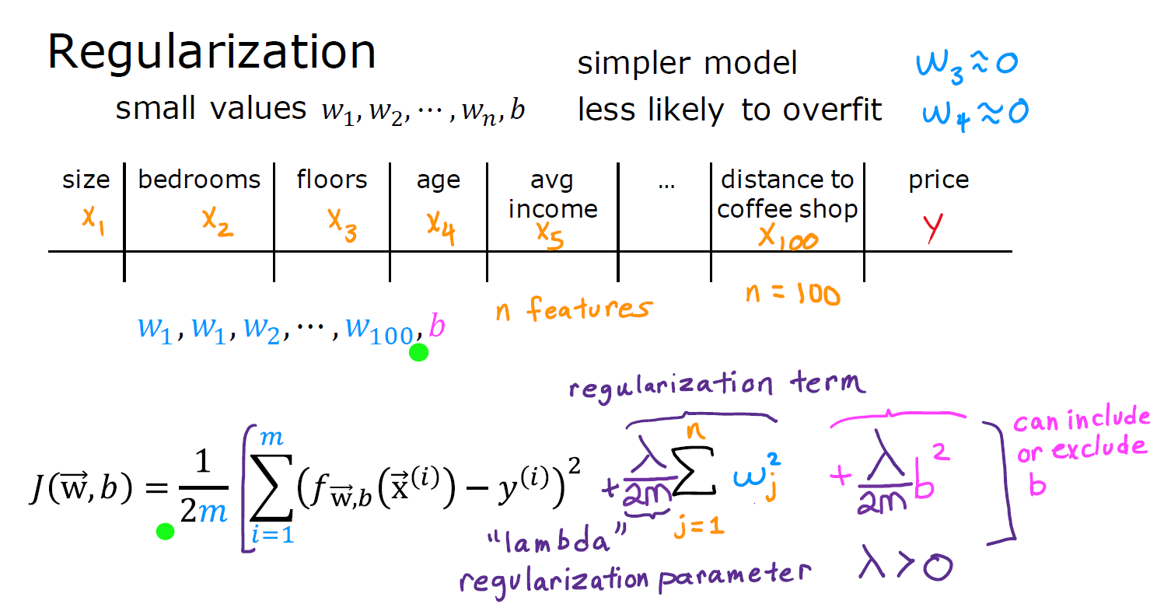
Cost Function with Regularization
Machine Learning Course
Abdel Rahman AlSabbagh

Slide 31
Cost Function with Regularization
Machine Learning Course
Abdel Rahman AlSabbagh

Slide 32
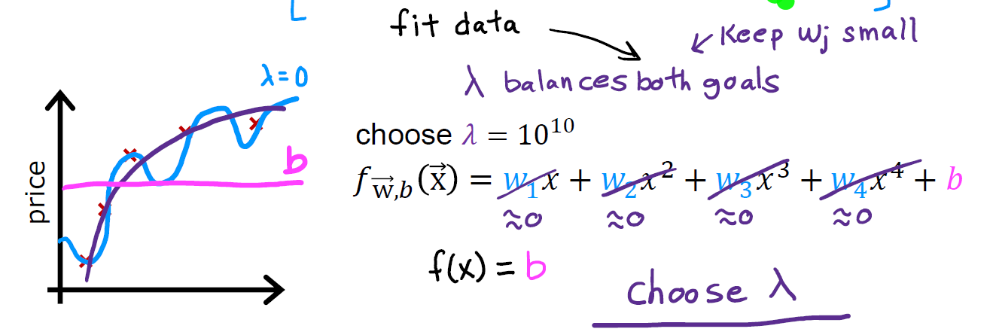
Cost Function with Regularization
Machine Learning Course
Abdel Rahman AlSabbagh

Slide 33
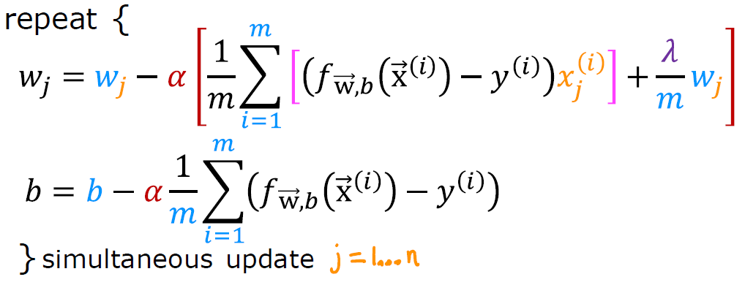
Gradient Descent Implementation
Machine Learning Course
Abdel Rahman AlSabbagh

Slide 34


Thank You
Next lecture will be In-Person on Mon, 22.5.2023, In Shaa allah!
sabbagh@ieee.org
Connect on Linkedin

