Slide 1



Bank Marketing Campaign Response Prediction
Multi‑Model Machine Learning Approach to Predicting Customer Term‑Deposit Subscriptions
Presented by: SANA ULLAH

Slide 2


🎯 Business Problem
Banks run large outreach campaigns to sell term deposits.
Contacting every customer raises costs
and reduces efficiency.
Unnecessary marketing costs.
Inefficient customer targeting.
"Can machine learning identify customers who are more likely to subscribe to a term deposit before the bank invests resources in contacting them?"

Slide 3

🎯 Project Objective
Primary Goal
Analysis Goals
Build a defensible classifier to predict term-deposit subscription prior to contact.
EDA for business patterns, targeted feature engineering, robust preprocessing.
Modeling Goals
Decision Principle
Develop multiple models, validate via cross‑validation, tune KNN, compare metrics, select candidate.
Prioritize evidence‑based model selection (metrics + business interpretability), not raw accuracy alone.

Slide 4
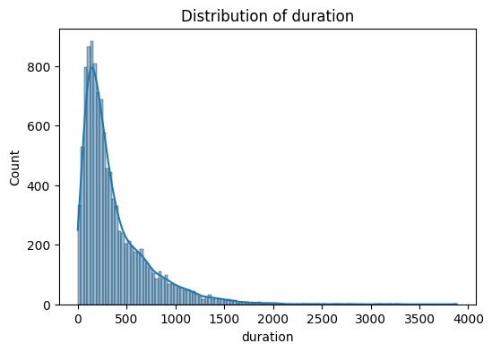
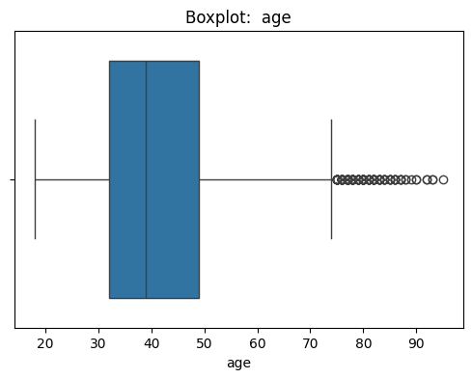
EDA : Data Quality
Histogram
Plot histograms of all numerical features and observed that some features are highly right-skewed, Which needs special treatment (Reduce skewness) in Data preprocessing.
Boxplot
Plot boxplot for all numerical features which shows multiple outilers, but after investigation, it seems to be a real data point. (Not Entry Error)

Slide 5

EDA: CUSTOMER BEHAVIOR
Questions investigated:-
How does subscription behavior vary across jobs?-
Does marital status relate to subscription behavior?
Do customers with Personal loans respond differently?
How Customers with housing loan respond ?
Is customer engagement associated with subscription?

Slide 6
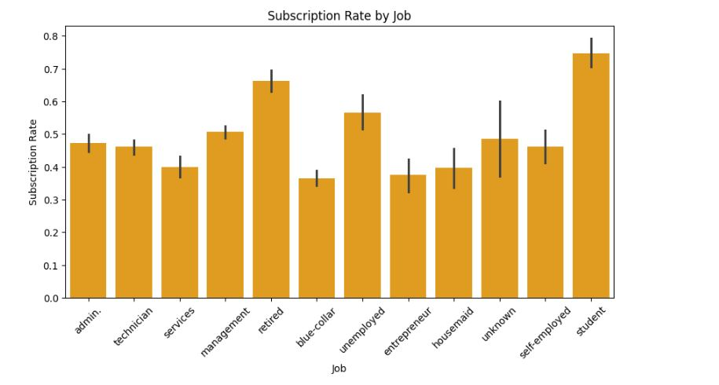
Business Insights
Interpretation: Customers without housing or personal loans show higher observed subscription rates. Single customers show relatively stronger responsiveness. Tertiary education segments show higher subscription propensity. These are observed associations — not causal claims.

Slide 7
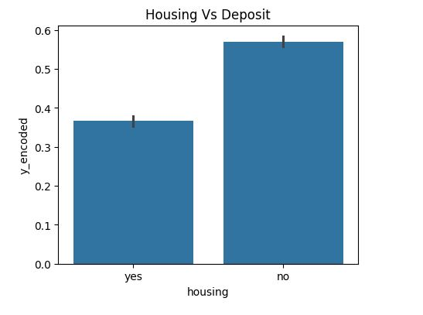
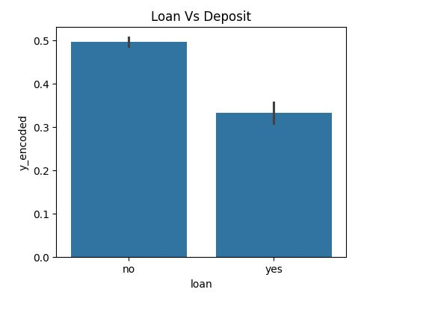
Business Insights
Interpretation: Customers without housing or personal loans show higher observed subscription rates. Single customers show relatively stronger responsiveness. Tertiary education segments show higher subscription propensity. These are observed associations — not causal claims.

Slide 8
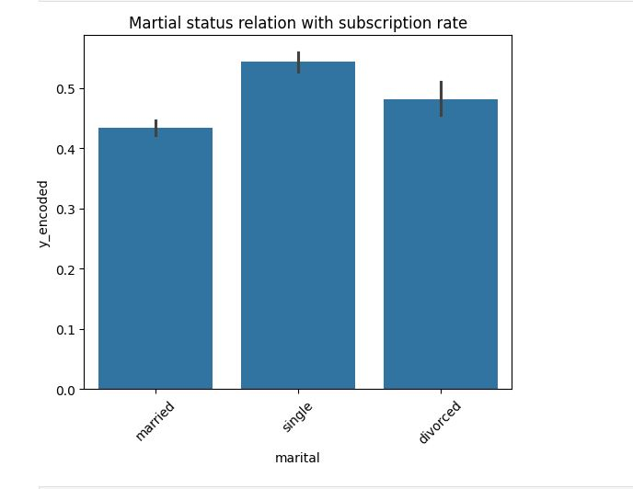
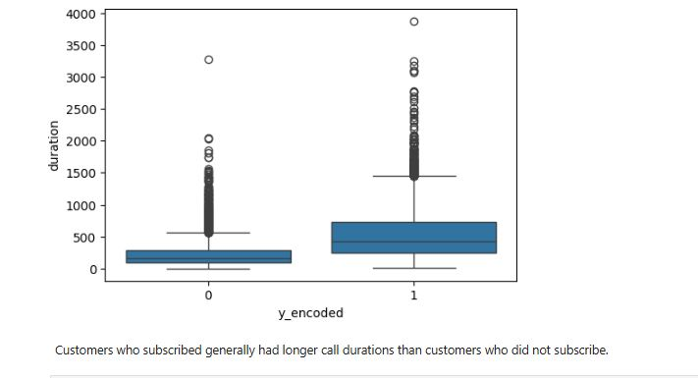
Business Insights
Interpretation: Customers without housing or personal loans show higher observed subscription rates. Single customers show relatively stronger responsiveness. Tertiary education segments show higher subscription propensity. These are observed associations — not causal claims.

Slide 9

Data Pre-processing
Numeric → Transformation ->scaling (StandardScaler);
Categorical → OneHotEncoder(handle_unknown="ignore");
Combined → full feature matrix.
Why scaling: required for distance‑based models (KNN) and scale‑sensitive models (SVM).

Slide 10
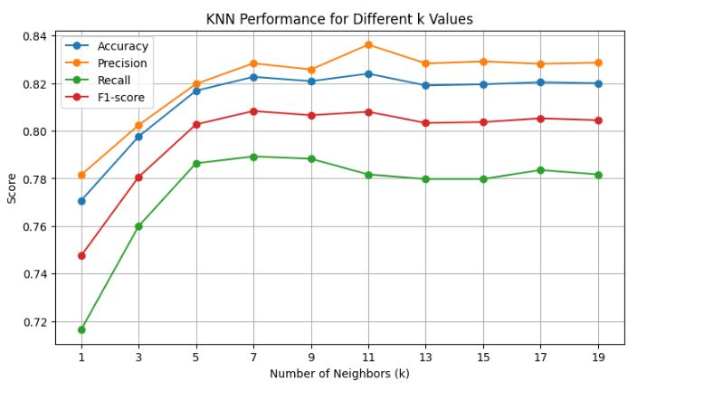
KNN CROSS-VALIDATION (Best K Value)
Baseline KNN Model :
Accuracy = 81.68%
Classification performance:
Class 0:Precision = 0.81Recall = 0.84F1 = 0.83
Class 1:Precision = 0.82Recall = 0.79F1 = 0.80

Slide 11
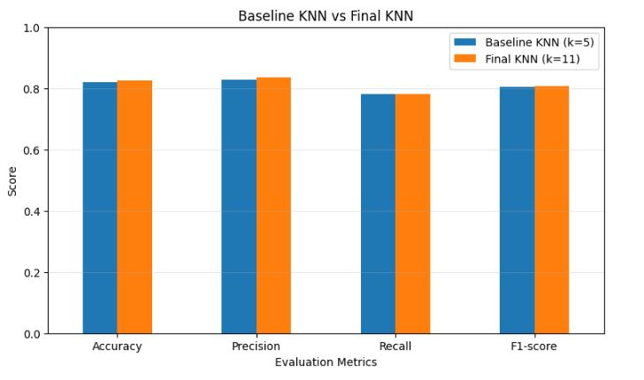
Baseline KNN vs Final KNN

Slide 12
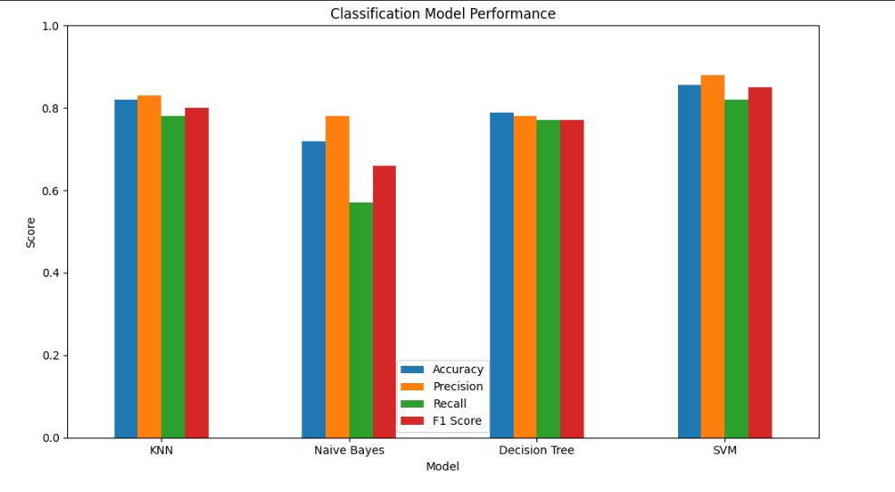
Models Comparison

Slide 13
Final Model Selection
🏆 Final Model SVM achieved:
Accuracy : 85.54%
Precision : 88%
Recall: 82%
F1-score : 85%
SVM was selected as the strongest-performing candidate among the evaluated models

Slide 14
Business Impact
Turning Customer Data into Smarter Marketing Decisions
Customer Data
↓
Machine Learning Model
↓
Predict Customer Response
↓
Identify High-Potential Customers
↓
Targeted Marketing
↓
Better Resource Allocation
Better Targeting Focus marketing efforts on customers with a higher predicted likelihood of subscribing.
Lower Campaign Waste Reduce unnecessary outreach to customers who are less likely to respond.
Data-Driven Decisions Move from broad customer targeting to evidence-based customer prioritization.

Slide 15
THANK YOU!

