Slide 1

Comprehensive Data Analysis on Illness Prevalence in Patients
Abdul Mahatab Sarban
AICTE Internship Student Registration ID) : STU65edfcd6637731710095574,
Sinhgad Acadamy of Engineering Pune,
Third year (Electronics and Telecommunication).

Slide 2

PROBLEM STATEMENT
Analyze the dataset to determine how many individuals report different counts of illnesses. This helps understand the spread and frequency of reported illnesses among the surveyed population.

Slide 3
Project Description This analysis was conducted using a dataset containing demographic and health-related variables. By categorizing individuals based on their count of illnesses, we aimed to identify patterns that could be relevant for healthcare providers and researchers.
The findings were visualized using Python libraries to create clear and interpretable charts.

Slide 4

WHO ARE THE END USERS?
Healthcare analysts
Medical researchers
Policy makers

Slide 5

Technology Used
Python
jupyter notebook
pandas for data manipulation
matplotlib for data visualization

Slide 6
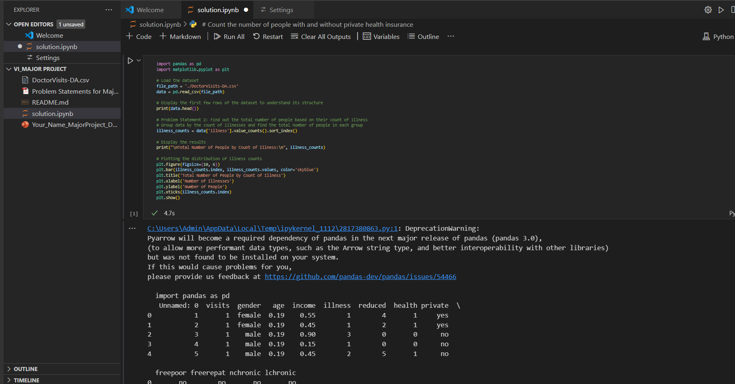
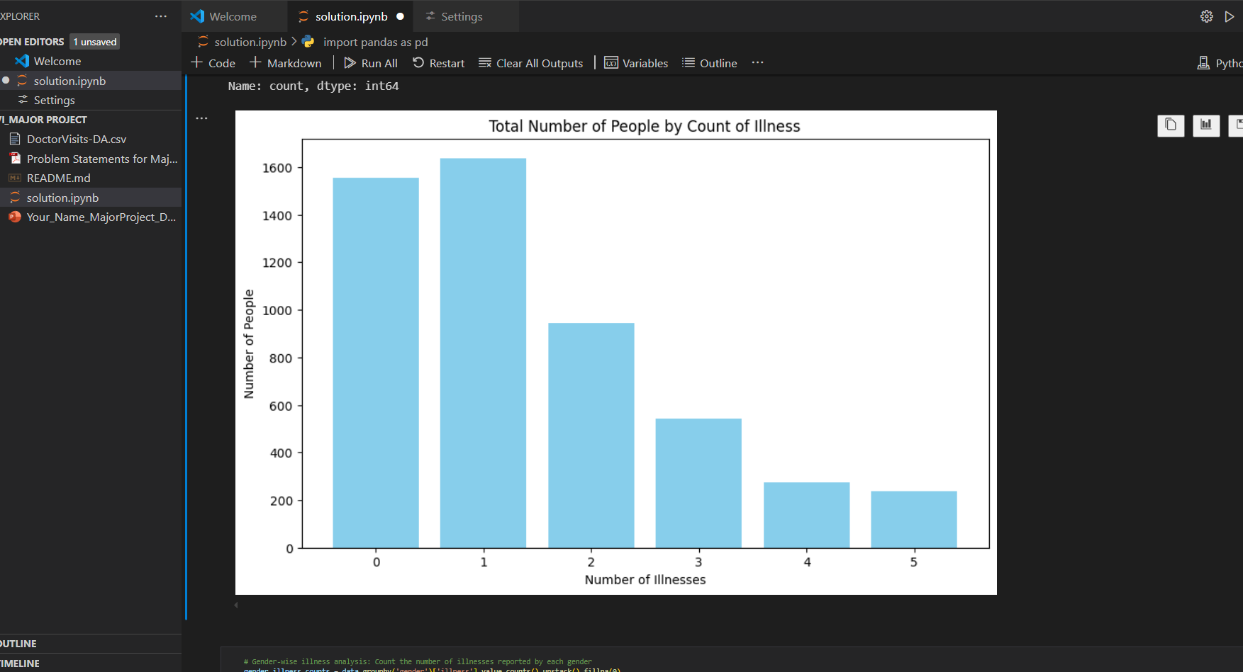
RESULTS
Demo Link

Slide 7
Thank you
.
.

