Slide 1


Department of Computer Science & Engineering (AI & ML)
7CSD Major Project Phase-1 Presentation
Academic Year 2026-27
Machine Learning-Based Employee Attrition Prediction Using Ensemble Learning and Data Analytics
Presented by
Team 6
  Abdul Waasay (B23DS027)
  Marupakula Jashwanth Goud (B23DS034)
  Pendyala Praneeth Reddy (B23DS050)
  Veerabathini Manish (B23DS060)
Supervisor Dr. B. Hanumanthu Assistant professor Dept. of CSE (AI&ML) | Coordinator Dr. M. Sujatha Assistant professor Dept. of CSE (AI&ML) | UG Major projectConvenor K. Vinay Kumar Assistant Professor Dept. of CSE(AI&ML) | Head of the Department Dr. A. Jothi Prabha Associate Professor Dept. of CSE (AI &ML)

Slide 2
Contents
01 Abstract
02 Introduction
03 Problem Statement
04 Objectives & Expected Outcomes
05 Literature Review
06 Methodology
07 Existing System – Open Issues and Challenges
08 Proposed System – Advantages and Limitations
09 Novelty of the Project
10 Work to be Shown in the Next Presentation
11 Major Project Schedule – Gantt Chart
12 References

Slide 3
Abstract
Study focus
Key evidence from the base paper
• Predict employee attrition using machine learning on HR data.
• Compare multiple classifiers and select the strongest model.
• Explain the main reasons behind employee departures.
• Dataset: 5,767 employee observations; 309 voluntary resignations (5.4%).
• 27 features were mapped; 14 were used for the final analysis.
• Random Forest with an 80:20 split achieved AUC 99.9% and accuracy 94.7%.

Slide 4
Introduction
WHY EMPLOYEE ATTRITION MATTERS
From HR intuition to analytics
Rich HR Data: Enterprise records enable proactive predictive modeling.
Early Detection: ML flags employees at high flight risk before they resign.
Actionable Insights: Predictions alone aren't enough—HR needs clear reasons to intervene.
Financial Loss: High recruitment and onboarding costs.
Operational Impact: Lost skills, lower morale, and reduced productivity.
Data-Driven Need: Moves HR from reactive exit interviews to proactive retention.
The project therefore combines prediction + explanation + data-driven retention insights.

Slide 5
Problem Statement
Prediction challenge
Interpretation challenge
No Direction: Feature ranking shows what matters, but not if it increases or decreases churn.
Black-Box Models: Complex ensemble models are hard for non-technical HR managers to trust.
Flawed Decisions: Without clear explanations, HR might apply the wrong retention strategies.
Many causes: People leave due to pay, stress, or bad management.
Unequal data: Very few employees leave (~5%), while most stay (95%).
Smart guessing risk: Models can just guess "Stay" for everyone and miss real risks.

Slide 6
Objectives & Expected Outcomes
Objectives
Expected Outcomes
• Study employee-level factors associated with attrition.
• Preprocess HR data and handle class imbalance.
• Compare Naïve Bayes, Logistic Regression, Decision Tree and Random Forest.
• Select the best-performing classifier using AUC, sensitivity, specificity and accuracy.
• Apply SHAP to quantify feature contribution and direction.
• A robust attrition-prediction model for identifying higher-risk employee groups.
• Ranked drivers of attrition, with directional interpretation.
• Individual-level insights that can guide targeted retention interventions.
• A data-driven framework that supports, rather than replaces, HR judgement.
Objectives
Expected Outcomes
Data Prep & Balancing: Clean HR records and handle severe class imbalance.
Model Comparison: Benchmark multiple classifiers (Tree-based & baseline models).
Performance Selection: Choose the best model using AUC, sensitivity, and accuracy.
Explainable AI: Apply directional attribution to show why employees leave.
Predictive Accuracy: Identifies at-risk employees before they resign.
Root-Cause Analysis: Ranks key factors causing employee turnover.
Actionable Guidance: Shows exactly how to intervene for each employee.
HR Empowerment: Enhances human decision-making with AI insights.

Slide 7
Literature Review
Workforce Turnover Determinants
Machine Learning & Explainable AI (XAI)
• Compensation & Reward Structures: Base salary and premiums show strong inverse correlations with attrition; bonus structures exhibit complex non-linear perceptions (Varkiani et al., 2025; Saradhi & Palshikar, 2011).
• Workload Stress & Overtime: Excessive working hours and overtime strain accelerate fatigue and significantly elevate voluntary resignation rates (Sexton et al., 2005; Varkiani et al., 2025).
• Career Velocity & Tenure Dynamics: Stagnant promotion velocity, appraisal ratings, and long role tenure without advancement drive employee departures (Alduayj & Rajpoot, 2018; Fallucchi et al., 2020).
• Organizational Support & Attachment: Attachment theory shows supervisory feedback, upskilling opportunities, and culture strongly enhance intention to stay (Patrick et al., 2024; Zhao et al., 2018).
• Ensemble Classifier Superiority: Tree-based ensembles (Random Forest, XGBoost) outperform traditional linear models (Logistic Regression, Naïve Bayes) on tabular HR records (Liaw & Wiener, 2002; Punnoose & Ajit, 2016; Varkiani et al., 2025).
• Class Imbalance Mitigation: Severe class imbalance (~5.4% attrition rate) requires synthetic resampling (ROSE, SMOTE) to eliminate majority-class prediction bias (Chawla et al., 2002; Varkiani et al., 2025).
• Directional Explainability (SHAP): Traditional feature importance ranks variables without direction; SHAP (Shapley Additive exPlanations) resolves the black-box dilemma by quantifying positive and negative forces (Lundberg & Lee, 2017; Varkiani et al., 2025).

Slide 8

Methodology
1
2
3
24-D Feature
Engineering
4
Imbalance
Mitigation
5
XGBoost &
K-Means
6
Multi-Source
Ingestion
→
Cleaning &
Winsorizing
→
→
→
→
SHAP XAI &
Retention Rules
Data Engineering & 24-D Feature Store [Phase 1 ]
ML Modeling, Persona Clustering & Retention Engine [Phase 2]
Data Ingestion: Ingests 6 relational HR tables (Compensation, Reviews, Workload, Tickets, Training, Employees).
Cleaning & Normalization: Schema validation, missing value imputation, and Winsorization to cap salary/workload outliers.
24-D Feature Store: Flattens disparate data into 24 core features capturing tenure, stress indices, and growth trends.
Class Balancing: Prevents model bias against minority employee departures.
Ensemble ML Model: XGBoost predicts continuous flight-risk probabilities ($0.0→1.0$).
Persona Clustering: K-Means ($k=3$) segments employees into cohorts (High Performers, Burnout Risk, Underutilized).
XAI & Retention Rules: SHAP explains why risk occurs $→$ triggers targeted HR retention action plans.

Slide 9
Existing System – Open Issues and Challenges
Existing approaches
Open issues
• Use statistical and machine-learning classifiers to predict employee turnover.
• Feature Importance is often used to rank the most influential variables.
• Some studies address class imbalance through resampling or weighting.
• Feature Importance does not indicate direction of effect.
• HR data can be difficult to obtain because of privacy and strategic sensitivity.
• Class imbalance can cause minority resignations to be overlooked.
• Black-box models reduce transparency for managerial decisions.
• Relationships can be counterintuitive and context-dependent.

Slide 10
Proposed System – Advantages and Limitations
HR Data
Preprocess
Balance
Ensemble Model
Explain
Action
Employee
features
→
Clean +
select
→
ROSE
→
Random
Forest
→
SHAP
→
Retention
insights
Advantages
Limitations
• Combines predictive performance with explainability.
• Random Forest handles multiple features and nonlinear relationships well.
• SHAP supports both global and individual-level interpretation.
• Outputs can be connected to targeted retention policies.
• Results are dependent on the quality and representativeness of HR data.
• The base study cannot assess time dependence because the two classes come from different periods.
• Model outputs require contextual HR interpretation; correlation should not be treated as automatic causation.

Slide 11
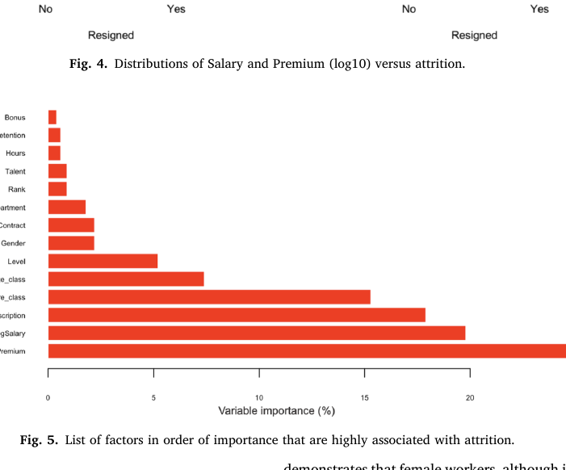
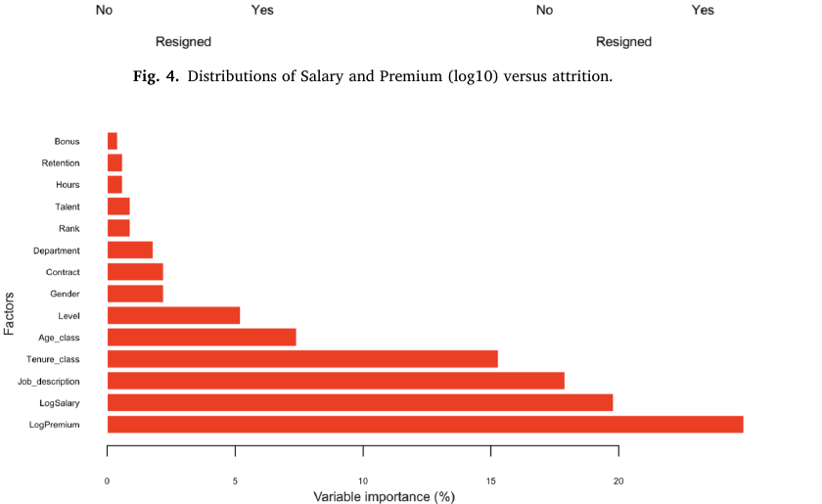
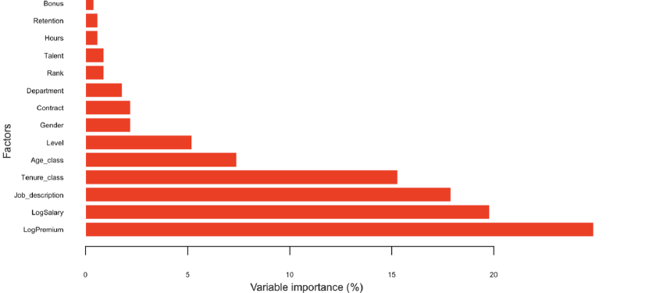
Novelty of the Project
Novelty of the Project
Novelty of the Project
1. Direction-aware explainability
• Goes beyond feature-importance ranking.
• Shows whether a factor raises or lowers attrition probability.
2. Ensemble + XAI
• Compare multiple classifiers and select the strongest model.
• Pair prediction with SHAP for transparent interpretation.
3. Individual-level insight
• Move from population trends to employee-specific drivers.
• Support targeted retention decisions.
1. Direction-aware explainability
2. Ensemble + XAI
3. Individual-level insight
1. Direction-aware explainability
• Goes beyond feature-importance ranking.
• Shows whether a factor raises or lowers attrition probability.
2. Ensemble + XAI
• Compare multiple classifiers and select the strongest model.
• Pair prediction with SHAP for transparent interpretation.
3. Individual-level insight
Personalized Diagnosis: Finds why a specific person might leave.
Targeted Action: Guides the right fix for that employee.
• Go beyond ranking feature importance by showing whether a factor pushes attrition probability up or down.
• Use the strongest classifier identified through model comparison and pair it with SHAP for transparent interpretation.
• Move from population-level trends toward employee-specific drivers for targeted retention decisions.
Why it matters
• Salary and Premium show inverse relationships with attrition in the base study.
• Some factors can have unexpected effects; Bonus and Retention may appear positively associated with leaving in a specific employee analysis.
• SHAP helps identify where HR intervention can be focused instead of relying only on a generic ranking.
Why it matters
• Salary and Premium show inverse relationships with attrition in the base study.
• Some factors can have unexpected effects; e.g., Bonus and Retention may appear positively associated with leaving in a specific employee analysis.
• SHAP helps identify where HR intervention can be focused instead of relying on a generic ranking.
Feature importance reported in the base paper
Why it matters
Proves what works: Higher pay and rewards clearly keep employees.
Finds hidden problems: Catches strange reasons why good employees still quit.
Exact solutions: Tells HR what to fix for each person, not just a score.
Feature importance reported in the base paper
Feature importance reported in the base paper

Slide 12
Work to be Shown in the Next Presentation
EDA
Model training
• Load/validate HR dataset; inspect distributions and attrition imbalance.
• Train baseline models and Random Forest with controlled train/test splits.
Evaluation
Explainability
• Compare AUC, sensitivity, specificity and accuracy.
• Generate SHAP global and individual explanations.

Slide 13
Major Project Schedule – Gantt Chart
Planned project timeline
Major Project Schedule – Gantt Chart
Planned schedule
W1
W2
W3
W4
W5
W6
W7
W8
Literature & problem definition
Planned project timeline
Dataset acquisition & understanding
W1
W2
W3
W4
W5
W6
W7
W8
Literature & problem definition
Preprocessing & EDA
Dataset acquisition & understanding
Model development & comparison
Preprocessing & EDA
SHAP & interpretation
W1–W8 are a planning view for the project; actual dates can be mapped to the department calendar.
W1–W8 planning view
Model development & comparison
Prototype, testing & documentation
SHAP & interpretation
Final presentation preparation
Prototype, testing & documentation
Final presentation preparation
W1–W8 is a planning view; actual dates can be mapped to the department calendar.

Slide 14
References
• Varkiani, S. M., Pattarin, F., Fabbri, T., & Fantoni, G. (2025). Predicting employee attrition and explaining its determinants. Expert Systems With Applications, 272, 126575. DOI: 10.1016/j.eswa.2025.126575.
• Lundberg, S. M., & Lee, S.-I. (2017). A Unified Approach to Interpreting Model Predictions. Advances in Neural Information Processing Systems.
• Liaw, A., & Wiener, M. (2002). Classification and Regression by randomForest. R News, 2(3), 18–22.
• Chawla, N. V., Bowyer, K. W., Hall, L. O., & Kegelmeyer, W. P. (2002). SMOTE: Synthetic Minority Over-sampling Technique. Journal of Artificial Intelligence Research, 16, 321–357.
• Alduayj, S. S., & Rajpoot, K. (2018). Predicting Employee Attrition using Machine Learning. IEEE International Conference on Innovations in Information Technology, 93–98.
• Patrick et al. (2024). Attachment Theory-based framework for intention to stay, as discussed in the base paper.
Primary source used throughout this presentation: the provided 2025 Expert Systems With Applications paper.

Slide 15

Thank you!
Questions & Discussion

