Slide 1

INTERNAL KNOWLEDGE ASSISTANT
A Retrieval-Augmented Generation System for Company Knowledge
Petalnex Pvt. Ltd. • AI Automation Internship
Final Capstone Presentation
Abdul Wadood

Slide 2




THE PROBLEM
Employees lose hours every week searching for information
Information Silos & Search Friction
The "Shoulder-Tap" Drain
Keyword search fails on phrasing mismatches — “time off” misses “Leave Absence Policy” entirely.
Senior staff and HR are constantly interrupted with repetitive questions, breaking deep-work focus.
Outdated Information Reliance
The Hallucination Risk
Hard-to-find documents push employees toward memory or peers — often outdated or deprecated.
A plain LLM will confidently invent policies that don't exist — a real legal and operational liability.
Petalnex Pvt. Ltd. • AI Automation Internship
2

Slide 3






CURRENT STATE
The existing process — manual, slow, and dead-ended
Employee has a question
Manually searches Drive, intranet, PDFs
Keyword search fails / dead end
Messages manager or HR on Slack/email
Waits — 15+ minutes, often longer
Result: 15+ minutes lost per query, and constant interruptions to senior staff.
Petalnex Pvt. Ltd. • AI Automation Internship
3

Slide 4




THE SOLUTION
A grounded RAG pipeline — not a guessing chatbot
Vector Database Architecture
RAG Pipeline
Company policies and SOPs are converted into embeddings and stored in Supabase pgvector.
Each question triggers a similarity search — only relevant passages are sent to the LLM.
Source-Aware Citations
Fallback & Human Escalation
Every AI answer cites the exact internal category or document it drew from.
No match found → the AI says so honestly and routes the question to a human.
Petalnex Pvt. Ltd. • AI Automation Internship
4

Slide 5
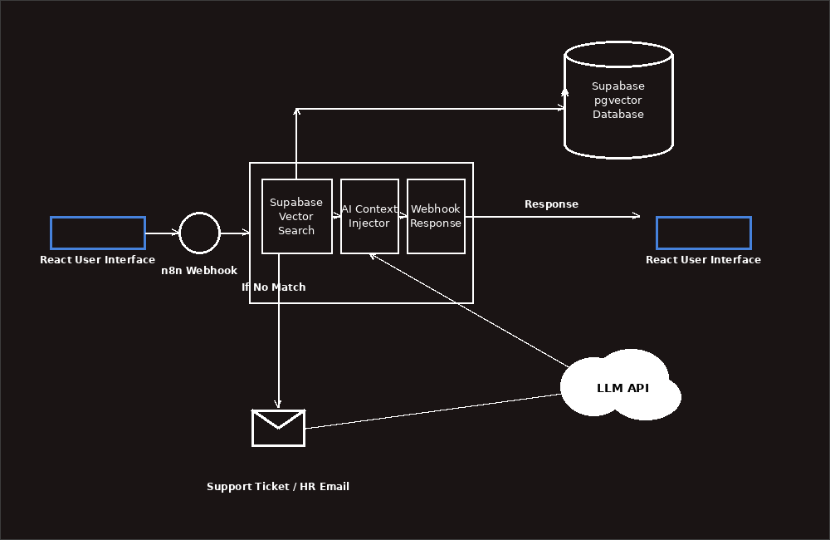
SYSTEM DESIGN
End-to-end architecture
Petalnex Pvt. Ltd. • AI Automation Internship
5

Slide 6






TECH STACK
Technologies powering the assistant
React
n8n (Docker)
Supabase (pgvector)
Frontend — accepts questions, renders answers
Orchestration — routing, validation, AI chaining
Vector database for embedded documents
Groq LLM
Google Gemini
Gmail
openai/gpt-oss-120b — grounded answer generation
gemini-embedding-001 — text-to-vector embeddings
HR escalation notifications for unanswered queries
Petalnex Pvt. Ltd. • AI Automation Internship
6

Slide 7



IMPLEMENTATION
Four n8n workflows make up the system
Document Ingestion
Converts company knowledge entries into embeddings and stores them in Supabase.
Core (Trigger + Validation + Auth)
Webhook intake, input validation, and x-api-key authentication before any logic runs.
AI / RAG Pipeline
Vector retrieval + grounded answer generation with source citation.
Global Error Handler
Catches unhandled failures from any linked workflow and alerts the admin.
Petalnex Pvt. Ltd. • AI Automation Internship
7

Slide 8



INTELLIGENCE LAYER
How AI is used — and constrained
Retrieval-Augmented Generation
Strict Grounding Rules
The LLM never answers from open knowledge — only from context retrieved for that specific question.
System prompt requires answers drawn only from provided context, with an explicit fallback rule.
Source Citation
Human Escalation
Every answer references the knowledge category it was drawn from — HR Policy, Products, or Support.
Unmatched questions are logged and routed to HR rather than answered with a guess.
Petalnex Pvt. Ltd. • AI Automation Internship
8

Slide 9

LIVE DEMONSTRATION
Employee question → Retrieval → Grounded AI answer → Source citation
“How many casual leaves are allowed?”
“What integrations do you support?”
“What is your company's stock price?” → honest fallback
Petalnex Pvt. Ltd. • AI Automation Internship
9

Slide 10

RELIABILITY
Built to survive the real world
Node-Level Handling
Workflow-Level Handling
Retry On Fail — up to 3 attempts on external API calls
Dedicated Global Error Handler workflow
Continue on Fail routes failures to a dedicated branch
Error Trigger node catches any unhandled failure
Errors logged to Supabase before any response is sent
Linked to every workflow via workflow-level Settings
Admin notified by email for every caught failure
Acts as a safety net beyond individual node retries
Petalnex Pvt. Ltd. • AI Automation Internship
10

Slide 11




TRUST & SAFETY
Security measures in place
Encrypted Credential Storage
Webhook Authentication
All API keys and database credentials live only in n8n's encrypted credential manager — never in code or docs.
Every request requires a valid x-api-key header; requests without it are rejected before any logic runs.
Least-Privilege Access
Key Rotation Discipline
The database connection is scoped strictly to the knowledge base table it needs to operate on.
A previously exposed API key was identified and rotated as part of a full security audit.
Petalnex Pvt. Ltd. • AI Automation Internship
11

Slide 12
IMPACT
Measurable business benefits
15 min → <5 sec
40%+
0%
Time to find a policy answer
Reduction in routine tickets to HR
Hallucinated policy answers — grounded or fallback only
Petalnex Pvt. Ltd. • AI Automation Internship
12

Slide 13



HONEST ASSESSMENT
Current limitations
Knowledge base currently covers a limited set of HR, product, and support entries — not the full document library.
Strict JSON output enforcement is not yet applied end-to-end; answers return as cited natural-language text.
The human-escalation branch (auto ticket + HR email) is designed but not fully wired into production.
Single-language support only, for now.
Petalnex Pvt. Ltd. • AI Automation Internship
13

Slide 14



ROADMAP
Where this goes next
1
2
3
4
5
Strict Structured Output
Complete Escalation Branch
Expand Knowledge Base
Conversation Memory
Production Deployment
End-to-end JSON schema enforcement for reliable downstream parsing.
Automatic ticket creation and HR email routing for unanswered queries.
Automated ingestion syncing from the full company document library.
Natural follow-up questions without repeating context.
Move from local Docker to a monitored, hosted n8n environment.
Petalnex Pvt. Ltd. • AI Automation Internship
14

Slide 15

Thank You
Questions & Discussion
Abdul Wadood
Petalnex Pvt. Ltd. — AI Automation Internship

