Slide 1
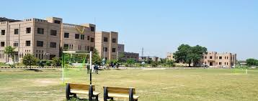
PUNJAB UNIVERSITY COLLEGE OF INFORMATION TECHNOLOGY
INTRODUCTION TO ECONOMICS
MACROECONOMICS Module 1
FIZZA AFTAB
Reference Book : Economics by Paul A. Samuelson

Slide 2

NATIONAL INCOME ACCOUNTING

Slide 3
Module Overview
Gross National Product (GDP)
Measuring GDP
Circular Flow of Income and expenditure
Components of GDP/Measuring GDP on Demand Side
Gross National Product/ Net National Product/ GDP per Capita
Nominal GDP vs Real GDP

Slide 4
NATIONAL INCOME ACCOUNTING
National income accounting is the science of measuring the aggregate output and income of an economy.
Gauging the economic performance of an economy is a basic objective of any government or society.

Slide 5
GROSS DOMESTIC PRODUCT (GDP)
The market value of all final goods and services produced within a country in a given year.

Slide 6
THINGS NOT INCLUDED IN GDP
Intermediate Goods
Illegal Goods and Services
Government Transfer Payments
Non-Market Activities
Used Goods

Slide 7
MEASURING GDP
We can measure national income in three ways:
By looking at Production: Adding only the money value of all final goods and services produced by firms.
By looking at Incomes: Total incomes earned by domestically located factors of production.
3. By looking at Expenditures: Total expenditures on domestically produced final goods and services.

Slide 8
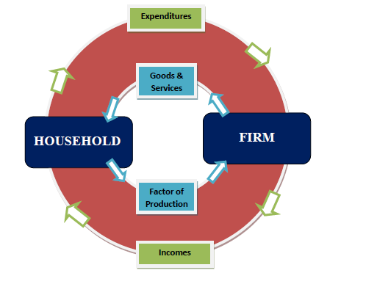
CIRCULAR FLOW OF INCOME AND EXPENDITURE:

Slide 9
MEASURING GDP ON DEMAND SIDE
GDP = C + I + G + (X-M)
C= Consumption
I= Investment
G= Government
(X-M) = (Export – Import) Trade Balance/Net Export

Slide 10
GROSS NATIONAL PRODUCT (GNP)
GNP = GDP – income of foreigners working in a country + countrymen working abroad

Slide 11
NET NATIONAL PRODUCT (NNP)
NNP = GNP – Depreciation
GDP PER CAPITA
GDP per Capita = GDP / Population

Slide 12
REAL GDP VS NOMINAL GDP
the value of GDP that is adjusted for inflation
the quantity of every good or service produced multiplied by the price at which it was sold, summed up for all goods and services
Real GDP = Nominal GDP ÷ Price Index/100
GDP deflator is a price index measuring the average prices of all goods and services

