Slide 1
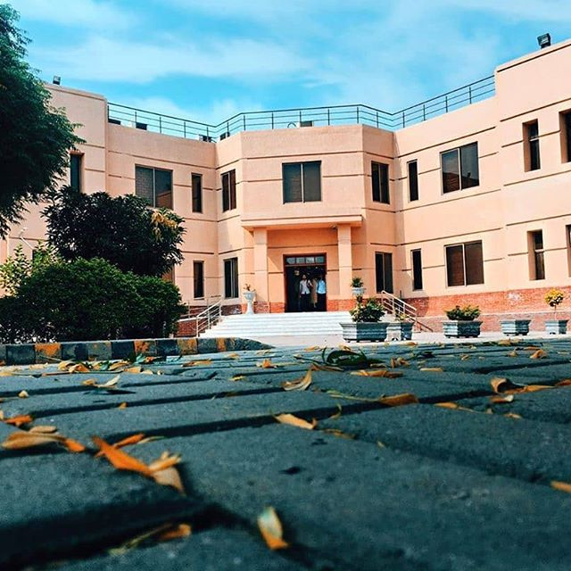
PUNJAB UNIVERSITY COLLEGE OF INFORMATION TECHNOLOGY
INTRODUCTION TO ECONOMICS
Module 2
FIZZA AFTAB
Reference Book : Economics by Paul A. Samuelson

Slide 2

Federal Budget

Slide 3
What is Federal Budget?
Federal budget is the annual statement of the expenditures and revenues of the federal government with the laws and regulations that approve and support those expenditures and taxes

Slide 4
Main Objective
To finance the activities of federal government
→ To encourage economic growth in an atmosphere of stability

Slide 5
Types of Budget
1.Balanced Budget (R=E)
2. Budget Surplus (R>E)
3. Budget Deficit (R<E)

Slide 6
Components of Budget
Revenue Budget
Revenue Receipts
Revenue Expenditure/Current Expenditure
Capital Budget
Capital ReCEIPTS
Capital Expenditure/ Development Expenditure

Slide 7
Revenue Budget
Revenue Receipts
Tax Revenue
Direct Tax
Indirect Tax
Revenue/Current Expenditures
Civil Administration
Subsidies
Non-Tax Revenue
Debt Serving

Slide 8
Capital Budget
Capital Revenue
Internal Borrowing
External Borrowing
Capital Expenditure
PSDP

