Slide 1
Lecture 3
Introduction to RDBMS and Relational Model - 2
Monday, September 10, 2001

Slide 2
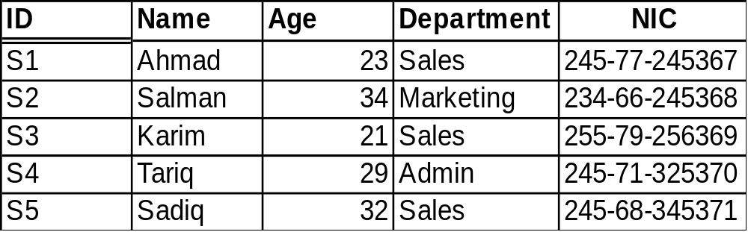
Terms in Relational Model
Candidate key
  General definition:
    A set of attributes which can uniquely identify each row in the table
  Relational Model Definition:
    Let R be a relation. Then candidate key for R is a subset of the set of attributes of R say K, such that:
    Uniqueness Property:
    no two distinct tuples of R have the same value for K.
    Irreducibility property:
    no proper subset of K has the uniqueness propert.
  Possible Candidate Keys:
    ID
    NIC

Slide 3
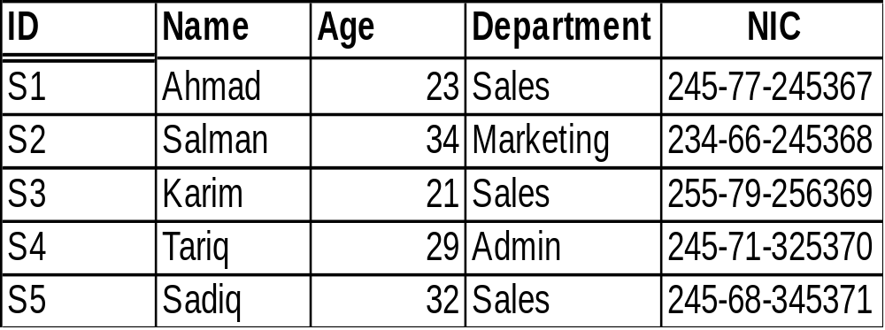
Terms in Relational Model
Primary key
  is a unique identifier for the table, that is , a column or column combination with the property that, at any given time, no two rows of the table contain same value in that column or column combination.
  One of the candidate keys
Alternate Keys
  All candidate keys other than primary key are called alternate keys
Primary Key: ID
Alternate Key: NIC

Slide 4
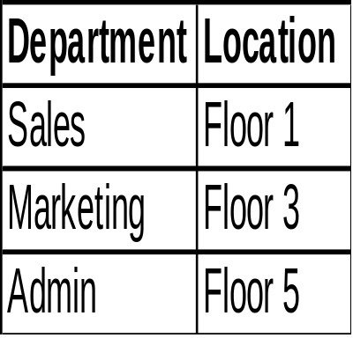
Terms in Relational Model
Foreign key
  General definition:
    A set of attributes in a table whose values are taken from the values of candidate key of some other table
  Relational Model Definition:
    Let R2 be a relation. Then a foreign key in R2 is a subset is a subset of the set of attributes of R2, say FK, such that:
    there exists a base relation R1 (R1 and R2 not necessarily distinct) with a candidate key CK and
    for all time, each value of FK in the current value of R2 is identical to the value of CK in some tuple in the current value of R1
Same values

Slide 5
Terms in Relational Model
Referenced tuple or Target tuple
Referencing relation
Referenced relation or Target relation
Simple key vs Composite key
Referencing relation
Target relation
Target tuple

Slide 6
Terms in Relational Model
Foreign key rules
  Restricted
  Cascade
  possible cases: update, delete
Integrity
  accuracy or correctness of data in database
Integrity Rules
  inform DBMS of certain constraints in the real world.
      Weights cant be naegative
      if city is Lahore then code is 042
Referential integrity
  database must not contain any unmatced foreign key values
Nulls
  candidate keys shouldn’t have null values

Slide 7
Assignment # 2
Consider the relations given below. Provide following information for each of them:
name of relation, heading of relation, cardinality, degree, domain of each attribute.
What would be the maximum number of elements in the domain of an attribute in a relation if its cardinality is 13.
S# P# Qty
S1 P1 300
S1 P2 200
S1 P3 400
S1 P4 200
S1 P5 100
S1 P6 100
S2 P1 300
S2 P2 400
S3 P2 200
S4 P2 200
S4 P4 300
S4 P5 400
Supplies
Parts
P# P.Name Color Weight City
P1 Nut Red 12 Lahore
P2 Bolt Green 17 Karachi
P3 Screw Blue 17 Multan
P4 Screw Red 14 Lahore
P5 Cam Blue 12 Karachi
P6 Cog Red 19 Lahore

