Slide 1
Lecture 4
Introduction to Relational Algebra - 1

Slide 2
What is Relational Algebra?
Operators
  Relational Algebra consists of eight operators:
    Four traditional set operators: UNION, INTERSECTION, DIFFERENCE, CARTESIAN PRODUCT
    Four special relational operators: RESTRICTION, PROJECTION, JOIN, DIVISION
Operands
  Relations are the operands used in Relational Algebra
Closure property of Relations
  output from some relational operator is always a relation.

Slide 3
Traditional Set Operators
UNION
  the union of two type-compatible relations A and B (A UNION B) is a relation with the same heading as each of A and B and with a body consisting of the set of all tuples belonging to A and B.
  relations must have same heading
  same tuples are included once
A
B

Slide 4
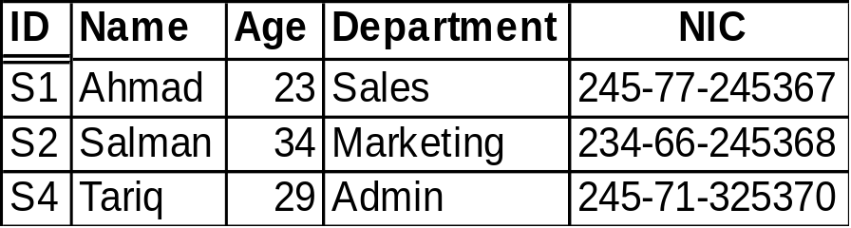
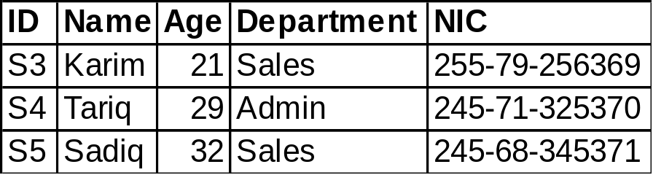
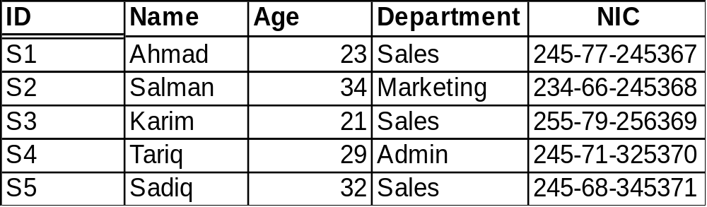
Traditional Set Operators
UNION
  Returns a relation consisting of all tuples appearing in either or both relations
A
B
A UNION B

Slide 5
Traditional Set Operators
INTERSECTION
  the intersection of two type-compatible relations A and B (A INTERSECT B) is a relation with the same heading as each of A and B and with a body consisting of the set of all tuples belonging to both A and B.
  relations must have same heading
A
B

Slide 6
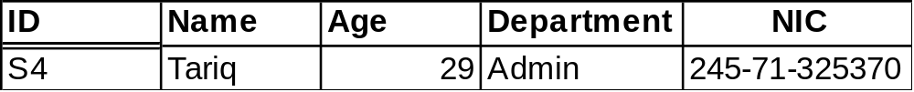
Traditional Set Operators
INTERSECTION
  Returns a relation consisting of all tuples appearing in both of two specified relations
A
B
A INTERSECT B

Slide 7
Traditional Set Operators
DIFFERENCE
  the difference between two type-compatible relations A and B, in that order (A MINUS B) is a relation with the same heading as each of A and B and with a body consisting of the set of all tuples belonging to A and not to B.
  relations must have same heading
  direction of operation does matter
A
B

Slide 8
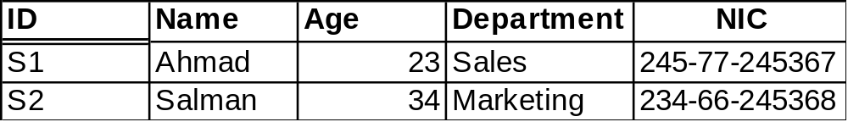
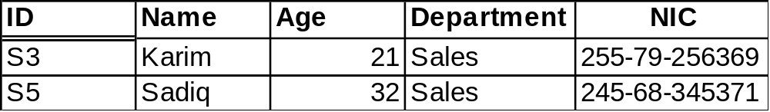
Traditional Set Operators
DIFFERENCE
  Returns a relation consisting of all tuples appearing in the first and not in the second of two specified relations
A
B
A MINUS B
B MINUS A

Slide 9
Traditional Set Operators
PRODUCT (CARTESIAN PRODUCT)
  the product of two relations A and B with no common attribute, (A TIMES B) is a relation with a same heading as set of all attributes in each of A and B and with a body consisting of the set of all tuples such that each resulting tuple is combination of a tuple from A and a tuple from B.
  Cardinality of resulting relation is equal to the product of the cardinalities of A and B.
  Degree of resulting relation is equal to the sum of the degrees of A and B.
Returns a relation consisting of all possible tuples that are a combination of two tuples, one from each of two specified relations.

Slide 10
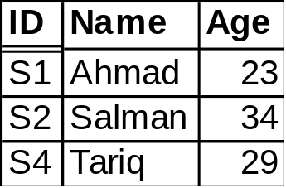
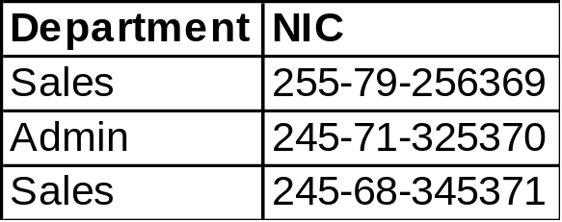
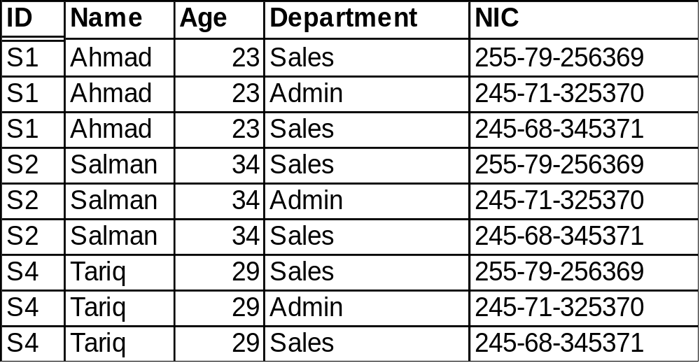
Traditional Set Operators
PRODUCT (CARTESIAN PRODUCT)
A
B
A TIMES B

Slide 11
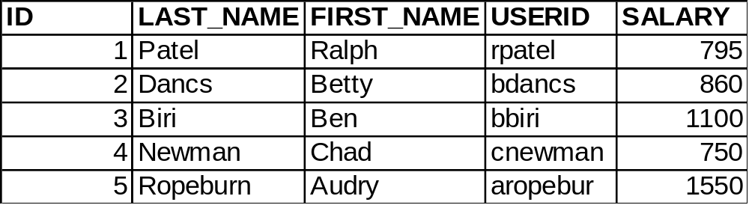
Quiz # 1
Q1: Identify the possible candidate keys in the given relation?
Q2: There are 4 candidate keys identified in a relation each having 12 elements. What would be the cardinality of the relation. Also write the lowest possible value of degree for that relation.
Q3: Explain meaning of RESTRICTED and CASCADE in case of update for a foreign key.
Q4: Give an example of repeating group from keeping in view the relation given above.

