Slide 1
Lecture 5
Introduction to Relational Algebra - 2

Slide 2
Some more about Traditional Set Operators
Commutative
  Union, Intersect and Times are Commutative:
    A UNION B is equal to B UNION A
    A INTERSECT B is equal to B INTERSECT A
    A TIMES B is equal to B TIMES A
  MINUS is not Commutative i.e.,
    A MINUS B is not equal to B MINUS A
Associative
  Union, Intersect and Times are Associative:
    (A UNION B) UNION C is equal to A UNION (B UNION C)
    (A INTERSECT B) INTERSECT C is equal to A INTERSECT (B INERSECT C)
    (A TIMES B) TIMES C is equal to A TIMES (B TIMES C)
  MINUS is not Associative i.e.,
    (A MINUS B) MINUS C is not equal to A MINUS (B MINUS C)

Slide 3
Special Relational Set Operators
RESTRICTION
  is actually abbreviation for θ-restriction, where “θ” stands for any simple scalar comparison operator(=,<,>,=)
  θ-restriction of relation A on attributes X and Y( in that order) A where X θ Y is a relation with the same heading as A and with a body consisting of the set of all tuples of A such that the condition “X θ Y” evaluates true for those tuples.
  X and Y must be defined on the same domain
  operator must make sense for that domain
A

Slide 4
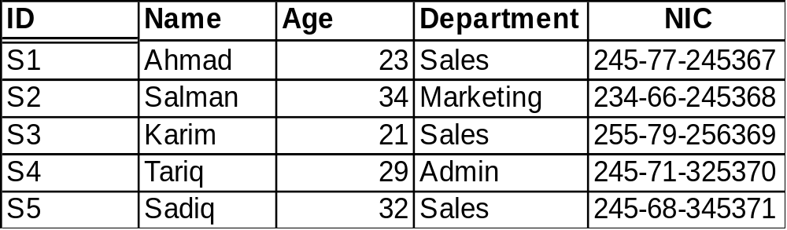
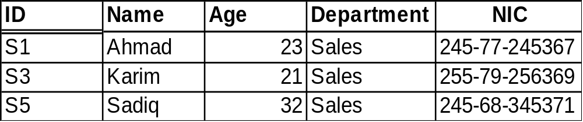
Special Relational Operators
RESTRICTION
  Returns a relation consisting of all tuples from a specified relation that satisfy a specified condition.
A
A WHERE Department=“Sales”

Slide 5
Special Relational Operators
PROJECTION
  the projection of relation A on X,Y,….,Z (where each of X,Y,….,Z is an attribute of A) is a relation with heading {X,Y,…,Z } and body consisting of the set of all tuples {X:x,Y:y,…,Z:z } such that a tuple appears in A with X-value x, Y-value y,…., Z-value z.
  projection yields a vertical subset of relation
A

Slide 6
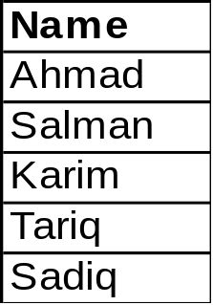
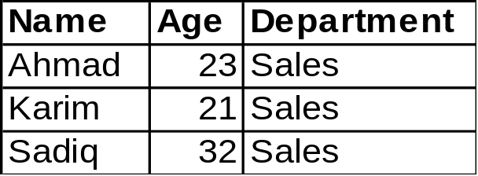
Special Relational Operators
PROJECTION
  Returns a relation consisting of all tuples that remain as (sub) tuples in a specified relation after specified attributes have been eliminated
A
A [Name]
A where Department=“Sales” [Name,Department]

Slide 7
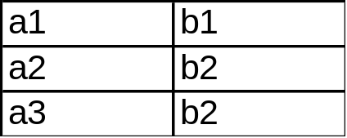
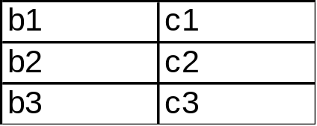
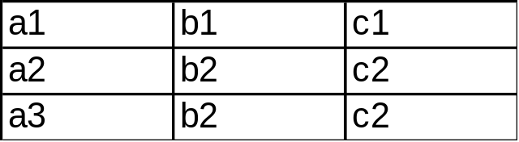
Special Relational Operators
JOIN(NATURAL JOIN)
  Let relations A and B have headings [X,…,Y] and [X,…,Z] respectively, then A JOIN B is a relation with heading [X,…,Y,…,Z] and with a body consisting of the set of all tuples [X:x,Y:y,Z:z] such that a tuple appears in A with X-value x and Y-value y and in B with X-value x and Z-value z.
  there should be some common attribute(s)
JOIN

Slide 8
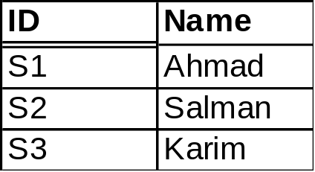
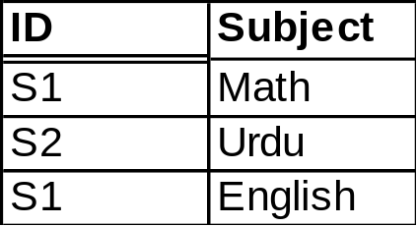
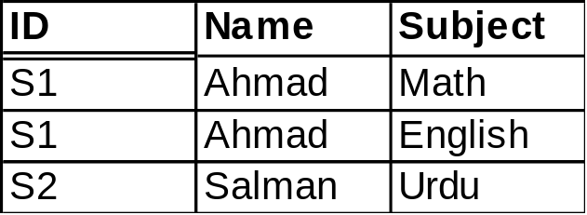
Special Relational Operators
JOIN(NATURAL JOIN)
  Returns a relation consisting of all possible tuples that are combination of two tuples, one from each of the two specified relations, such that two tuples contributing to any given combination have a common value for the common attributes (and that value appears just once)
A
B
A JOIN B

Slide 9
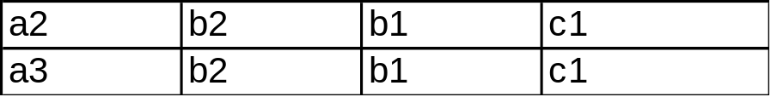
Special Relational Operators
θ-JOIN
  Let relations A and B have no attribute names in common (as in Cartesian Product), and let θ be as defined in restriction. Then the θ- JOIN of relation A on attribute X with relation B on attribute Y is defined by the result of the expression (A TIMES B) where X θ Y
  it is a relation with same heading as Cartesian Product of A and B and with a body consisting of the set of all those tuples belonging to that Cartesian Product of that evaluate true for X θ Y.
  if θ is “equals”, the θ-JOIN is called an EQUIJOIN.
θ-JOIN

Slide 10
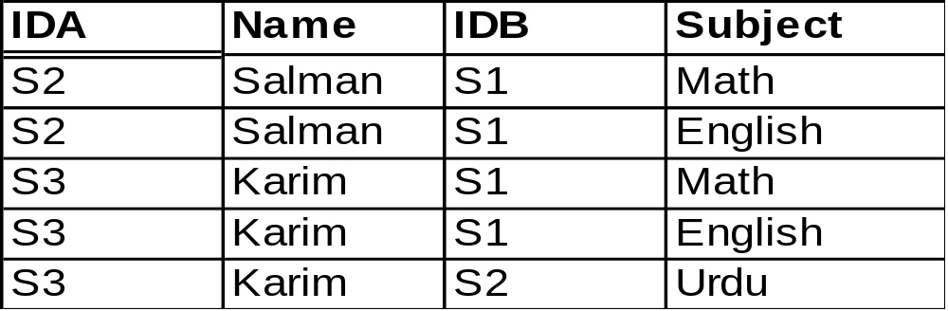
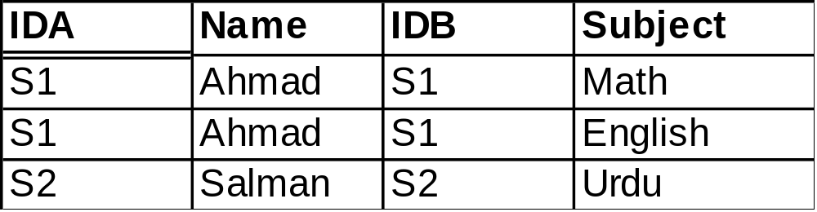
Special Relational Operators
θ- JOIN
A
B
(A TIMES B) where IDA > IDB
(A TIMES B) where IDA = IDB

Slide 11
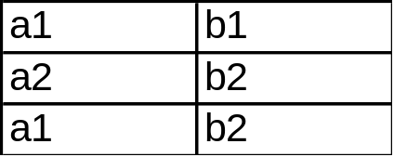
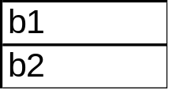

Special Relational Operators
DIVISION
  Let relations A and B have headings { x₁, x₂, …, x_{m}, y₁, y₂,…, y_{n}} and {y₁, y₂,…, y_{n}} respectively; i.e., attributes y₁, y₂,…, y_{n} are common, A additionally has attributes x₁, x₂, …, x_{m} , B has no other attributes. Then division of A by B A DIVIDEDBY B is a relation with heading x₁, x₂, …, x_{m} and body consisting of the set of all tuples {X₁:x₁,X₂:x₂,…,X_{m}:x_{m} } such that a tuple {X₁:x₁,X₂:x₂,…,X_{m}:x_{m}, Y₁:y₁,Y₂:y₂,…,Y_{n}:y_{n} } appears in A for all tuples {Y₁:y₁,Y₂:y₂,…,Y_{n}:y_{n} } appearing in B.
  A is called dividend(DEND) and B is called divisor(DOR)
DIVIDEDBY

Slide 12
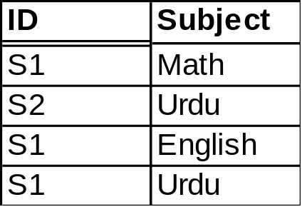
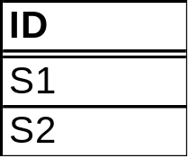

Special Relational Operators
DIVISION
  Take two relations, one binary and one unary, and returns a relation consisting of all values of one attribute of binary relation that match(in the other attribute) all the values in the unary relation.
A
B
A DIVIDEBY B

Slide 13
Special Relational Operators
Some Facts
  If A and B have no common attribute names in common, A JOIN B is equal to A TIMES B
  In EQUIJOIN, if one of the two attributes having common values is eliminated (may be through projection), then the result is equal to the natural join.
  JOIN is both commutative and associative i.e., A JOIN B = B JOIN A A JOIN (B JOIN C) = (A JOIN B) JOIN C

Slide 14
Quiz # 2
Consider relations A and B such that
  Cardinalty of A= 12, Degree of A= 4
  Cardinalty of B= 10, Degree of B= 4
  Cardinalty of A UNION B = 20
what would be the value of following:
  Cardinalty and Degree of A INTERSECT B
  Cardinalty and Degree of A TIMES B
  Degree of A UNION B
  Cardinalty and Degree of A MINUS B
  Cardinalty and Degree of B MINUS A

