Slide 1
Chapter 5:
Logical Database Design and the Relational Model
Modern Database Management
6th Edition
Jeffrey A. Hoffer, Mary B. Prescott, Fred R. McFadden

Slide 2
Relation
Definition: A relation is a named, two-dimensional table of data
  Table is made up of rows (records), and columns (attribute or field)
Not all tables qualify as relations
Requirements:
  Every relation has a unique name.
  Every attribute value is atomic (not multivalued, not composite)
  Every row is unique (can’t have two rows with exactly the same values for all their fields)
  Attributes (columns) in tables have unique names
  The order of the columns is irrelevant
  The order of the rows is irrelevant
NOTE: all relations are in 1st Normal form

Slide 3
Correspondence with ER Model
Relations (tables) correspond with entity types and with many-to-many relationship types
Rows correspond with entity instances and with many-to-many relationship instances
Columns correspond with attributes
NOTE: The word relation (in relational database) is NOT the same same the word relationship (in ER model)

Slide 4

Key Fields
Keys are special fields that serve two main purposes:
  Primary keys are unique identifiers of the relation in question. Examples include employee numbers, social security numbers, etc. This is how we can guarantee that all rows are unique
  Foreign keys are identifiers that enable a dependent relation (on the many side of a relationship) to refer to its parent relation (on the one side of the relationship)
Keys can be simple (a single field) or composite (more than one field)
Keys usually are used as indexes to speed up the response to user queries (More on this in Ch. 6)

Slide 5
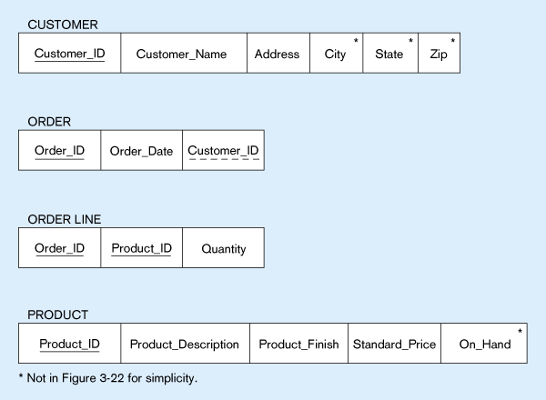
Figure 5-3 -- Schema for four relations (Pine Valley Furniture)
Primary Key
Foreign Key (implements 1:N relationship between customer and order)
Combined, these are a composite primary key (uniquely identifies the order line)…individually they are foreign keys (implement M:N relationship between order and product)

Slide 6
Integrity Constraints
Domain Constraints
  Allowable values for an attribute. See Table 5-1
Entity Integrity
  No primary key attribute may be null. All primary key fields MUST have data
Action Assertions
  Business rules. Recall from Ch. 4

Slide 7
Integrity Constraints
Referential Integrity – rule that states that any foreign key value (on the relation of the many side) MUST match a primary key value in the relation of the one side. (Or the foreign key can be null)
  For example: Delete Rules
    Restrict – don’t allow delete of “parent” side if related rows exist in “dependent” side
    Cascade – automatically delete “dependent” side rows that correspond with the “parent” side row to be deleted
    Set-to-Null – set the foreign key in the dependent side to null if deleting from the parent side → not allowed for weak entities

Slide 8
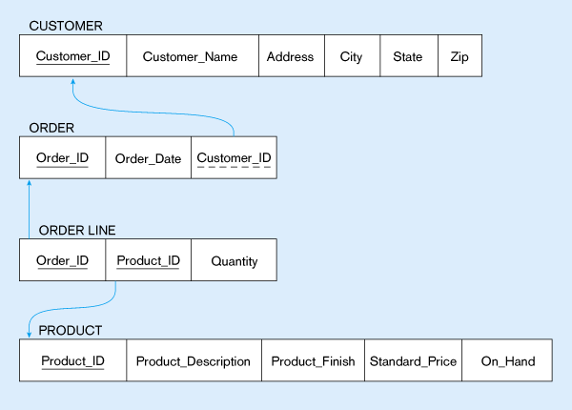
Figure 5-5:
Referential integrity constraints (Pine Valley Furniture)
Referential integrity constraints are drawn via arrows from dependent to parent table

Slide 9
Transforming EER Diagrams into Relations
Mapping Regular Entities to Relations
  Simple attributes: E-R attributes map directly onto the relation
  Composite attributes: Use only their simple, component attributes
  Multi-valued Attribute - Becomes a separate relation with a foreign key taken from the superior entity

Slide 10


Figure 5-8: Mapping a regular entity
(a) CUSTOMER entity type with simple attributes
(b) CUSTOMER relation

Slide 11

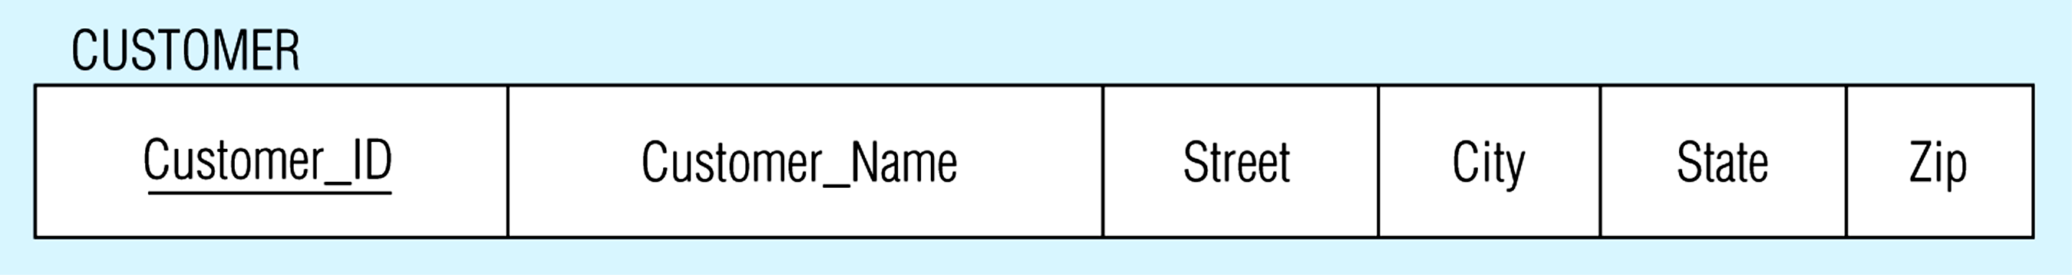
Figure 5-9: Mapping a composite attribute
(a) CUSTOMER entity type with composite attribute
(b) CUSTOMER relation with address detail

Slide 12


Figure 5-10: Mapping a multivalued attribute
(a)
Multivalued attribute becomes a separate relation with foreign key
(b)
1 – to – many relationship between original entity and new relation

Slide 13
Transforming EER Diagrams into Relations
Mapping Weak Entities
  Becomes a separate relation with a foreign key taken from the superior entity
  Primary key composed of:
    Partial identifier of weak entity
    Primary key of identifying relation (strong entity)

Slide 14
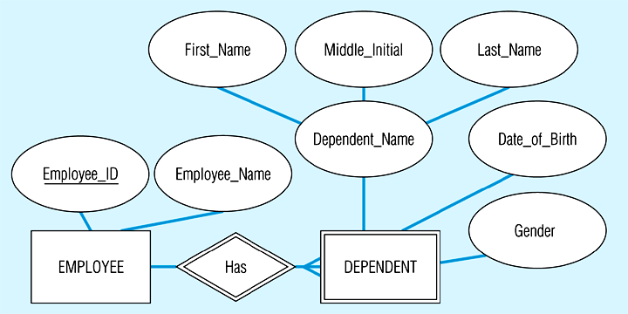
Figure 5-11: Example of mapping a weak entity
(a) Weak entity DEPENDENT

Slide 15
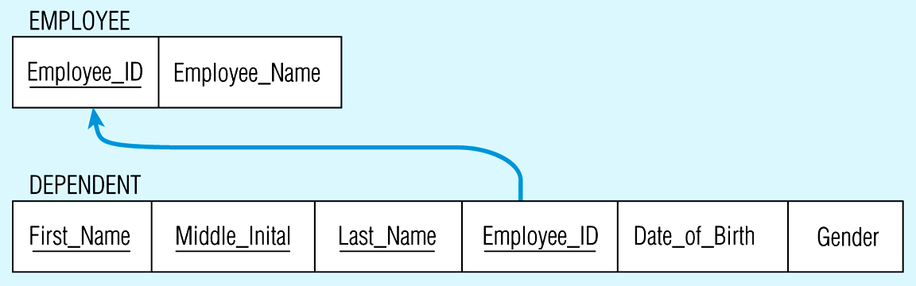
Figure 5-11(b) Relations resulting from weak entity
NOTE: the domain constraint for the foreign key should NOT allow null value if DEPENDENT is a weak entity
Foreign key
Composite primary key

Slide 16
Transforming EER Diagrams into Relations
Mapping Binary Relationships
  One-to-Many - Primary key on the one side becomes a foreign key on the many side
  Many-to-Many - Create a new relation with the primary keys of the two entities as its primary key
  One-to-One - Primary key on the mandatory side becomes a foreign key on the optional side

Slide 17
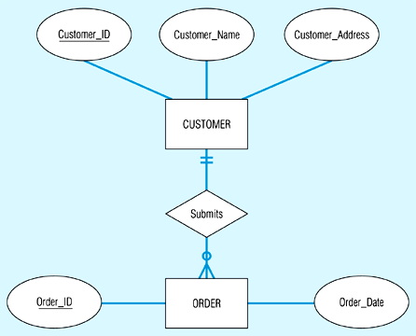
Figure 5-12: Example of mapping a 1:M relationship
(a) Relationship between customers and orders
Note the mandatory one

Slide 18
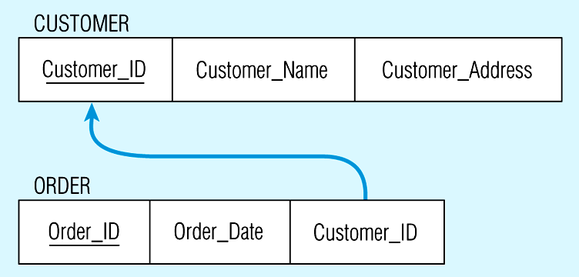
Figure 5-12(b) Mapping the relationship
Again, no null value in the foreign key…this is because of the mandatory minimum cardinality
Foreign key

Slide 19

Figure 5-13: Example of mapping an M:N relationship
(a) ER diagram (M:N)
The Supplies relationship will need to become a separate relation

Slide 20

Figure 5-13(b) Three resulting relations
Composite primary key
New intersection relation
Foreign key
Foreign key

Slide 21
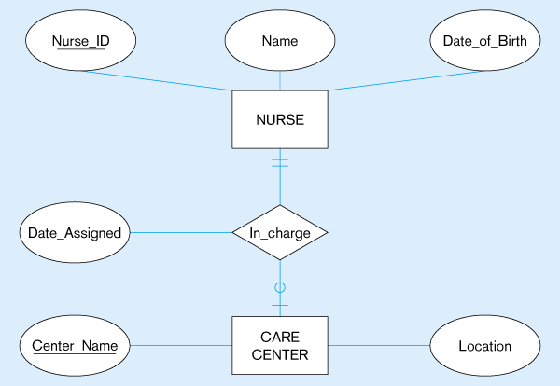
Figure 5-14: Mapping a binary 1:1 relationship
(a) Binary 1:1 relationship

Slide 22
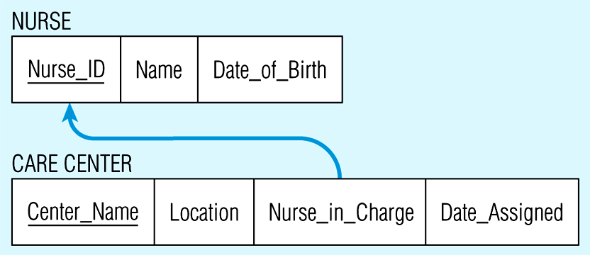
Figure 5-14(b) Resulting relations

Slide 23
Transforming EER Diagrams into Relations
Mapping Associative Entities
  Identifier Not Assigned
    Default primary key for the association relation is composed of the primary keys of the two entities (as in M:N relationship)
  Identifier Assigned
    It is natural and familiar to end-users
    Default identifier may not be unique

Slide 24
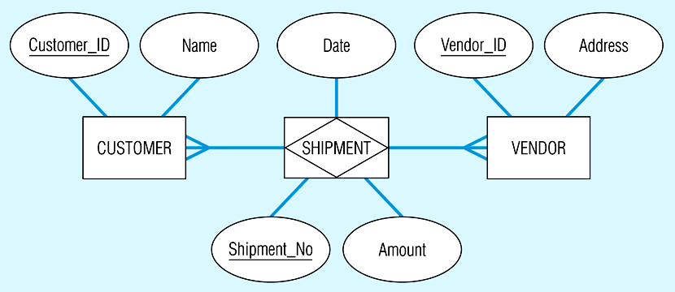
Figure 5-15: Mapping an associative entity
(a) Associative entity

Slide 25
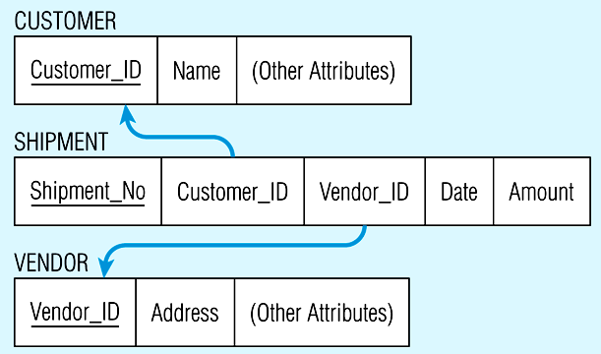
Figure 5-15(b) Three resulting relations

Slide 26
Transforming EER Diagrams into Relations
Mapping Unary Relationships
  One-to-Many - Recursive foreign key in the same relation
  Many-to-Many - Two relations:
    One for the entity type
    One for an associative relation in which the primary key has two attributes, both taken from the primary key of the entity

Slide 27
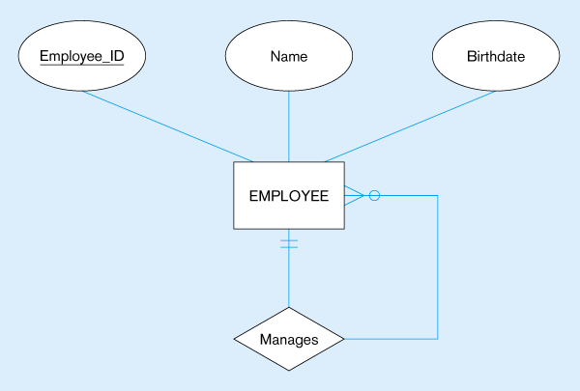

Figure 5-17: Mapping a unary 1:N relationship
(a) EMPLOYEE entity with Manages relationship
(b) EMPLOYEE relation with recursive foreign key

Slide 28


Figure 5-18: Mapping a unary M:N relationship
(a) Bill-of-materials relationships (M:N)
(b) ITEM and COMPONENT relations

Slide 29
Transforming EER Diagrams into Relations
Mapping Ternary (and n-ary) Relationships
  One relation for each entity and one for the associative entity
  Associative entity has foreign keys to each entity in the relationship

Slide 30
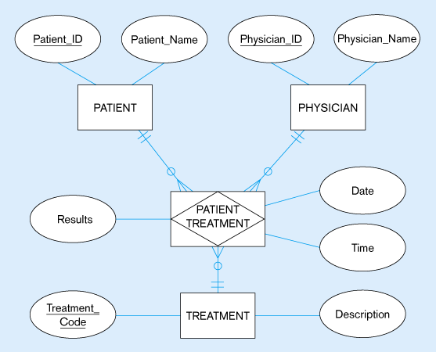
Figure 5-19: Mapping a ternary relationship
(a) Ternary relationship with associative entity

Slide 31
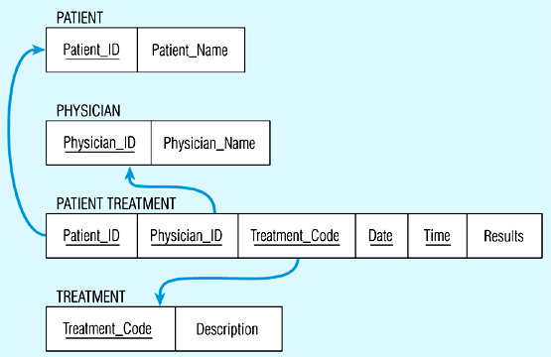
Figure 5-19(b) Mapping the ternary relationship
Remember that the primary key MUST be unique

Slide 32
Transforming EER Diagrams into Relations
Mapping Supertype/Subtype Relationships
  One relation for supertype and for each subtype
  Supertype attributes (including identifier and subtype discriminator) go into supertype relation
  Subtype attributes go into each subtype; primary key of supertype relation also becomes primary key of subtype relation
  1:1 relationship established between supertype and each subtype, with supertype as primary table

Slide 33
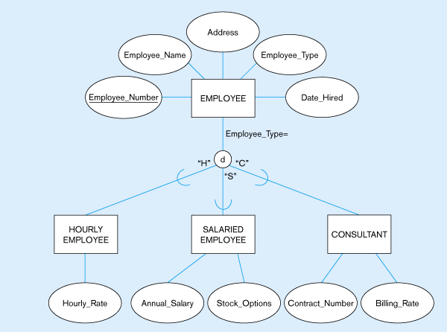
Figure 5-20: Supertype/subtype relationships

Slide 34
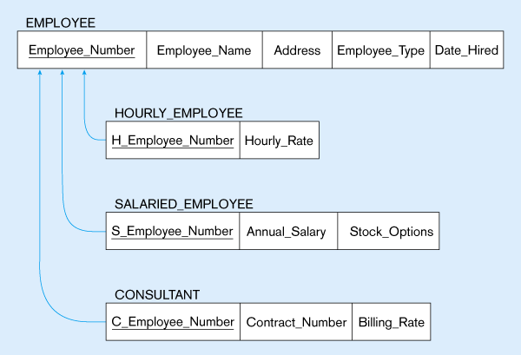
Figure 5-21:
Mapping Supertype/subtype relationships to relations

Slide 35
Data Normalization
Primarily a tool to validate and improve a logical design so that it satisfies certain constraints that avoid unnecessary duplication of data
The process of decomposing relations with anomalies to produce smaller, well-structured relations

Slide 36
Well-Structured Relations
A relation that contains minimal data redundancy and allows users to insert, delete, and update rows without causing data inconsistencies
Goal is to avoid anomalies
  Insertion Anomaly – adding new rows forces user to create duplicate data
  Deletion Anomaly – deleting rows may cause a loss of data that would be needed for other future rows
  Modification Anomaly – changing data in a row forces changes to other rows because of duplication
General rule of thumb: a table should not pertain to more than one entity type

Slide 37

Example – Figure 5.2b
Question – Is this a relation?
Answer – Yes: unique rows and no multivalued attributes
Question – What’s the primary key?
Answer – Composite: Emp_ID, Course_Title

Slide 38
Anomalies in this Table
Insertion – can’t enter a new employee without having the employee take a class
Deletion – if we remove employee 140, we lose information about the existence of a Tax Acc class
Modification – giving a salary increase to employee 100 forces us to update multiple records
Why do these anomalies exist?
  Because we’ve combined two themes (entity types) into one relation. This results in duplication, and an unnecessary dependency between the entities

Slide 39
Functional Dependencies and Keys
Functional Dependency: The value of one attribute (the determinant) determines the value of another attribute
Candidate Key:
  A unique identifier. One of the candidate keys will become the primary key
    E.g. perhaps there is both credit card number and SS# in a table…in this case both are candidate keys
  Each non-key field is functionally dependent on every candidate key

Slide 40
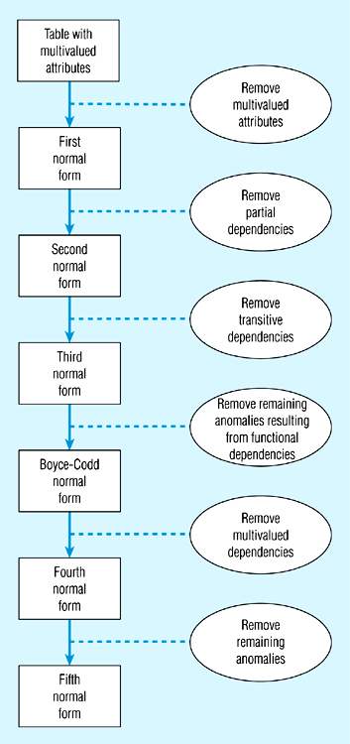
5.22 -Steps in normalization

Slide 41
First Normal Form
No multivalued attributes
Every attribute value is atomic
Fig. 5-2a is not in 1st Normal Form (multivalued attributes) ➔ it is not a relation
Fig. 5-2b is in 1st Normal form
All relations are in 1st Normal Form

Slide 42
Second Normal Form
1NF plus every non-key attribute is fully functionally dependent on the ENTIRE primary key
  Every non-key attribute must be defined by the entire key, not by only part of the key
  No partial functional dependencies
Fig. 5-2b is NOT in 2nd Normal Form (see fig 5-23b)

Slide 43
Fig 5.23(b) – Functional Dependencies in EMPLOYEE2
Dependency on entire primary key
EmpID
CourseTitle
Name
DeptName
Salary
DateCompleted
Dependency on only part of the key
EmpID, CourseTitle ➔ DateCompleted
EmpID ➔ Name, DeptName, Salary
Therefore, NOT in 2nd Normal Form!!

Slide 44
Getting it into 2nd Normal Form
See p193 – decomposed into two separate relations
Both are full functional dependencies
EmpID
Name
DeptName
Salary
EmpID
CourseTitle
DateCompleted

Slide 45
Third Normal Form
2NF PLUS no transitive dependencies (one attribute functionally determines a second, which functionally determines a third)
Fig. 5-24, 5-25

Slide 46
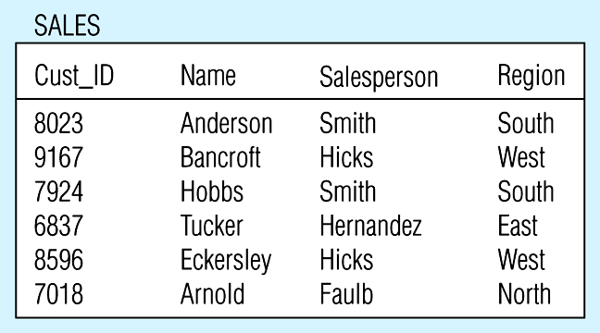
Figure 5-24 -- Relation with transitive dependency
(a) SALES relation with simple data

Slide 47
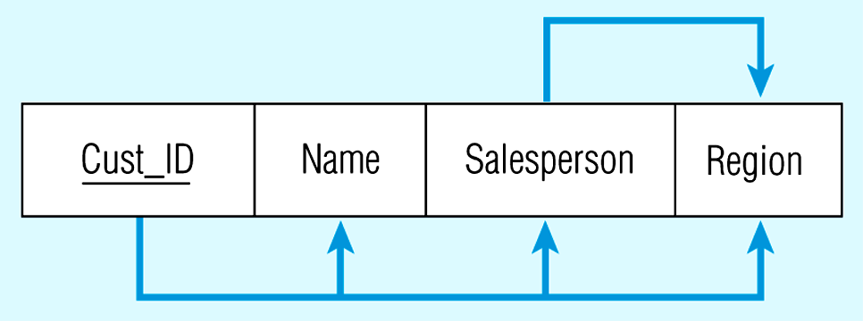
Figure 5-24(b) Relation with transitive dependency
CustID → Name
CustID → Salesperson
CustID → Region
All this is OK
(2nd NF)
BUT
CustID → Salesperson → Region
Transitive dependency
(not 3rd NF)

Slide 48
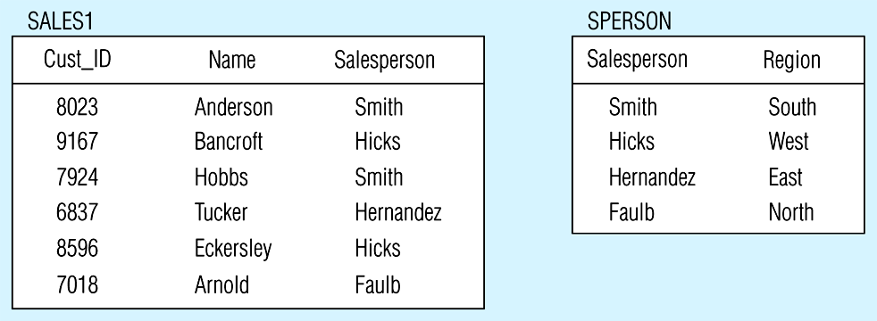
Figure 5.25 -- Removing a transitive dependency
(a) Decomposing the SALES relation

Slide 49
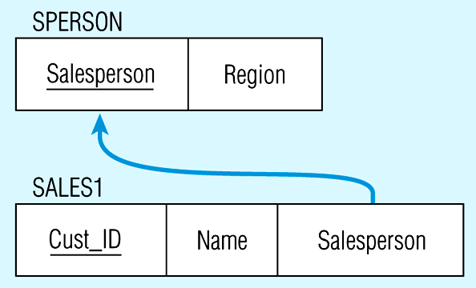
Figure 5.25(b) Relations in 3NF
Salesperson → Region
CustID → Name
CustID → Salesperson
Now, there are no transitive dependencies…
Both relations are in 3rd NF

Slide 50
Other Normal Forms
(from Appendix B)
Boyce-Codd NF
  All determinants are candidate keys…there is no determinant that is not a unique identifier
4th NF
  No multivalued dependencies
5th NF
  No “lossless joins”
Domain-key NF
  The “ultimate” NF…perfect elimination of all possible anomalies

