Slide 1



Dashboard
View in Power BI
Last data refresh:
2/5/2021 5:08:22 PM West Asia Standard Time
Downloaded at:
2/5/2021 5:11:05 PM West Asia Standard Time

Slide 2
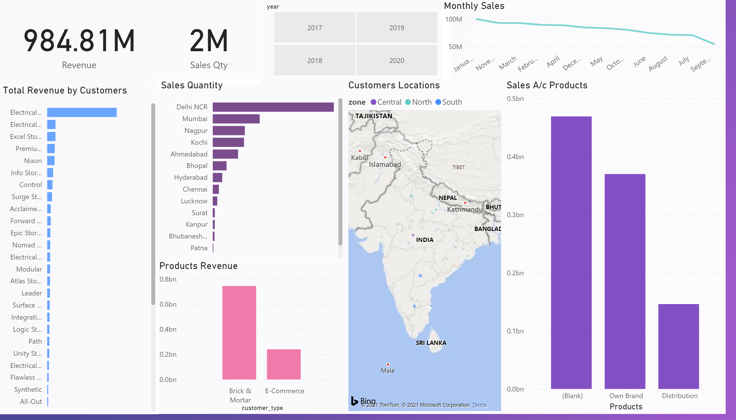
Page 1
Notes:
Products Revenue
No alt text provided.
card
No alt text provided.
Total Revenue by Customers
No alt text provided.
card
No alt text provided.
Sales Quantity
No alt text provided.
Year
No alt text provided.
Monthly Sales
No alt text provided.
Customers Locations
No alt text provided.
Sales A/c Products
No alt text provided.

