Slide 1
Proposal Presentation CSE440 Section 1 Group 3
Group Members:
Abdul Zabbar Dewan – 2013222042
Md Tamim Ahamed - 2014286042
Mir Bayazid Protik - 1921085042
project ideas to present as proposal:
Detection and analysis of Machine Learning techniques for maternal health risk assessment during pregnancy

Slide 2
Maternal Health Risk assessment during pregnancy using Machine Learning Techniques.
Problem Type: Classification Problem – Can be specified as a binary Classification Problem
Prediction:
The system will predict the risk level/severity of health problem during the time of pregnancy.
How many classes?
Classification can be done in two class (Since Binary Classification Problem)
Name of the Classes:
High Risk & Low Risk
Sample Size: There are a total of 1205 samples in the dataset 1 so there are 1205 samples in total. In dataset 2 there are 1014 samples.
Features: Number of Features in the dataset 1 are 11 & in dataset 2 there are 6 features.

Slide 3
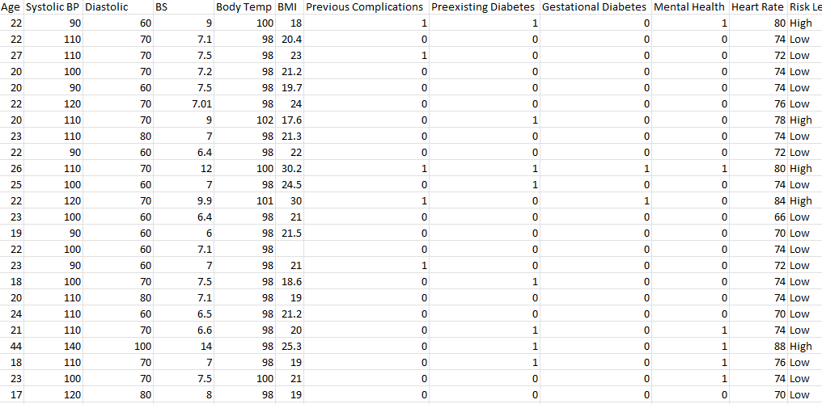
Name of the Features of dataset 1 are:
Age, Systolic BP, Diastolic, BS, Body Temp, BMI, Previous Complications, Preexisting Diabetes, Gestational Diabetes, Mental Health, Heart Rate
Name of the features if Dataset 2: Age, Systolic BP, Diastolic, BS, Body Temp, BMI

Slide 4
Dataset Source
The Maternal Health Risk Related dataset was collected from Mendely and UCI Public Datasets
Dataset Type : Public & Open Acess dataset. The datasets are secure to use and access for the project
Datasets Contains Data on Bangladeshi Women.
Dataset 1 Link: https://data.mendeley.com/datasets/p5w98dvbbk/1
Dataset 1 Publish Date: 1 November 2024
Dataset 2 Link: https://archive.ics.uci.edu/dataset/863/maternal+health+risk
Dataset 2 Publish Date: 14 August 2023

Slide 5
Recent Journal on this Topic:
Journal Name: Scientific Reports
Link of the paper: https://www.nature.com/articles/s41598-024-71934-x
Paper Title: Ensemble machine learning framework for predicting maternal health risk during pregnancy
Published: 14 September 2024
Novelty of the paper: The study introduces QEML-MHRC, a novel ensemble machine learning approach that integrates four ensemble techniques (Boosting, Bagging, Stacking, and Voting) to improve maternal health risk prediction. Unlike previous work, the study emphasizes class-wise performance evaluation for multi-class classification problems, ensuring better handling of imbalanced datasets.

