Slide 1
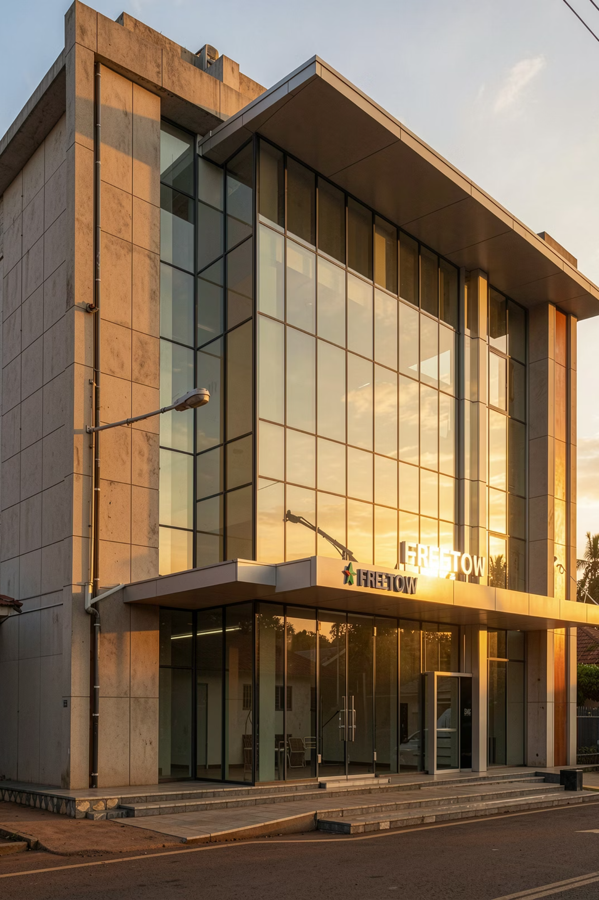
Rokel Commercial Bank — Network & Server Infrastructure
A complete network design, implementation, and Windows Server 2022 configuration for RCB's Freetown head office — addressing DCOMP 114 Projects 1 & 2.
DCOMP 114 FINAL REPORT

Slide 2
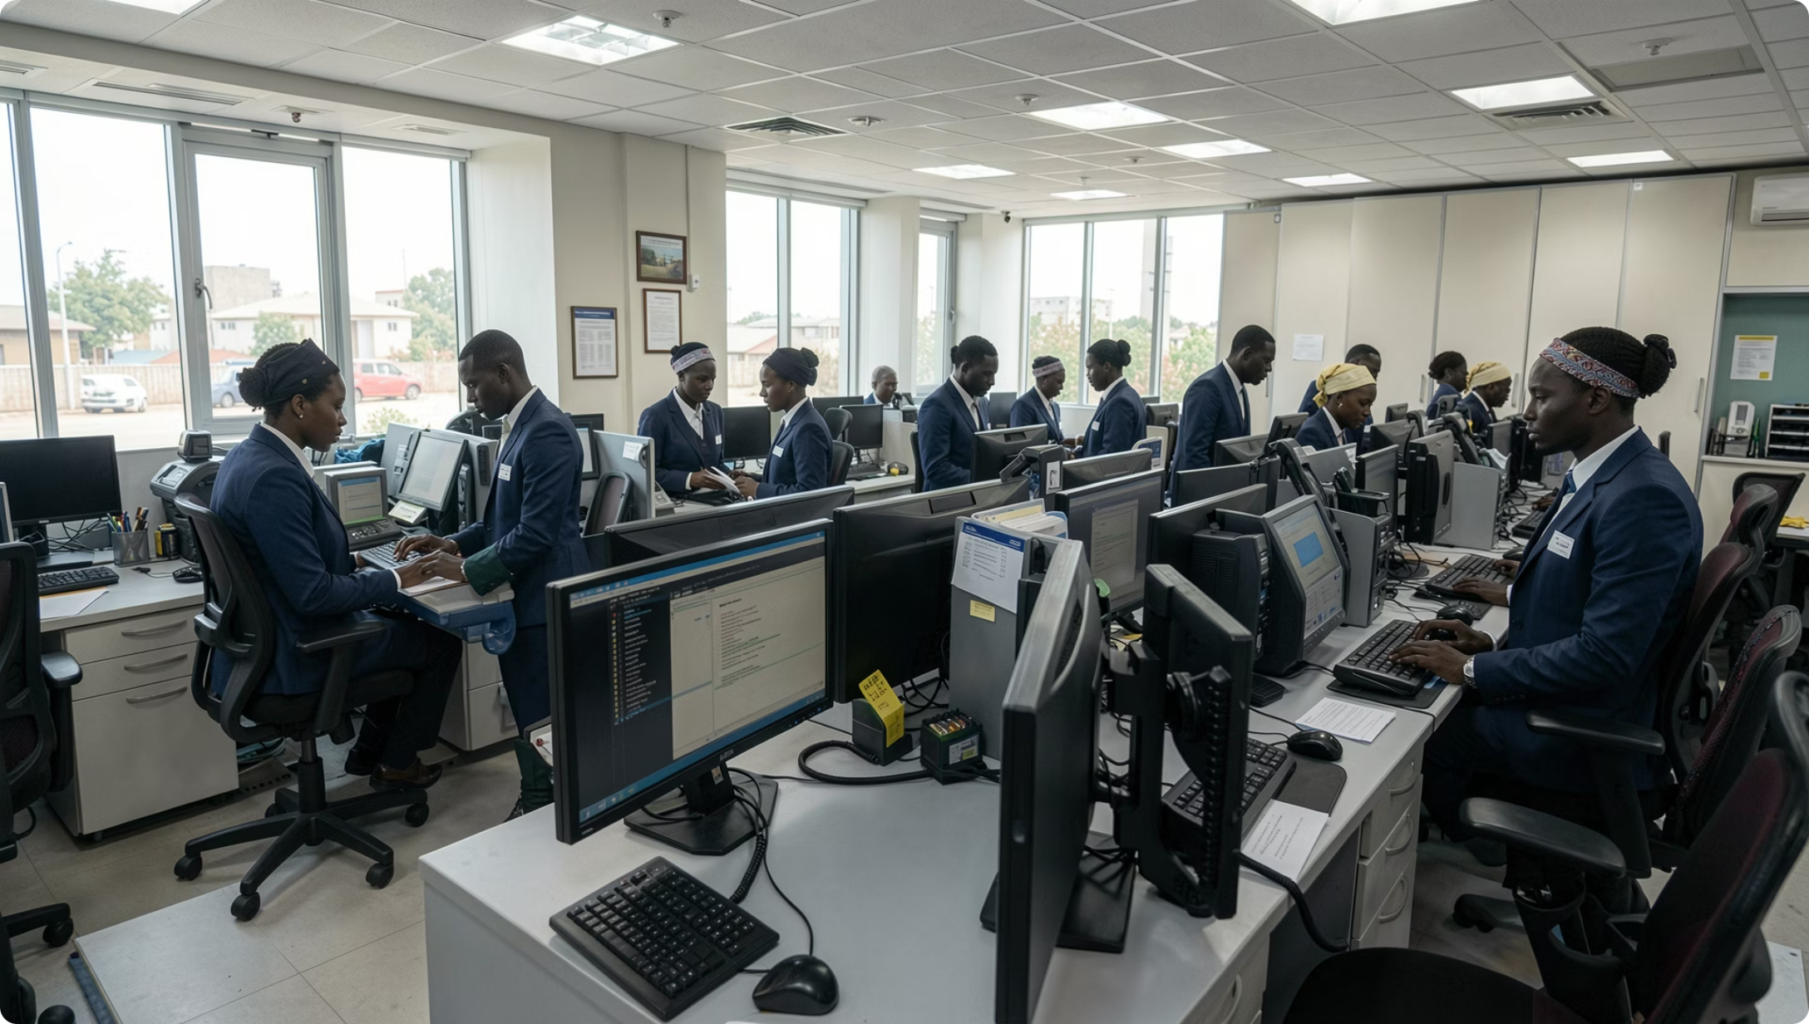
Company Profile & Business Justification
RCB at a Glance
Founded 1917 · State-owned · Licensed by Bank of Sierra Leone · 200,000+ customers across 14 branches · 62,000 daily transactions · Retail, Corporate, Trade Finance & Mobile Money via IPS.
Why This Project
Legacy 2016 flat network: single broadcast domain, no segmentation, no centralized auth, no backup. Violates BSL Circular BDS/2023/04. RCB Digital First program mandates modernization.

Slide 3
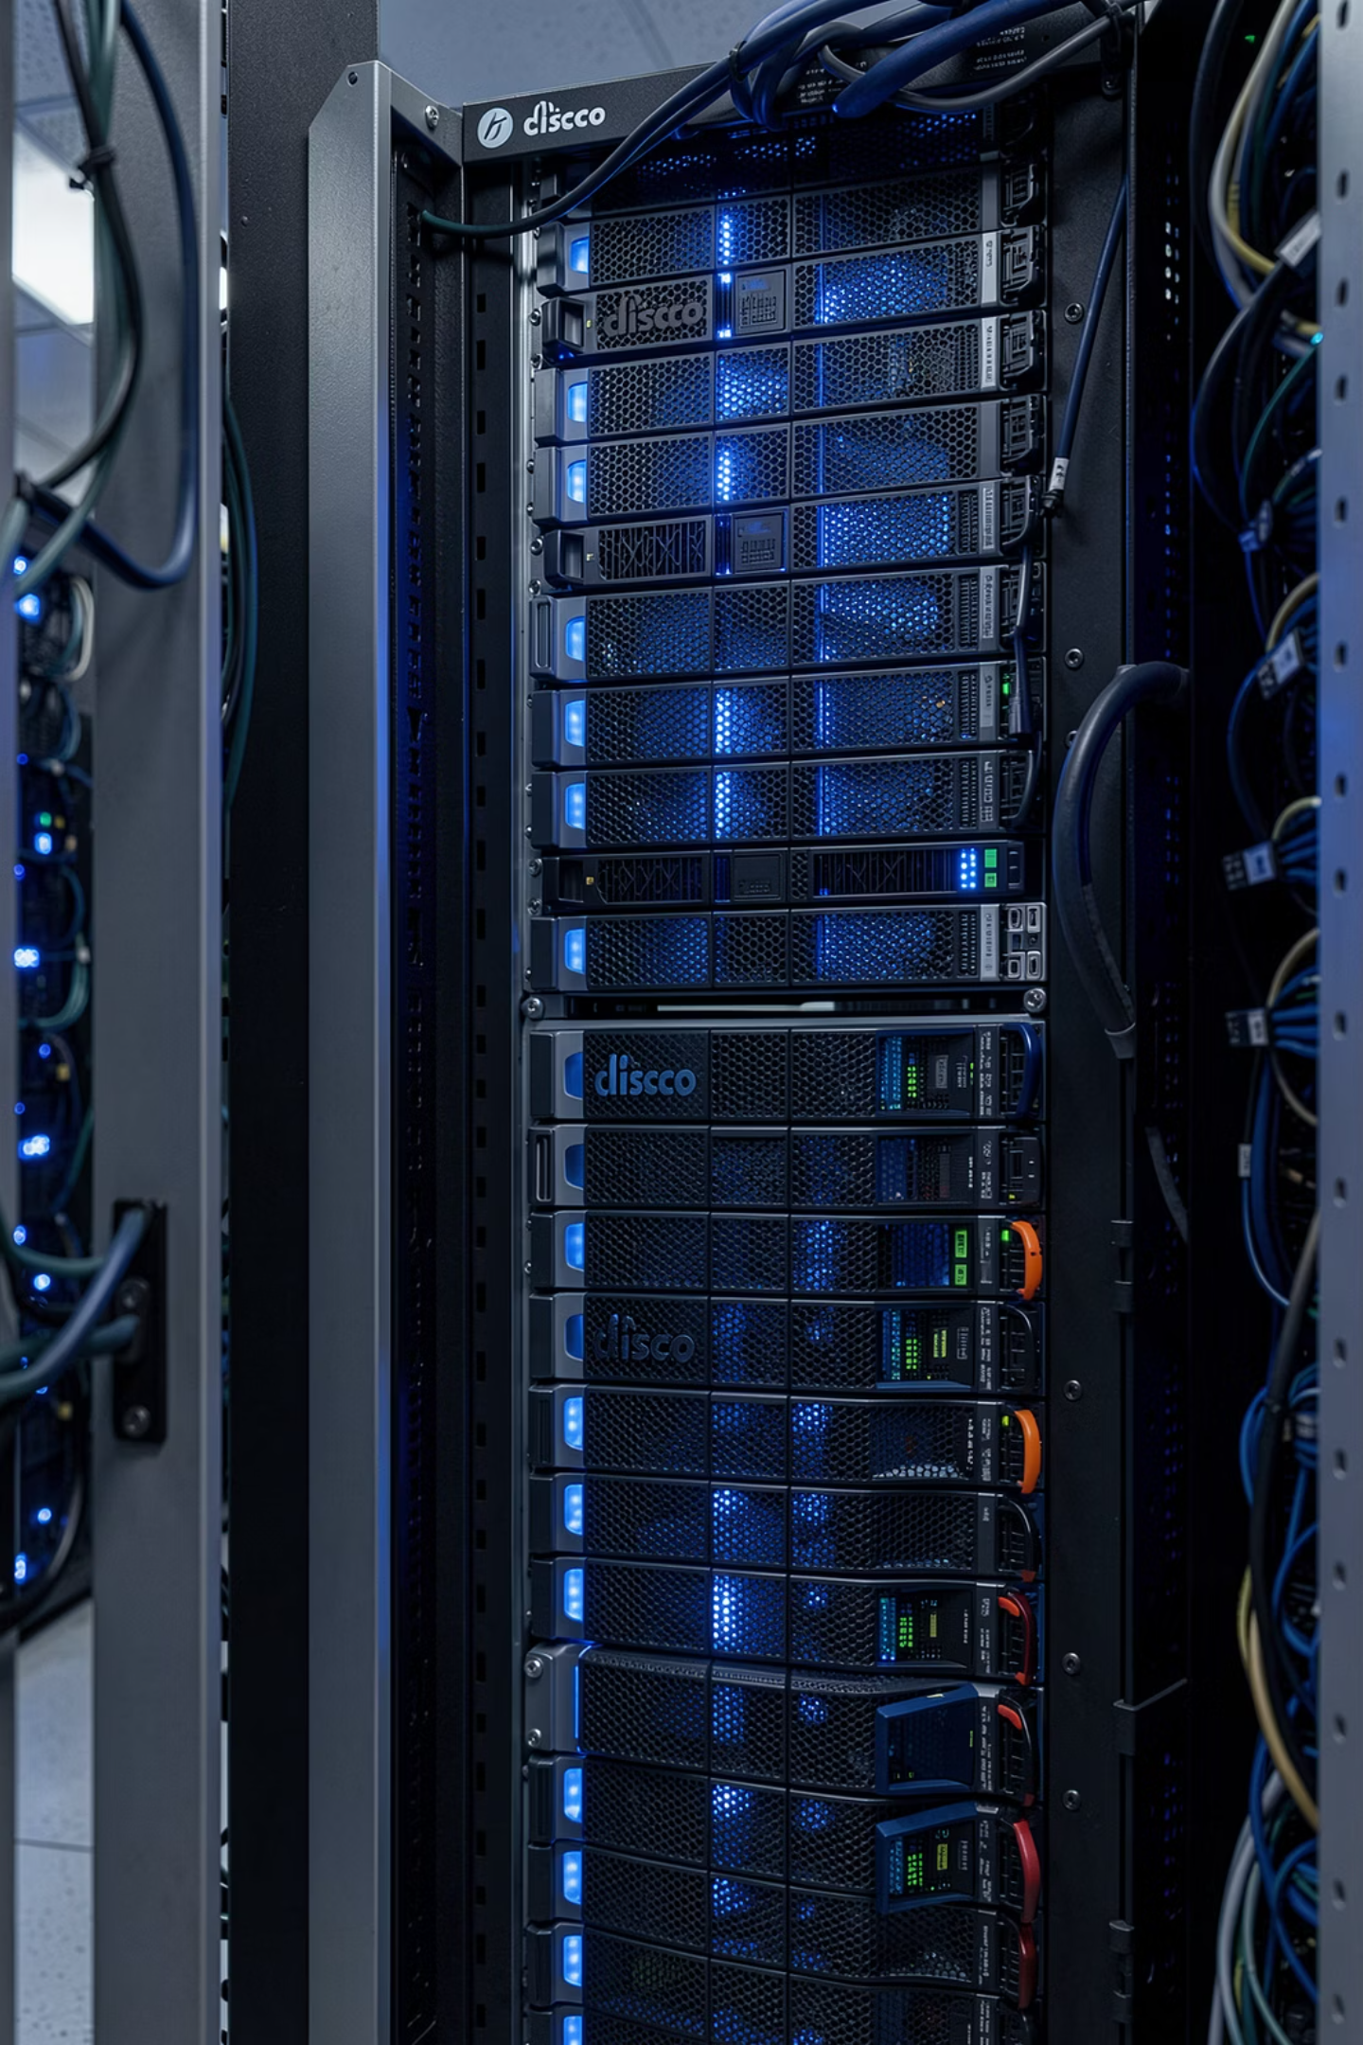
Project 1 — Network Topology Design
Three-Tier Architecture
Standards Compliance
IEEE 802.1Q, 802.3u, 802.11ac · RFC 1918 · BSL ICT Security Framework 2023
Core (L3 routing), Distribution (VLAN aggregation), Access (end-device connectivity). Cisco Catalyst 3560 core with SVIs.
WAN Connectivity
20 Mbps SIERRATEL fiber primary + 5 Mbps VSAT failover. Cisco 2911 with NAT/PAT and DSCP QoS.

Slide 4

VLAN Architecture & VLSM IP Addressing
Six VLANs segment the network by department using VLSM on 172.16.0.0/16, maximizing address efficiency and enabling ACL security boundaries.
VLAN
Name
Subnet
Gateway
Hosts
10
VLAN_IT
172.16.10.0/27
.1
30
20
VLAN_BANK
172.16.20.0/26
.1
62
30
VLAN_FIN
172.16.30.0/27
.1
30
40
VLAN_EXEC
172.16.40.0/28
.1
14
60
VLAN_GUEST
172.16.60.0/25
.1
126
99
VLAN_SRV
172.16.99.0/28
.1
14

Slide 5
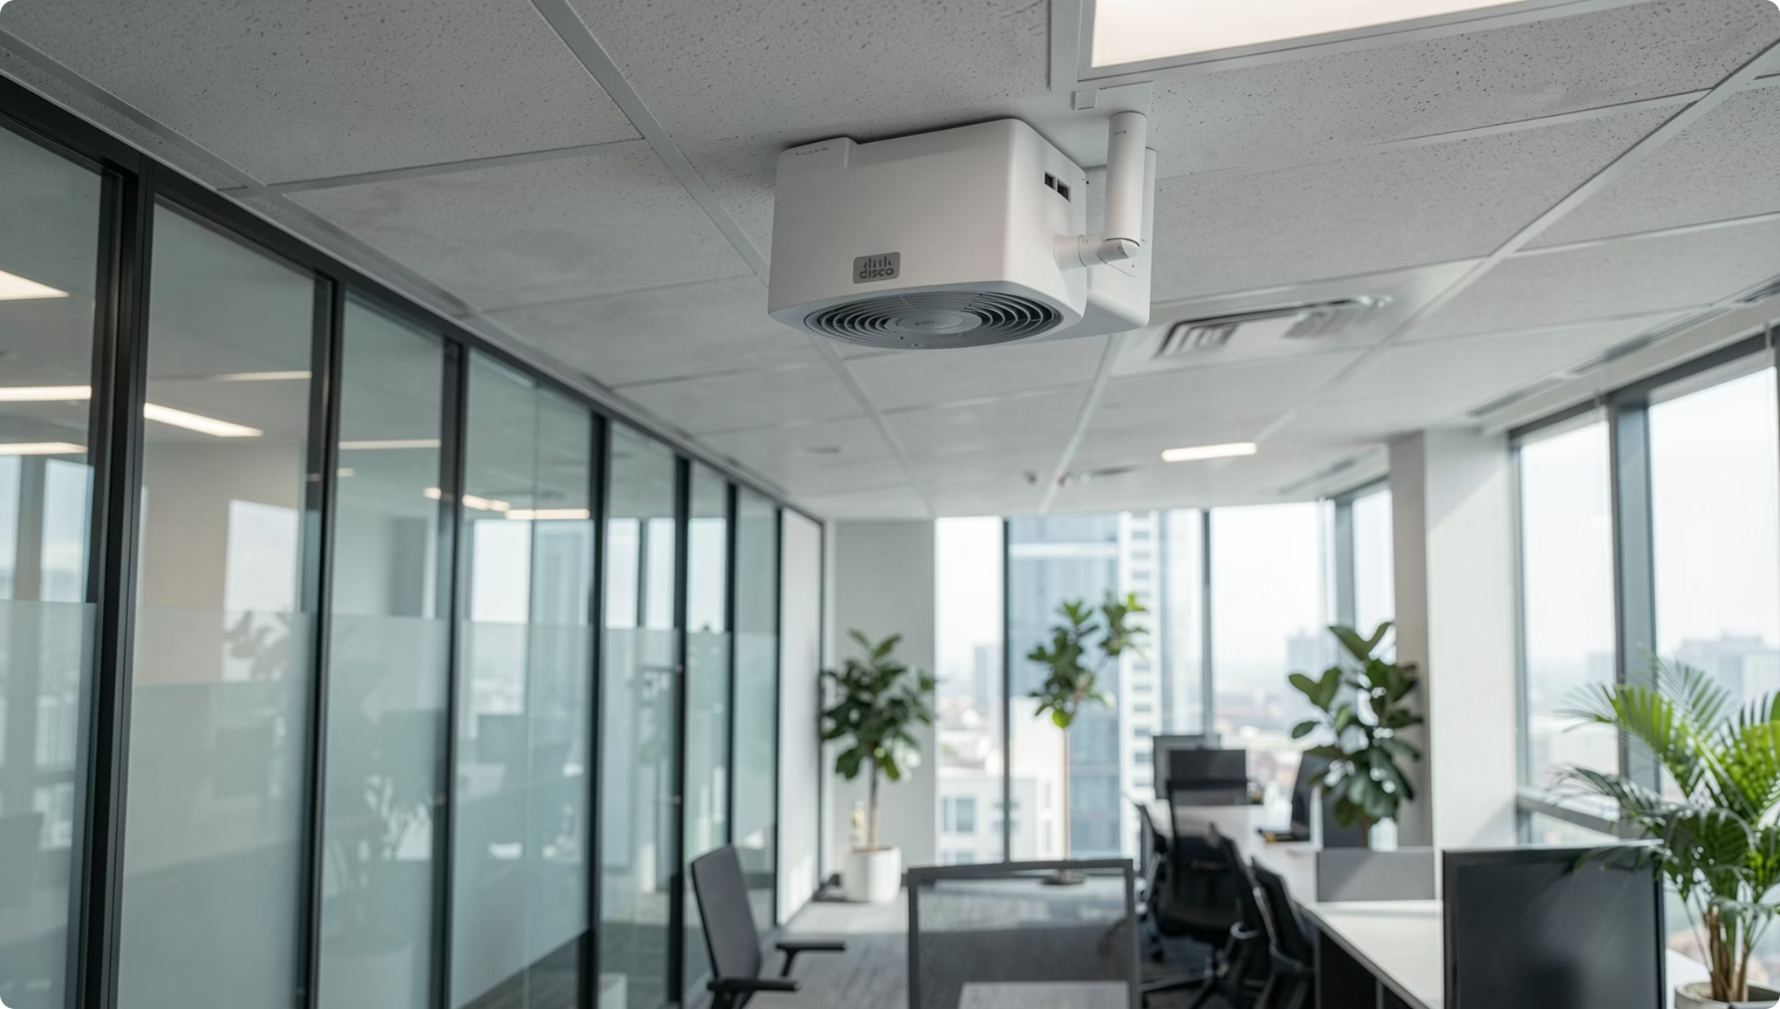


Security Controls — ACLs & Wireless
Access Control Lists on SW-CORE
ACL 101: Banking → Finance DENY — Retail staff cannot access treasury data
ACL 102: Guest → All Internal DENY — Internet-only isolation
ACL 103: IT → Servers PERMIT — Admin management access
ACL 104: All others → Servers DENY
Two Cisco Aironet 1832i APs: RCB-STAFF (WPA2-Enterprise + 802.1X/RADIUS) and RCB-GUEST (WPA2-PSK, VLAN 60, 5 Mbps rate-limited).

Slide 6



Project 2 — Server Configuration
Virtualization Platform
VMware Workstation Pro 17 on Dell PowerEdge R550 (Xeon Silver, 64 GB RAM, 4 TB RAID 5). VMs: DC-RCB01, FS-RCB01, WS-RCB01 on VLAN 99.
Active Directory
Domain rcbank.local. OU structure mirrors departments. PowerShell bulk import provisions all 70 accounts (firstname.lastname, 12-char passwords, expiry dates).
DHCP & DNS
DHCP scopes per VLAN via relay on SW-CORE. DNS integrated with AD DS — all services resolvable by FQDN within rcbank.local.
SMB & DFS File Sharing
SMB 3.0 encrypted transfers. DFS namespace \\rcbank.local\Shared with NTFS permissions enforced per department.

Slide 7


Group Policy & Backup Strategy
Key GPOs
3-2-1 Backup Policy (BSL-Mandated)
Company Baseline: Firewall ON, removable media disabled, auto-update enabled
Type
Frequency
Retention
Location
Password Policy: Min 12 chars, complexity ON, 60-day max age, 5-attempt lockout
Full Server
Weekly
4 weeks
Onsite + Offsite
Finance Restricted Access: Map F: drive, block non-Finance shares
Incremental
Daily
2 weeks
Onsite NAS
AD System State
Daily
30 days
Separate volume
Admin Workstation Lockdown: USB AutoPlay disabled, RDP restricted to IT subnet
VM Snapshot
Per change
3 max
VMware datastore
RTO: 4 hours — validated quarterly.

Slide 8

Testing & Verification Results
Network Connectivity — 8/8 PASSED
Server Services — 6/6 PASSED
AD DS: Domain join verified in ADUC
DHCP: All scopes issued valid leases
DNS: Forward lookup returned correct IPs
GPO: Password Policy & Drive Mapping applied
SMB: Finance share mapped, read/write confirmed
Backup: Veeam job complete, restore tested OK
Intra-VLAN (IT) ✓
Inter-VLAN (IT→Banking) ✓
ACL Block (Banking→Finance) ✓
Guest VLAN Isolation ✓
DHCP Assignment ✓
DNS Resolution ✓
Zero failures recorded. All critical ACLs functioning correctly.
SMB Finance Share ✓
NAT Internet Access ✓

Slide 9
Challenges & Security Compliance
Key Challenges Resolved
Regulatory Alignment
1
DHCP 169.x.x.x — Added ip helper-address on all SVIs
BSL BDS/2023/04 — VLAN segmentation + ACLs; centralized AD auth
PCI DSS v4.0 — Finance VLAN isolated; Banking blocked by ACL 101
2
ACL blocking IT traffic — Reordered: PERMIT IT above DENY all
3
AD DS promotion failed — Cleared DNS suffix conflict, flushed DNS
ISO 27001 — Least privilege via RBAC OUs and GPO enforcement
NIST 800-41 — Cisco ASA 5505 perimeter firewall with DMZ
4
DFS inaccessible — Firewall exception for TCP 445 scoped to Finance/IT
Defense-in-Depth: 7 layers — ASA firewall, VLAN segmentation, ACLs, WPA2-Enterprise, GPO endpoint policies, SMB 3.0 encryption, enhanced audit logging.

Slide 10
Conclusion & Future Recommendations
All DCOMP 114 objectives delivered: three-tier topology, Cisco VLANs/ACLs, VLSM addressing, Windows Server 2022 with AD DS, DHCP, DNS, SMB, and Veeam backup. 14/14 tests passed. Network compliant with BSL ICT Security Standards 2023.
01
02
Deploy secondary DC DC-RCB02 to eliminate auth single point of failure
Implement Wazuh SIEM for real-time security event correlation
03
04
Migrate to SD-WAN for improved WAN failover and traffic visibility
Deploy PRTG Network Monitor for 24/7 device health monitoring
05
06
Integrate Microsoft Entra ID via Azure AD Connect for hybrid MFA
Conduct quarterly BSL-mandated penetration testing per Circular BDS/2023/04

