Slide 1

EDA PROJECT
GOOGLE PLAY STORE APPS
T5 Bootcamp

Slide 2
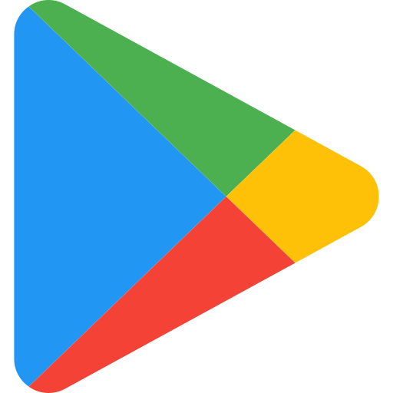
Google Play, also branded as the Google Play Store and formerly Android Market
, is a digital distribution service operated and developed by Google.
Introduction
It serves as the official app store for certified devices running on the Android
operating system and its derivatives as well as Chrome OS, allowing users to
browse and download applications developed with the Android software
development
T5 Bootcamp

Slide 3
Describe | column
Apps name | App
Category to which the app belongs | Category
rate app | Rating
Size apps | Size
number of downloads | Installs
Free or paid app | Type
Price apps | Price
Content Rating apps | Content Rating
Last update date | Last Updated
Android Ver mobile | Android Ver
column
T5 Bootcamp

Slide 4
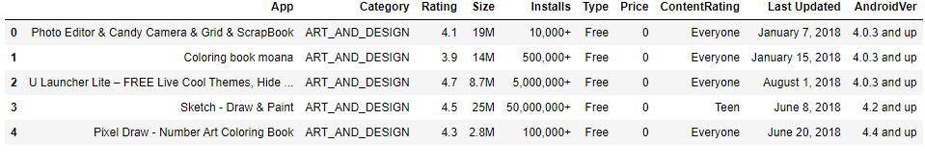
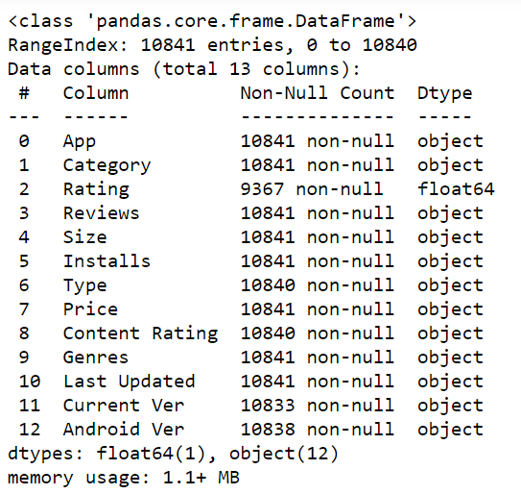
View data
Info data
T5 Bootcamp

Slide 5
Application in jupyter Notebook
Python programing
Tools
Numpy
pandas
matplolib
PowerPoint
Click Link data
# Q1 : how many free apps and price ?
questions
# Q2 : What are the most downloaded categories?
# Q3: What is the most downloaded version?
# Q4: what the most download years ?
# Q5: What is the most paid category?
T5 Bootcamp

