Slide 1
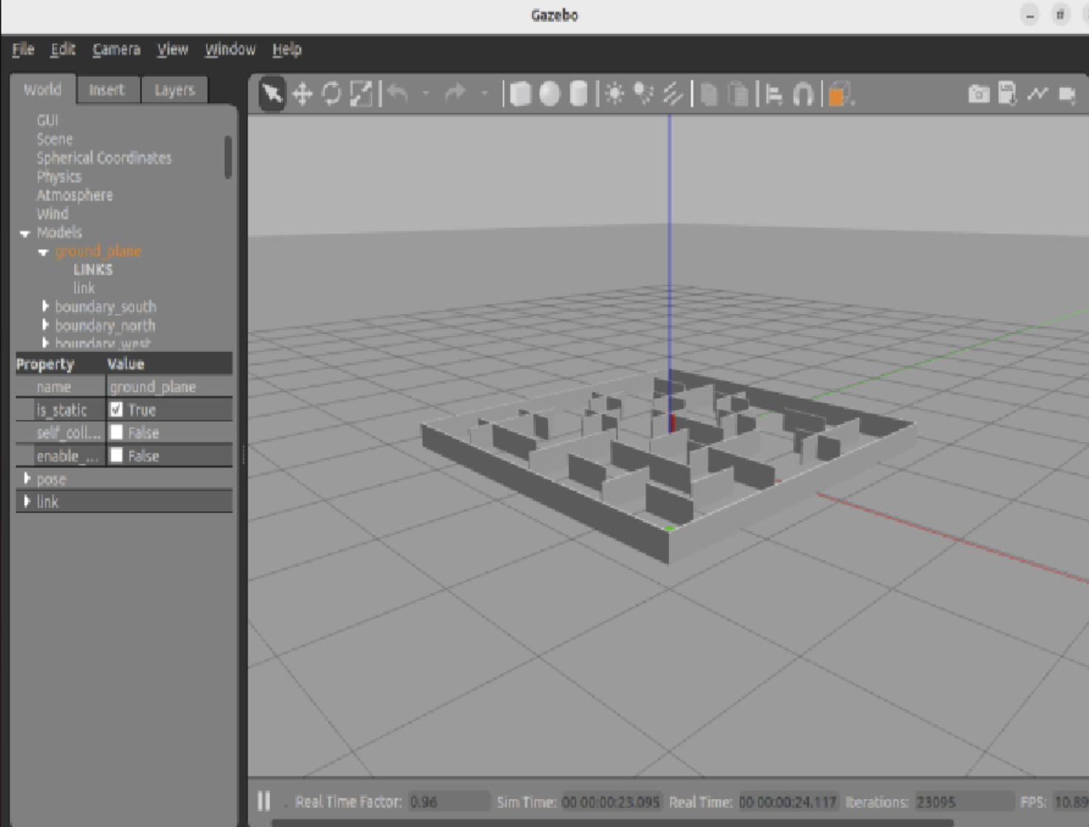
AI 407 Introduction to Robotics
TurtleBot3 Autonomous Object Retrieval
and Placement in a Maze Environment
ROS 2 Humble + Gazebo Simulation
Team: [Names] Lab Section: [Section]
AI407 Robotics Project | 1

Slide 2
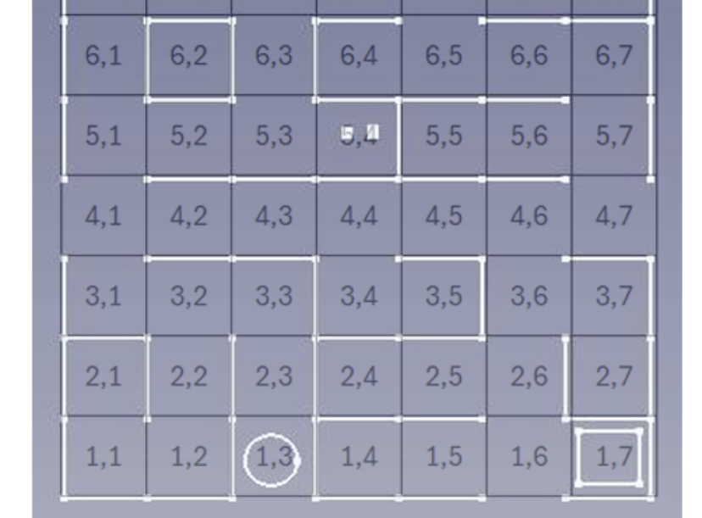
Project Goal and Requirements
Navigate a 7×7 maze from a given start cell.
Find two objects in the same unknown cell and display the discovered location.
Transport objects one at a time to the target cell.
Remember discovered paths to avoid repeated trial-and-error.
Return to the original starting point after both deliveries.
Start: (1,3)
Objects: Found (5,4)
Target: (1,7)
AI407 Robotics Project | 2

Slide 3
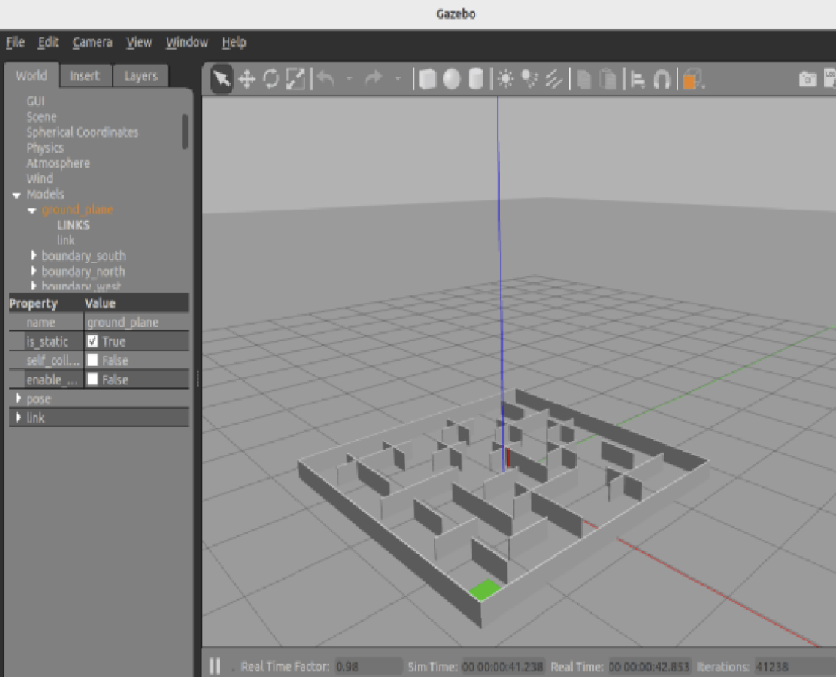
Gazebo Maze Design
Maze size: 3.5 m × 3.5 m.
7 rows × 7 columns, with 0.5 m cell spacing.
Wall height: 0.20 m; wall thickness: 0.015 m.
Start marker, target marker, robot model, and two objects are included.
Internal walls create turns, blocked paths, and dead ends.
AI407 Robotics Project | 3

Slide 4
Simulation Architecture
Gazebo World
ROS 2 Launch
Task Node
Mission Output
maze + robot + objects
loads world + node
search + BFS + memory
delivery + return home
World file defines physical maze dimensions.
Launch file starts Gazebo and the mission node.
The node stores paths to the object, target, and start.
Objects are moved visually to represent pick-and-place.
AI407 Robotics Project | 4

Slide 5
Algorithm Flow
1
2
3
4
5
6
Start at (1,3)
Search cells
Found (5,4)
Pick object
Go target (1,7)
Repeat + return
Search phase uses trial-and-error style exploration.
Once the objects are found, routes are saved in memory.
The second delivery uses the remembered path instead of searching again.
AI407 Robotics Project | 5

Slide 6
Simulation Results
Gazebo maze loads successfully.
Robot starts at the correct cell marker.
Terminal output displays: Found (5,4).
Both objects are delivered to the target cell.
Robot returns to the starting position and stops.
AI407 Robotics Project | 6

Slide 7
Project Code Package
worlds/phase3_7x7_maze.world: Gazebo simulation environment.
launch/simulation.launch.py: starts Gazebo and the autonomous task node.
maze_task_node.py: mission logic, path memory, object pickup/drop, and return home.
maps/maze_graph.json: location metric notes and cell settings.
cd ~/ai407_ws
colcon build
source install/setup.bash
ros2 launch ai407_maze_project simulation.launch.py
AI407 Robotics Project | 7

Slide 8
Conclusion
The simulation demonstrates the complete required mission sequence.
Maze dimensions and object dimensions follow the project specification.
The robot uses path memory after discovering the object location.
The package is ready for Phase 3 video recording and final demo preparation.
Mission complete: Search → Pick → Deliver → Repeat → Return
AI407 Robotics Project | 8

