Slide 1
Is424 CRUD PROJECT
Name: Abdulaziz Altaweel
Student ID: 443102489
Section : 77443

Slide 2
Introduction
Our project is a CRUD-based Web Application built using Django, designed to manage items, products, or services for users. The application incorporates modern web development practices with an intuitive interface, allowing users to perform essential operations like adding, viewing, editing, and deleting items. Key features include user authentication, form validations, and a responsive design using Bootstrap.

Slide 3
Issue/Problem
Debugging and Testing:
Issue: Debugging runtime errors like incorrect form rendering or failure in data submission.
Solution: Using Django's detailed error tracebacks and testing views and forms iteratively
User Experience Challenges:
Issue: Errors during form submissions, such as invalid data causing the application to crash instead of showing user-friendly error messages.
Solution: Adding logic to hide/show navigation items based on user authentication status.

Slide 4
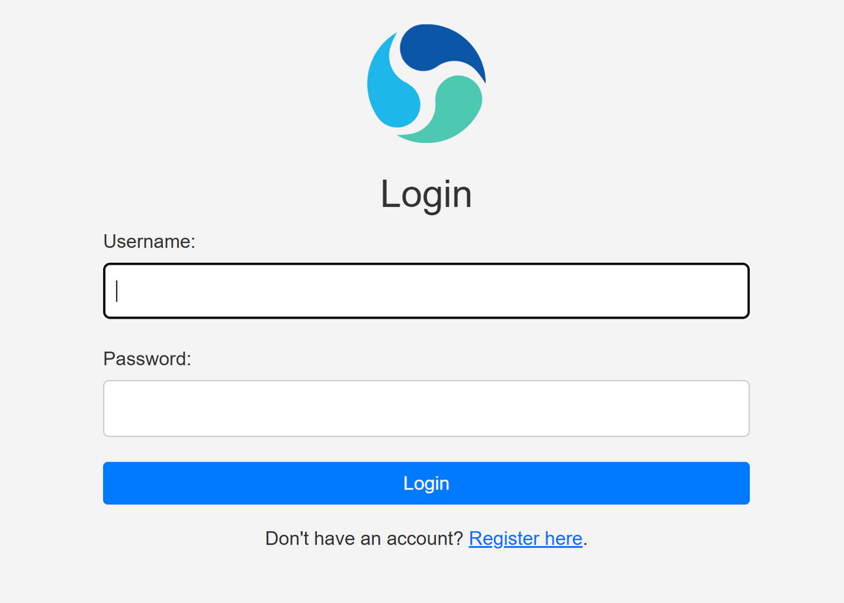
Solution structure
Log in view:
Authenticate users by verifying their credentials (username and password).
Protect access to certain parts of the application by restricting them to logged-in users only

Slide 5
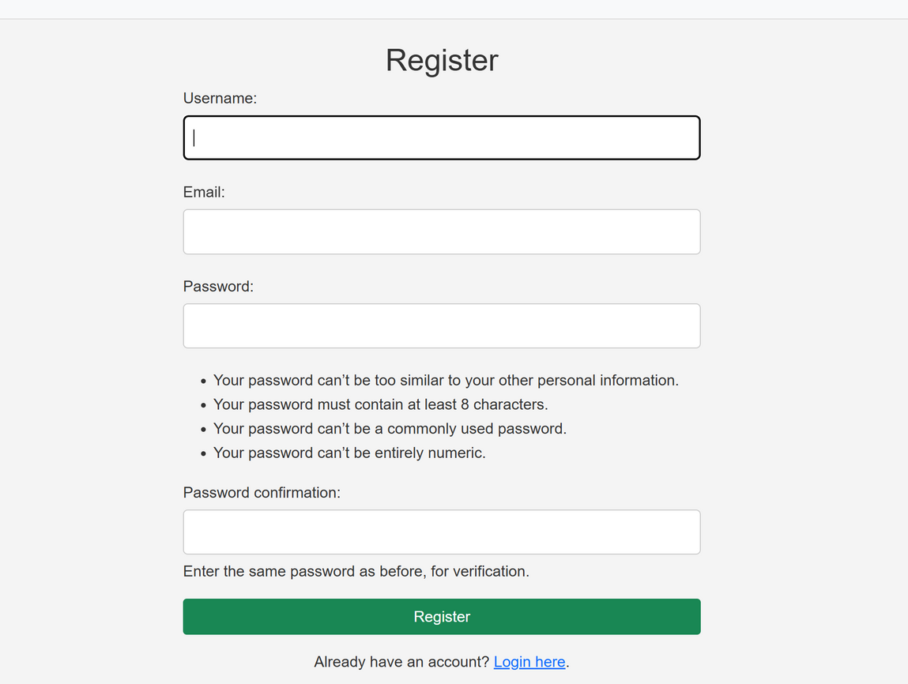
Solution structure
Register View:
To enable unregistered users to sign up for the system by providing their information (username, email, and password).
To ensure that only valid and unique credentials are submitted for creating an account.

Slide 6
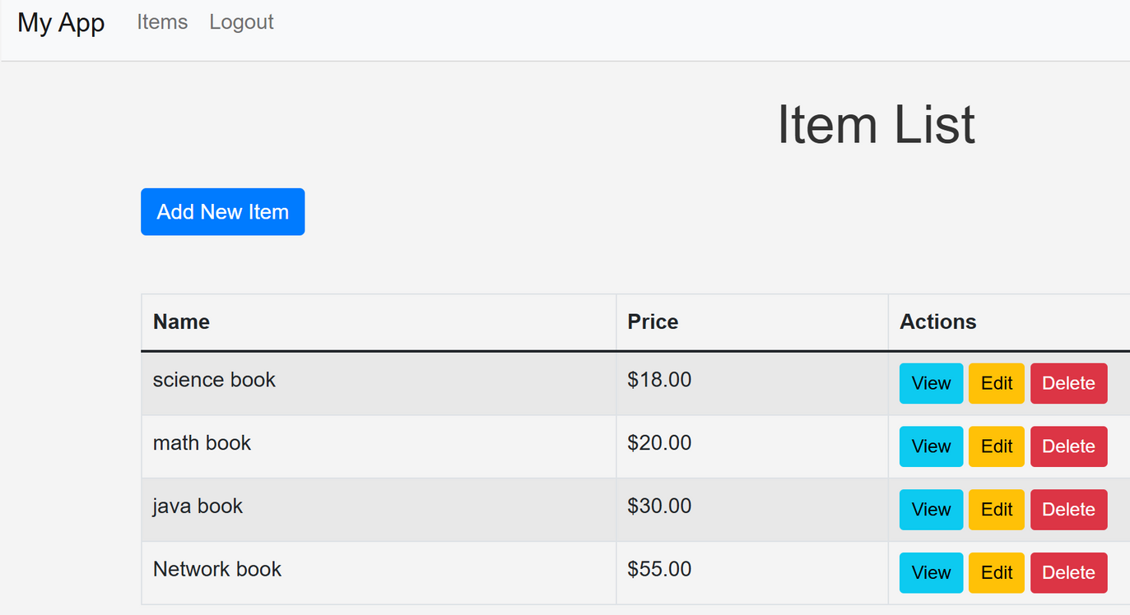
Solution structure
Item List View:
To allow users to view all the items/products/services provided by the system in a structured format.
To facilitate interaction with individual items through various actions such as viewing details, editing, or deleting.

Slide 7
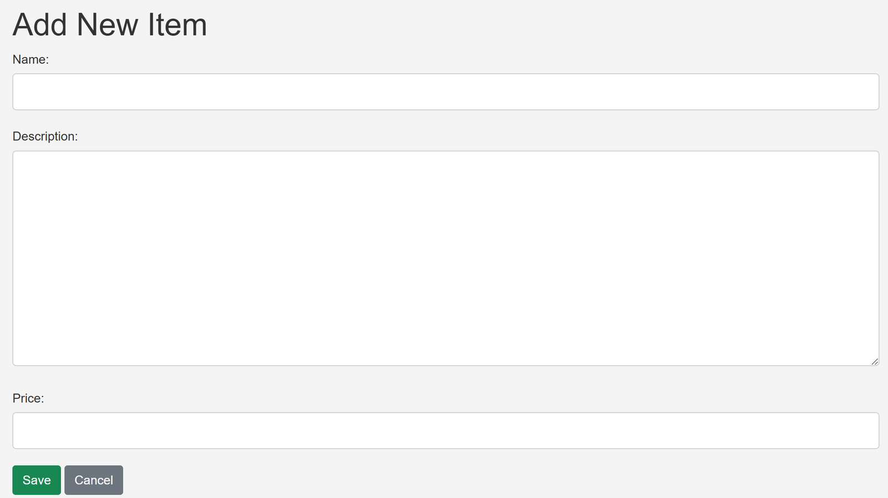
Solution structure
Add New Item:
Allows users to dynamically add items, products, or services to the system's inventory.
Enables users to interact with the system by contributing content or submitting new items.

Slide 8
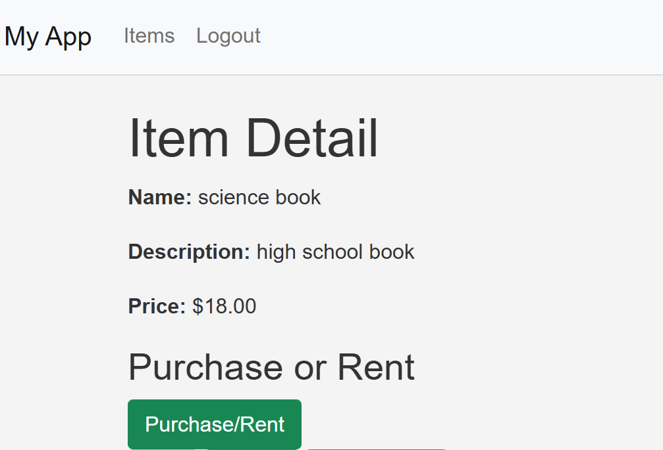
Solution structure
view item:
Allows users to view detailed information about a specific item, product, or service.

Slide 9
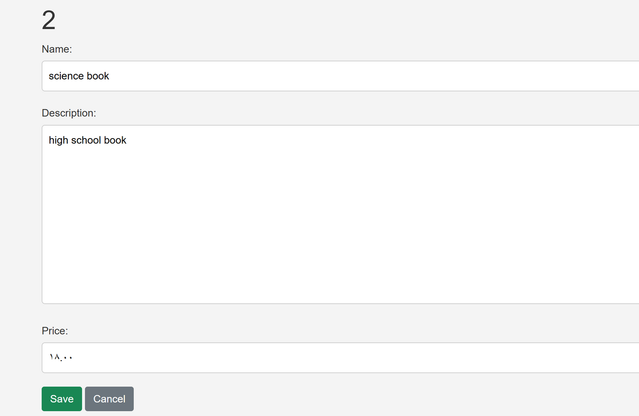
Solution structure
Edit Item:
Enables users to modify the details of an existing item, such as its name, description, or price.
Ensures that items remain aligned with user needs or organizational standards by allowing edits.

Slide 10
Conclusion
Developing this system was a valuable learning experience. The project highlighted the importance of planning, integration of backend and frontend technologies, and consistent testing. Key lessons included structuring the application for scalability and improving user experience through effective design.

Slide 11
Thank
You

