Slide 1
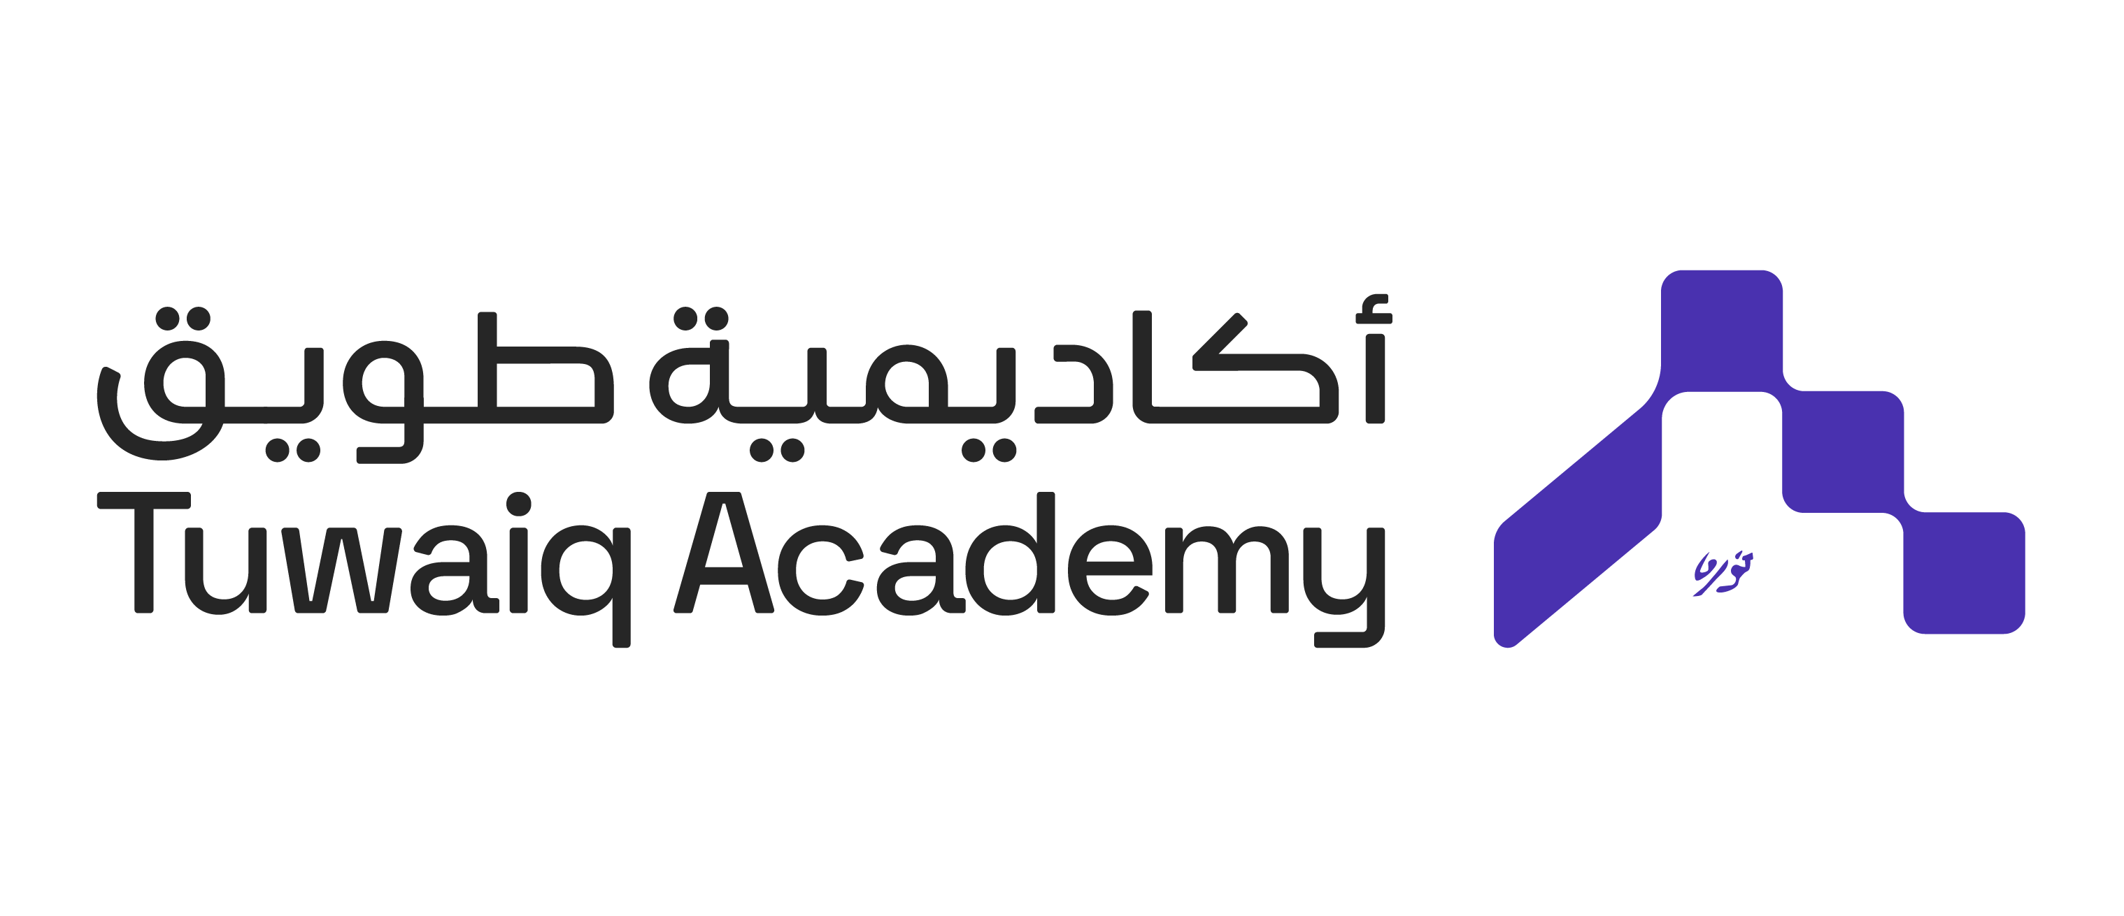
سِكَّة Railways Management System
Capstone-2
Abdulaziz Alharbi

Slide 2
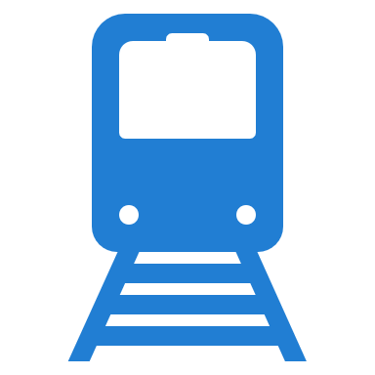
Problem
The absence of a comprehensive and unified railway system amidst the growing use of public transportation in Saudi Arabia.

Slide 3
Description
The increasing use of public transportation
Railway management systems are weak and fail to keep pace with technological advancements.
The confusion faced by users when using railway systems.

Slide 4
Solution سِكَّة
Multi Users System.
Statistics and Summary of Information.
Loyalty Points.
Trips Controlling and Tracking

