Slide 1
Assignment 3
Complete Spoken‑Video
Translation Pipeline
Preserving speaker voice characteristics and synchronizing lip movements
1
2
3
4
5
6
Video
ASR
Translate
Voice
Lip‑sync
Baseline
Mohamed Kitaz & Abdulaziz Kitaz
Johannes Kepler University Linz
1
Notes:
Introduce the assignment goal: translate a spoken video into German while keeping the original speaker identity and aligning the lips. Mention that the work covers all four tasks.

Slide 2
What the system has to do
The challenge is not only translation: it is identity-preserving audio‑visual generation.
Input
Target
Evaluation
One English video from identity id0001
h_vamljclHE / 00000.avi
German speech with similar voice
+ synchronized mouth movement
Embeddings + FOP baseline
classification on id0001
91.36 s
German
36
100%
original audio duration
target language
baseline identities
baseline accuracy on two A3 samples
Main output: outputs/video_lipsync/sample_lipsync_full_de.mp4
Assignment 3 | Complete Pipeline
2
Notes:
Explain the input and output in one minute: one English input video is converted to a German lip-synced video, then evaluated using embeddings and the FOP baseline.

Slide 3
Task 1 — Pipeline overview
Seven practical stages turn the original English clip into a German lip‑synchronized video.
1
2
3
4
5
6
7
FFmpeg
Whisper
Translator
XTTS v2
Duration match
Wav2Lip
Final video
extract WAV audio
detect language + transcribe
English → German
voice‑cloned German speech
pad/trim to 91.36 s
synchronize lips
German lip‑synced output
Key generated artifacts
Stage
File
Detail
Original audio
sample_original.wav
91.36 s
Speaker prompt
sample_speaker_prompt_20s.wav
20 s
German TTS audio
sample_generated_de_full_safe.wav
88.52 s
Matched audio
sample_generated_de_full_safe_matched.wav
91.36 s
Final video
sample_lipsync_full_de.mp4
91.24 s
Assignment 3 | Complete Pipeline
3
Notes:
Walk through the seven stages quickly. Emphasize that matching audio length before Wav2Lip prevents timing mismatch.

Slide 4
Task 1 — Implementation choices
The pipeline uses established models, with small fixes for long speech and timing.
Whisper detected English and produced the transcription.
The text was translated to German, then lightly cleaned for clear output.
XTTS v2 used a 20‑second speaker prompt to clone the voice style.
Long German text was split into 8 chunks to avoid XTTS truncation warnings.
Generated German audio was padded from 88.52 s to 91.36 s before lip‑sync.
Timing alignment
Original audio
91.36 s
Generated German
88.52 s
Matched German
91.36 s
Final lip‑synced video: 25 FPS, 112 × 112 output
The output size is smaller because Wav2Lip was run with resize_factor = 2 for CPU‑friendly inference.
Assignment 3 | Complete Pipeline
4
Notes:
This slide gives the practical engineering details. Mention that splitting the German text prevented XTTS warnings and padding kept the audio-video timing aligned.

Slide 5
Task 2 — Embedding extraction
Original and generated samples were represented with the same feature dimensions as the FOP baseline.
Encoders used
Cosine similarity: original vs generated
Audio: ECAPA‑TDNN via SpeechBrain
Visual: FaceNet / InceptionResnetV1
Visual embedding: mean of 32 evenly sampled frames
Audio
0.6962
Visual
0.9805
192
512
audio embedding dimensions
visual embedding dimensions
Interpretation
The face identity is almost unchanged after lip‑sync. Audio identity remains meaningful but changes more because the speech is synthetic and translated.
Assignment 3 | Complete Pipeline
5
Notes:
Explain that Task 2 matches the expected FOP feature dimensions: 192 for ECAPA and 512 for FaceNet. Mention visual similarity is very high; audio similarity lower but still meaningful.

Slide 6
Task 3 — Baseline evaluation
The generated sample remains recognizable by the FOP identity classifier.
Sample
True
Pred.
Top‑1
2nd best
Margin
Original English
0
0
0.9999
0.0000
0.9999
Generated German
0
0
0.9541
0.0422
0.9119
Confidence margin
Generated German probability gap
margin = probability(correct identity) − probability(second‑best identity)
id0001
0.9541
Why this is stronger than only cosine similarity:
It directly tests the Poly‑SIM classification objective.
It checks whether the correct identity is clearly separated from the nearest competitor.
Generated German still has a strong margin: 0.9119.
2nd
0.0422
Both samples were classified correctly as label 0.
Assignment 3 | Complete Pipeline
6
Notes:
Make clear that the earlier incorrect output was fixed by using output[1] as the logits. The generated sample is correct with high confidence and a large margin.

Slide 7
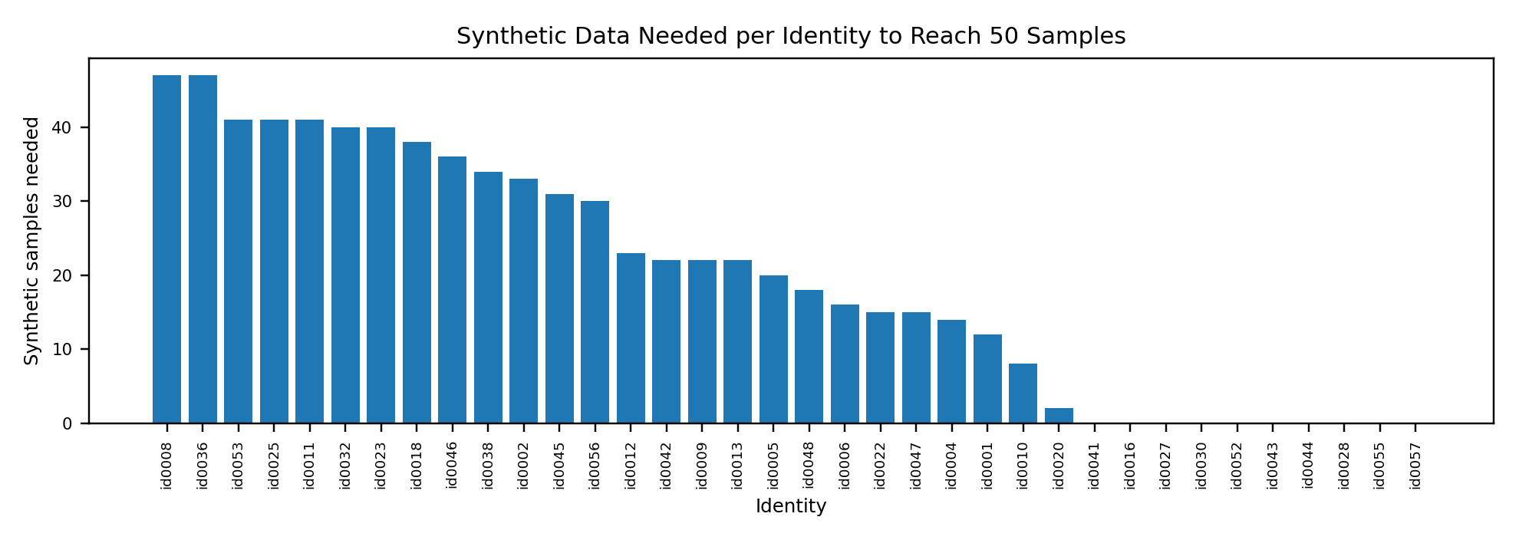
Task 4 — Synthetic data requirement
Synthetic generation should focus on identities with the fewest real samples.
36
3
155
50
708
identities
minimum real samples
maximum real samples
target per identity
synthetic samples needed
Top identities needing new samples
ID
Real
Needed
id0008
3
47
id0036
3
47
id0053
9
41
id0025
9
41
id0011
9
41
Rule used: synthetic_needed = max(0, 50 − current_real_samples)
Assignment 3 | Complete Pipeline
7
Notes:
Explain why 50 was chosen: close to the upper distribution, but not as extreme as the largest class. The total needed is 708 samples.

Slide 8
Final takeaways
The pipeline works end‑to‑end and preserves enough identity information for the baseline.
Pipeline completed
Identity preserved
Data balancing plan
English video was transcribed, translated, voice‑cloned, duration‑matched, and lip‑synchronized into German.
Generated German sample was correctly classified as id0001 with confidence 0.9541 and margin 0.9119.
A target of 50 samples per identity requires 708 synthetic samples, focused on low‑resource identities.
Submission files
Report PDF • cleaned notebook • outputs/video_lipsync/sample_lipsync_full_de.mp4 • embedding/result CSVs • repo README
https://github.com/Abdulaziz123123123/Special_topics_2026.git
Assignment 3 | Complete Pipeline
8
Notes:
End with the three key claims: pipeline completed, identity preserved, and the synthetic data plan is quantified.

