Slide 1
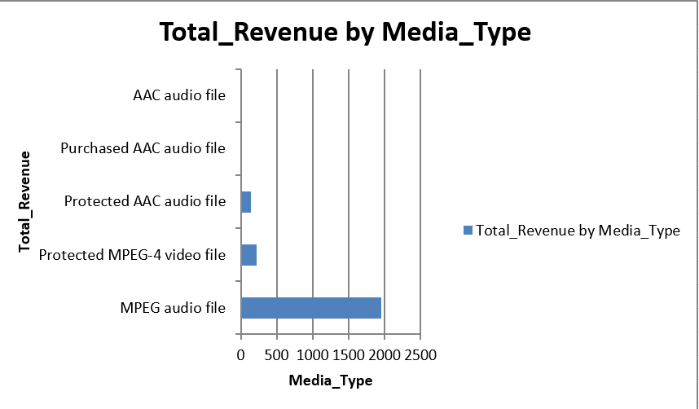
What is the total revenue for each media type?
The chart provides a clear visual representation of the media type, highlighting total revenue for each media type. The highest total revenue is approximately 2000 for MPEG audio file.

Slide 2
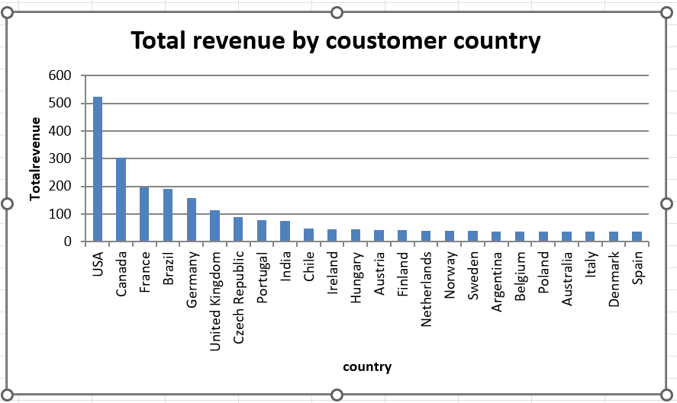
What is the total revenue for each customer country?
The chart provides a clear visual representation of the customer country, highlighting total revenue for each customer country. The highest total revenue is approximately 520 for USA.

Slide 3
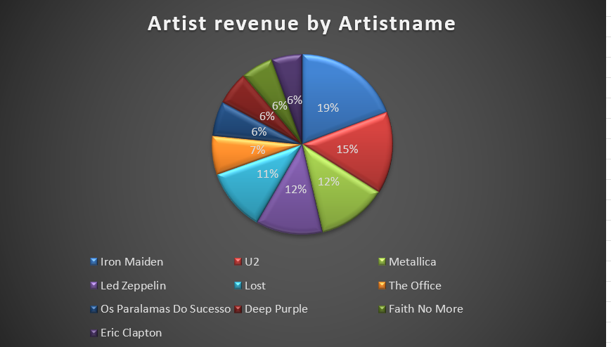
What is the total revenue for each artist?
The pie chart illustrates the share of total artist revenue by artist, with Iron Maiden holding the largest slice at 19% of overall revenue.

Slide 4
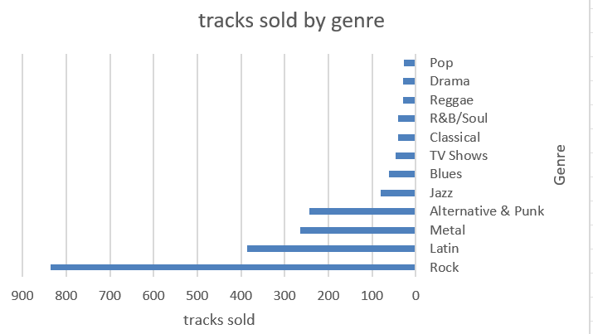
What are the top 12 genres by total tracks sold?
The chart provides a clear visual representation of the genre, highlighting tracks sold for each genre. The highest tracks sold is approximately 830 for Rock.

