Slide 1
Image Car-Make Classification
Ibrahim & Abdulaziz

Slide 2
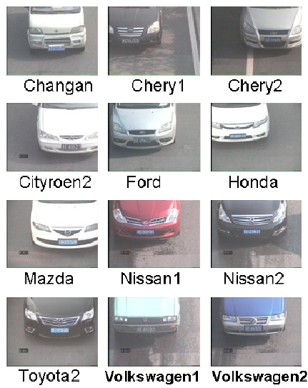
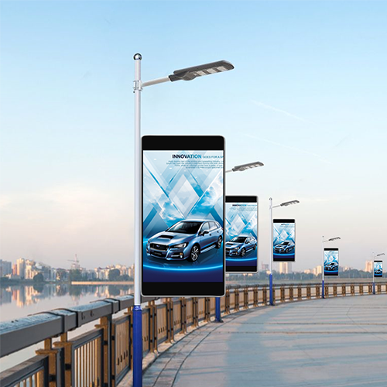
Why Car-Make Classification?
Outdoor targeted Advertisement

Slide 3
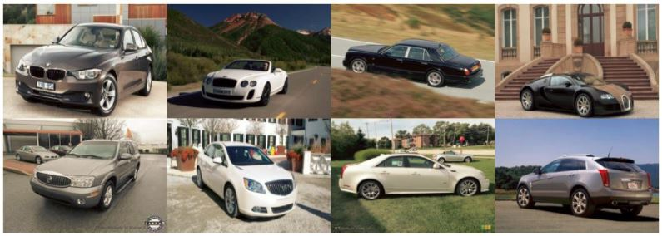



Dataset
16k Images
9k for training
196 Classes of cars

Slide 4
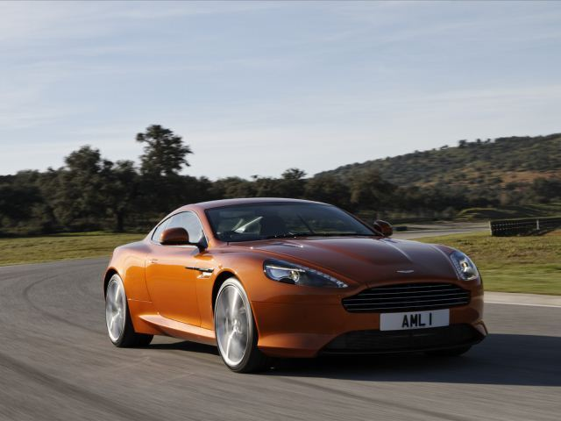
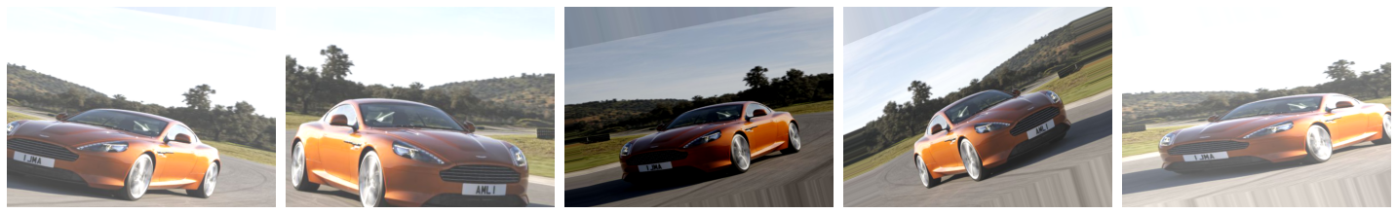
Augmentation

Slide 5




C Challenges
Code changes.
Getting Tensorflow to recognize GPU was difficult
Tracking Experiments got messy

Slide 6

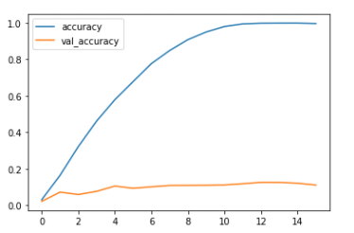



MobileNetV2 - Transfer Learning
Raw Images
Trainable FC
4096
4096
1024
It quickly overfitted trainning
Validation Stuck at minimum

Slide 7
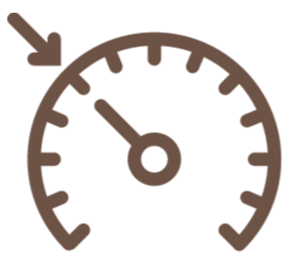
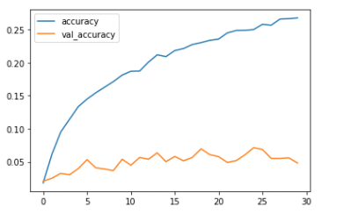

MobileNetV2 - Transfer Learning
Raw Images
L2 regularization
Trainable FC
1024
1024
512
Became Slower to Train

Slide 8

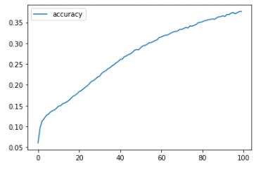
MobileNetV2 - Transfer Learning
Augmented Images
L2 regularization
Trainable FC
1024
1024
512
Became Slower to Train
Fluctuating Validation

Slide 9

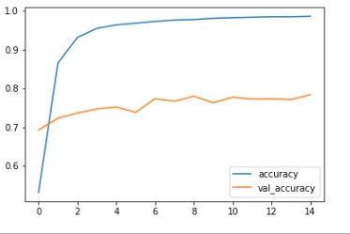
Train only the last 24 layers
Augmented Images
Model still overfitted
Higher Validation Accuracy

Slide 10

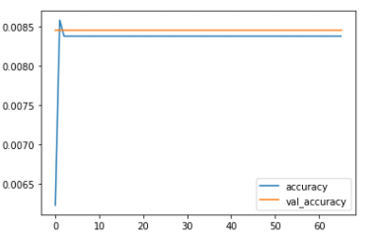

VGG-16 Experiment
Painfully slow.
Requires large GPU memory.
Wrong setup have wasted time.

Slide 11
Thank you

