Slide 1
Linear Regression and Web Scraping Project
T5C04
Ibrahim Alzuhairi & Abdulaziz Alshehri

Slide 2


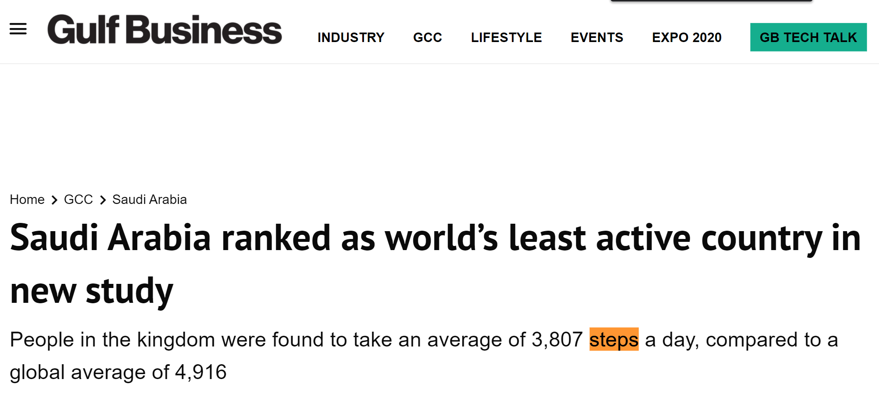
PROBLEM - Statement
Saudi's sedentary lifestyle
1 of 4 have Diabetes

Slide 3
PROBLEM - Statement
1,400,000
Steps in 2020

Slide 4

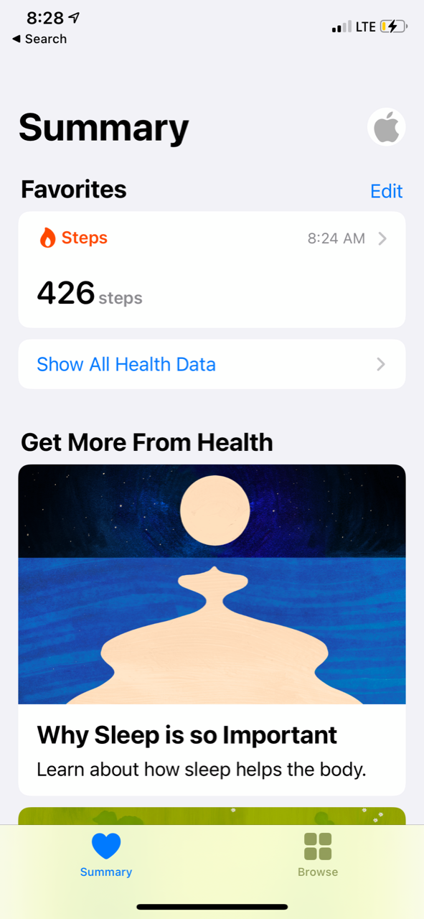
PROBLEM - Statement
Tawaklna App
iPhone Health App

Slide 5
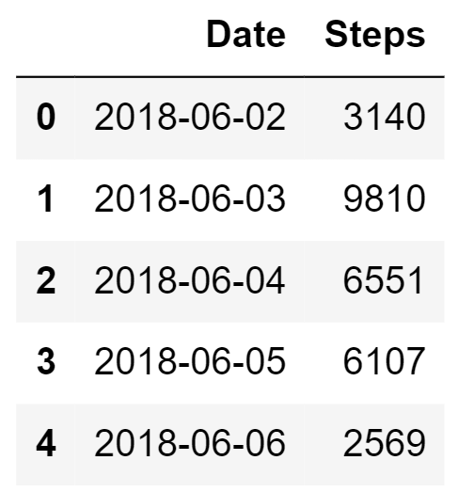
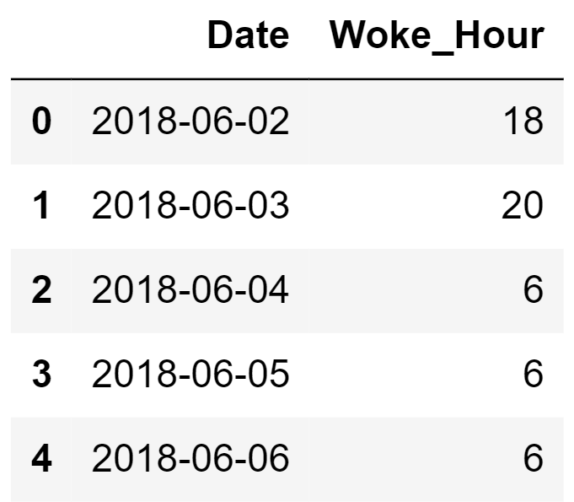
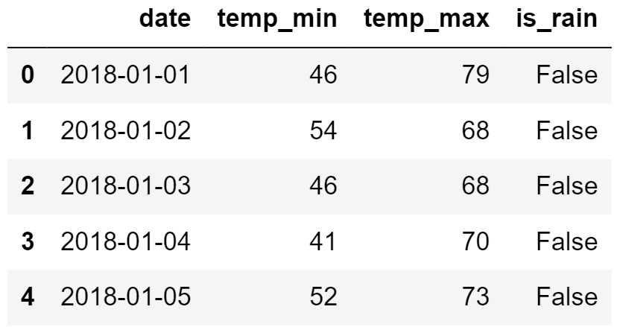
PROBLEM - Data
1. steps - (1207 x 2)
2. sleep - (1207 x 2)
3. weather - (1207 x 4) (Scraping ~10 hours)

Slide 6
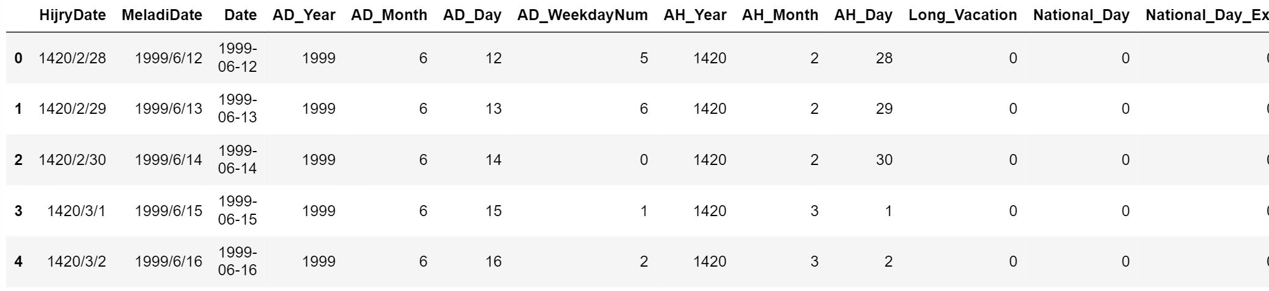
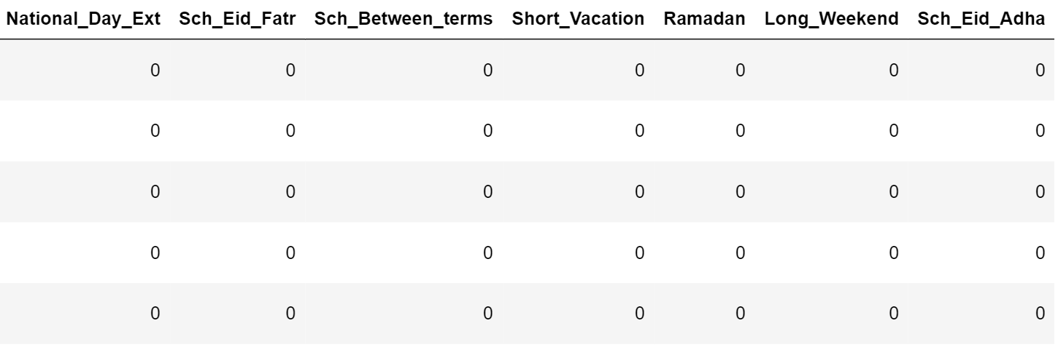
PROBLEM - Data
4. calendar - (14,532 x 20) (Scraping ~2 days)

Slide 7
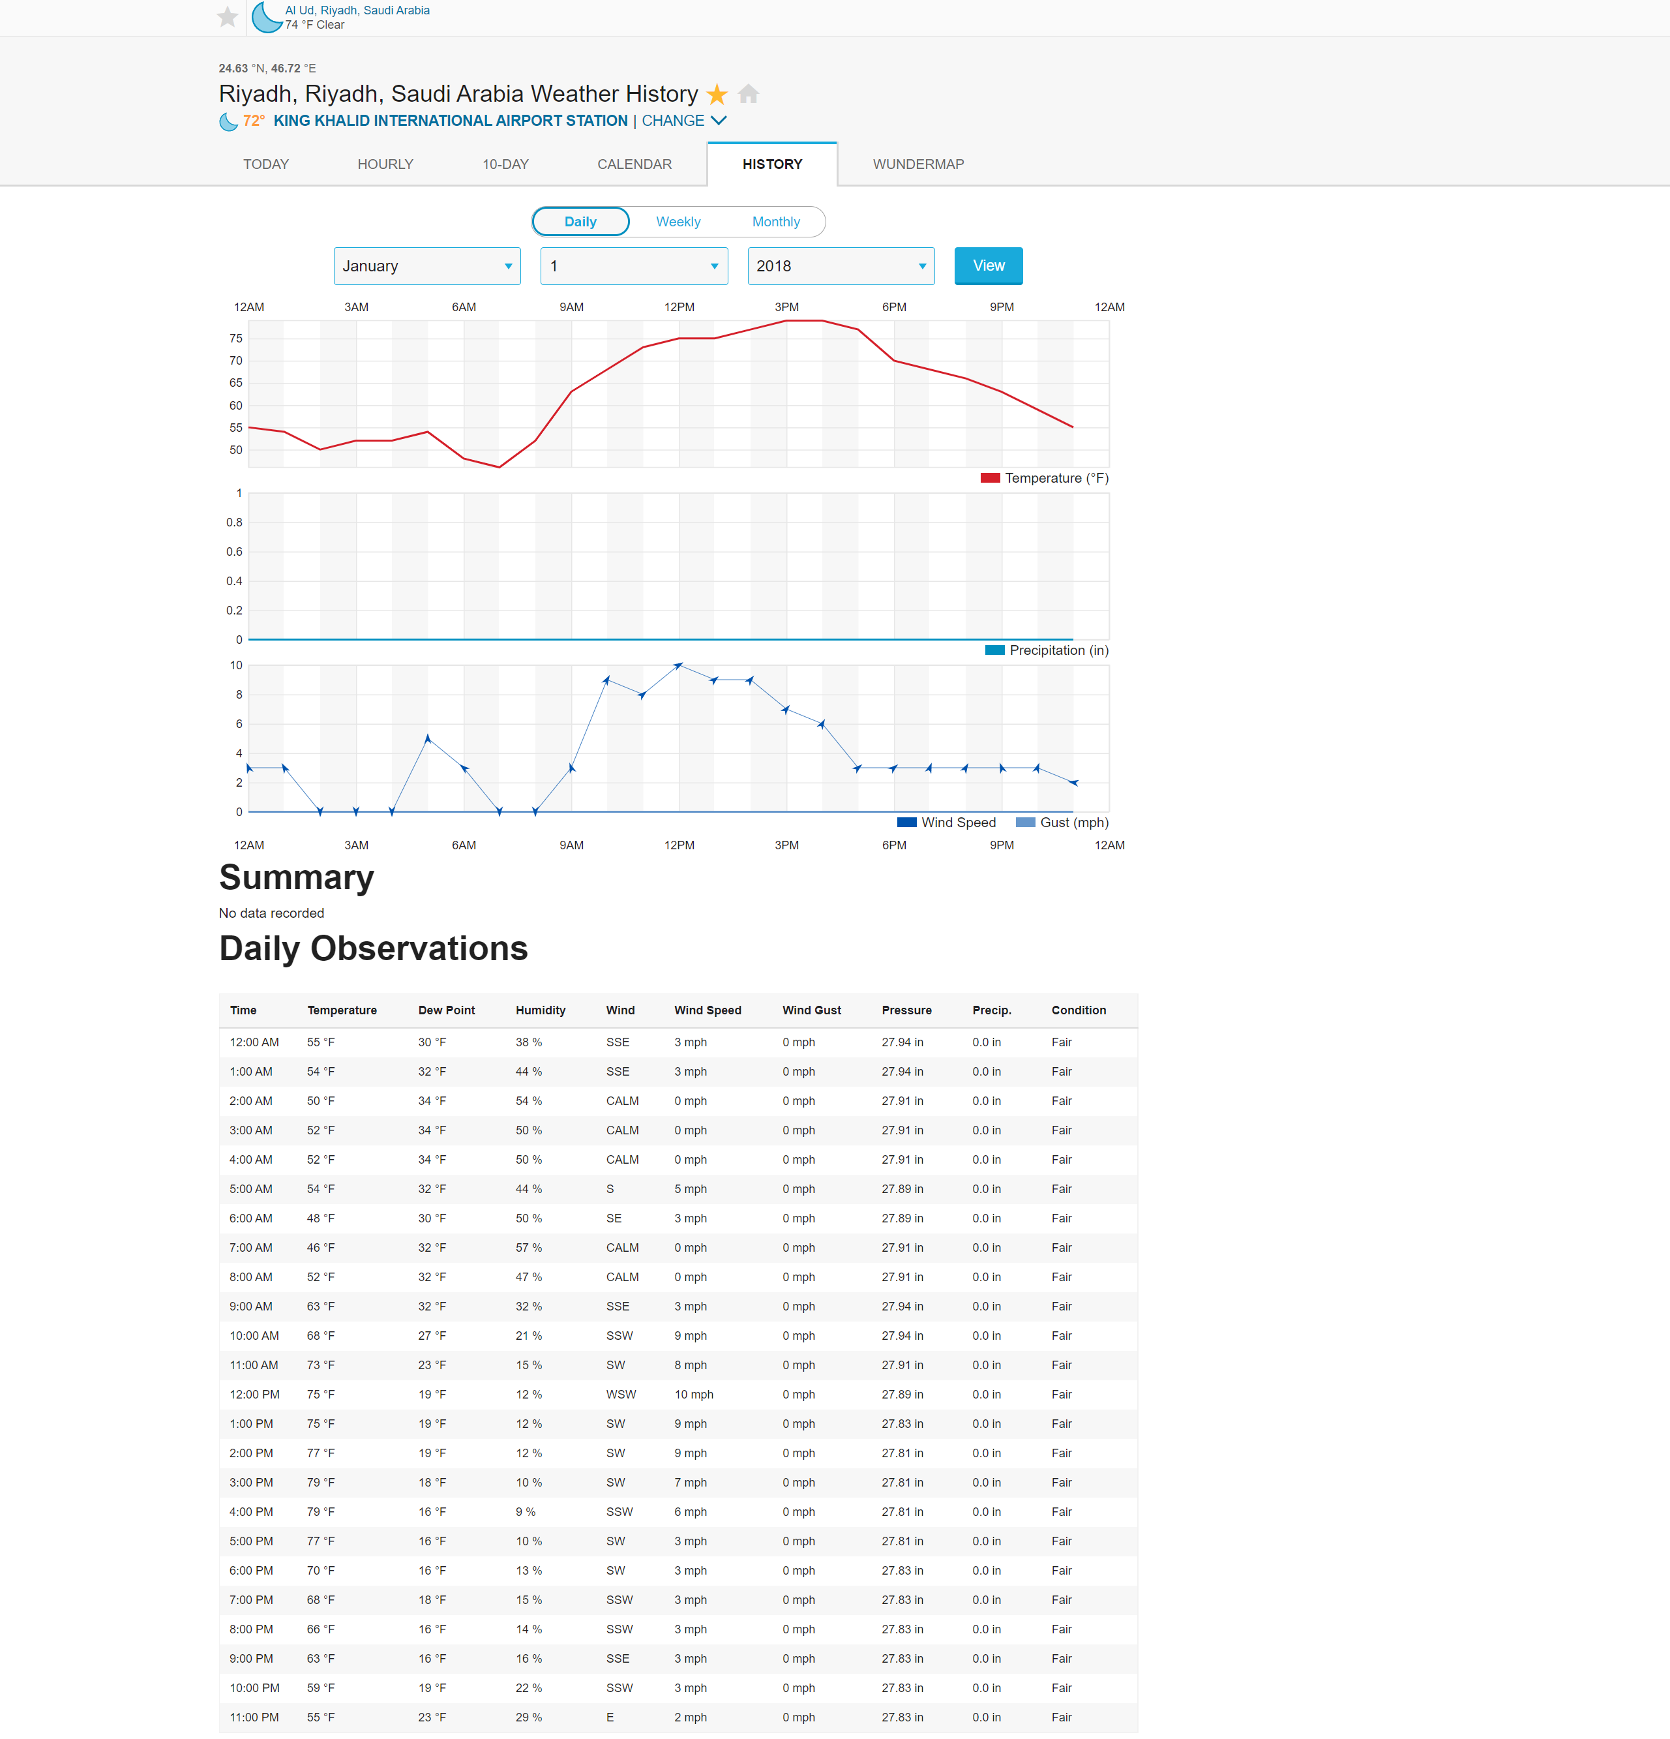
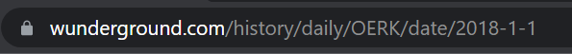
Weather website
PROBLEM – Data
Difficulties
Data is loaded by JavaScript.
Error handling.
Poor internet connection.

Slide 8
PROBLEM – Data Summary

Slide 9
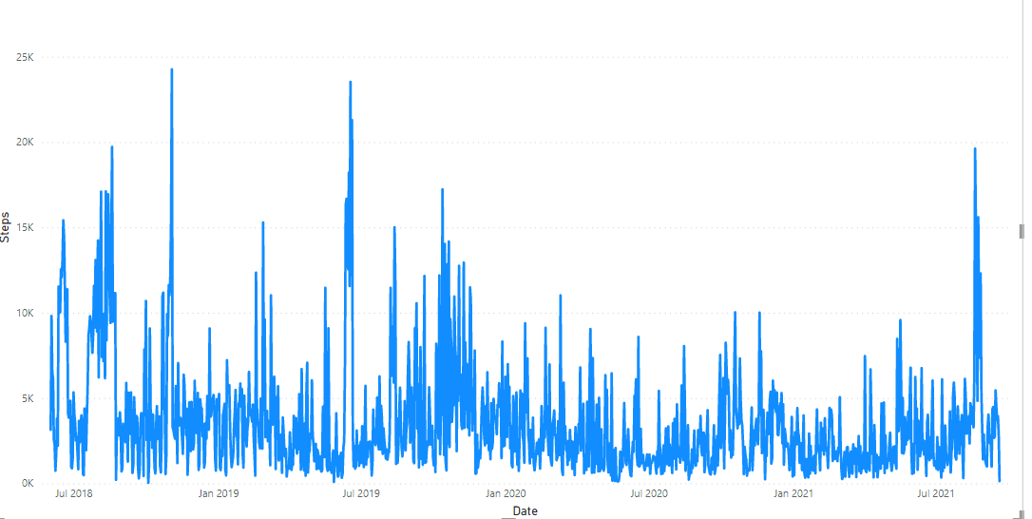
EDA - Exploring

Slide 10
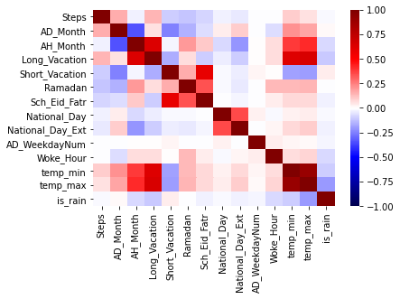
EDA - Exploring
Correlation

Slide 11
EXPERIMENTS - Feature Selection
Using Lasso() from 25 to 15 feature

Slide 12
EXPERIMENT - Summary
Wakeup Hours
Lag only
R- Square
0.06
0.05
0.07
0.25
0.35
Calendar Only
Weather
Combined
Mean Absolute Error 1800

Slide 13
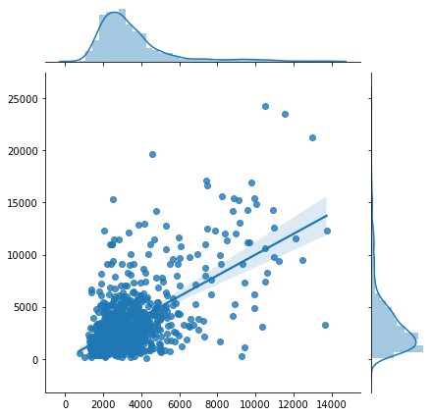
RESULTS - Prediction
True Y
Predict Y

Slide 14
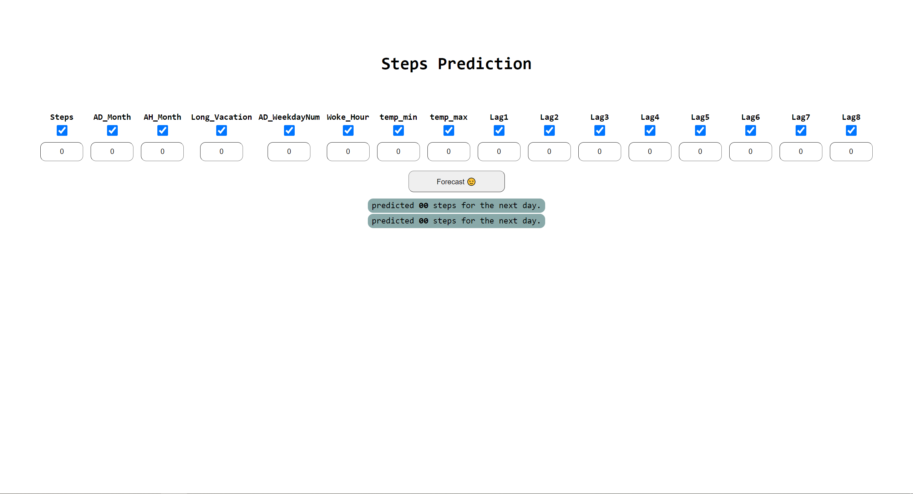

Try it out
Web form
Web Form
Allow playing with features
Easy to use.
Web API
Easy integration.
$25 / request
https://51.144.85.121/health/form.php

Slide 15

Questions

