Slide 1
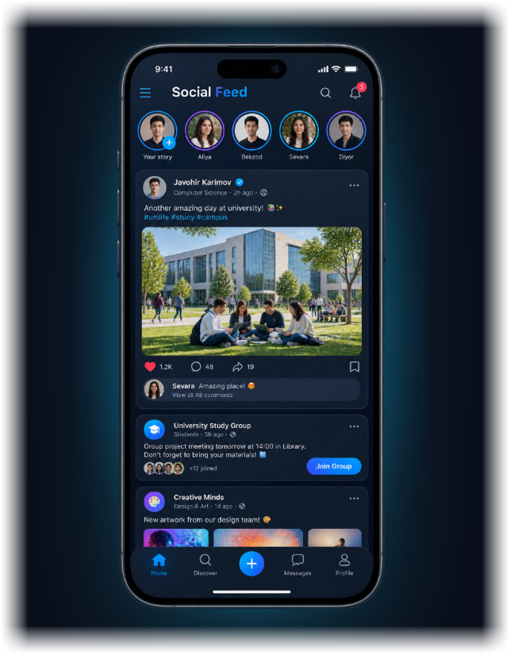
DIGITAL LIFE · UNIVERSITY PRESENTATION
Social Networks
in My Life
Ijtimoiy tarmoqlar mening hayotimda
How social media shapes the way we communicate, learn and live
Ijtimoiy tarmoqlar muloqot, ta’lim va turmush tarzimizni qanday shakllantiradi
Abdulaziz • Ma’mun University • 2026
Notes:
🗣️ English Speech (Say this):
Hello everyone! My name is Abdulaziz. Today I will talk about 'Social Networks in My Life'. We use social media every day to communicate, study, and relax. Let's see how they affect our lives.
🇺🇿 O‘zbekcha matn:
Assalomu alaykum! Mening ismim Abdulaziz. Bugun men 'Ijtimoiy tarmoqlar mening hayotimda' mavzusida gapirib beraman. Biz har kuni muloqot qilish, o‘qish va dam olish uchun tarmoqlardan foydalanamiz. Keling, ular hayotimizga qanday ta’sir qilishini ko‘rib chiqamiz.

Slide 2
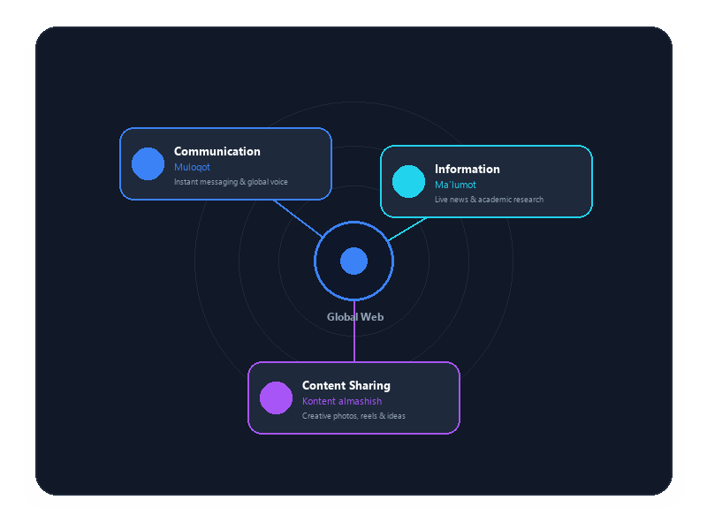
UNIVERSITY PRESENTATION (EN / UZ) • SLIDE 02 OF 09
What Are Social Networks?
Ijtimoiy tarmoqlar nima?
Social networks are online platforms where people can communicate, share information and create content. They have become an important part of modern life.
Ijtimoiy tarmoqlar — odamlar muloqot qilishi, ma’lumot almashishi va kontent yaratishi mumkin bo‘lgan onlayn platformalardir. Ular zamonaviy hayotning muhim qismiga aylandi.
1. Communication
Muloqot — connecting instantly with friends and family
2. Information
Ma’lumot — accessing news, updates and global awareness
3. Content sharing
Kontent almashish — publishing creative photos, videos and ideas
Notes:
🗣️ English Speech (Say this):
First, what are social networks? They are websites and apps where people connect, share information, and post content. Today, they are an important part of our daily life.
🇺🇿 O‘zbekcha matn:
Avvalo, ijtimoiy tarmoqlar nima? Bu odamlar muloqot qiladigan, ma’lumot va kontent ulashadigan saytlar hamda ilovalardir. Bugun ular kundalik hayotimizning muhim qismiga aylandi.

Slide 3
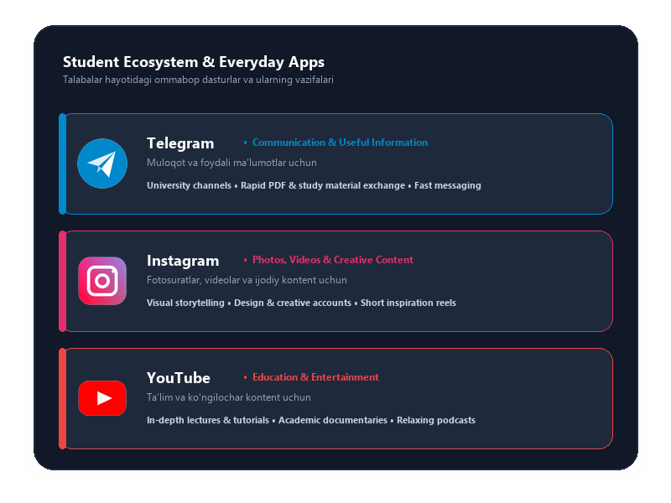
UNIVERSITY PRESENTATION (EN / UZ) • SLIDE 03 OF 09
Social Networks I Use
Men foydalanadigan ijtimoiy tarmoqlar
POPULAR STUDENT PLATFORMS
Students commonly rely on several established platforms for their daily routines, studies, and creative expression.
Talabalar o‘zlarining kundalik faoliyati, ta’limi va ijodiy intilishlarida bir nechta asosiy platformalardan foydalanadilar.
• Telegram — communication and useful information
muloqot va foydali ma’lumotlar uchun
• Instagram — photos, videos and creative content
fotosuratlar, videolar va ijodiy kontent uchun
• YouTube — education and entertainment
ta’lim va ko‘ngilochar kontent uchun
Notes:
🗣️ English Speech (Say this):
Here are the main apps I use: First, Telegram — for quick messaging and study groups. Second, Instagram — for photos and creative reels. And third, YouTube — for learning video tutorials and relaxing.
🇺🇿 O‘zbekcha matn:
Men eng ko‘p foydalanadigan ilovalar: Birinchidan, Telegram — tezkor xabarlar va o‘quv guruhlari uchun. Ikkinchidan, Instagram — rasmlar va qiziqarli videolar uchun. Uchinchidan, YouTube — darslar o‘rganish va hordiq chiqarish uchun.

Slide 4
UNIVERSITY PRESENTATION (EN / UZ) • SLIDE 04 OF 09
Why Do I Use Social Networks?
Nega ijtimoiy tarmoqlardan foydalanaman?
I use social networks for several reasons. They help me communicate with other people, find useful information, learn new things and relax in my free time.
Men ijtimoiy tarmoqlardan bir nechta sabablar tufayli foydalanaman. Ular menga boshqa odamlar bilan muloqot qilish, foydali ma’lumot topish, yangi narsalarni o‘rganish va bo‘sh vaqtimda dam olishga yordam beradi.
01
Communication
Muloqot
Staying connected with friends, family, and classmates seamlessly.
Do‘stlar, oila va kursdoshlar bilan oson va yaqin aloqada bo‘lish.
02
Information
Ma’lumot
Discovering news, campus updates, and global affairs.
Yangiliklar, universitet xabarlari va jahon voqealarini bilib borish.
03
Learning
O‘rganish
Acquiring practical skills, foreign languages, and study advice.
Amaliy ko‘nikmalar, chet tillari va o‘quv maslahatlarini o‘zlashtirish.
04
Entertainment
Ko‘ngilochar
Listening to favorite music, watching videos, and resting peacefully.
Sevimli musiqa tinglash, videolar ko‘rish va maroqli dam olish.
Notes:
🗣️ English Speech (Say this):
Why do I use social networks? There are four main reasons: to stay in touch with friends, to read latest news, to learn new skills, and to relax after my studies.
🇺🇿 O‘zbekcha matn:
Nega ijtimoiy tarmoqlardan foydalanaman? To‘rtta asosiy sabab bor: do‘stlar bilan aloqada bo‘lish, yangiliklarni bilish, yangi narsalarni o‘rganish va darslardan keyin dam olish.

Slide 5
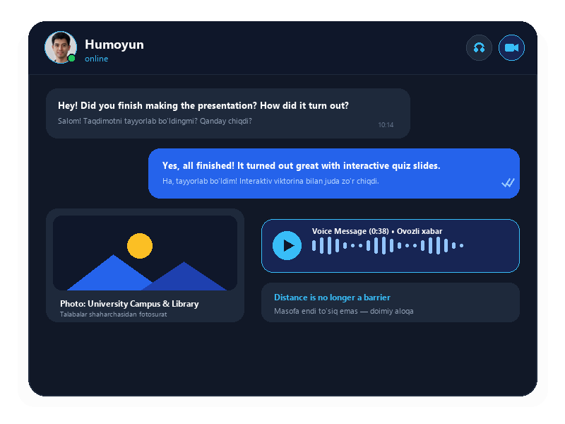
UNIVERSITY PRESENTATION (EN / UZ) • SLIDE 05 OF 09
Communication with People
Odamlar bilan muloqot
CORE STORY • SPEED & ACCESSIBILITY
Social networks make communication faster and easier. I can send messages, share photos and talk to friends and family even when they are far away.
Ijtimoiy tarmoqlar muloqotni tezroq va osonroq qiladi. Men do‘stlarim va oilam uzoqda bo‘lsa ham, xabar yuborishim, fotosurat ulashishim va ular bilan suhbatlashishim mumkin.
✔ Instant Connection Across Borders
Chegarasiz tezkor aloqa
✔ Sharing Daily Moments & Photos
Kundalik muhim lahzalarni ulashish
✔ Face-to-Face Video Conversations
Yuzma-yuz bevosita video muloqot
Notes:
🗣️ English Speech (Say this):
Let's look at communication. Social networks make talking to people very fast and easy. Even if our friends live far away, we can send messages, photos, and make video calls in seconds.
🇺🇿 O‘zbekcha matn:
Muloqot haqida gapiradigan bo‘lsak, ijtimoiy tarmoqlar uni juda tez va oson qildi. Do‘stlarimiz uzoqda bo‘lsa ham, bir necha soniyada xabar yozishimiz, rasm yuborishimiz va video qo‘ng‘iroq qilishimiz mumkin.

Slide 6
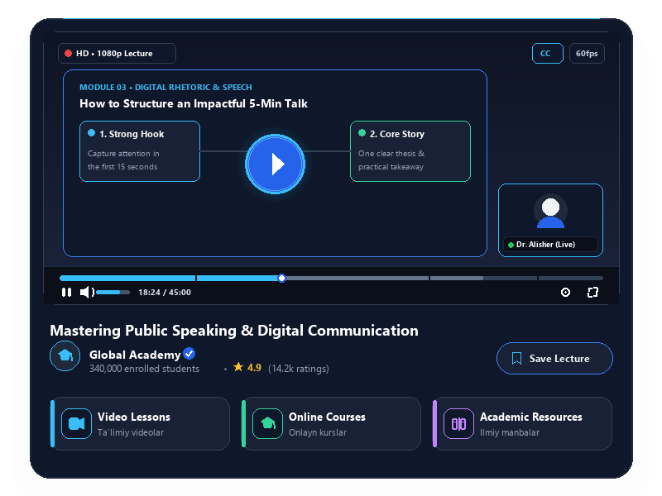
UNIVERSITY PRESENTATION (EN / UZ) • SLIDE 06 OF 09
Learning and Education
O‘rganish va ta’lim
ACADEMIC & DIGITAL LEARNING
Social networks can also be useful for education. I can watch educational videos, follow useful channels and find new information about different topics.
Ijtimoiy tarmoqlar ta’lim uchun ham foydali bo‘lishi mumkin. Men ta’limiy videolar ko‘rishim, foydali kanallarni kuzatishim va turli mavzular haqida yangi ma’lumot topishim mumkin.
• Video lessons
video darslar
• Online courses
onlayn kurslar
• Educational channels
ta’limiy kanallar
• Useful information
foydali ma’lumotlar
Notes:
🗣️ English Speech (Say this):
Next is education. Social networks are not just for fun — they are great for studying. We can watch free video lessons, learn English, and share study materials with classmates.
🇺🇿 O‘zbekcha matn:
Keyingisi — ta’lim. Ijtimoiy tarmoqlar faqat o‘yin-kulgi uchun emas, balki o‘qish uchun ham juda foydali. Biz bepul video darslarni ko‘rishimiz, ingliz tilini o‘rganishimiz va kursdoshlar bilan materiallar almashishimiz mumkin.

Slide 7
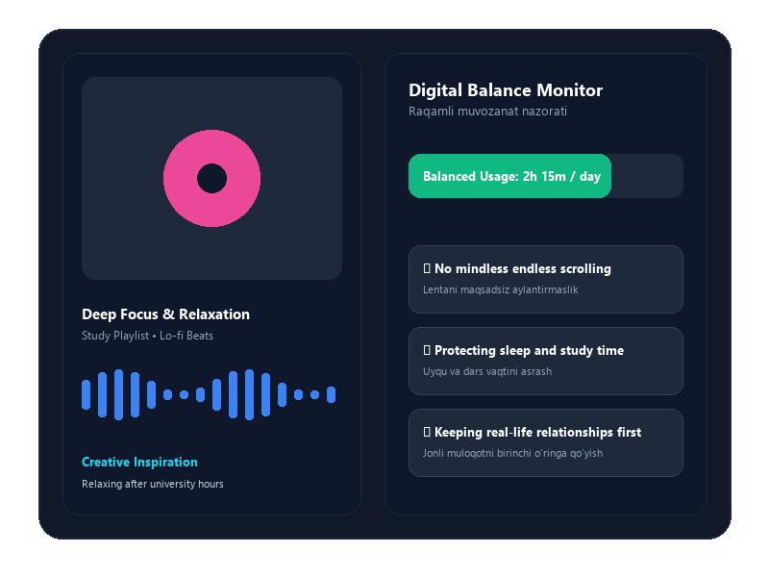
UNIVERSITY PRESENTATION (EN / UZ) • SLIDE 07 OF 09
Entertainment and Free Time
Ko‘ngilochar va bo‘sh vaqt
RECREATION & DIGITAL WELLBEING
Social networks are also a way to relax. I can watch videos, listen to music, see interesting content and discover new ideas. However, I try not to spend too much time online.
Ijtimoiy tarmoqlar dam olish usuli hamdir. Men videolar ko‘rishim, musiqa tinglashim, qiziqarli kontent tomosha qilishim va yangi g‘oyalarni kashf qilishim mumkin. Biroq internetda juda ko‘p vaqt sarflamaslikka harakat qilaman.
✔ Relaxation & Music
Dam olish va musiqa
✔ Inspiration & Ideas
Ilhom va yangi g‘oyalar
✔ Healthy Screen Limits
Sog‘lom ekran vaqti me’yori
Notes:
🗣️ English Speech (Say this):
Now about entertainment. In our free time, we listen to music and watch interesting videos to rest. But it is important to control our screen time and not scroll for too many hours.
🇺🇿 O‘zbekcha matn:
Endi esa dam olish haqida. Bo‘sh vaqtimizda hordiq chiqarish uchun musiqa tinglaymiz va videolar ko‘ramiz. Ammo me’yorni bilish va internetda soatlab vaqt yo‘qotmaslik muhim.

Slide 8
UNIVERSITY PRESENTATION (EN / UZ) • SLIDE 08 OF 09
Advantages and Disadvantages
Afzalliklari va kamchiliklari
ADVANTAGES
AFZALLIKLARI
✔ Easy communication
Oson muloqot
✔ Quick access to information
Ma’lumotga tezkor kirish
✔ Educational opportunities
Ta’lim imkoniyatlari
✔ Entertainment
Ko‘ngilochar imkoniyatlar
DISADVANTAGES
KAMCHILIKLARI
✖ Too much screen time
Ekran qarshisida ortiqcha vaqt
✖ Distraction
Diqqatni chalg‘itishi
✖ False information
Noto‘g‘ri ma’lumotlar
✖ Privacy problems
Maxfiylik muammolari
Notes:
🗣️ English Speech (Say this):
Let's compare the pros and cons. The advantages are: easy communication, quick access to information, education, and entertainment. The disadvantages are: too much screen time, distraction, false information, and privacy problems.
🇺🇿 O‘zbekcha matn:
Afzalliklari va kamchiliklarini solishtiraylik. Afzalliklari — oson muloqot, ma’lumotga tez kirish, ta’lim va ko‘ngilochar imkoniyatlar. Kamchiliklari — ekran qarshisida ortiqcha vaqt, diqqatning chalg‘ishi, noto‘g‘ri ma’lumotlar va maxfiylik muammolari.

Slide 9
FINAL THOUGHTS • SLIDE 09 OF 09
“Social networks are useful when we use them wisely.”
“Ijtimoiy tarmoqlardan oqilona foydalansak, ular foydali vositaga aylanishi mumkin.”
Social networks are an important part of modern life. They help me communicate, learn and relax. However, I believe it is important to use them responsibly and keep a healthy balance between online and real life.
Ijtimoiy tarmoqlar zamonaviy hayotning muhim qismidir. Ular menga muloqot qilish, o‘rganish va dam olishga yordam beradi. Biroq ulardan mas’uliyat bilan foydalanish va onlayn hamda real hayot o‘rtasida sog‘lom muvozanatni saqlash muhim deb hisoblayman.
Thank you for your attention!
E’tiboringiz uchun rahmat!
Notes:
🗣️ English Speech (Say this):
To conclude: social networks are powerful tools if we use them wisely. They help us connect, learn, and relax. The key is to keep a healthy balance between our screens and real life. Thank you for your attention!
🇺🇿 O‘zbekcha matn:
Xulosa qilib aytganda: ijtimoiy tarmoqlar to‘g‘ri foydalanilsa, katta foyda keltiradi. Ular muloqot qilish, o‘rganish va dam olishga yordam beradi. Eng asosiysi — virtual olam va real hayot o‘rtasida muvozanatni saqlashdir. E’tiboringiz uchun rahmat!

