Slide 1

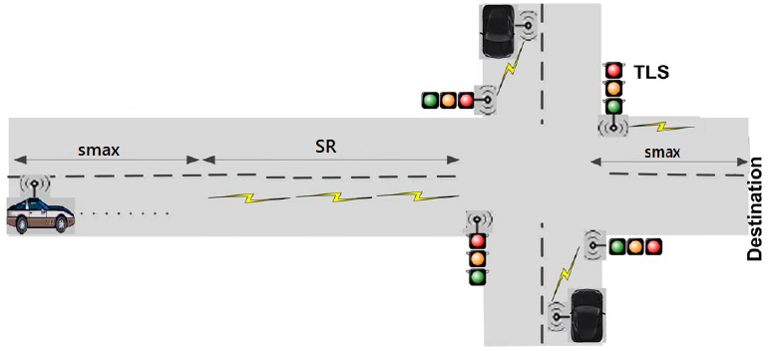
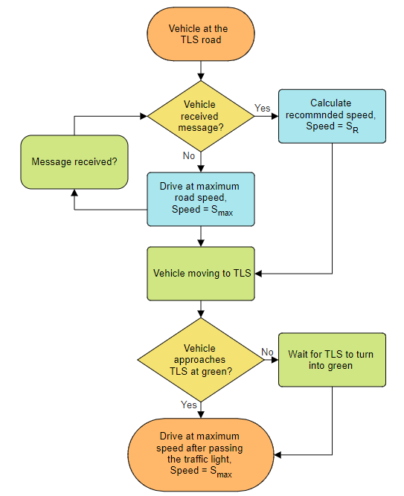
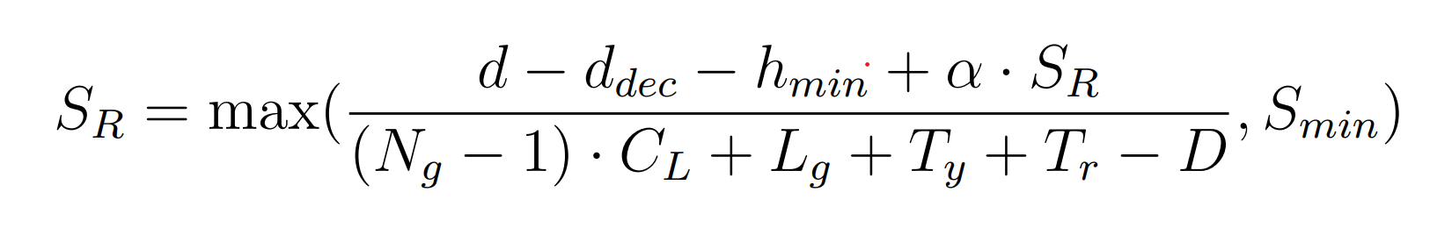
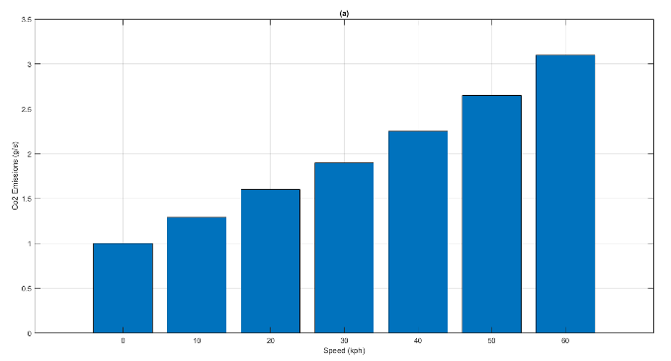
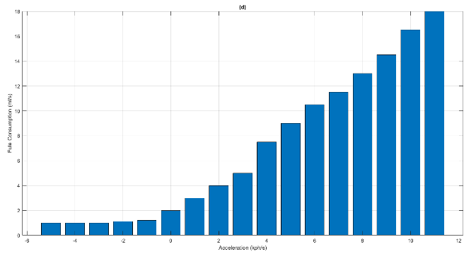
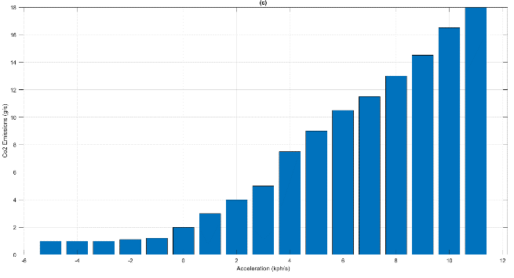
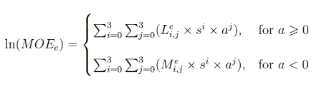
King Saud University
College of Computer and Information Science
Department of Computer Engineering
Design an Eco-friendly and Intelligent Traffic Intersection
Supervised by: Dr. Mazin Alsabaan
Done by: ( Abdulaziz Alfaleh, Yazeed Alomar)
Abstract
System Overview
The volatile world economy has greatly affected fuel prices, while pollution and gas emissions are increasing to negatively impact global warming.
Rising fuel costs have made drivers more concerned about how much of their monthly budgets are allocated for gasoline. In terms of the air pollution problem, greenhouse gas (GHG) emissions from vehicles are considered to be one of the main contributing sources.
Carbon dioxide (CO2) is the largest component of GHG emissions. As a result, it is important to develop and implement effective strategies to reduce fuel expenditure and prevent the expected increase of CO2 emission from vehicles
Objectives
Figure 2: Traffic light communicate with approaching vehicles
This project's objective is to design a vehicular network communication system that aims to reduce fuel consumption caused by vehicles. The system will allow traffic light signal (TLS) to communicate with approaching vehicles and inform them about the intersection status. Based on this information, the vehicle will calculate the recommended speed (S_{R}) that causes less environmental damage and reduces carbon emissions and fuel consumption
Statistics
Road transport accounts for about a fifth of EU emissions. CO₂ emissions from passenger transport varies significantly depending on the transport mode. Passenger cars are a major polluter, accounting for 61% of total CO₂ emissions from EU road transport
Calculations
The effect of speed and acceleration on vehicle fuel consumption and CO2 emissions can be investigated by using a fuel consumption and emission model. In this project, we use the VT-Micro model to estimate the CO2 emission and fuel consumption based on vehicle speed and acceleration
VT-Micro is a statistical model developed based on testing data. These data include fuel consumption and emission rate measurements as a function of the vehicle’s instantaneous speed and acceleration levels. Therefore, the input variables of this model are the vehicle’s instantaneous speed and acceleration
Figure3: System flow chart
System Equations
Calculate Recommended Speed (S_{R})
S_{R}: Recommended Speed , S_{min}: Minimum speed limit (km/h)
d: Distance between the vehicle and the TLS after receiving the message
d_{dec}: Distance traveled during the deceleration from S_{max} to S_{R}
h_{min}: The minimum space headway or the deceleration distance
α: Time the vehicle has to comfortably decelerate from S_{max} to S_{R}
N_{g}: The number of light cycles completed before the vehicle can pass the TLS
C_{L}: TLS cycle length (s(. L_{g}: Time remaining to switch from green to yellow
T_{y}: Full yellow phase time (s). T_{r}: Full red phase time (s)
D: Packet delay (s), which is defined as the difference of the time of receiving the packet and the time of initiating the packet from the TLS
VT-Micro Model
ln(y):
Natural logarithm function of y, where y is a real number;
s: Instantaneous vehicle speed (km/h);
a: Instantaneous vehicle acceleration (km/h/s);
MOEe:
Instantaneous fuel consumption or emission rate (L/s or mg/s);
e: An index denoting fuel consumption or emission type, such as CO₂, HC, and NOx emissions. e is not an exponential
Figure 1: The impact of speed and acceleration on vehicle fuel consumption and CO2 emissions

