Slide 1

2-dars
Stack va Queue.
Dunder metodlar

Slide 2

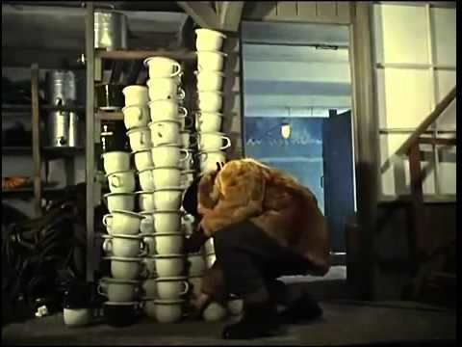
Stack (LIFO) data structure
Last in, first out

Slide 3
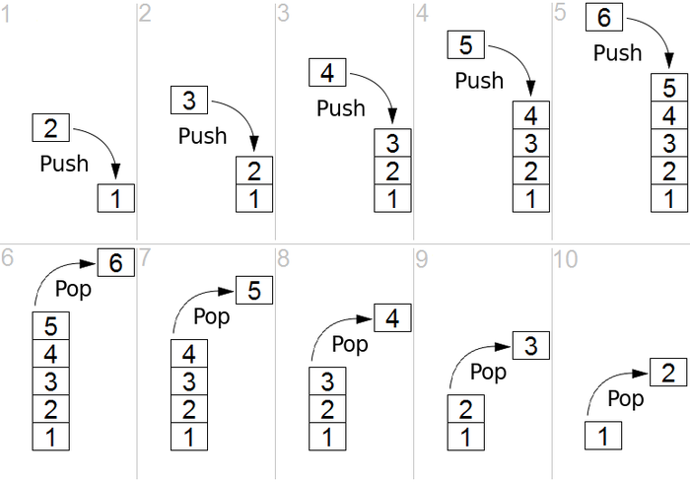
Stack (LIFO)
Push – oxiriga element qo’shadi
Pop – oxiridan element o’chiradi

Slide 4
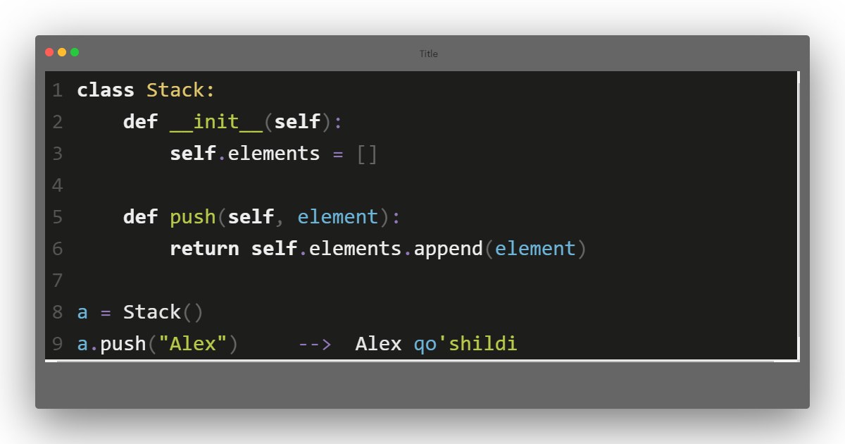
Stack (LIFO)
obyekt oldik

Slide 5
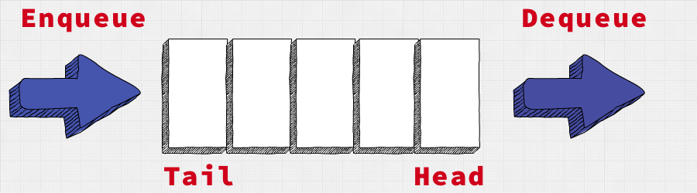
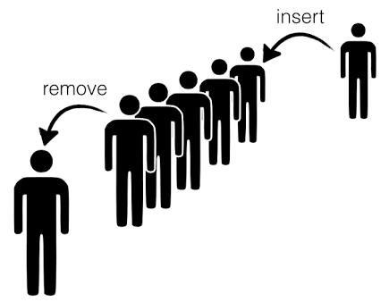
Queue (FIFO)
First in, first out

Slide 6
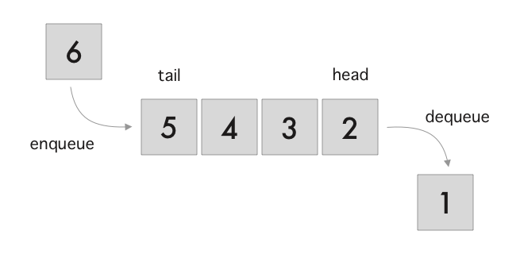
Queue (FIFO)
deque – boshidan element o’chiradi
enque – oxiriga element qo’shadi

Slide 7
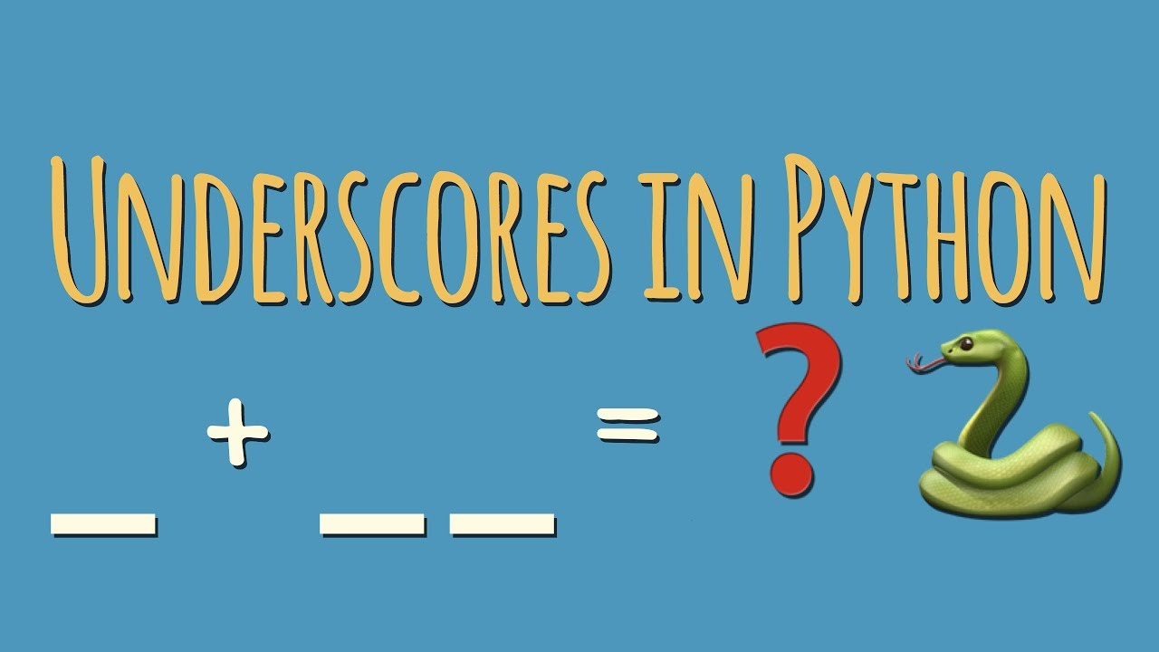
Dunder yoki “sehrli” metodlar

Slide 8

Dunder yoki “sehrli” metodlar
__init__
__str__
__repr__
__delitem__
__eq__
__getitem__
__add__

Slide 9
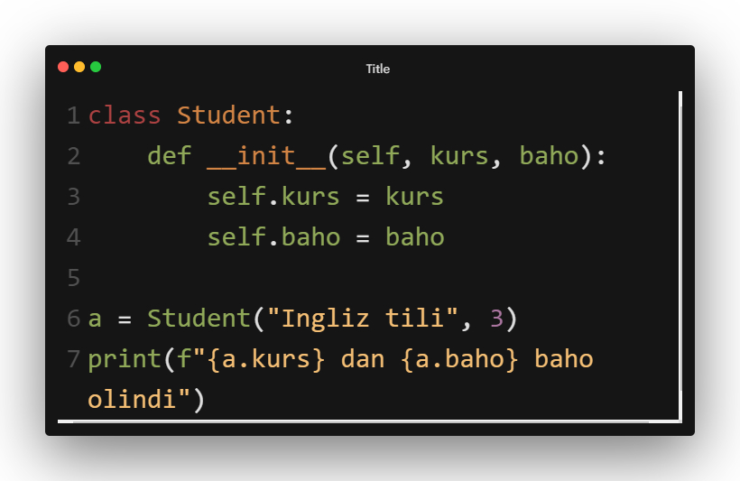

Dunder yoki “sehrli” metodlar

Slide 10
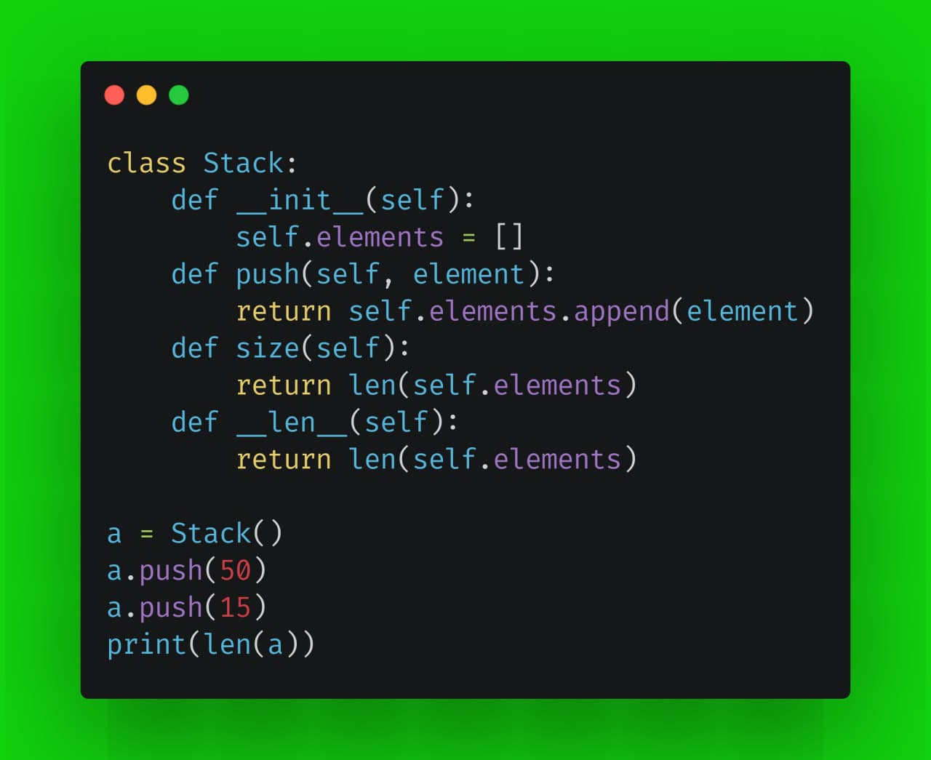

Slide 11
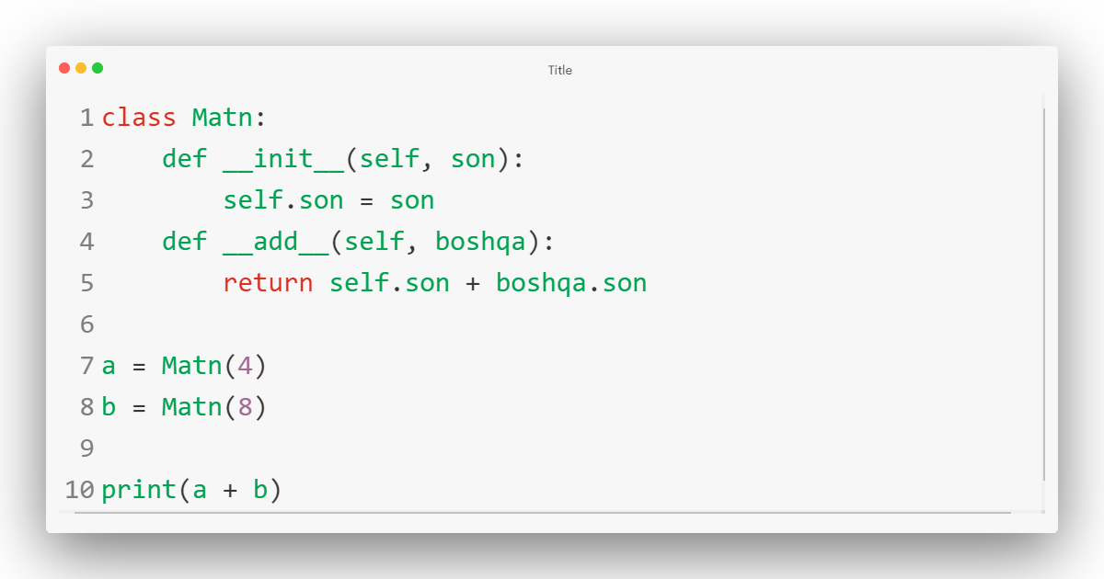
Dunder metodlar
__add__ orqali 2ta obyektni qo’sha oldik

Slide 12
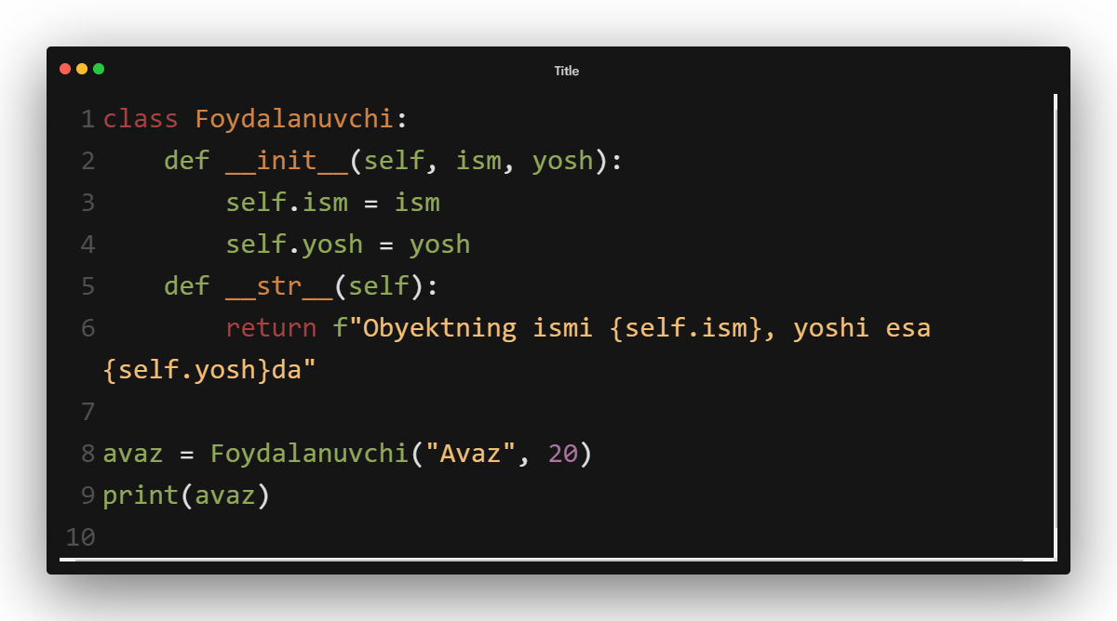
Dunder metodlar

Slide 13

Dunder metodlar, “sehrli” emas

Slide 14
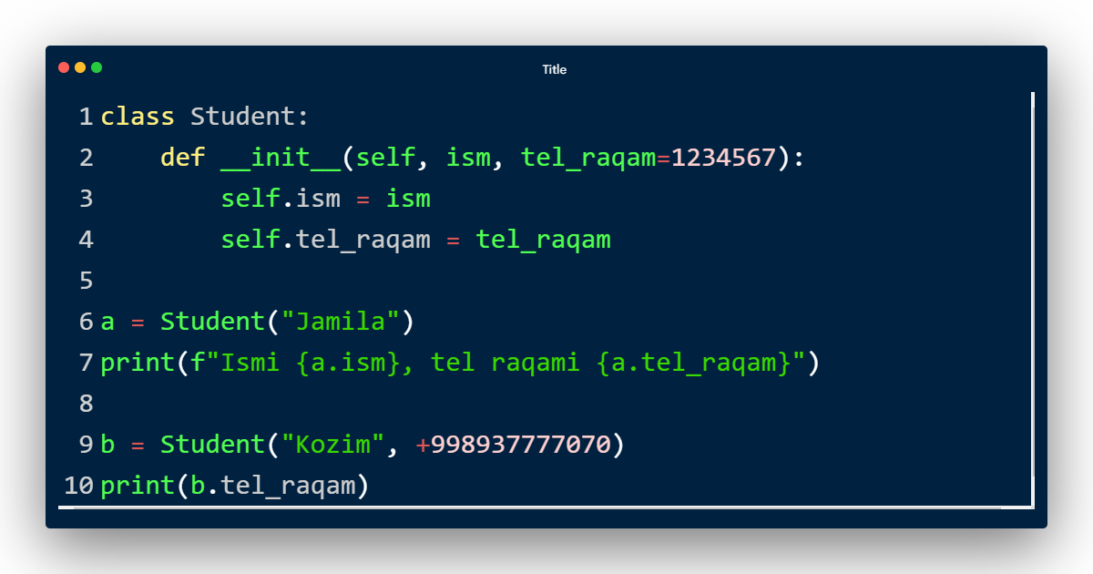
Default qiymat

Slide 15


