Slide 1

Ruhana AI
The AI Video Agent
for Customer Success.
Product deck
Notes:
Ruhana AI positioning: a website-native video agent for sales and customer support.
The cover follows the supplied Cervana composition while using original Ruhana artwork and branding.

Slide 2
Problem
01
Businesses lose $3.8T in sales to poor customer experiences, while digital visitors leave without help.
02
Generic chatbots answer FAQs but cannot read the page, product or buying intent shaping each visit.
03
Visitors abandon slow, repetitive support before they reach a useful answer or a qualified human.
04
Teams connect separate avatar, voice, model and analytics tools, adding weeks of technical setup.
05
Financial and public teams need private deployment, retention controls and a clear path to people.
06
Conversation counts show activity, but not which agent changed revenue, resolution or conversion.
Notes:
Qualtrics estimated $3.8 trillion in global sales at risk from poor customer experiences in 2025: https://www.qualtrics.com/articles/customer-experience/trillion-sales-at-risk-2025/
Capgemini reports that 55% of consumers would leave a brand after poor service and 71% prefer human agents for empathy: https://www.capgemini.com/wp-content/uploads/2025/03/Final-Web-Version-Report-Customer-Service-Transformation.pdf
No universal conversion uplift is claimed.

Slide 3
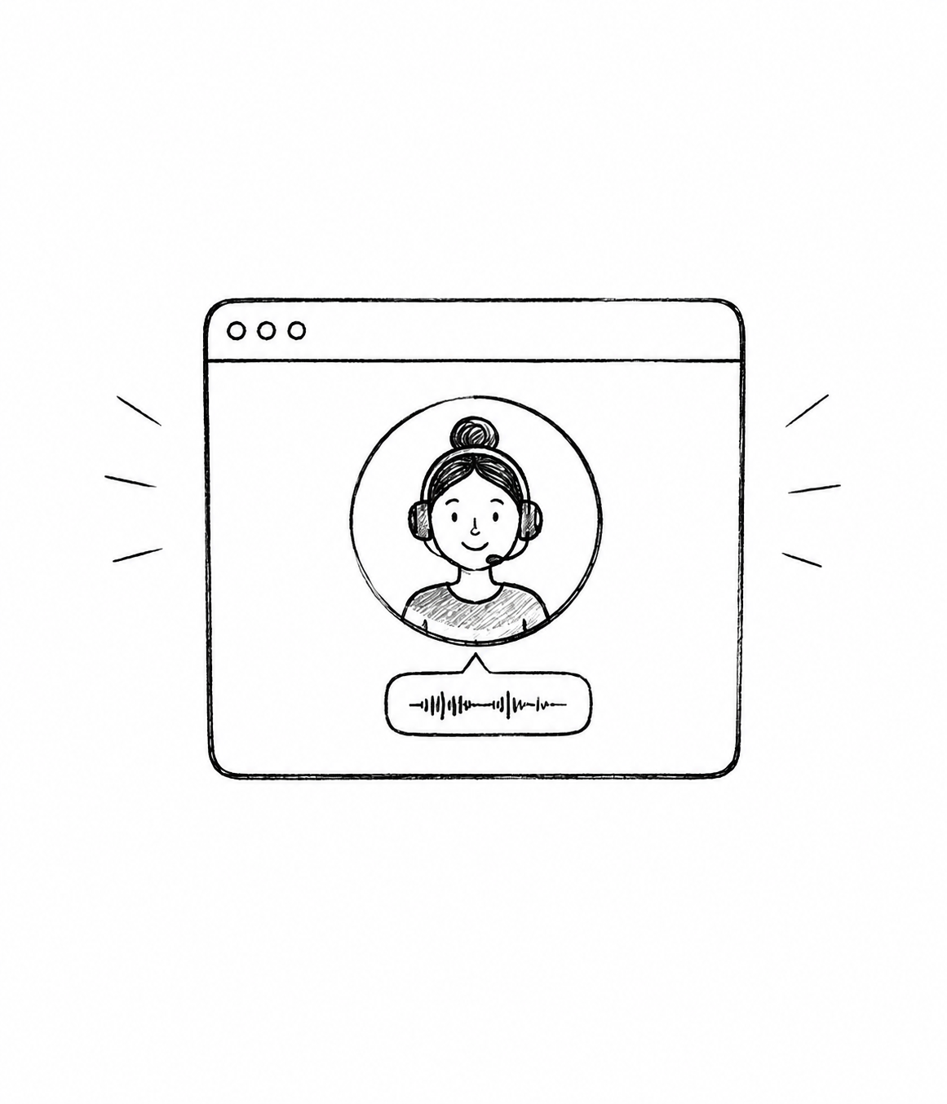
Solution
Ruhana is a complete video agent for websites, built with voice, context, actions and analytics. No developer required.
1
Answers in real time
3
Moves work forward
5
Hands off cleanly
Sales and support by voice or text.
Qualifies, recommends, books and completes approved actions.
Concurrent multilingual sessions retain full context.
2
Understands the visit
4
Deploys simply
Reads the page, product and visitor journey.
One website snippet connects the existing stack.
Notes:
Capabilities reflect the product architecture and intended deployment experience.
The solution artwork is original, generated for Ruhana, and not copied from a competitor.

Slide 4

Why Now
1
Real-time video models now feel natural enough for live sales and support.
2
Voice models deliver low-latency speech across the languages buyers already use.
3
Website context supplies the product and journey details generic chatbots miss.
4
Buyers increasingly expect immediate conversational help before deciding or leaving.
5
Outcome analytics can connect each conversation to revenue, resolution or conversion.
Notes:
The timing argument is based on recent improvements in real-time video, voice and language models.
The business claim is directional and intentionally avoids a fabricated uplift percentage.

Slide 5
Market Size
TAM
$41.4B
SAM
Global conversational AI by 2030
SOM
$10.4M
1% of SAM in five years
$1.04B
Avatar-led customer service by 2030
Notes:
Grand View Research estimates the avatar-based online customer-service market at $267.9M in 2025 and $2.3728B in 2033, a 31.2% CAGR: https://www.grandviewresearch.com/horizon/statistics/ai-avatar-market/application/avatar-based-online-customer-service/global
Grand View Research estimates the conversational AI market at $41.39B by 2030: https://www.prnewswire.com/news-releases/conversational-ai-market-to-be-worth-41-39-billion-by-2030-at-cagr-23-7---grand-view-research-inc-302452404.html
SAM is the 2030 interpolation of the cited avatar customer-service market. SOM is an illustrative 1% objective, not a forecast.

Slide 6

Target Market
Warm interests
E-commerce
Website-first teams where every missed conversation means lost revenue, unresolved support or a customer leaving without confidence.
SaaS & support
RUHANA
Hospitality
Finance
Healthcare
Notes:
Target segments are an initial go-to-market focus, not claimed customers.
Regulated deployment is positioned as an enterprise pathway subject to implementation and contractual confirmation.

Slide 7
Competitive Landscape
Open gaps
Competitors
Limited page intent
Actions need engineering
Usage metrics, not outcomes
Anam
LemonSlice
Tavus
Their focus
Real-time avatars
Persona creation
Developer infrastructure
Ruhana advantage
Website context
Sales and support actions
Outcome analytics
Notes:
Competitor framing is based on public product positioning and pricing pages reviewed in September 2026.
Anam: https://anam.ai/ and https://anam.ai/pricing
LemonSlice: https://lemonslice.com/
Tavus: https://www.tavus.io/
The slide describes product focus, not a claim that competitors cannot add similar capabilities.

Slide 8
Product
Website event
Page + visitor context
Live video conversation
Approved action
Outcome recorded
01
02
03
04
05
Embed layer
Context layer
Agent layer
Integration layer
Analytics layer
Notes:
The five native stages summarize Ruhana's website-to-outcome architecture.
The diagram is intentionally simple and editable.

Slide 9

Business Model
Monthly subscription
One-time setup
Launch $39
Growth $129
Scale $349
Enterprise $999+
$250+
Private deployment
or custom integration
Minutes included
Overage only when used
No free tier
Notes:
Recommended business model: paid subscriptions plus optional setup or private-deployment work.
Prices are product recommendations, not current revenue.

Slide 10
Plans & Pricing
Launch
Growth
Scale
Enterprise
$39
$129
$349
$999+
100 min / month
400 min / month
1,200 min / month
3,500+ min / month
— 1 agent
— 1 website
— Transcripts
— Outcome analytics
— 3 agents
— 3 websites
— Integrations
— Journey funnels
— Priority support
— 10 agents
— 10 websites
— Webhooks
— Revenue attribution
— Launch review
— Custom capacity
— Private deployment
— SSO + SLA
— Success engineering
$0.32 / extra min
$0.29 / extra min
$0.27 / extra min
From $0.26 / extra min
Notes:
Pricing is a recommended launch structure and has not been presented as historical sales.
Modeled pooled production cost is $0.13 per connected minute.
At full included usage, modeled gross margins are approximately 66.7%, 59.7%, 55.3% and 54.5%.
OpenAI GPT-5.6 Terra pricing used in the model is $2/M input tokens, $0.20/M cached input and $12/M output: https://developers.openai.com/api/docs/models/gpt-5.6-terra
Competitive context: https://anam.ai/pricing

Slide 11
Projected Financials
Metric | Q1 | Q2 | Q3 | Q4 | Year 1
New customers | 12 | 23 | 40 | 55 | 130
Total active | 12 | 35 | 75 | 130 | 130
SUBSCRIPTION REVENUE | $2.0k | $7.0k | $18.0k | $36.0k | $63.0k
Setup and services | $1.0k | $2.0k | $3.0k | $4.0k | $10.0k
Total revenue | $3.0k | $9.0k | $21.0k | $40.0k | $73.0k
Variable cost | $1.5k | $4.0k | $9.4k | $18.0k | $32.9k
Operating spend | $18.0k | $24.0k | $32.0k | $45.0k | $119.0k
Operating result | ($16.5k) | ($19.0k) | ($20.4k) | ($23.0k) | ($78.9k)
Gross margin | 50% | 56% | 55% | 55% | 55%
Illustrative management base case. Not current results.
Notes:
All financial figures are an illustrative one-year management base case, not actual results.
The model assumes a paid-only mix, pooled unit cost near $0.13 per connected minute and gross margin maintained at or above 50%.
Operating spend is illustrative and includes product, engineering, go-to-market and general operations.

Slide 12

Why Ruhana
Will Win
Ruhana adapts across industries while the website keeps each agent specific.
1
Website-first, not generic
2
Execution-led go-to-market
We start from the page, visitor intent and business outcome—not a blank conversation.
We launch with design partners, prove one KPI and expand where the agent works.
3
Brand as trust
4
Compounding product data
A premium human interface sits beside clear controls, handoff and measurable accountability.
Each deployment improves intents, actions and outcome models that generic avatar APIs do not own.
Notes:
The differentiation is Ruhana's product thesis, not a patent or permanent exclusivity claim.
Gartner notes that agents need organizational semantics and context to deliver reliable outcomes: https://www.gartner.com/en/newsroom/press-releases/2026-05-11-gartner-says-lack-of-semantics-causes-inaccurate-artificial-intelligence-agents-and-wasted-spending

Slide 13

Timeline & Traction
Jul 2026
Early Sep
Oct 2026
Q1 2027
Product architecture
Builder + auth
Design partners
Vertical playbook
BUILT
BUILT
PLAN
PLAN
Aug 2026
Late Sep
Nov 2026
Dashboard + analytics
Live widget pilot
First paid deployment
BUILT
NEXT
PLAN
Ongoing: website integrations and enterprise deployment path
Notes:
Built milestones reflect the current repository and public product state.
Pilot, partner and paid-deployment milestones are plans, not completed traction.
Formal dates should be refreshed before external circulation.

Slide 14

Team
AH
H
RA
+
Abdul Hadi Asif
Huzaifa
Rabi Ahmed
Customer Success Lead
Product & Experience
AI & Platform
Analytics Engineering
Next hire
Notes:
Contributor names reflect current repository history and user-provided ownership.
Contribution areas are working labels. Confirm formal titles before external circulation.

