Slide 1
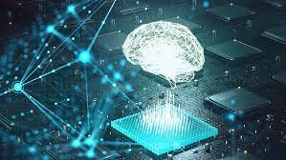



SIGNATURE CLASSIFICATION USING CNN MODEL
PRESENTED BY
UNDER THE SUPERVISION
DR.PRAMOD KUMAR NAIK
ASSOCIATE PROFESSOR
Abdul Hafeez (ENG21CS0004)
Alisha Aric Fernandes (ENG21CS0029)
Bhamini A V (ENG21CS0072)
Dhanvi Bhat (ENG21CS0074)

Slide 2

1 | ABSTRACT
2 | PROBLEM STATEMENT
3 | INTRODUCTION
4 | FUNCTIONAL ,NON-FUNCTIONAL AND SYSTEM REQUIREMENTS
5 | DESIGN
6 | METHODOLODY
7 | CONCLUSION AND REFERENCES
AGENDA

Slide 3
ABSTARCT
A signature of a person is simply a handwritten sign or marks that resembles to his/ her name often stylized and unique and indicates person’s identity.
Traditionally signature was manually compared with copies of genuine signatures for verification. So, in order to tackle such problem new efficient tool is needed .
Our project aims to automate the process of signature classification by using convolutional neural networks which will in turn help to credit the money just by scanning the signature.
03

Slide 4
PROBLEM STATEMENT
PROBLEM:
In terms of security, signature recognition can be considered more secure than face recognition because it is harder to replicate someone's signature than to obtain an image of their face. Signature recognition is safe as it requires the person to physically sign on a document or screen.
SOLUTION:
By using AIML,DeepLearning we try to develop a CNN model with high accuracy to classify the signatures.
Back to Agenda

Slide 5
INTRODUCTION
Initially the dataset has been split into a training set and a testing set, with a 70:30 ratio. This means that 70% of the data has been reserved for training the model, and the remaining 30% of the data will be used for testing the model's performance. To increase the diversity of the dataset we have used data augmentation techniques in which the original data is modified in various ways, such as rotation, flipping, shifting and zooming. The idea is to credit the money to the classified class.This approach can be beneficial for banks and financial institutions as it can reduce the time and effort required for signature verification and credit the amount quickly and securely.Assumption-signatures are distinct and consistent.
Back to Agenda

Slide 6
REQUIREMENTS
FUNCTIONAL | Preprocessing Feature Extraction Classification Amount transaction
NON-FUNCTIONAL | Security Performance Reliability Usability Accuracy
SYSTEM/SOFTWARE | IDE- Google colab Programming Language-Python Libraries-Tensorflow , Keras API

Slide 7
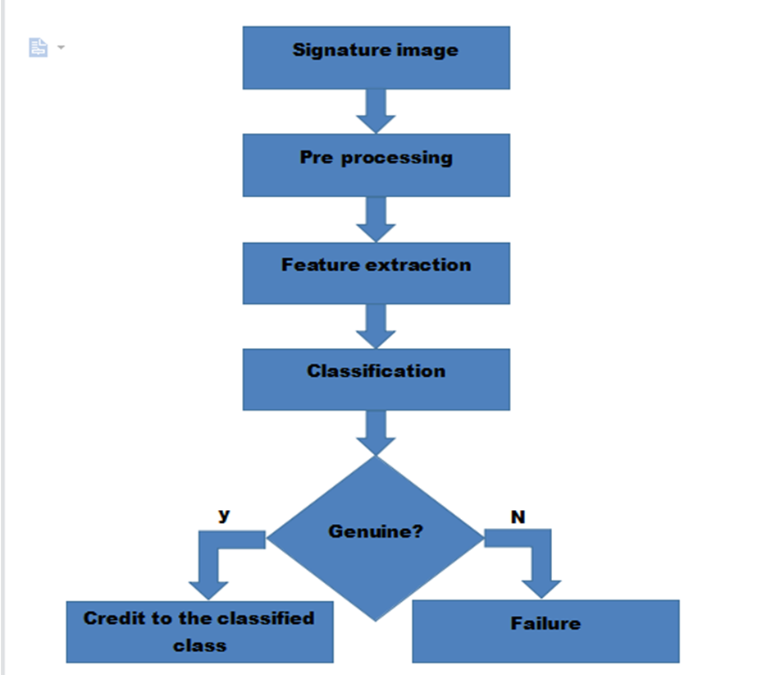
DESIGN

Slide 8
ARCHITECTURE
There are 14 layers which are added sequentially to the model.
Rescaling layer
Random zoom layer
Random rotation layer
Two Conv2D layer
Two MaxPooling2D layer
Batch Normalization layer
Three Dropout layers
Flatten layer
Two Dense layer
Back to Agenda

Slide 9

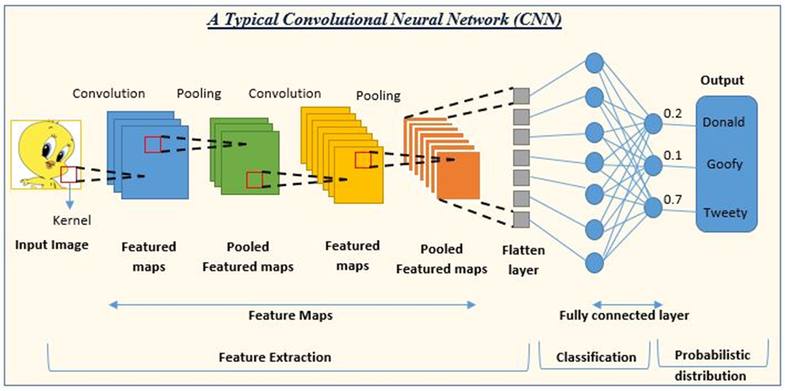
ARCHITECTURE

Slide 10
FILTERING OF AN IMAGE

Slide 11
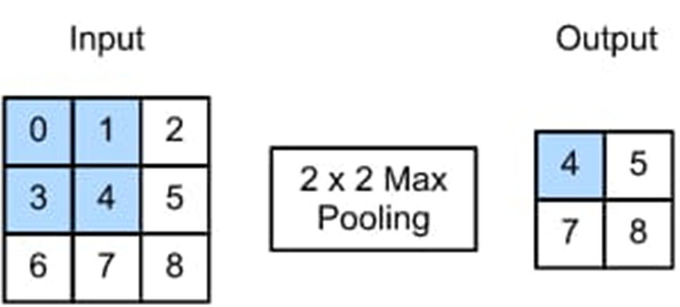
MAX POOLING

Slide 12
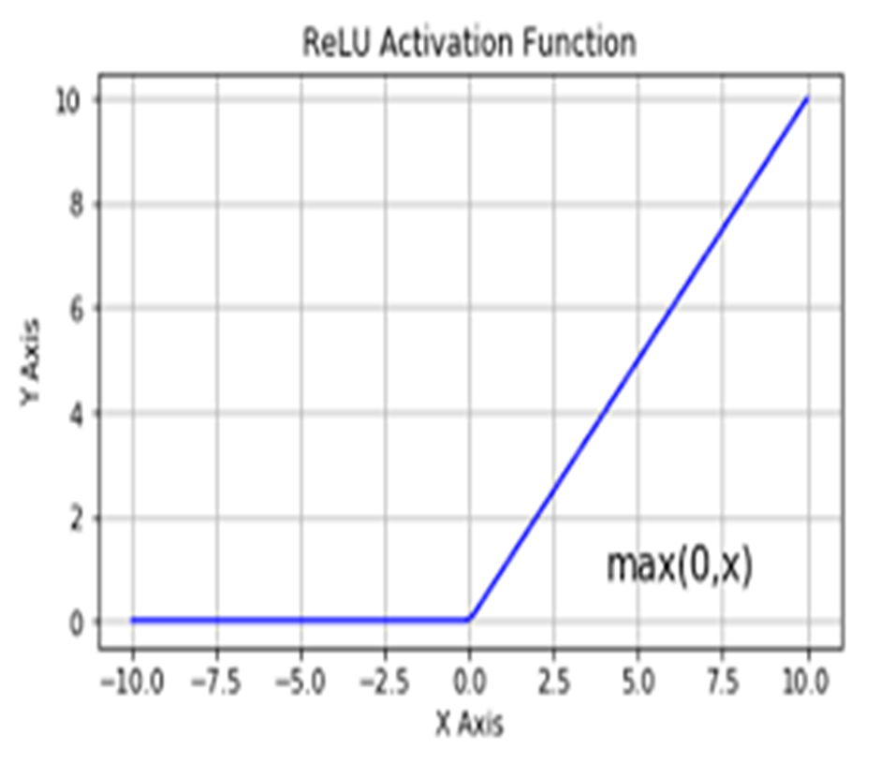
RELU FUNCTION

Slide 13
BRIEF
Rescaling: This layer rescales the input image pixel values to a specified range (usually between 0 and 1) to help improve training.
RandomZoom: This layer randomly zooms into the input image to add more variability to the training data.
RandomRotation: This layer randomly rotates the input image to add more variability to the training data.

Slide 14
Conv2D: This layer applies a 2D convolution operation on the input image to extract features. The layer has 16 filters (or channels) and a kernel size of (3,3).
MaxPooling2D: This layer performs max pooling operation on the output of the previous layer to downsample the feature maps and reduce the dimensionality. The layer uses a pool size of (2,2).

Slide 15
BatchNormalization: This layer normalizes the output of the previous layer to help improve training and reduce overfitting.
Dropout: This layer randomly drops out (disables) a fraction of the neurons to help reduce overfitting.
88 88Conv2D_1: This layer applies another 2D convolution operation on the output of the previous layer to extract more complex features. The layer has 16 filters and a kernel size of (3,3).

Slide 16
MaxPooling2D_1: This layer performs another max pooling operation on the output of the previous layer to further downsample the feature maps. The layer uses a pool size of (2,2).
Dropout_1: This layer randomly drops out a fraction of the neurons again to help reduce overfitting.
Flatten: This layer flattens the output of the previous layer into a 1D vector to feed into the dense layers.

Slide 17
Dense: This layer is a fully connected (dense) layer with 256 neurons that performs a linear operation on the input vector followed by a non-linear activation function (usually ReLU).
Dropout_2: This layer randomly drops out a fraction of the neurons to help reduce overfitting.

Slide 18
Dense_1: This layer is the output layer with 4 neurons (assuming this is a multi-class classification task) that performs a linear operation on the input vector followed by a softmax activation function to output probabilities for each class.

Slide 19
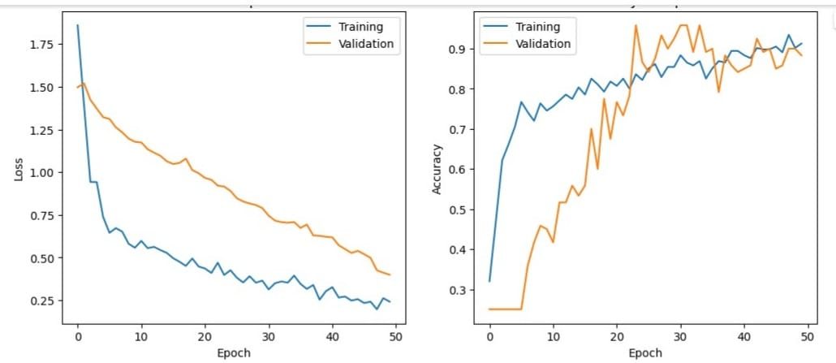
ANALYSIS

Slide 20
METHODOLOGY
Approach : Collect the dataset of signatures for classification purpose. We did this by manually signing on the paper and created 4 folders(class) in Google drive and mounted it using google colab.
Divide the dataset into training and testing set in 70:30 ratio.
Pre-process the dataset and prepare it for classification.
Train a CNN(convulational neural network) model for signature classification.
Evaluate the performance by calculating accuracy.

Slide 21
CONCLUSION
Accuracy
Work Done
Future plan
% of work done
93.33%
CNN model which classifies signatures
money credit by scanning the signature
60%

Slide 22
Literature Review 1
Author’s Name/ Paper Title | Conference Name and year | Technology/ Design | Results shared by author | What you infer
DR.R.Palson Kennedy Nitesh Kumar Vinod Kumar “Human Signature Verification using CNN with tesnsorflow | 2022 IJCRT International Journal Of Creative Research Thoughts | CNN | To identify a genuine or a fake signature | Signature has unique feature and can be classified using the neural technology.

Slide 23
REFRENCES
1.https://www.researchgate.net/publication/220307975_Offline_signature_recognition_using_neural_networks_approach
2.https://www.researchgate.net/publication/351322176_A_Review__Signature_Verification_System_Using_Deep_Learning_A_Challenging_Problem
3.https://www.researchgate.net/publication/360719735_Signature_Verification_Using_Deep_Learning
4.https://www.mdpi.com/1996-1073/15/20/7611
5..https://www.mdpi.com/1886366
.

Slide 24
THANK YOU !!

