Slide 1
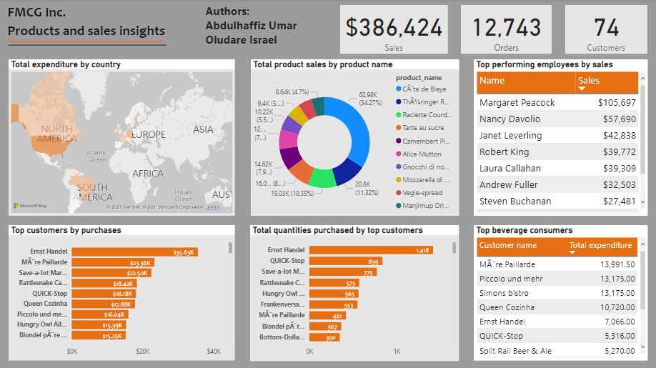

Slide 2
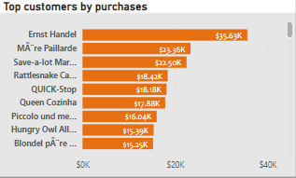
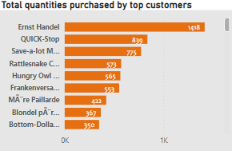
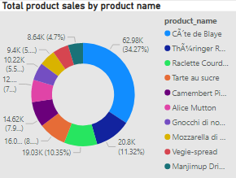
Ernst Handel is the top purchasing customer with $35,631 purchases. He was followed by Mare Paillarde at $23,362 and Save a lot markets at $22,500. The average purchase stood at $5,222.
The total purchase was $386,424 across all products by 74 customers.
Ernst Handel again came top in terms of total number of quantities purchased, with 1418 counts of orders. He was followed this time by Quick stop at 839 and Save a lot market at 775. the total number of orders was 12,743 for the e dataset and the top 10 customers accounted for 43 percent of total orders.
Cate de blaye is the top product in the product pipeline, with a total of $63,976 product sales, accounting for 34.27 percent of overall product sales. The next was ThÃ¼ringer Rostbratwurst
With $20, 796 sales, making up 11 percent of total product sales.
Recommendations
FMGC should consolidate their efforts in USA and Germany as the continent hosts their largest market
There is a significant gap between the most performing employee and the rest of the top performing employees, an insight on what makes Margaret Peacock successful can help scale up the productivity of the rest of the employees.
Product advertisement should be targeted towards Cate de blaye, ThÃ¼ringer Rostbratwurst, and Raclette Courdavault.

