Slide 1
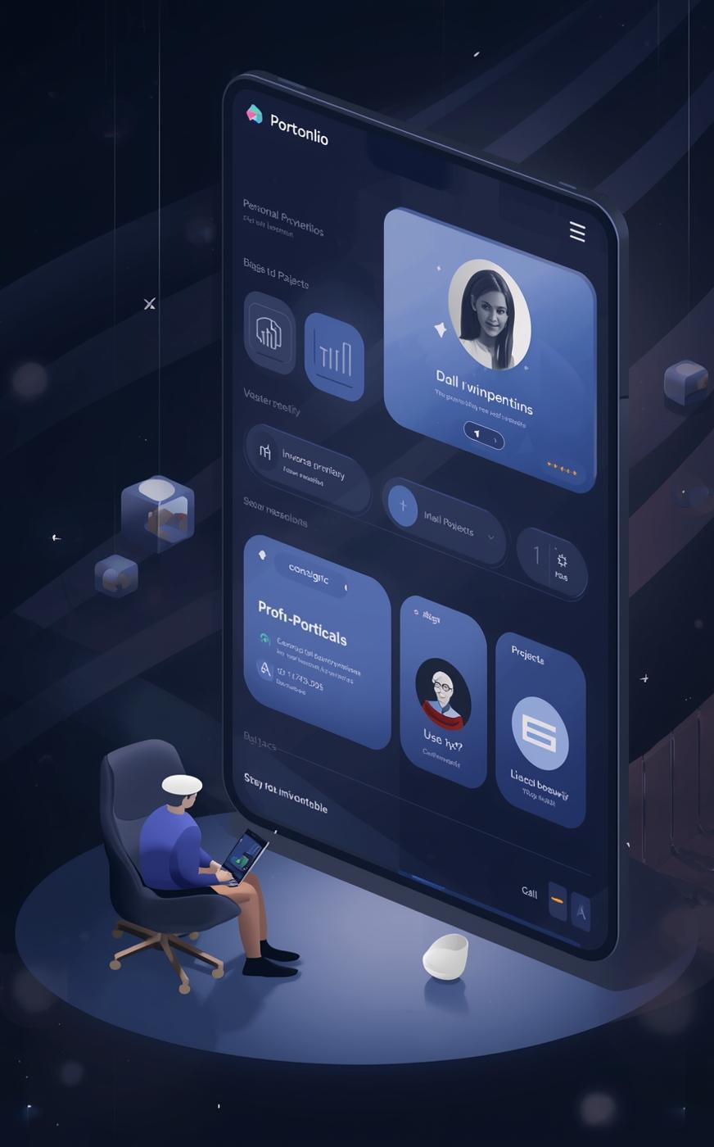

ABDULJALIL ALSHAQAQIQ
Personal Portfolio Web Application
Presented by Abduljalil Alshaqaqiq

Slide 2

Project Overview
Purpose and Rationale
This portfolio web application aims to showcase skills and projects interactively and professionally, targeting recruiters and peers in the industry while offering a polished and responsive experience.

Slide 3
Main Features
Light/Dark Theme
Personalized Greeting
Users can toggle between light and dark themes, with their preference persisted using localStorage for a personalized experience.
The application greets users with a personalized message, remembering their names and session duration to enhance engagement.
Project Search
Live GitHub Feed
Users can efficiently search, filter, and sort projects, allowing for quick access to relevant information tailored to their interests.
The app integrates live data from GitHub repositories, showcasing project updates dynamically to keep users informed of recent changes.
Developer Tips
Contact Form
A random developer tip generator enriches the user experience by providing useful insights and advice during their browsing session.
The contact form features client-side validation and backend submission, ensuring secure and seamless communication between users and the admin.

Slide 4

Technical Architecture Overview
  01
  02
  03
The frontend stack utilizes React, enhanced with Vite for speed.
The backend is built with Express and MongoDB for data management.
Data flows securely through API endpoints for efficient user interaction.

Slide 5
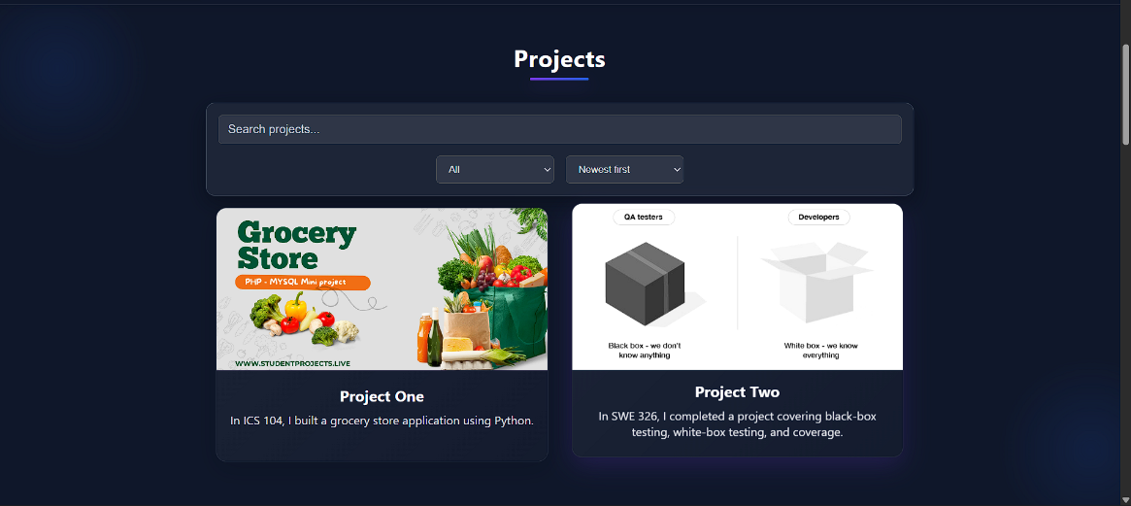

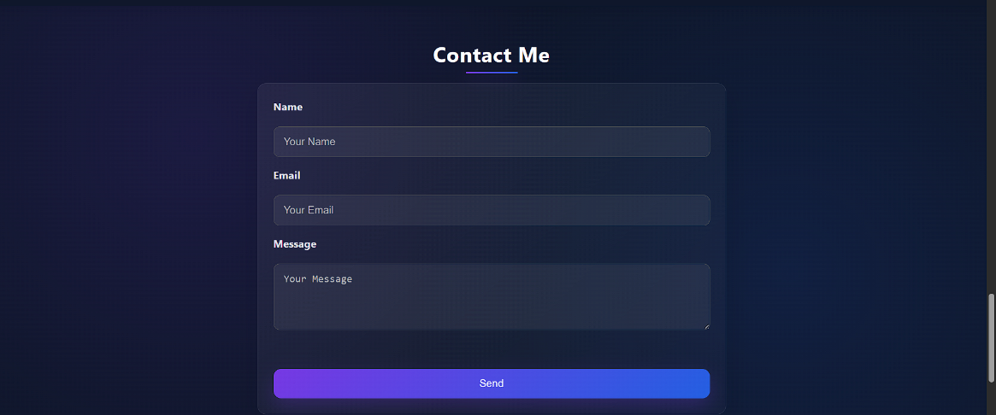
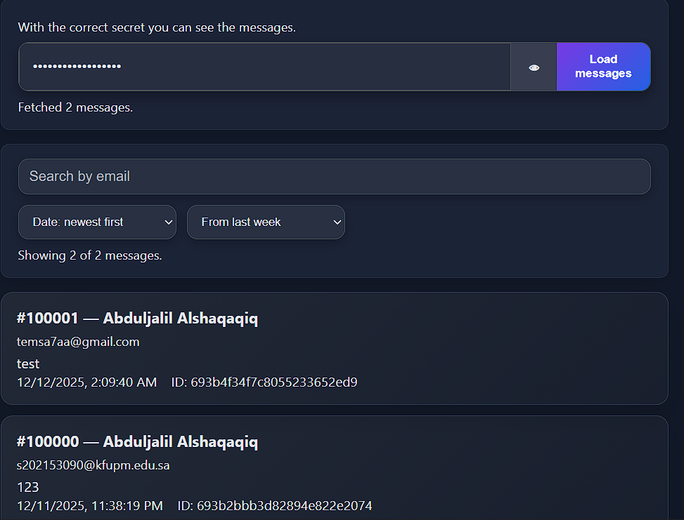
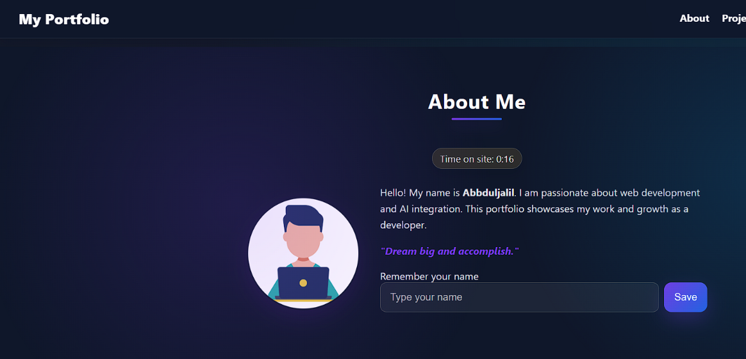
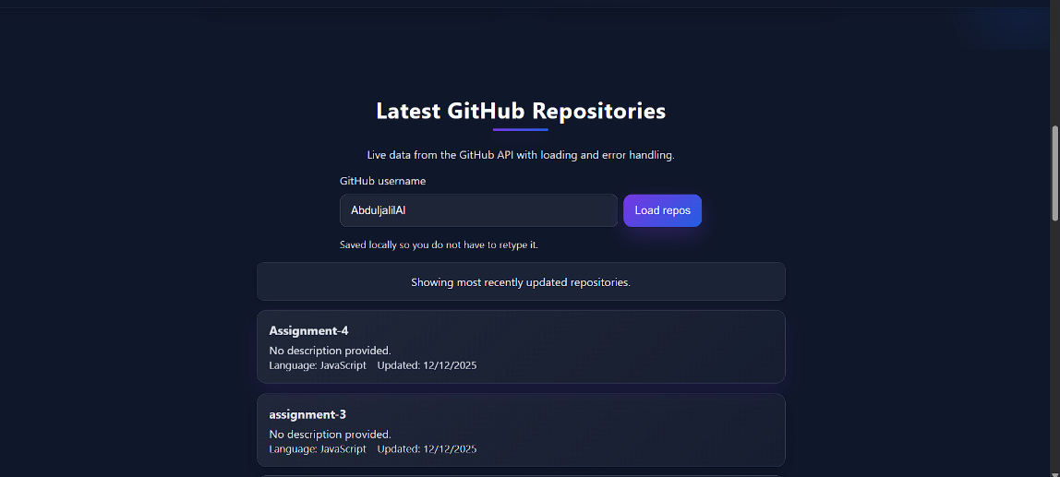
Picture from the web

Slide 6


AI Integration in Development
Enhancing Project with AI
AI ChatGPT for creative support and manual code implementation significantly improved the user experience, ensuring functionality and aesthetics aligned with project goals.

Slide 7
Admin Inbox Deep-Dive
Rationale & Security
The admin inbox was created for secure message management, ensuring only authorized personnel can access sensitive information through a secret header.
In-depth exploration of inbox features and security
Unique Incremental IDs
Unique IDs are generated using a MongoDB Counter model, starting at 100000 to maintain organization and avoid conflicts in message identification.
Filtering Capabilities
Implemented filtering allows admins to search by email or date, making it easier to sort and manage incoming messages efficiently.

Slide 8
Lessons Learned & Future Improvements
Insights and upcoming goals
React State Management
API Error Handling
Gained valuable insights into effective state management practices using React. Implemented hooks for improved component interaction and reactivity, leading to a more robust application structure.
Learned the significance of robust API error handling to enhance user experience. Established comprehensive validation and error messages, ensuring users understand issues and can resolve them efficiently.

Slide 9
Demo Highlights
Theme Toggle
Users can effortlessly switch between light and dark modes, enhancing accessibility and personal preference while maintaining a visually appealing design.
Key features showcased in the portfolio application
Projects Filtering
The application enables users to easily filter and sort projects, allowing for quick access to relevant work and showcasing versatility.
GitHub Feed
A dynamic feed integrates live data from GitHub repositories, presenting the latest updates on projects and contributions directly within the portfolio.

