Slide 1

C++ Presentation
Made by : Abdulkadir Mirza

Slide 2
Basic Terms
Class − A class can be defined as a template/blueprint that describes the behaviors/states that object of its type support.
Object − Objects have states and behaviors.
Methods − A method is basically a behavior. A class can contain many methods.
Instance Variables − Each object has its unique set of instance variables. An object's state is created by the values assigned to these instance variables.

Slide 3
Introduction
C++ is a super set of C programming with additional implementation of object-oriented concepts.
C++ is a compiled, general-purpose, case-sensitive, free-form programming language that supports procedural, object-oriented, and generic programming.
C++ is regarded as a middle-level language, as it comprises a combination of both high-level and low-level language features.

Slide 4
Applications of C++ Programming
Application Software Development,
Programming Languages Development,
Computation Programming,
Games Development,
Embedded System
The ANSI standard has been stable for a while, and all the major C++ compiler manufacturers support the ANSI standard.

Slide 5
Object-Oriented Programming
C++ fully supports object-oriented programming, including the four pillars of object-oriented development −
Encapsulation
Data hiding
Inheritance
Polymorphism

Slide 6
References and Pointers
References and Pointers (which you will learn about in the next chapter) are important in C++, because they give you the ability to manipulate the data in the computer's memory - which can reduce the code and improve the performance.
These two features are one of the things that make C++ stand out from other programming languages, like Python and Java.

Slide 7
A pointer variable points to a data type (like int or string) of the same type, and is created with the * operator.
A reference variable is a "reference" to an existing variable, and it is created with the & operator.
When used in declaration (string* ptr), it creates a pointer variable.
When not used in declaration, it act as a dereference operator.

Slide 8
Function Arguments
Call by Value
This method copies the actual value of an argument into the formal parameter of the function.
Call by Pointer
This method copies the address of an argument into the formal parameter.
Call by Reference
This method copies the reference of an argument into the formal parameter.

Slide 9
Passing By Pointer Vs Passing By Reference
Passing by Pointer:
The memory location of the variables is passed to the parameters in the function, and then the operations are performed.
Passing by Reference:
It allows a function to modify a variable without having to create a copy of it. We have to declare reference variables. The memory location of the passed variable and parameter is the same and therefore, any change to the parameter reflects in the variable as well.

Slide 10
Friend class and Function
A friend class can access private and protected members of other class in which it is declared as friend. It is sometimes useful to allow a particular class to access private members of other class.
Like friend class, a friend function can be given a special grant to access private and protected members. A friend function can be:
a) A member of another class
b) A global function

Slide 11
new, delete
The new operator denotes a request for memory allocation on the Free Store. If sufficient memory is available, a new operator initializes the memory and returns the address of the newly allocated and initialized memory to the pointer variable.
New creates the memory in the heap segment which can be accessed throughout the program with the help of the address only.
delete operator deallocates the memory allocated and associated with the pointer given in its arguments.

Slide 12
Constructor, Destructor
A constructor in C++ is a special method that is automatically called when an object of a class is created.
To create a constructor, use the same name as the class, followed by parentheses ()
Default Constructor – No value is Passed
Parameterized Constructor – Values are passed at the time of object creation
Copy Constructor – Another object of the same class type is passed.
Destructor – Called at the time of program ending to deallocate memory , uninitialize values.

Slide 13
Encapsulation
In normal terms Encapsulation is defined as wrapping up of data and information under a single unit. In Object Oriented Programming, Encapsulation is defined as binding together the data and the functions that manipulates them. To achieve this, you must declare class variables/attributes as private (cannot be accessed from outside the class).
If you want others to read or modify the value of a private member, you can provide public get and set methods.
Encapsulation ensures better control of your data, because you (or others) can change one part of the code without affecting other parts.

Slide 14
Inheritance
derived class (child) - the class that inherits from another class
base class (parent) - the class being inherited from
Inheritance allows us to define a class in terms of another class, which makes it easier to create and maintain an application.
This also provides an opportunity to reuse the code functionality and fast implementation time.
A class can be derived from more than one classes, which means it can inherit data and functions from multiple base classes.

Slide 15
A derived class inherits all base class methods with the following exceptions −
Constructors, destructors and copy constructors of the base class.
Overloaded operators of the base class.
The friend functions of the base class.
Function Overriding:
In the Inherited class, we can override the methods of the parent class by defining same method with the new implementation that we want it to do.

Slide 16
Types of Inheritance:
Single Inheritance – Base class is derived by one class.
Multilevel Inheritance - A class can also be derived from one class, which is already derived from another class.
Multiple Inheritance - A class can also be derived from more than one base class, using a comma-separated list
Access-specifier is one of public, protected, or private, and it defines how the members will be inherited by the derived class.

Slide 17
Access Specifiers
In C++, there are three access specifiers:
public - members are accessible from outside the class
private - members cannot be accessed (or viewed) from outside the class
protected - members cannot be accessed from outside the class, however, they can be accessed in inherited classes.
By default, all members of a class are private if you don't specify an access specifier

Slide 18
Compile time (early binding) VS Runtime (late binding)
Runtime polymorphism is achieved only through a pointer (or reference) of base class type. Also, a base class pointer can point to the objects of base class as well as to the objects of derived class.
Late binding (Runtime) is done in accordance with the content of pointer (i.e. location pointed to by pointer) and Early binding (Compile time) is done according to the type of pointer.

Slide 19
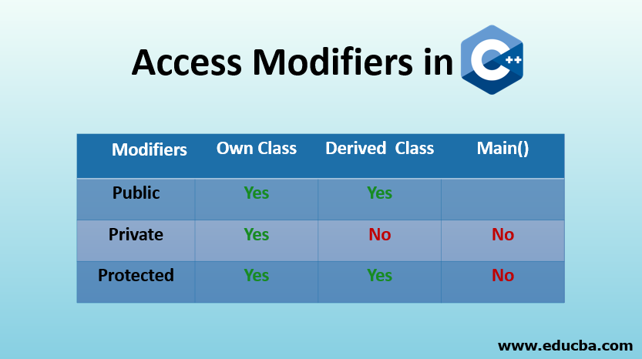

Slide 20
Virtual base class
In Inheritance we encounter a diamond problem in hybrid inheritance, to overcome this we can use virtual base class.
Virtual base classes offer a way to save space and avoid ambiguities in class hierarchies that use multiple inheritances.
When a base class is specified as a virtual base, it can act as an indirect base more than once without duplication of its data members.
A single copy of its data members is shared by all the base classes that use virtual base.

Slide 21
Virtual Function in C++
A virtual function is a member function which is declared within a base class and is re-defined (overridden) by a derived class.
When you refer to a derived class object using a pointer or a reference to the base class, you can call a virtual function for that object and execute the derived class’s version of the function.
They are mainly used to achieve Runtime polymorphism
Functions are declared with a virtual keyword in base class.

Slide 22
Interfaces in C++ (Abstract Classes)
An interface describes the behavior or capabilities of a C++ class without committing to a particular implementation of that class.
A class is made abstract by declaring at least one of its functions as pure virtual function. A pure virtual function is specified by placing "= 0" in its declaration.
The purpose of an abstract class (often referred to as an ABC) is to provide an appropriate base class from which other classes can inherit. Abstract classes cannot be used to instantiate objects and serves only as an interface. Attempting to instantiate an object of an abstract class causes a compilation error.

Slide 23
Polymorphism
The word polymorphism means having many forms. In simple words, we can define polymorphism as the ability of a message to be displayed in more than one form.
Compile time polymorphism: This type of polymorphism is achieved by function overloading or operator overloading.
Function Overloading: When there are multiple functions with same name but different parameters then these functions are said to be overloaded. Functions can be overloaded by change in number of arguments or/and change in type of arguments.

Slide 24
Function Overloading
Function Overloading is defined as the process of having two or more function with the same name, but different in parameters is known as function overloading in C++.
In function overloading, the function is redefined by using either different types of arguments or a different number of arguments.
The advantage of Function overloading is that it increases the readability of the program because you don't need to use different names for the same action.

Slide 25
Operator Overloading
In C++, we can make operators work for user-defined classes.
This means C++ can provide the operators with a special meaning for a data type.
Operator functions are the same as normal functions. The only differences are, the name of an operator function is always the operator keyword followed by the symbol of the operator and operator functions are called when the corresponding operator is used.

Slide 26
Almost all operators can be overloaded except a few. Following is the list of operators that cannot be overloaded.
-sizeof; typeid; Scope resolution (::); Class member access operators (.(dot), .* (pointer to member operator)); Ternary or conditional (?:)
Operator overloading enables programmers to use notation closer to the target domain. For example we can add two matrices by writing M1 + M2 rather than writing M1.add(M2).
Operator overloading provides similar syntactic support of built-in types to user-defined types.
Operator overloading makes the program easier to understand.

Slide 27
C++ Files and Streams
ofstream - This data type represents the output file stream and is used to create files and to write information to files.
ifstream - This data type represents the input file stream and is used to read information from files.
fstream - This data type represents the file stream generally, and has the capabilities of both ofstream and ifstream which means it can create files, write information to files, and read information from files.

Slide 28
Exception Handling
A C++ exception is a response to an exceptional circumstance that arises while a program is running, such as an attempt to divide by zero.
Exceptions provide a way to transfer control from one part of a program to another. C++ exception handling is built upon three keywords: try, catch, and throw.
try − A try block identifies a block of code for which particular exceptions will be activated. It's followed by one or more catch blocks.
throw − A program throws an exception when a problem shows up. This is done using a throw keyword.
catch − A program catches an exception with an exception handler at the place in a program where you want to handle the problem.

Slide 29
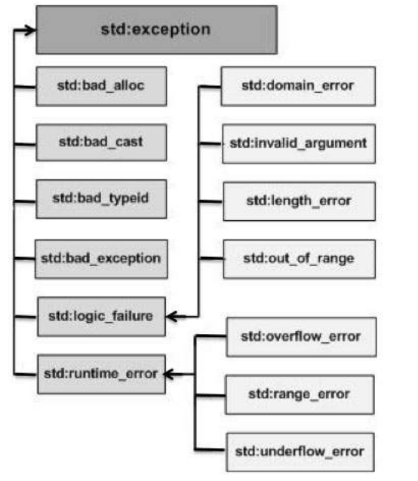

Slide 30
Define New Exceptions
You can define your own exceptions by inheriting and overriding exception class functionality.
what() is a public method provided by exception class and it has been overridden by all the child exception classes. This returns the cause of an exception.

Slide 31
C++ Templates
Templates are the foundation of generic programming, which involves writing code in a way that is independent of any particular type.
A template is a blueprint or formula for creating a generic class or a function. The library containers like iterators and algorithms are examples of generic programming and have been developed using template concept.
We can define and use template functions and classes on our own with user-defined logics and implementations independent of type.

Slide 32
Standard Template Library(STL)
The Standard Template Library (STL) is a set of C++ template classes to provide common programming data structures and functions such as lists, stacks, arrays, etc.
It is a library of container classes, algorithms, and iterators.
Algorithms
The header algorithm defines a collection of functions especially designed to be used on ranges of elements. They act on containers and provide means for various operations for the contents of the containers.

Slide 33
Containers or container classes store objects and data.
Sequence Containers: implement data structures which can be accessed in a sequential manner.
vector, list, deque, arrays, forward_list( Introduced in C++11)
Container Adaptors : provide a different interface for sequential containers.
queue, priority_queue, stack
Associative Containers : implement sorted data structures that can be quickly searched (O(log n) complexity).
set, multiset, map, multimap

Slide 34
Namespaces
Namespaces allow us to group named entities that otherwise would have global scope into narrower scopes, giving them namespace scope.
This allows organizing the elements of programs into different logical scopes referred to by names.
Namespace provide the space where we can define or declare identifier i.e. variable, method, classes.
Namespace is a feature added in C++ and not present in C.
C++ has a default namespace named std, which contains all the default library of the C++ included using #include directive.

Slide 35
CMakeLists
CMake is a cross-platform tool that automates the building process of software projects.
CMake is much more high-level. It's tailored to compile C++, for which you write much less build code, but can be also used for general purpose build.
CMakeLists.txt file contains a set of directives and instructions describing the project's source files and targets (executable, library, or both).

Slide 36
Unittest++
Unittest++ is a lightweight unit testing framework for C++. It was designed to do test-driven development on a wide variety of platforms.
Simplicity, portability, speed, and small footprint are all very important aspects of Unittest++.
Unittest++ is mostly standard C++ and makes minimal use of advanced library and language features, which means it should be easily portable to just about any platform.
It is supported on Windows, Linux and MacOS X.

Slide 37
Protobuf
Protocol Buffers is a free and open-source cross-platform data format used to serialize structured data.
It is useful in developing programs to communicate with each other over a network or for storing data.
These are Language-Neutral and benchmarked on XML.
Binary Serialization, Uses a determined schema to encode and decode, can be compiled to many languages.
Light-weight, Easy to modify Schema

Slide 38
Like JSON and XML, the Protobufs are language and platform-neutral.
The Protobuf is optimized to be faster than JSON and XML by removing many responsibilities usually done by data formats and making it focus only on the ability to serialize and deserialize data as fast as possible.
Another important optimization is regarding how much network bandwidth is being utilized by making the transmitted data as small as possible.
The definition of the data to be serialized is written in configuration files called proto files (.proto). These files will contain the configurations known as messages.
The proto files can be compiled to generate the code in the user's programming language.

Slide 39
References
https://www.tutorialspoint.com/cplusplus/
https://www.geeksforgeeks.org/c-programming-basics/
Google
C++ Training (Ganpat University)

Slide 40
Thank You

