Slide 1
The Media of Burien Project II
Prepared by: Abdulkadir S Fiqi

Slide 2
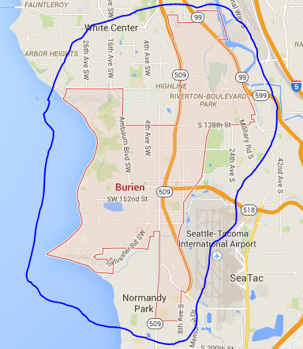

Slide 3
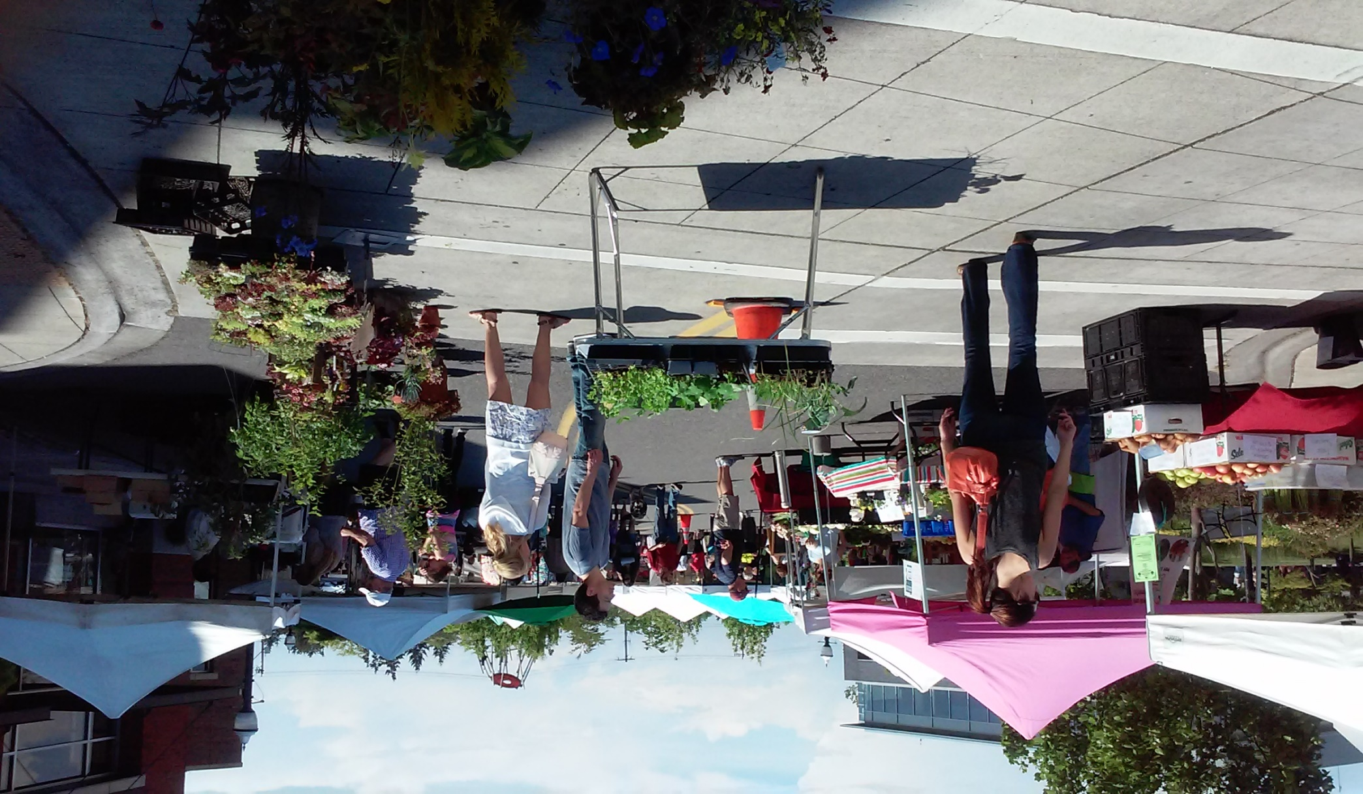
Three different media sources and their
Interesting articles about social, economics and cultural
A Topix website
B The B-Town blog
C Highline times

Slide 4
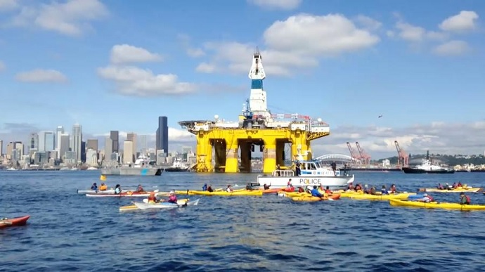
Topix published article about the arrival Shell Oil Rig in terminal 5
The Polar Poineer arrival created controversy.
Environmental activist rally to “Unwelcome” the rig.
The City of Seattle fines the rig for lock of proper permit $500 per day.

Slide 5
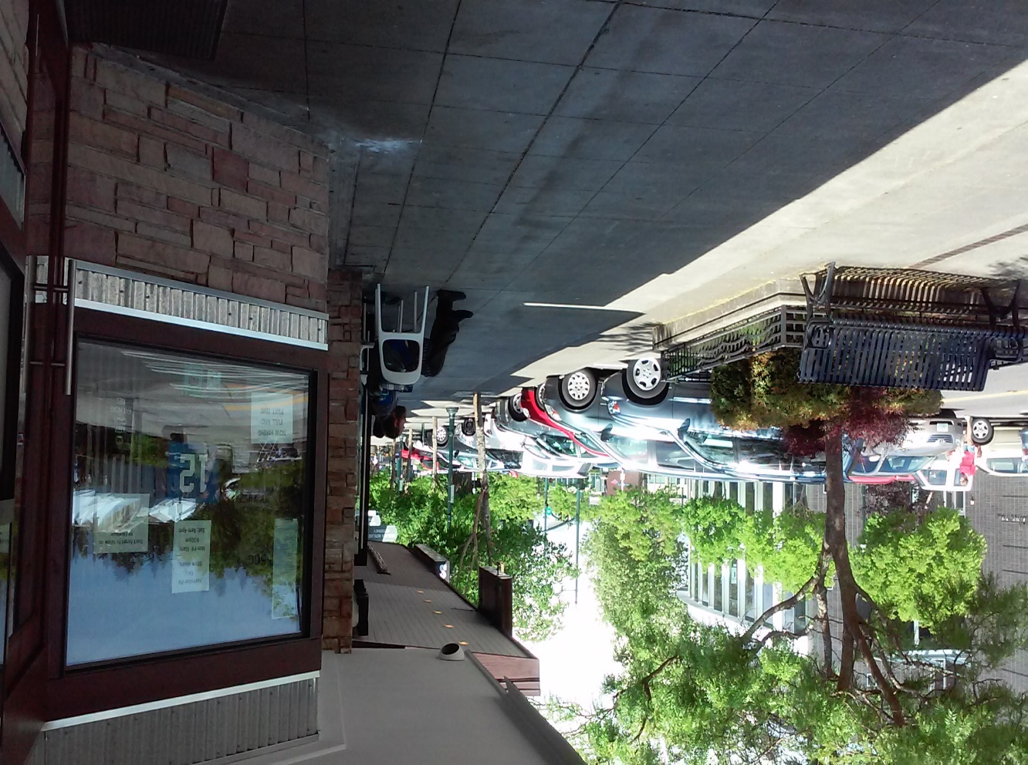
The B-town published an article about the homeless people in Burien.
Professor Sara Rankin of SU an advocate homeless peoples urged, the residents of Burien have to challenge themselves to spend one night on the streets and next day stay without money and no using private restrooms, to feel the struggle of homelessness.

Slide 6
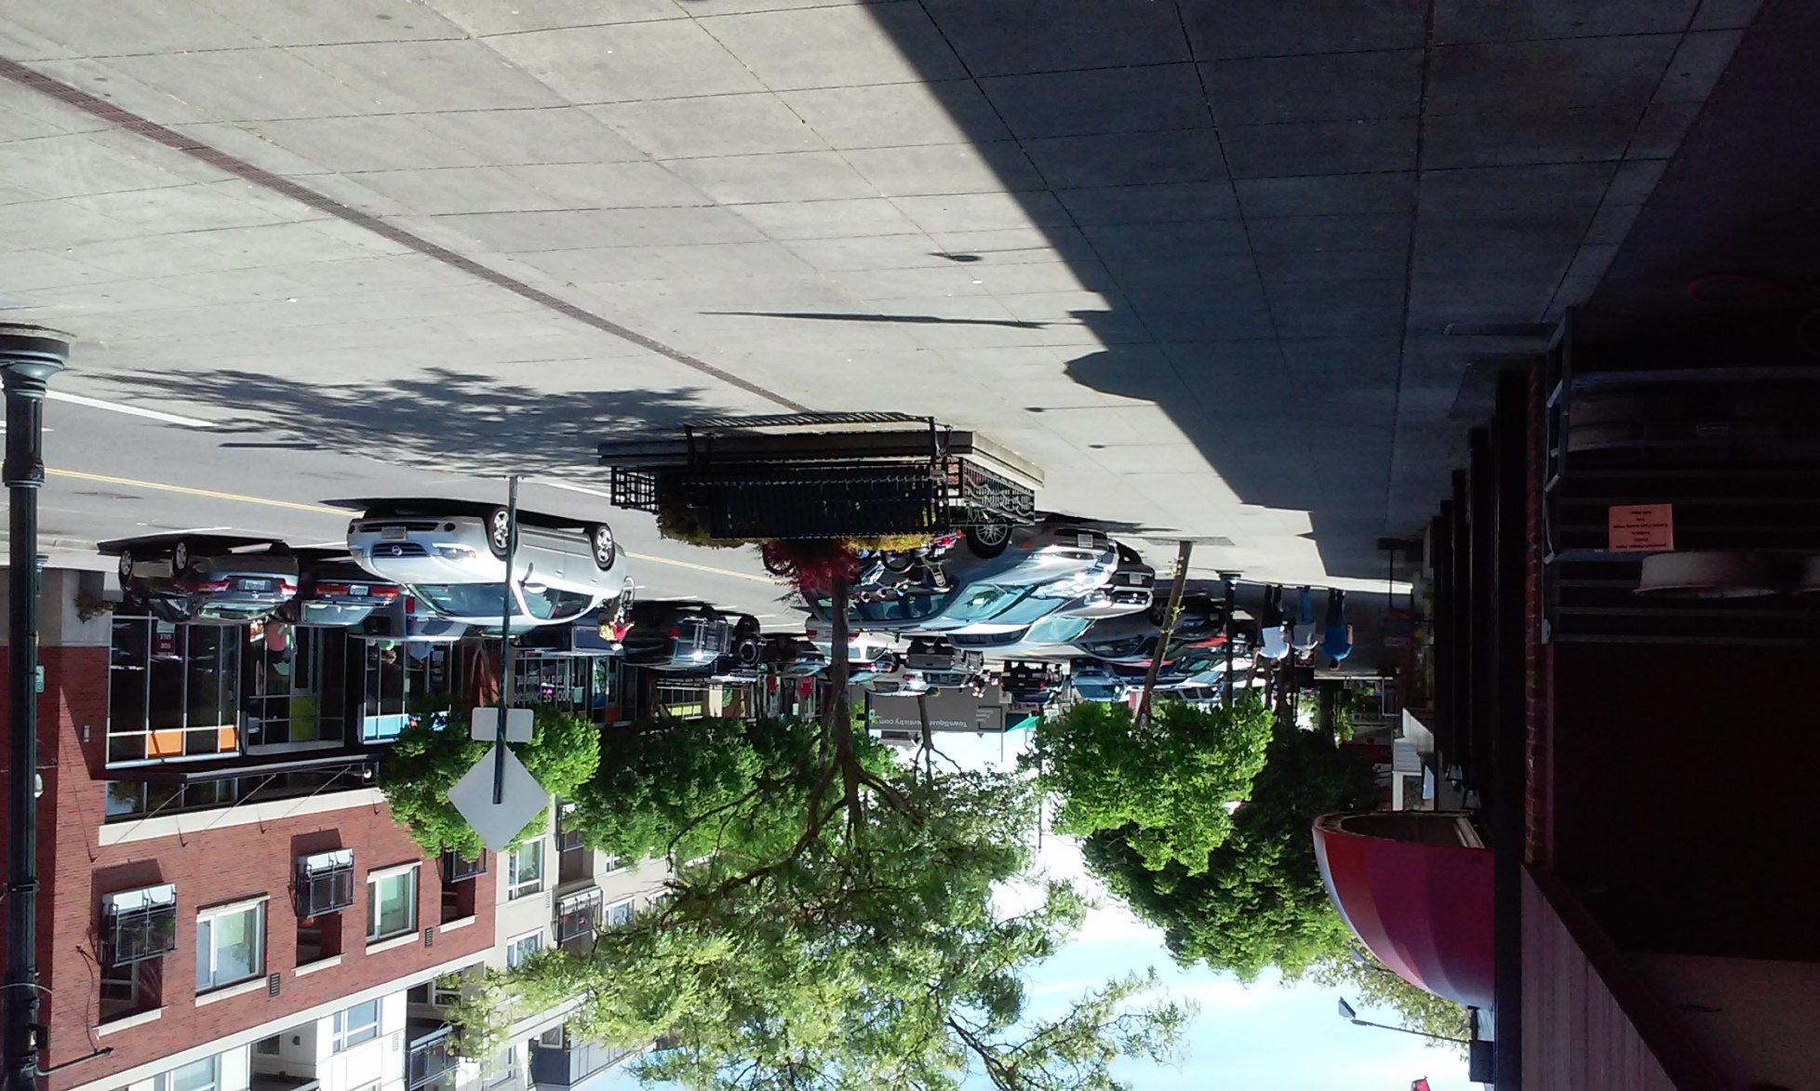
Highline Times published an article about new office in Burien
The City of Burien launched an office that promote the community of local filmmaking industry.
According to Burien’s Economics Development Manager Dan Trimple, the office intended to support the filmmaking community.

Slide 7
Questions and Comments
Thanks

