Slide 2




Design, and Implementation of Autonomous System For Path Identification, and Robotic Execution, with 3D Vision, and ROS2
6-Axis Robotic Arm with Closed-Loop Control , and Vision System
MCU
Control System
Machine Vision
Team Members: [Ahmed Al-Duais]

Slide 3
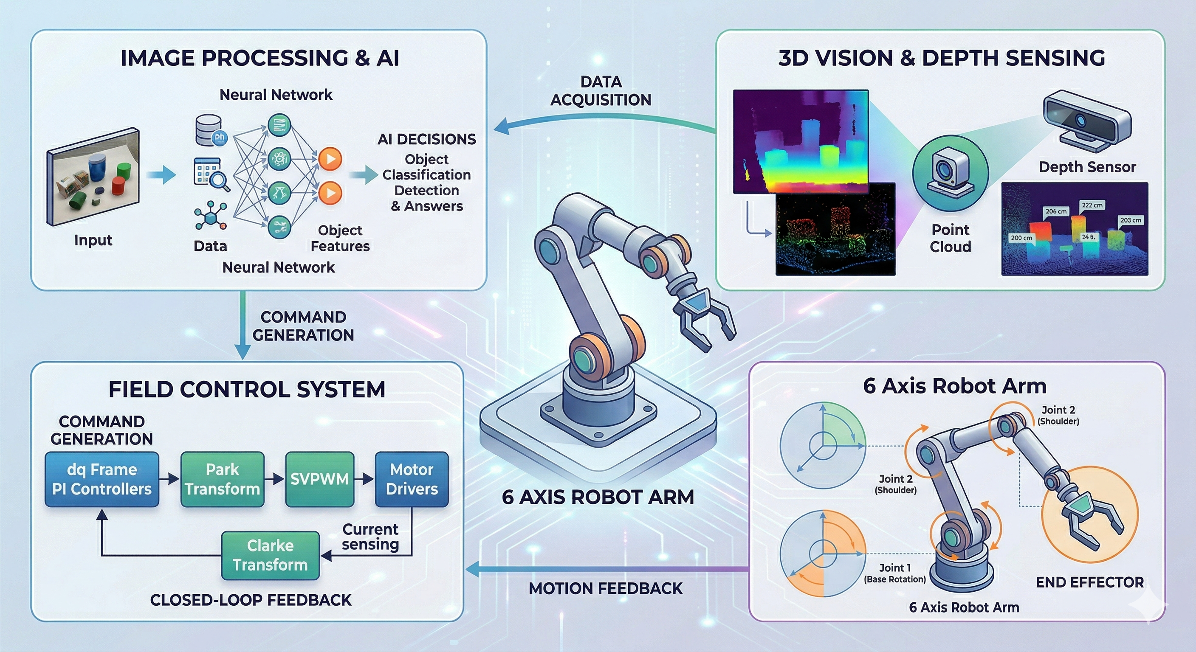

PROJECT OVERVIEW
Advanced 6-axis robotic system with embedded intelligence
3D vision, and Depth sensing
Determining The Aspects of Path in 3D Dimension
3D Vision & Depth Sensing

Slide 4

PROJECT OVERVIEW
Advanced 6-axis robotic system with embedded intelligence
3D vision, and Depth sensing
Determining The Aspects of Path in 3D Dimension
Image Processing, AI
Processing The Taken Image, to Identify The Path of the Operation
Image Processing

Slide 5

PROJECT OVERVIEW
Advanced 6-axis robotic system with embedded intelligence
3D vision, and Depth sensing
Determining The Aspects of Path in 3D Dimension
Image Processing, AI
Processing The Taken Image, to Identify The Path of the Operation
Control System
Specify the Parameters Needed to Execute The Identified Path
Control System

Slide 6

PROJECT OVERVIEW
Advanced 6-axis robotic system with embedded intelligence
3D vision, and Depth sensing
Determining The Aspects of Path in 3D Dimension
Image Processing, AI
Processing The Taken Image, to Identify The Path of the Operation
Control System
Specify the Parameters Needed to Execute The Identified Path
6 Axis Robotic Arm
6Axis Robot
Execute The Identified Path

