Slide 1

DUGONG WATCH
Seagrass Habitat Risk Mapping for Dugong Conservation
Marawah / Bu Tinah Marine Biosphere Reserve — Abu Dhabi, UAE
Prototypes for Humanity 2026

Slide 2



Why this matters
A globally significant population
~3,000-3,500 dugongs live in Abu Dhabi waters - the 2nd largest population on Earth, after Australia.
Almost entirely seagrass-dependent
Dugongs feed almost exclusively on seagrass meadows, mainly Halodule uninervis, in shallow (<5m) Gulf waters.
That habitat is under real pressure
Coastal development, dredging, desalination discharge, marine heat, and vessel traffic are all eroding it.

Slide 3





A five-stage pipeline
Each track hands its output to the next
A
B
C
D
E
Data & GEE
›
ML Classification
›
Risk Modelling
›
Dashboard
›
Report & Submission
Sentinel-2 imagery, cloud masking, feature stack
Random Forest seagrass mapping, 85.3% accuracy
Weighted threat overlay, ranked hotspots
Interactive risk map for stakeholders
Findings, methodology, impact

Slide 4
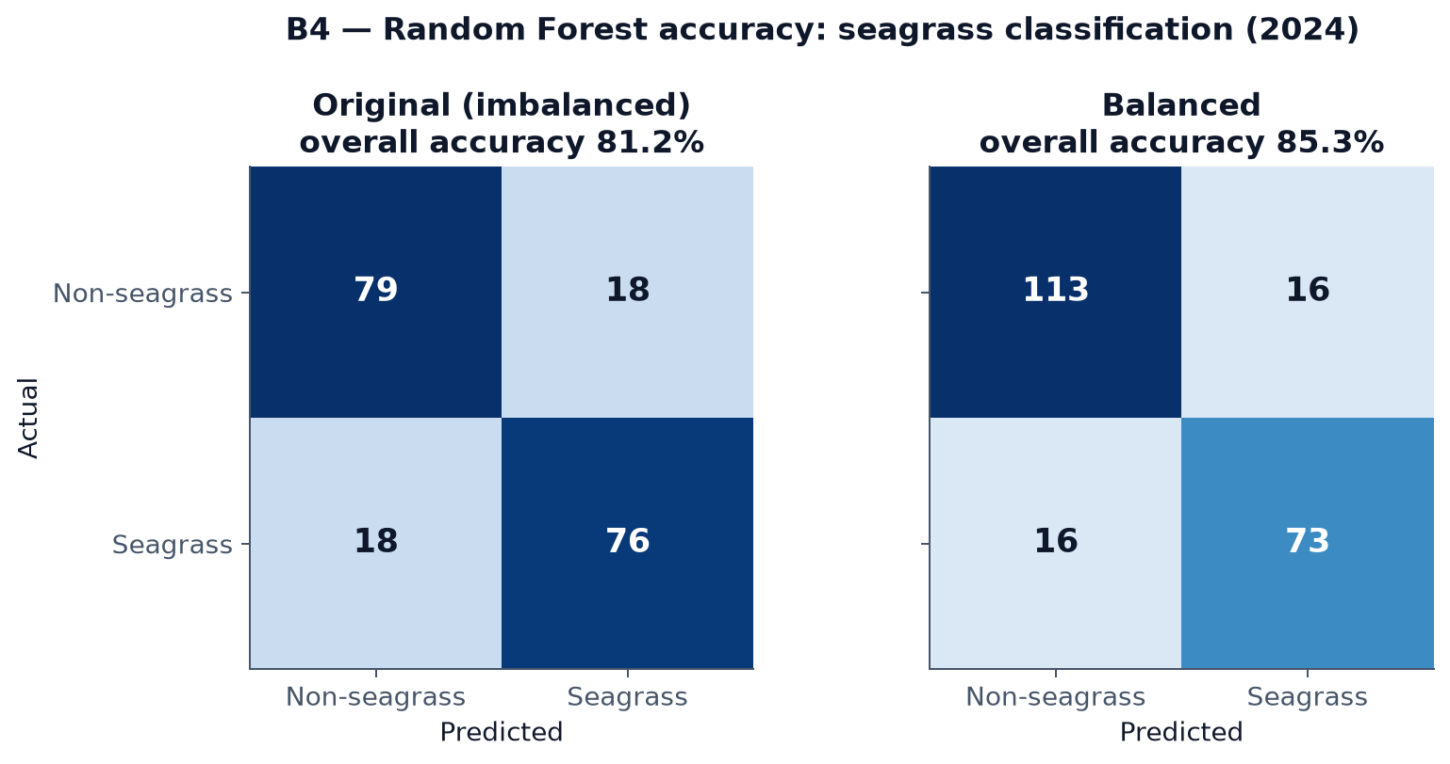
Track B — classifying seagrass from space
85.3%
overall accuracy, class-balanced Random Forest
within the 73-87% published target range for this method

Slide 5
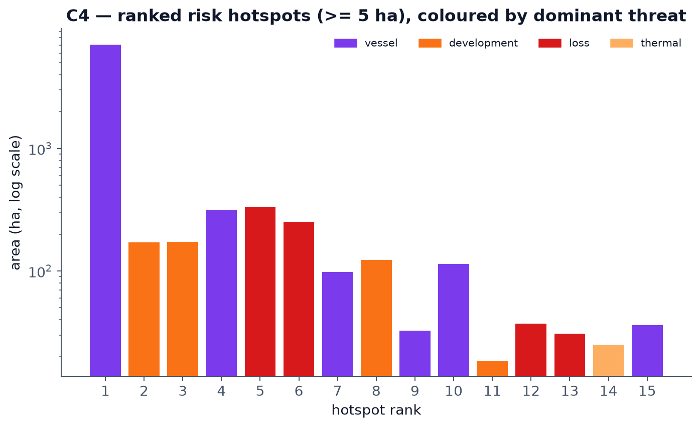
Track C — where is habitat most at risk?
Risk = Value × Threat — seagrass presence weighted by dugong use, times a weighted overlay of 5 real threat factors
105
ranked risk hotspots identified (≥ 5 ha)
3x
higher mean risk inside the dugong core vs. the whole reserve

Slide 6
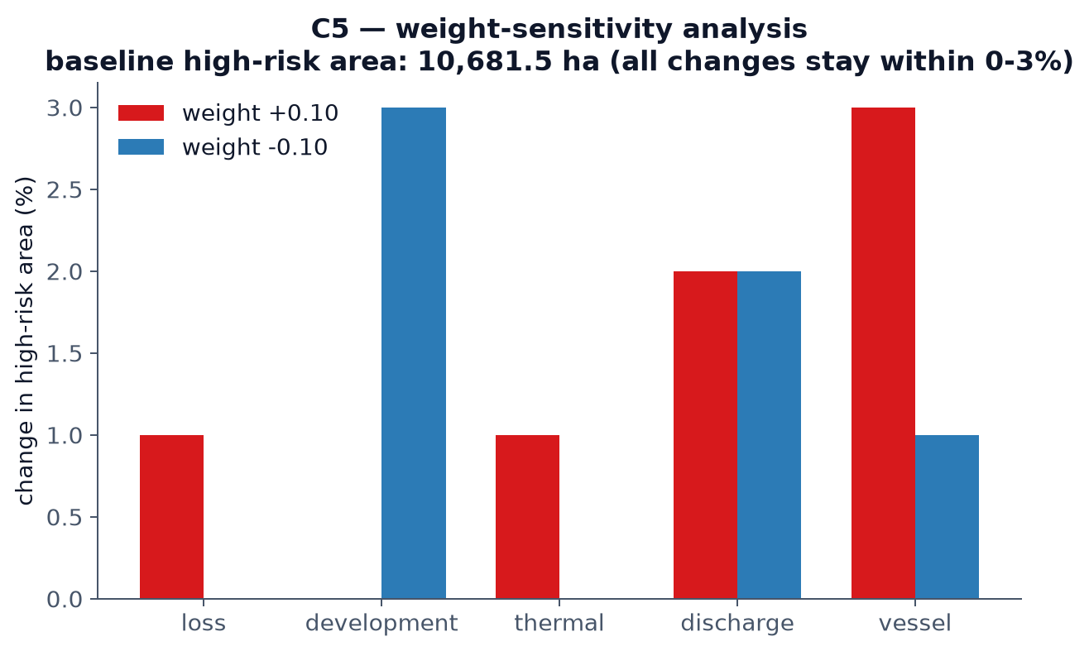
Is the risk model trustworthy?
We stress-tested it: every one of the 5 weights was perturbed ±10% and the hotspots were re-ranked.

Slide 7

Track D — a dashboard for decision-makers
Live risk map
5-class risk map, ranked hotspots with click-through detail
Very Low
Low
Toggleable threat layers: protected areas, dugong cores, discharge, development, vessels
Moderate
High
Continuous risk index + threat pressure for drill-down analysis
Very High

Slide 8
From pixels to protection
A reproducible, evidence-based way to rank where conservation effort matters most — built entirely on free satellite data and open methodology.
Dugong Watch — Prototypes for Humanity 2026

