Slide 1

DUGONG WATCH
Seagrass Habitat Risk Mapping for Dugong Conservation
Marawah / Bu Tinah Marine Biosphere Reserve — Abu Dhabi, UAE
Prototypes for Humanity 2026 · Final Presentation

Slide 2
AT A GLANCE
From raw pixels to ranked priorities
Dugong Watch turns free satellite imagery into a transparent, ranked map of where dugong seagrass habitat is both valuable and under real pressure.
85.3%
105
3×
seagrass classification accuracy (balanced Random Forest)
ranked risk hotspots identified (≥ 5 ha)
higher mean risk inside the dugong core vs. reserve-wide
5
774.6
$0
real threat factors combined into one weighted index
km² study area, entirely inside the biosphere reserve
marginal data cost — free Sentinel-2 / Landsat imagery
Dugong Watch · Prototypes for Humanity 2026
2

Slide 3






ROADMAP
What we’ll walk through
1. The problem
2. The pipeline
Why dugong habitat needs a risk map, and why one doesn’t exist yet
How five tracks turn imagery into a ranked, auditable output
3. Classification
4. Risk modelling
Mapping seagrass from Sentinel-2 with a validated ML model
Combining habitat value with five weighted threat factors
5. Validation
6. Impact & limits
Three independent checks that the risk output is trustworthy
What it enables locally and globally — and what it is not, yet
Dugong Watch · Prototypes for Humanity 2026
3

Slide 4


THE PROBLEM · 1 OF 4
A globally significant population
3,000–3,500
Vulnerable (IUCN)
The dugong is the only strictly herbivorous marine mammal, and is listed as Vulnerable to extinction globally.
dugongs in Abu Dhabi waters
A UNESCO biosphere
The second-largest dugong population on Earth, after Australia — concentrated in the Marawah / Bu Tinah region and recognised by UNESCO as a Man and the Biosphere reserve.
Marawah is the UAE’s first UNESCO Man & Biosphere reserve, and a designated Marine Protected Area.
Shallow, warm waters
Dugongs forage in waters under ~5 m deep, in one of the hottest, most rapidly developing seas on Earth.
Dugong Watch · Prototypes for Humanity 2026
4

Slide 5

THE PROBLEM · 2 OF 4
Survival hangs on one resource: seagrass
Dugongs feed almost exclusively on seagrass meadows. Protect the seagrass and you protect the dugong; lose it and the population has nowhere to go. That makes seagrass the single most decision-relevant thing to map — and to protect.
›
›
Healthy seagrass
Feeds the dugong
Sustains the population
Dense meadows in shallow Gulf waters
A single adult grazes ~30 kg of seagrass daily
No seagrass → no foraging → no dugongs
Dugong Watch · Prototypes for Humanity 2026
5

Slide 6





THE PROBLEM · 3 OF 4
Five measurable pressures on the habitat
Coastal development
Desalination & discharge
Marine heat stress
Dredging and land reclamation directly bury or smother meadows.
Brine and industrial outfall raise salinity and temperature locally.
The Gulf is among the hottest seas on Earth; heatwaves bleach seagrass.
Vessel pressure
Observed loss
Propeller scarring and groundings damage shallow foraging beds.
Measured seagrass decline between 2019 and 2024 from imagery itself.
Dugong Watch · Prototypes for Humanity 2026
6

Slide 7


THE PROBLEM · 4 OF 4
The question no existing tool answers
Not simply “where is there seagrass,” but where is seagrass both present and under enough pressure that its loss would matter for dugong survival?
Answering it means combining three things that are rarely brought together:
Habitat maps
Change over time
Threat data
Where seagrass exists — but surveys are episodic and expensive to run at scale.
Whether it is being lost — rarely tracked consistently across years.
What pressures act where — scattered across non-standardised sources.
Dugong Watch · Prototypes for Humanity 2026
7

Slide 8

THE SOLUTION
An end-to-end, auditable pipeline
Guiding principle: transparency over sophistication. Every weight is a documented parameter, every threat layer’s provenance is labelled, and the model’s own sensitivity to its assumptions is tested — not assumed.
1
2
3
4
Classify
Detect change
Rank risk
Deliver
Seagrass presence from free Sentinel-2 imagery, trained on official EAD survey polygons.
Seagrass gain and loss between 2019 and 2024 from the same imagery source.
Combine habitat value with five weighted threat factors into one 0–1 index.
A ranked, interactive map a non-technical stakeholder can use directly.
Dugong Watch · Prototypes for Humanity 2026
8

Slide 9


THE SOLUTION
Five tracks, each feeding the next
A
B
C
D
E
›
›
›
›
Data & GEE
ML Classification
Risk Modelling
Dashboard
Report
Sentinel-2 imagery, cloud masking, 14-band feature stack
Random Forest seagrass mapping, 85.3% accuracy
Weighted threat overlay, 105 ranked hotspots
Interactive risk map for stakeholders
Findings, methodology, impact, limitations
Owner-per-track structure keeps every stage independently reviewable and reproducible.
Dugong Watch · Prototypes for Humanity 2026
9

Slide 10
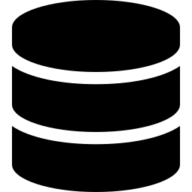
METHODOLOGY · DATA
Study area and data sources
774.6 km² polygon covering the Marawah / Bu Tinah region (lon 52.98–53.32, lat 24.19–24.48), falling entirely inside the Marawah Marine Biosphere Reserve.
Sentinel-2 Surface Reflectance
Level-2A, cloud-masked (QA60), median-composited per year. 222 scenes built the 2024 composite. 2019 & 2024 compared.
Landsat 8/9 thermal (ST_B10)
Summer surface temperature (Jun–Sep), converted to °C, water-masked so hot dry land can’t skew the thermal signal.
EAD habitat vector data
118 seagrass + 171 non-seagrass training polygons; a separate 118-polygon reference layer; a 1,954-polygon regional context layer.
All data is free and public — no proprietary or purchased imagery anywhere in the pipeline.
Dugong Watch · Prototypes for Humanity 2026
10

Slide 11
METHODOLOGY · FEATURES
From raw bands to a 14-feature stack
Each annual composite is reduced to 14 predictor features per 10 m pixel — ten raw Sentinel-2 bands plus four spectral indices that sharpen the water–vegetation distinction seagrass classification depends on.
10 raw Sentinel-2 bands
4 derived spectral indices
B2 (blue)
B3 (green)
NDVI
vegetation vigour
B4 (red)
B5 (red edge)
NDWI
open-water index
B6 (red edge)
B7 (red edge)
MNDWI
modified water index
B8 (NIR)
B8A (narrow NIR)
BSI
bare-soil index
B11 (SWIR)
B12 (SWIR)
Dugong Watch · Prototypes for Humanity 2026
11

Slide 12
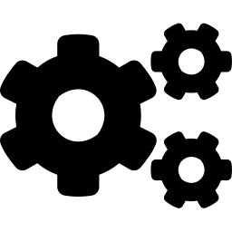

TRACK B · CLASSIFICATION
Random Forest, trained on survey data
Stratified sampling
Random Forest, 100 trees
Random points drawn inside training polygons (not one per polygon, since sizes vary up to ~61 km²), each with its 14 band values.
ee.Classifier.smileRandomForest, fixed seed for reproducibility, trained on an 80/20 train/test split.
Balanced vs. original
One model, two years
A class-balanced model (equal seagrass / non-seagrass samples) beat the imbalanced one on every metric — and is used downstream.
The same trained classifier is applied to 2019 and 2024, so any difference reflects real change, not model drift.
Dugong Watch · Prototypes for Humanity 2026
12

Slide 13
UNDER THE HOOD · TRACK B CODE
The classifier, in real code
M2_classification / Seagrass_Dugong_Mapping.ipynb
One deterministic pipeline
PREDICTOR_BANDS = ["B2","B3","B4","B5","B6","B7","B8",
"B8A","B11","B12","NDVI","NDWI","MNDWI","BSI"]
def build_feature_stack(start, end, bounds):
coll = (ee.ImageCollection("COPERNICUS/S2_SR_HARMONIZED")
.filterBounds(bounds).filterDate(start, end)
.filter(ee.Filter.lt("CLOUDY_PIXEL_PERCENTAGE",20))
.map(mask_s2_clouds))
comp = coll.median().clip(bounds) # per-year median
ndvi = comp.normalizedDifference(["B8","B4"])
# + NDWI, MNDWI, BSI spectral indices ...
return comp.addBands([ndvi,ndwi,mndwi,bsi])
rf = ee.Classifier.smileRandomForest(
numberOfTrees=100, seed=42).train(
features=balanced_training_set,
classProperty="class",
inputProperties=predictor_bands)
Fixed seed (42) means anyone re-running gets the identical model — a requirement for an auditable tool.
14 features per pixel
10 raw Sentinel-2 bands + 4 spectral indices, computed server-side in Earth Engine at 10 m.
Same code, both years
The exact function builds the 2019 and 2024 stacks, so change reflects the ground, not the model.
Dugong Watch · Prototypes for Humanity 2026
13

Slide 14
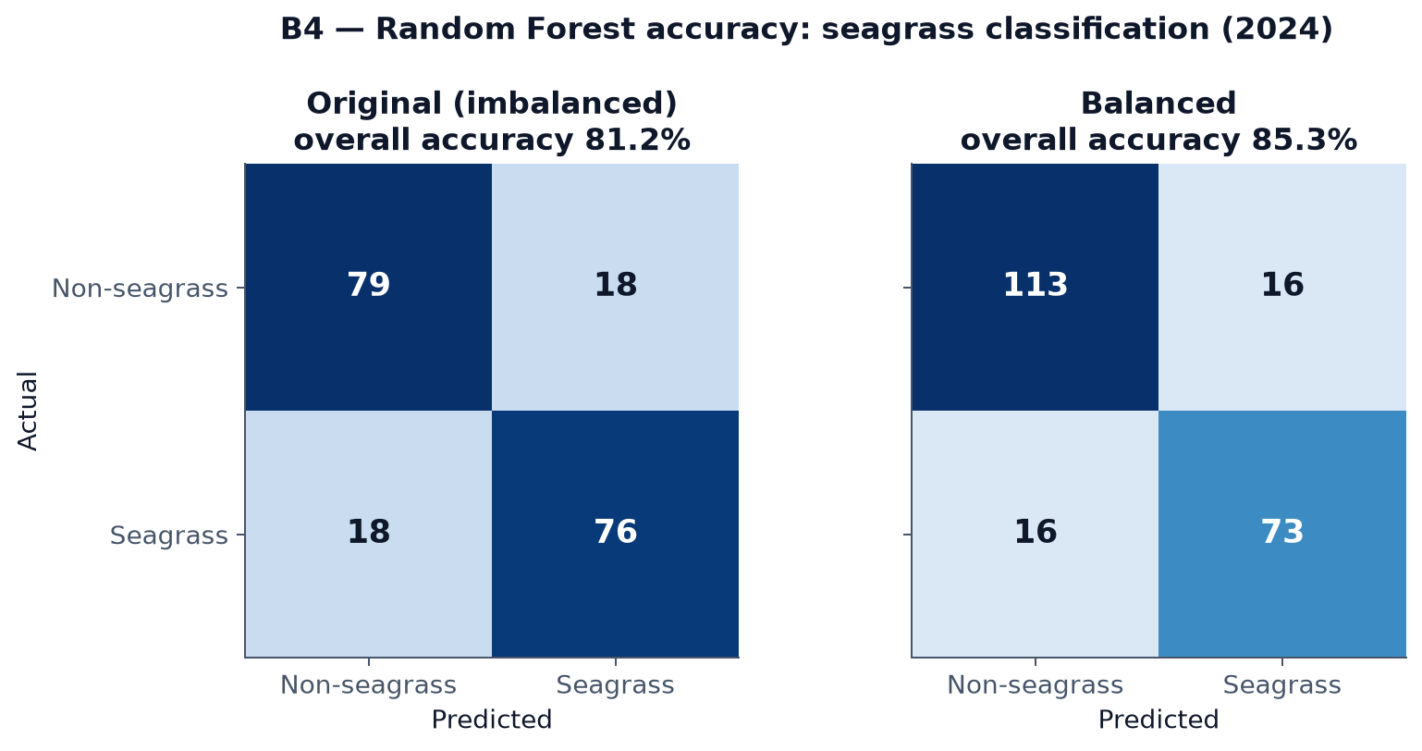
TRACK B · RESULTS
85.3% accuracy, confusion shown
85.3%
overall accuracy, class-balanced model
Cohen’s κ = 0.696
substantial agreement, up from 0.623 for the imbalanced model
Dugong Watch · Prototypes for Humanity 2026
14

Slide 15
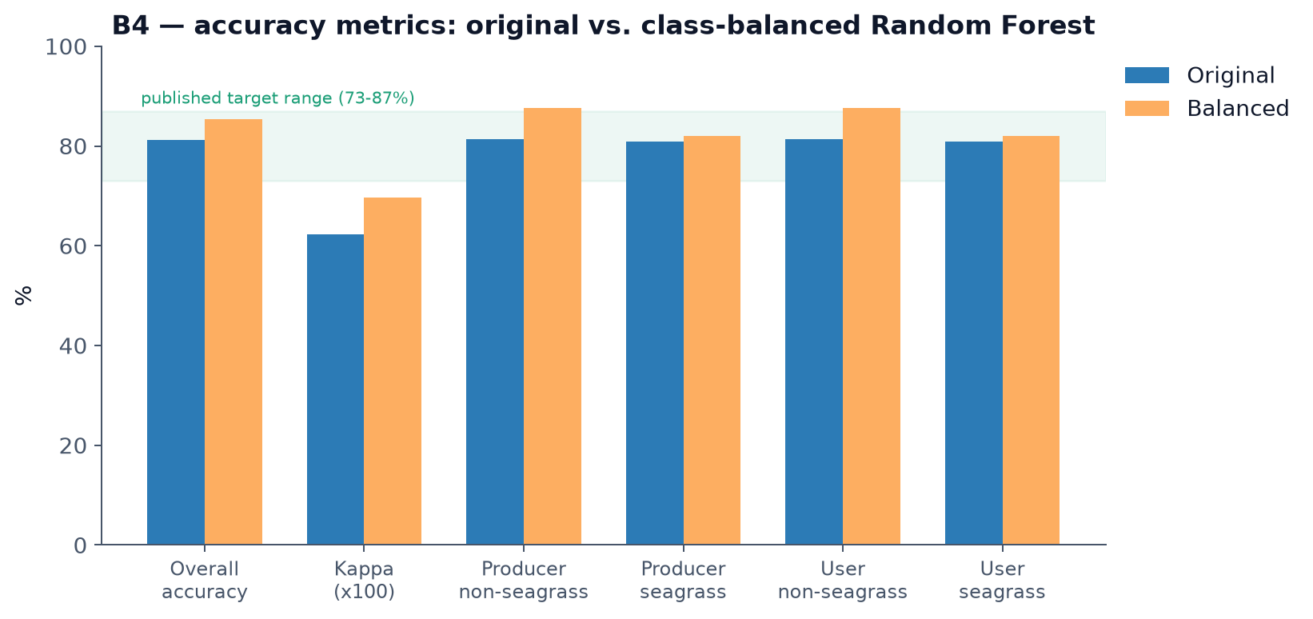
TRACK B · RESULTS
Every metric in the published range
Overall accuracy, kappa, and producer’s / user’s accuracy for both classes — the balanced model (orange) sits inside the 73–87% range reported for comparable satellite seagrass methods.
Dugong Watch · Prototypes for Humanity 2026
15

Slide 16
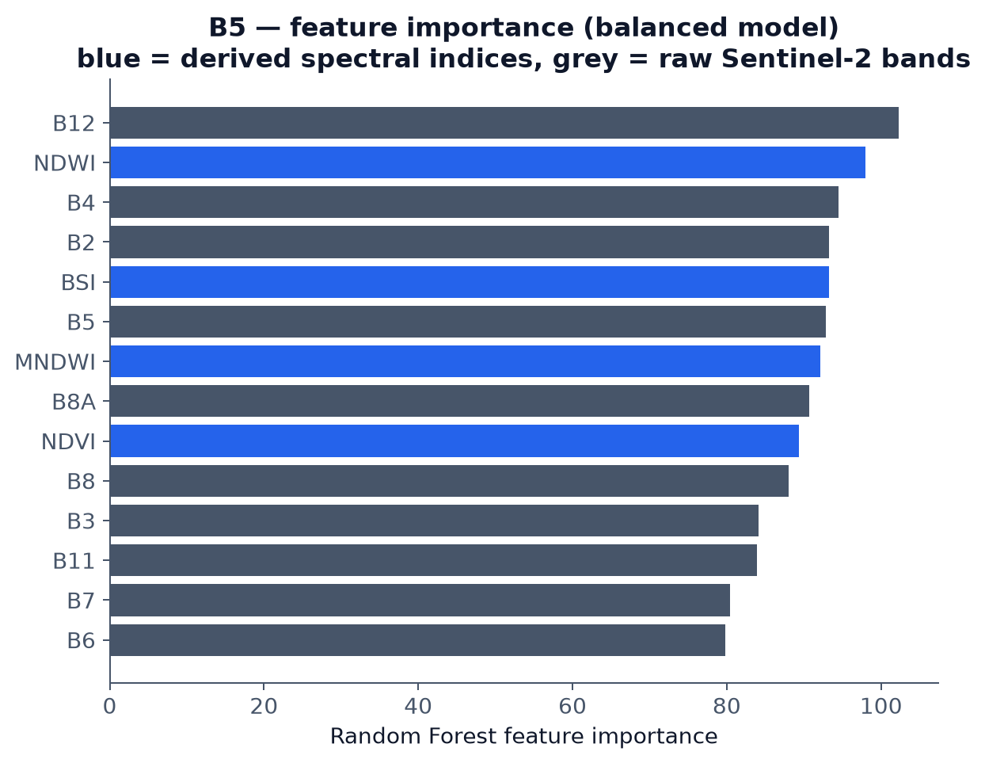
TRACK B · RESULTS
What the model actually looks at
Interpretation
Water- and vegetation-index bands (NDWI, BSI, MNDWI, NDVI) rank among the top features
— alongside the raw shortwave-infrared band B12.
That matches the physics: seagrass discrimination depends on both spectral water characteristics and a vegetation signal, so the derived indices earning their place is a sign the model is learning the right thing.
Dugong Watch · Prototypes for Humanity 2026
16

Slide 17
TRACK B · CHANGE DETECTION
Seagrass change, 2019 → 2024
Applying one classifier to both years and differencing the results yields four change categories — the “loss” layer becomes the single most heavily weighted threat factor in the risk model.
Stable non-seagrass
Stable seagrass
Gain
Loss
Bare / unvegetated bottom in both years
Persistent meadow — the reliable core
New seagrass detected by 2024
Seagrass present in 2019, gone by 2024
Because loss is measured, not assumed, hotspots dominated by “loss” are flagged transparently for read-alongside with classifier accuracy.
Dugong Watch · Prototypes for Humanity 2026
17

Slide 18
TRACK C · RISK MODEL
The risk equation, in one line
Risk = Value × Threat
An exposure × consequence structure (after Halpern et al. 2008 / InVEST HRA): a location scores high only when valuable habitat and real pressure coincide.
Value (what’s at stake)
Threat (what acts on it)
Seagrass presence, weighted up to ~1.7× where dugong use is highest.
A weighted sum of five normalised 0–1 pressure factors.
Dugong Watch · Prototypes for Humanity 2026
18

Slide 19

TRACK C · VALUE LAYER
Not all seagrass is equally at stake
Value = SeagrassPresence × (0.6 + 0.4 × DugongUse)
Presence from classification
SeagrassPresence comes directly from the 2024 Random Forest output — no seagrass, no value.
Dugong use, by distance-decay
A continuous 0–1 surface built outward from documented high-density anchors: Marawah core, Bu Tinah, central foraging grounds.
Weighted, but never zero
Seagrass in a known dugong core is weighted up to ~1.7× more than at the reserve’s edge — yet every pixel keeps some value, since the whole AOI is prime habitat.
Dugong Watch · Prototypes for Humanity 2026
19

Slide 20
TRACK C · THREAT LAYER
Five weighted, justified factors
Each factor is normalised 0–1; distance factors use exp(−distance/λ) with factor-specific decay lengths (λ ≈ 3–5 km). Every weight is documented in RISK_METHODOLOGY.md.
Threat factor | Measured as | Weight
Observed seagrass loss (2019→2024) | Smoothed density of “loss” change pixels | 0.30
Coastal development / dredging | Distance-decay from mapped development points | 0.20
Thermal stress | Landsat summer surface temperature, water-masked | 0.20
Desalination / industrial discharge | Distance-decay from mapped discharge points | 0.15
Vessel / navigation pressure | Distance-decay from ports, landings, routes | 0.15
Loss carries the highest weight because measured decline is the strongest evidence of habitat already failing.
Dugong Watch · Prototypes for Humanity 2026
20

Slide 21
UNDER THE HOOD · TRACK C CODE
The risk model, in real code
C_risk_gis / Dugong_Habitat_Risk.ipynb
Every constant is visible
# distance-decay pressure: exp(-d / lambda)
def decay(fc, lam_m):
d = fc.distance(searchRadius=100000)
return d.divide(lam_m).multiply(-1).exp().clamp(0,1)
WEIGHTS = {"loss":0.30, "development":0.20,
"thermal":0.20, "discharge":0.15, "vessel":0.15}
# VALUE = seagrass x dugong-use weight
value = seagrass.multiply(
dugong_use.multiply(0.4).add(0.6))
# THREAT = weighted sum of 5 normalized factors
threat = (T1.multiply(0.30).add(T2.multiply(0.20))
.add(T3.multiply(0.20)).add(T4.multiply(0.15))
.add(T5.multiply(0.15)))
risk = normalize(value.multiply(threat)) # 0..1
No black box — the five weights and the decay lengths are literals you can read, question, and change.
Value gates threat
Multiplying value × threat means pressure over bare seabed scores ~0; only pressure on real habitat counts.
Normalised, reproducible
All factors are scaled 0–1 over the AOI, so the final index is a clean relative ranking.
Dugong Watch · Prototypes for Humanity 2026
21

Slide 22
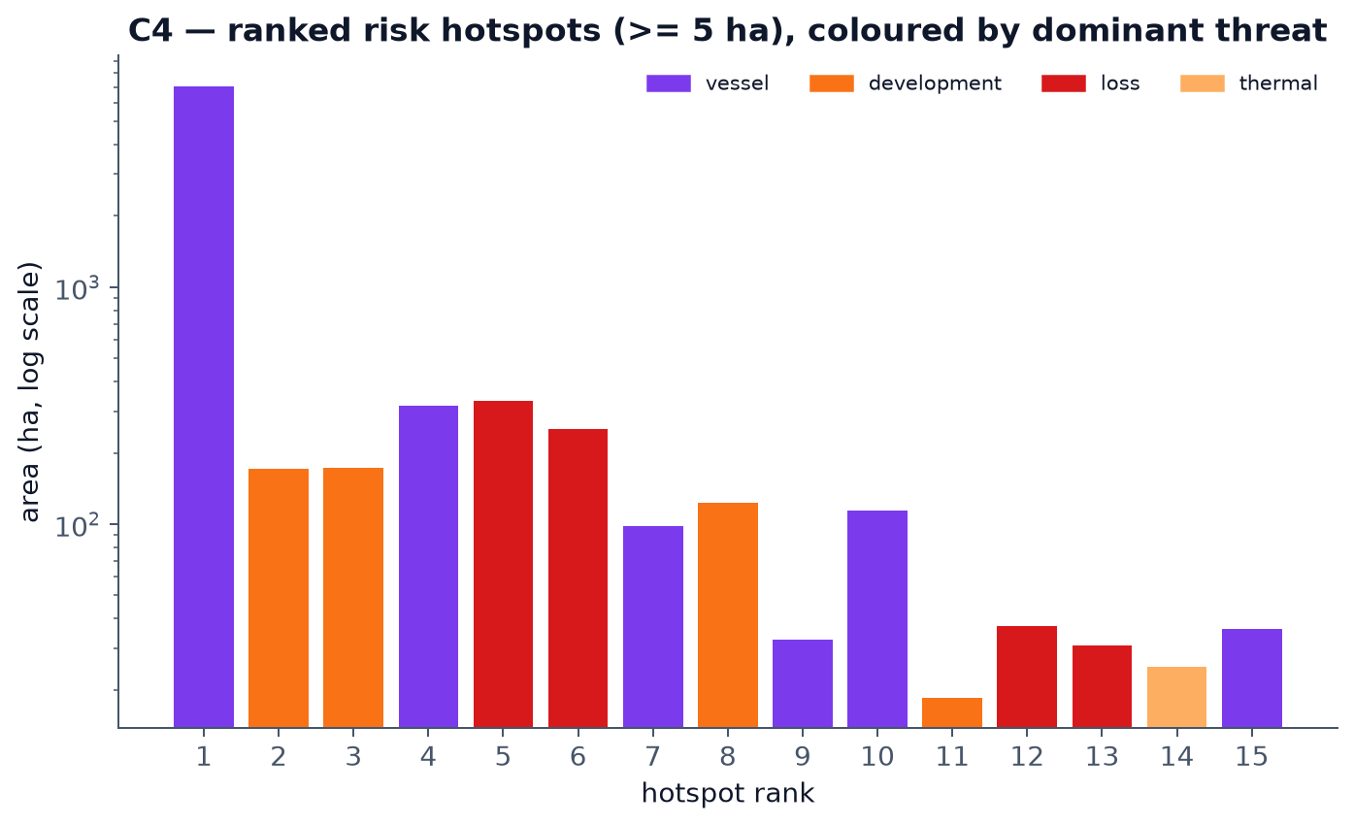
TRACK C · OUTPUT
105 ranked hotspots, not a generic map
105
ranked hotspots ≥ 5 ha
18.5–7,049
hectare range across hotspots; dominant threats: vessels, development, loss
Dugong Watch · Prototypes for Humanity 2026
22

Slide 23
READING THE MAP · WHY
Why the risk sits where it does
The model attributes every hotspot to a dominant driver. Across the top-ranked hotspots, two pressures stand out — and they line up with what the map shows.
Vessel pressure — the biggest zone
The single largest high-risk hotspot (7,184 ha) is vessel-dominated: the central navigation channel where propeller and grounding damage hit shallow foraging beds. It is the red streak visible on the dashboard.
Observed loss — the heaviest weight
Measured 2019→2024 seagrass decline carries the highest weight (0.30). Loss-dominated hotspots mark meadows already retreating, where intervention is most time-critical.
Coastal development — small but intense
Development-dominated hotspots are smaller yet carry the highest mean-risk values (up to ~0.57), clustered along the developed south-east shoreline.
Dugong Watch · Prototypes for Humanity 2026
23

Slide 24

VALIDATION
Is the risk model trustworthy?
Beyond classifier accuracy, we ran three independent tests of whether the risk output is real signal — not an artefact of the parameters we chose.
1. Face validity
2. Zonal comparison
3. Weight sensitivity
Does mean risk fall with distance from a real discharge point, as the model’s own construction should produce?
Is mean risk inside the documented dugong core meaningfully higher than the reserve-wide average?
Do the flagged hotspots survive perturbing each of the five weights by ±10%?
Yes — ~0.26 near, ~0.09–0.14 far
Yes — 3× higher in the core
Yes — ≤ 3% change in high-risk area
Dugong Watch · Prototypes for Humanity 2026
24

Slide 25
VALIDATION · ZONAL COMPARISON
Risk targets where dugongs actually are
0.461
0.153
3×
mean risk inside the documented dugong core
mean risk across the whole study area
Exactly the result a correct model should produce: risk concentrates where valuable habitat and real pressure meet — not spread uniformly, and not at random.
Dugong Watch · Prototypes for Humanity 2026
25

Slide 26
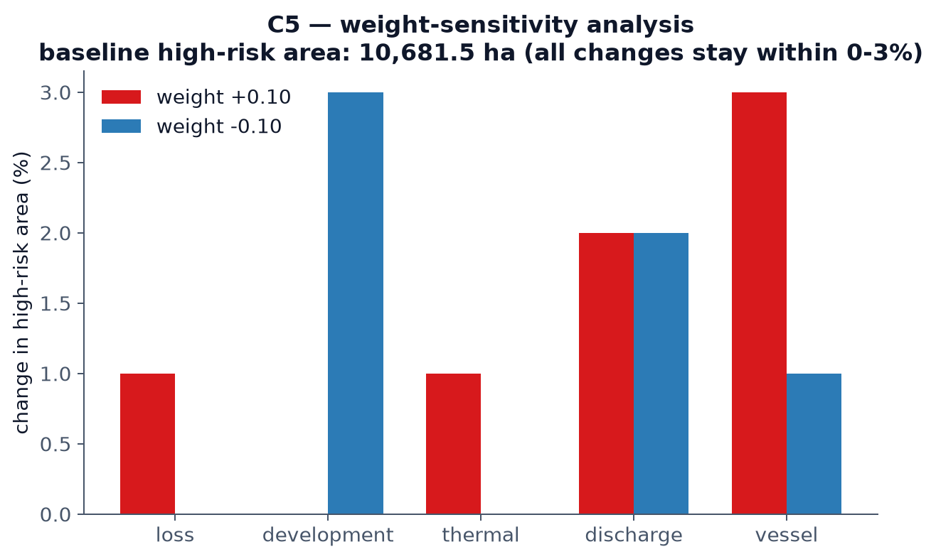
VALIDATION · WEIGHT SENSITIVITY
The hotspots survive stress-testing
Each of the five weights was perturbed ±0.10 (re-normalised to sum to 1.0) and the high-risk area recomputed. No perturbation moved it by more than 3% off the 10,681.5 ha baseline.
Why this matters
≤ 3% change in high-risk area for any single-weight ±10% shift.
A different but equally defensible weighting would produce a similar ranking. The output is robust — not an artefact of one arbitrary set of assumptions.
Dugong Watch · Prototypes for Humanity 2026
26

Slide 27
UNDER THE HOOD · REAL OUTPUT
What the code actually prints
Not mock-ups — these are the real printed results from re-running the notebooks end-to-end against live Earth Engine data.
$ jupyter · pipeline output
85.32%
balanced classifier accuracy
===== RANDOM FOREST CLASSIFICATION SUMMARY =====
Overall Accuracy : 85.32%
Kappa : 0.696
Producer (Seagrass) : 82.02%
User (Seagrass) : 82.02%
Class breaks (risk): [0.049, 0.092, 0.158, 0.24]
Hotspot patches (>= 5 ha): 105
Baseline high-risk area: 10681.5 ha
vessel +0.10 -> high-risk +3%
development -0.10 -> high-risk +3%
... all perturbations within +/-3%
105
ranked hotspots extracted
≤ 3%
sensitivity to any weight ±10%
Dugong Watch · Prototypes for Humanity 2026
27

Slide 28

TRACK D · DELIVERY
A dashboard for decision-makers
Ranked hotspots
Live risk map
5-class risk map with click-through detail on each ranked patch.
Very Low
Low
Toggleable threat layers
Moderate
Protected areas, dugong cores, discharge, development, vessels.
High
Very High
Drill-down analysis
Continuous risk index and threat-pressure surfaces underneath.
Dugong Watch · Prototypes for Humanity 2026
28

Slide 29
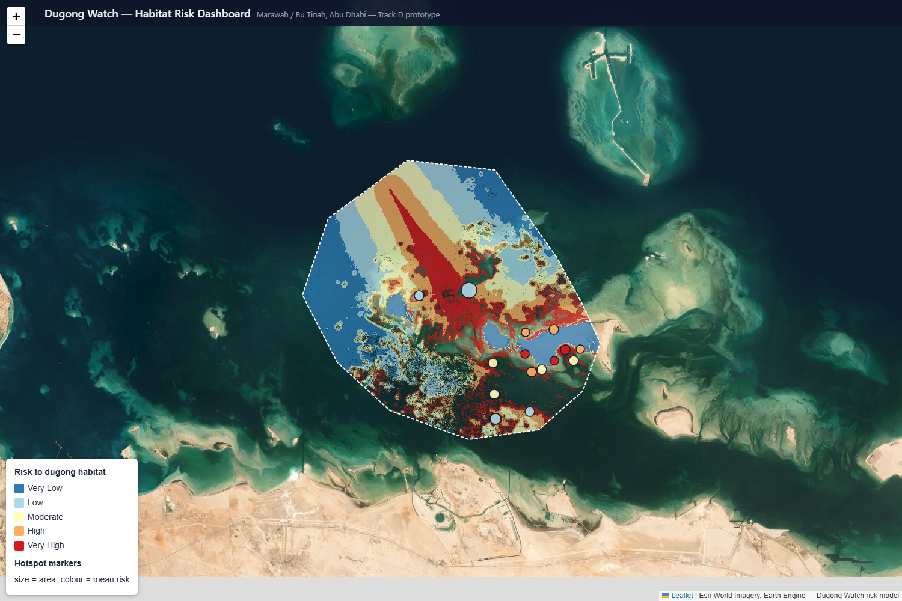
TRACK D · LIVE PROTOTYPE
The dashboard prototype, running on live data
Real risk tiles
The blue→red gradient is the live Earth Engine risk model, not a static picture.
The red streak = the driver
The central Very-High corridor is the vessel channel — you can see the top hotspot’s cause.
Built for non-experts
Toggle layers, click any hotspot for its rank, area, mean risk, and dominant threat.
Esri satellite basemap · Earth Engine risk tiles · Marawah / Bu Tinah AOI · 105 hotspot markers
Dugong Watch · Prototypes for Humanity 2026
29

Slide 30
READING THE MAP · ACTION
From risk to response: what the map enables
Each dominant driver points to a concrete, targeted intervention — and the ranking says where to do it first. These are recommendations the output supports, not actions taken.
Vessel pressure
Observed loss
Seasonal speed / no-wake zones and re-routing around the central foraging channel; targeted mooring-buoy placement.
Focus monitoring and seagrass restoration on loss-dominated hotspots; re-run change detection to track recovery.
Coastal development
Thermal & discharge
Condition dredging permits and set buffer zones around the high-value hotspots nearest the shore.
Weigh into siting of new desalination / industrial outfalls; protect cooler thermal-refuge meadows.
Dugong Watch · Prototypes for Humanity 2026
30

Slide 31
WHY IT’S DIFFERENT
Why it beats a survey or generic index
→
A living monitoring baseline — Re-runs on new imagery at ~zero marginal cost — tracks whether hotspots stabilise or worsen.
Static habitat survey
→
Risk conditioned on dugong use — Shows where loss would matter for dugongs, not just where seagrass happens to be.
Generic seagrass extent map
→
Value × threat, both explicit — Only scores high where habitat value and real pressure coincide — and every weight is documented.
Generic environmental index
→
Audited & stress-tested — Three validation checks; every weight perturbed ±10%; all code and data reproducible.
Black-box model
Dugong Watch · Prototypes for Humanity 2026
31

Slide 32
IMPACT · LOCAL
For Abu Dhabi: an evidence-based start
Prioritised action
Ranks 105 concrete locations by habitat value × real pressure — directly informs where a boundary review, dredging permit condition, or monitoring buoy should go first.
A repeatable baseline
Built on free, continuously updated imagery — re-run in any future year at near-zero cost to track whether hotspots are stabilising or worsening.
Serves the reserve’s mandate
The 3× zonal finding gives Marawah’s UNESCO / MPA evidence-based mandate a concrete, quantified starting point — not just “the core matters.”
Dugong Watch · Prototypes for Humanity 2026
32

Slide 33
IMPACT · REGIONAL & GLOBAL
A reusable model, not a one-off map
The exposure × consequence structure, the threat factors, and the validation approach are not specific to seagrass or the Arabian Gulf.
Transferable structure
Other species & regions
Free tools lower the barrier
Combine a habitat-value layer with a weighted, distance-decayed threat overlay, validate against ground truth, stress-test the weights — applies to any satellite-visible, single-species habitat.
Dugongs elsewhere in the Indo-Pacific, manatee seagrass in the Americas, or any coastal species tied to a mappable habitat type.
Sentinel-2 / Landsat via Earth Engine + open-source Python. The barrier to adoption is know-how, not cost or licensing — key for lower-resource programmes.
Dugong Watch · Prototypes for Humanity 2026
33

Slide 34
FORWARD · SCALING
Scaling: same pipeline, wider reach
Because every input is free and every step is code, scaling is a matter of pointing the pipeline at more area, more years, or another species — not buying more data.
Geographic
Temporal
Operational
Extend from the AOI to all of Abu Dhabi’s coast, the wider Arabian Gulf, and other dugong / manatee habitats in the Indo-Pacific and Americas — no new data cost.
Re-run each year as new imagery lands, turning a one-off assessment into a continuous monitoring baseline; the change-detection step is already built for it.
Automate as a scheduled Earth Engine job and hand the dashboard to EAD; ingest official GIS layers to replace the schematic inputs.
Dugong Watch · Prototypes for Humanity 2026
34

Slide 35

FORWARD · IMPROVEMENTS
Where the model goes next
Close the training gap
Deep learning at scale
Richer threat layers
Retrain on the full 319-polygon non-seagrass set (a known pagination bug truncated it to 171).
RF wins on today’s ~1,000-sample tabular data; CNN / temporal models become worth it once more labels exist.
Real AIS vessel density, official discharge & thermal plumes, bathymetry, and storm exposure.
Calibrate to absolute risk
Uncertainty maps
Productionise delivery
Validate against field surveys to convert the relative index into a calibrated probability of loss.
Per-pixel classification confidence and ensemble weighting, shown alongside the risk layer.
Static map tiles or a hosted Earth Engine App so the dashboard never depends on expiring tokens.
Dugong Watch · Prototypes for Humanity 2026
35

Slide 36
TRANSPARENCY
What this is — and what it isn’t, yet
A transparent limitations section is part of the design philosophy, not a formality. Stated plainly:
Threat data is partly schematic
A known training-data gap
Built-infrastructure coordinates are real and verified; reserve boundary, dugong-density surface, and vessel routes are documented approximations pending official EAD GIS layers.
A pagination bug truncated non-seagrass training polygons to 171 of the true 319. The download code is fixed; results shown were trained on the smaller set — retraining is a known next step.
Relative risk, not absolute
No field validation yet
The index ranks locations within the study area against each other; it is not a calibrated probability of habitat loss.
Internal validation shows the method behaves sensibly; it does not confirm any individual hotspot’s on-the-ground condition. That needs a site visit or independent survey.
Dugong Watch · Prototypes for Humanity 2026
36

Slide 37
NEXT STEPS
From prototype to deployed tool
1
2
Integrate official EAD GIS layers
Retrain on the full 319-polygon set
Replace schematic boundaries and surfaces with authoritative data — sharpens output without changing the method.
Re-run the fixed download and retrain the classifier to close the known training-data gap.
3
4
Field-validate top hotspots
Co-design with the agencies
Ground-truth a sample of ranked hotspots against recent survey data or a site visit.
Put the dashboard in front of the regulators and researchers who’d use it, and act on what “actionable” means to them.
Dugong Watch · Prototypes for Humanity 2026
37

Slide 38
From pixels to protection
A reproducible, evidence-based way to rank where dugong conservation effort matters most — built entirely on free satellite data and open, auditable methodology.
Dugong Watch · Prototypes for Humanity 2026 · Marawah / Bu Tinah, Abu Dhabi

