Slide 1
Tableau Assignment - Citi Bike Analytics Summer 2018 Data Set
File created on: 4/7/2019 9:36:10 PM

Slide 2
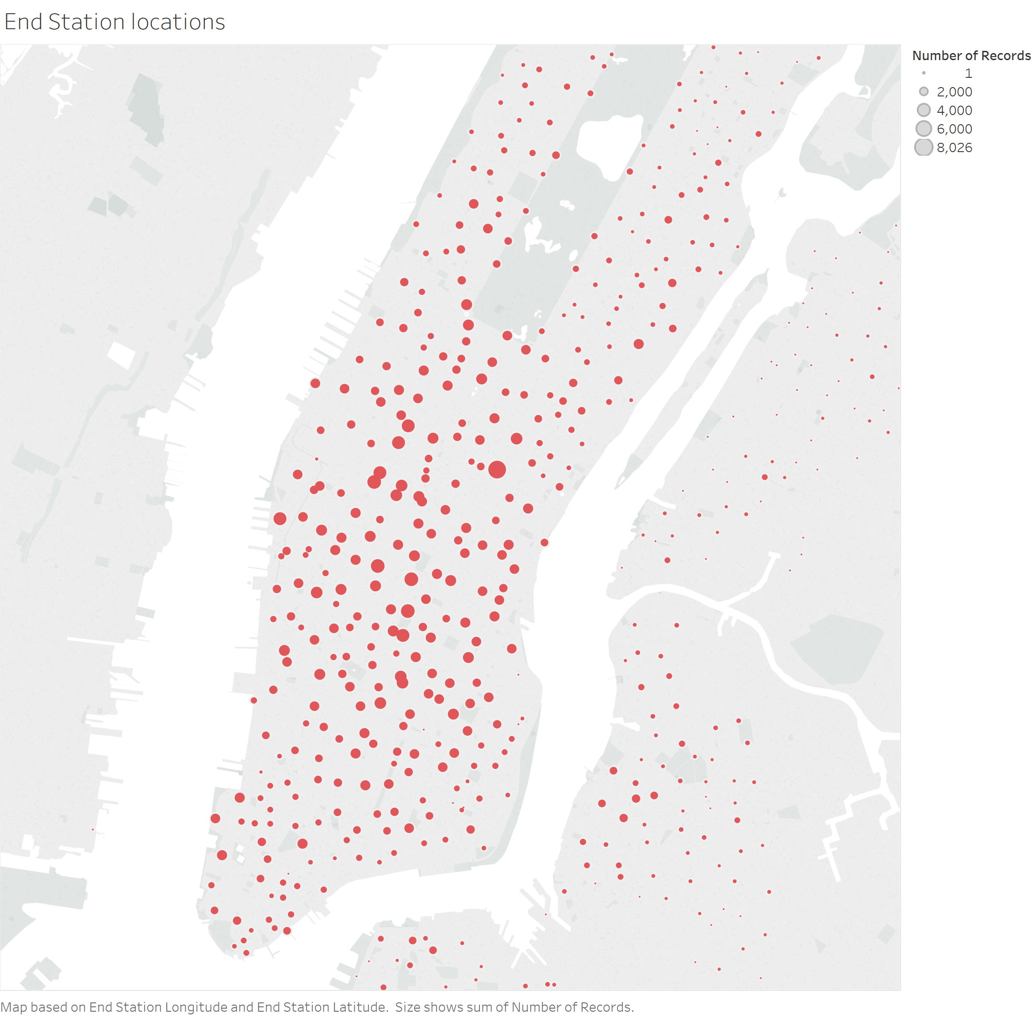

Slide 3
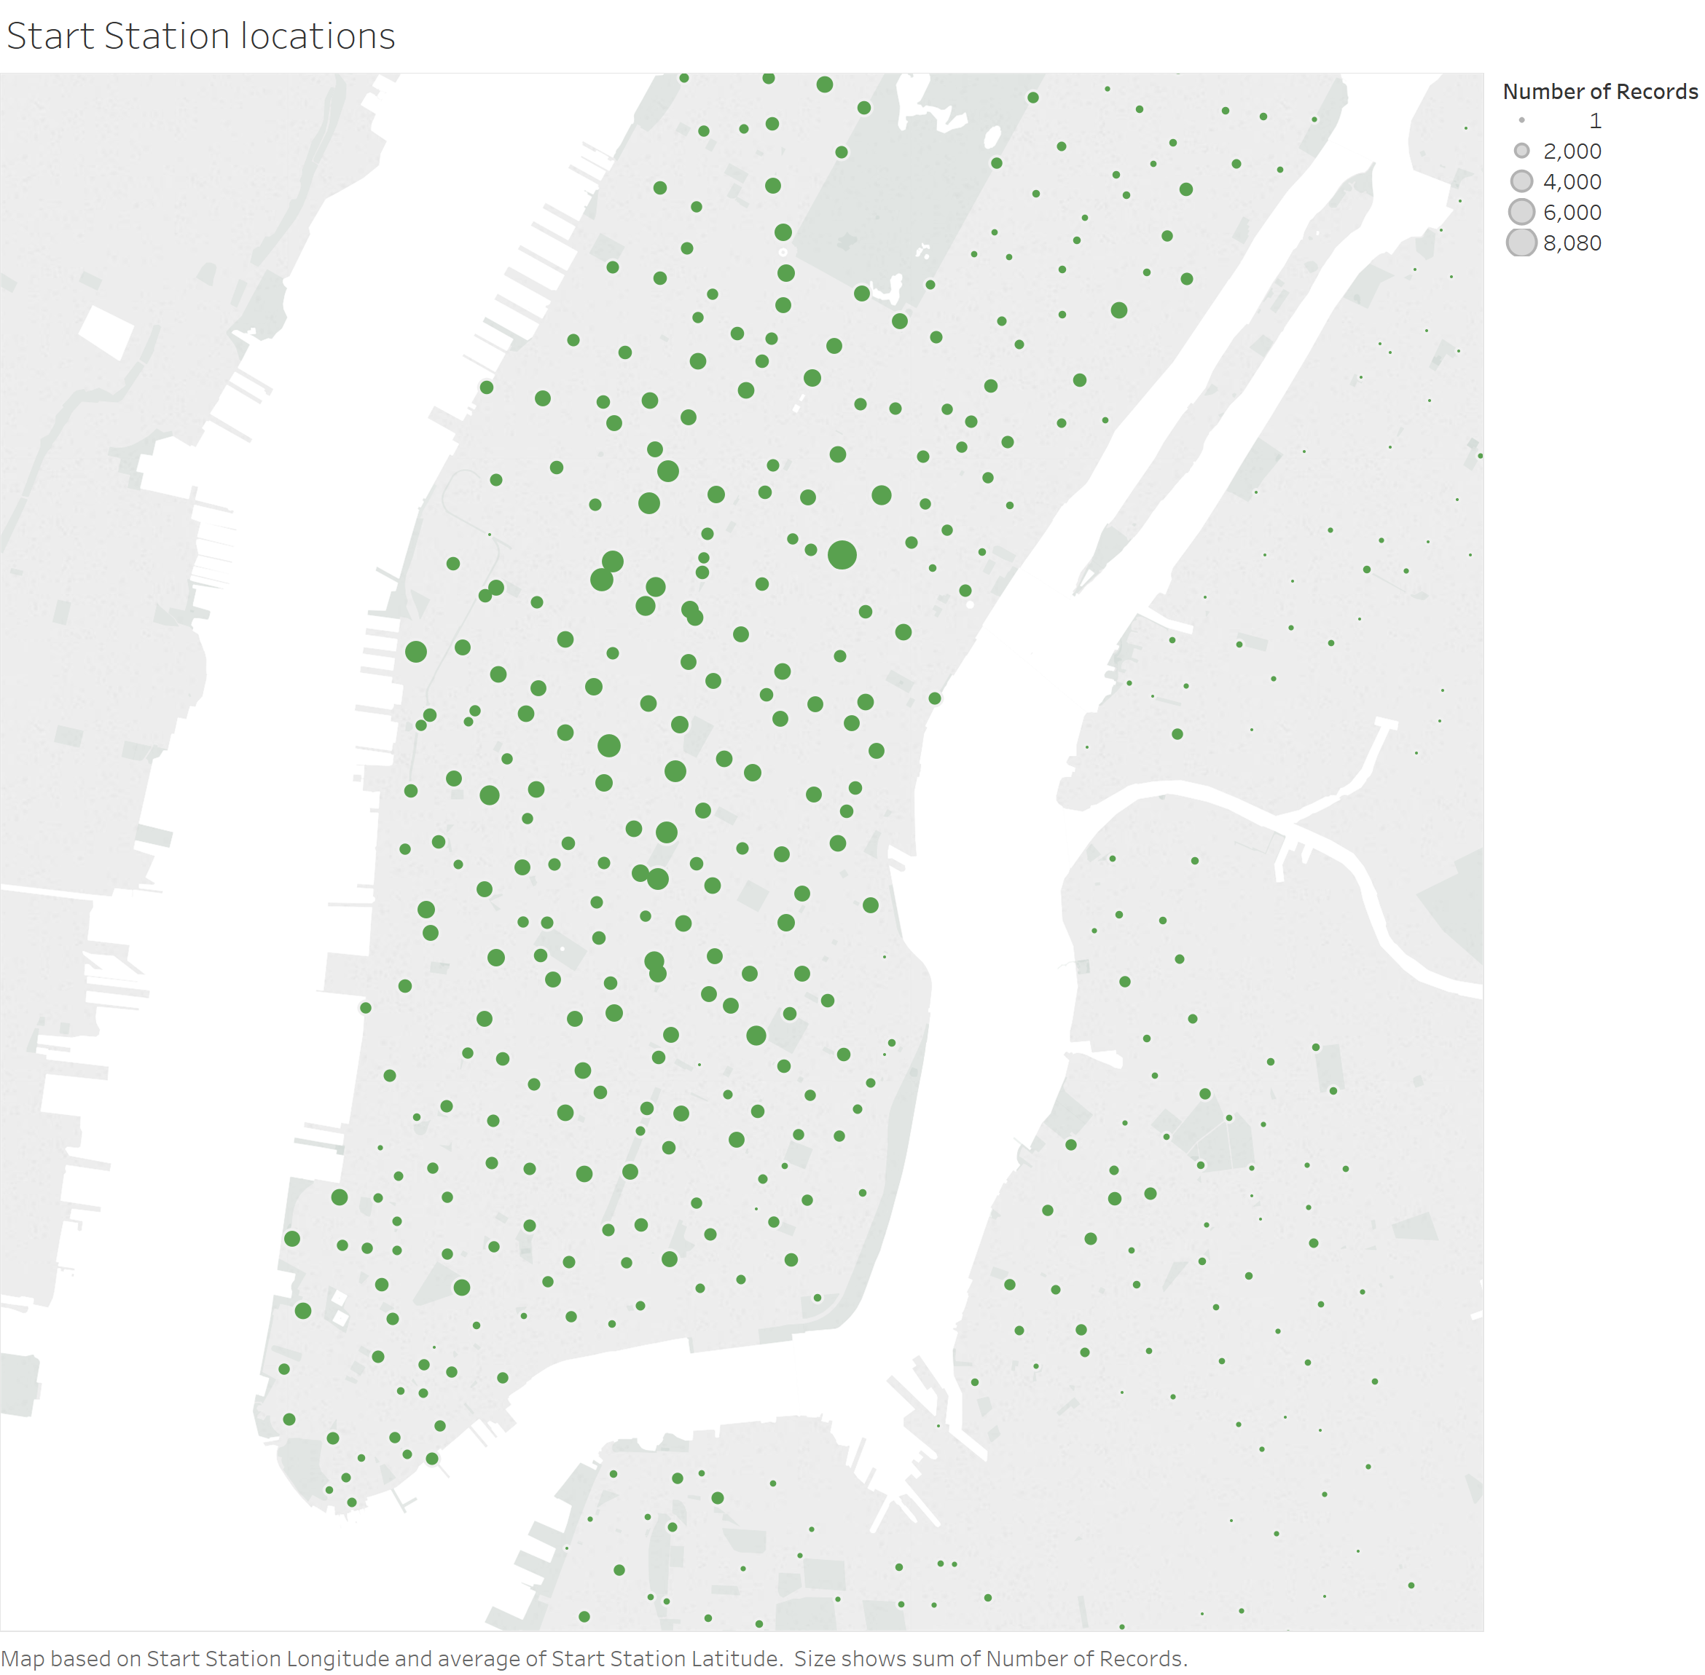

Slide 4
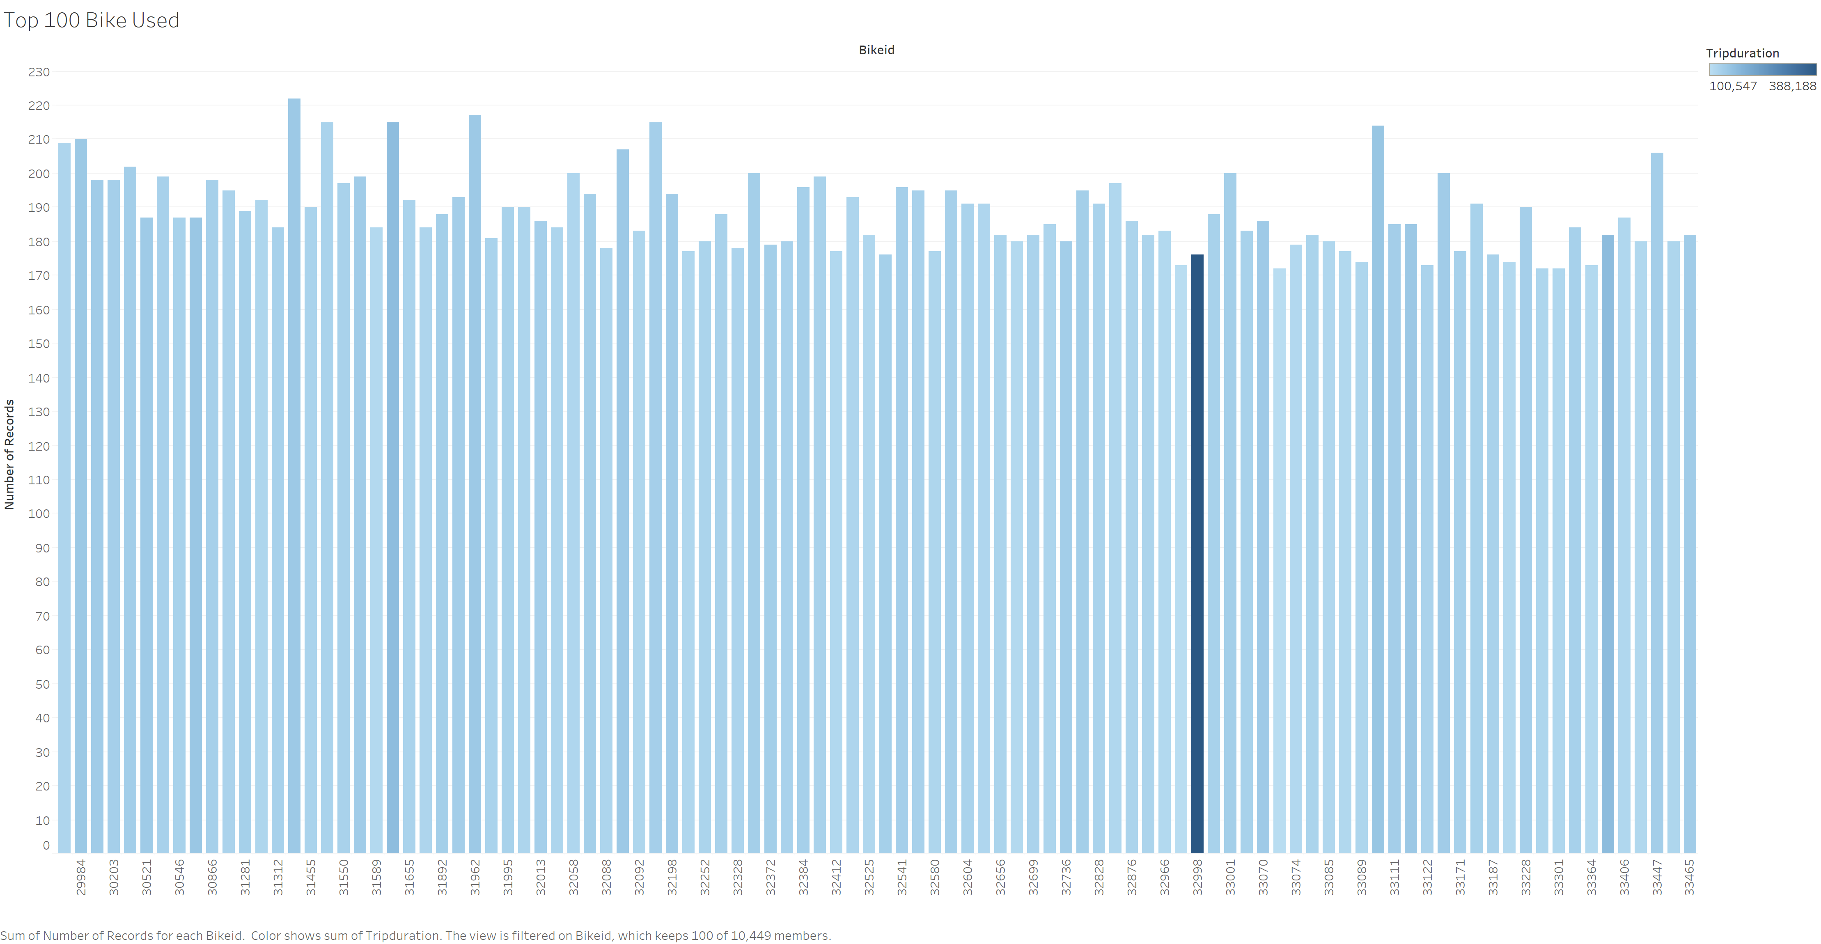

Slide 5
