Slide 1

Final Project Presentation
on
Sentiment Analysis on Twitter Data using PySpark
Team Members
Group-D19
D. Mohammad Abdulla - BL.EN.U4AIE21044
G. Tejdeep Reddy - BL.EN.U4AIE21048
G. Mukesh Venkata Sai - BL.EN.U4AIE21050
Date: 28th June 2023
Course :Big Data Analytics 21AIE214
AI 4th sem –D Sec

Slide 2
Outline
Introduction
Problem statement
Dataset
Proposed Framework
Evaluation Metrics
Results
Conclusion
Scope for Improvements
References

Slide 3
Introduction
This presentation explores the implementation of Machine Learning and PySpark for Twitter Sentiment Analysis.
Twitter sentiment analysis analyzes emotions and opinions in Twitter data using machine learning algorithms.
Twitter's vast user base of over 330 million active users makes it a valuable source of information for businesses and individuals.
Sentiment analysis helps understand public sentiment towards specific topics or brands, enabling informed decision-making.
Machine learning algorithms play a crucial role in sentiment analysis by automatically classifying tweets into positive, negative, or neutral sentiments.
PySpark is introduced as a powerful tool for processing large-scale Twitter data, leveraging Apache Spark's distributed computing capabilities.

Slide 4
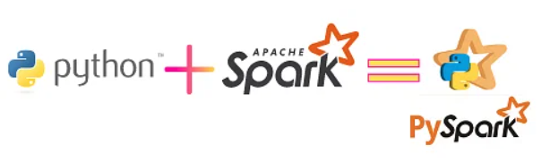
Pyspark
PySpark is a Python API for Apache Spark
the collaboration of Apache Spark with Python.
Some of the industry giants like Yahoo, Netflix, etc., are leveraging various functionalities of Spark PySpark
PySpark allows us to create model workflows in cluster environments for model training and serving.
It has the benefit of being able to scale to far more giant data sets compared to the Python Pandas library.

Slide 5
Pyspark
PySpark is a powerful tool for sentiment analysis due to the following reasons:
Scalability
Distributed Data Processing
Performance Optimization
Feature Extraction
istributed Machine Learning

Slide 6
Problem Statement
In this project, we aim to perform sentiment analysis on Twitter data using PySpark and machine learning. We will apply various preprocessing techniques, such as text cleaning, tokenization, and feature extraction, to transform the raw text data into a format suitable for sentiment analysis.
PySpark's built-in transformers and estimators will be utilized for these tasks.
We will split the preprocessed Twitter data into training and testing sets, allowing us to train a sentiment analysis model using machine learning algorithms available in PySpark

Slide 7
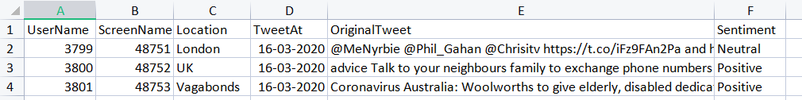
Dataset
We took a twitter sentiment analysis dataset
This dataset includes thousands of tweets collected for sentiment analysis.
It is labeled with sentiment polarity (positive, negative, or neutral) and can be used for training and testing sentiment analysis models.
The dataset we took, there are totally of 6 colums

Slide 8
What is sentimental analysis?
Sentiment analysis, also known as opinion mining, determines the sentiment or emotional tone expressed in text.
It uses natural language processing (NLP) and machine learning techniques to classify text into positive, negative, or neutral sentiments.
Steps involved in sentiment analysis include text preprocessing, feature extraction, model training, sentiment classification, and evaluation.
Text preprocessing involves cleaning, tokenization, stemming, and removing stop words.

Slide 9
Proposed Framework
Preprocessing Before training the machine learning model, the tweets are preprocessed to clean and tokenize the text. The preprocessing steps include:
Removing URLs, mentions, and special characters from the tweets
Converting the text to lowercase
Tokenizing the text into words
Removing stop words and words with a length of less than 3
Data Cleaning: The dataset is cleaned using regular expressions to remove special characters, punctuations, numbers, and URLs.

Slide 10
Tokenization: The text is split into words and stored in a new column.
Stop Words Removal: Stop words like "the", "a", "an", etc., are removed from the text. N-grams Creation: The text is split into n-grams to capture the context of the text. TF-IDF Vectorization: The n-grams are converted into vectors using the TF-IDF algorithm. Training and Testing: The data is split into training and testing sets, and a Logistic Regression model is trained on the training data. Evaluation: The model is evaluated using accuracy, F1-score, confusion matrix, and ROC-AUC.

Slide 11
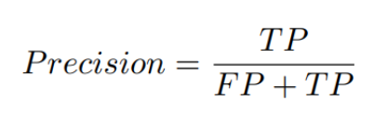
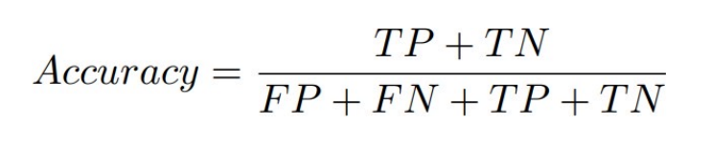
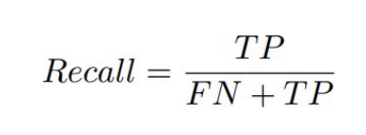
Evaluation Metrics
Precision:
Precision is the proportion of correct predictions among all predictions of a certain class. It is the proportion of true positives among all positive predictions.
Accuracy:
Accuracy is the proportion of examples that were correctly classified. More precisely, it is the sum of the number of true positives and true negatives, divided by the number of examples in the dataset
Recall:
Recall is the proportion of examples of a certain class that have been predicted by the model as belonging to that class. It is the proportion of true positives among all true examples.

Slide 12
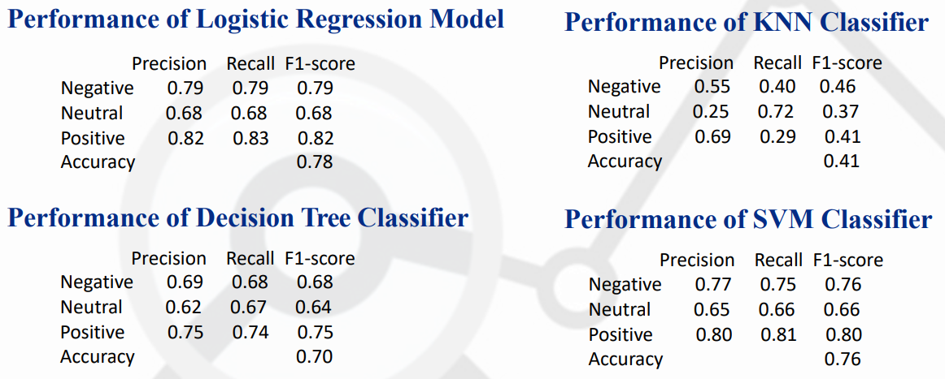
Results
Performance Metrics and Accuracy (count vector)

Slide 13
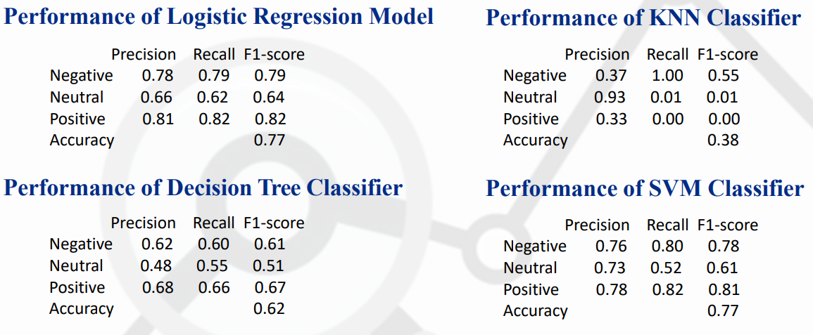
Performance Metrics and Accuracy (TF-IDF Vector)

Slide 14
Conclusion
Sentiment analysis on Twitter data using PySpark provides valuable insights into public sentiment, brand perception, and emerging trends
By leveraging PySpark's distributed computing capabilities and machine learning algorithms, we can efficiently process and analyze large volumes of Twitter data
The proposed framework outlines the step-by-step process, including data acquisition, preprocessing, feature extraction, model training, evaluation, and sentiment prediction

Slide 15
Scope for Improvements
Handling Noisy Data : Enhancing the data preprocessing steps to handle these noise sources can improve the accuracy of sentiment analysis
Advanced Feature Engineering : We can explore sentiment lexicons, part-of-speech tagging, or syntactic parsing
Emotion Detection: Expanding the sentiment analysis task to include emotion detection can allow deeper understanding of sentiment
Domain-Specific Sentiment Analysis: Tailoring the sentiment analysis model to specific domains

Slide 16
References
https://www.projectpro.io/article/spark-streaming-example/540
https://www.youtube.com/watch?v=OyQAjXeY4cU
https://medium.com/analytics-vidhya/congressional-tweets-using-sentiment-analysis-to-cluster-members-of-congress-in-pyspark-10afa4d1556e
https://ieeexplore.ieee.org/document/8639195
https://towardsdatascience.com/sentiment-analysis-on-streaming-twitter-data-using-spark-structured-streaming-python-fc873684bfe3

Slide 17
Thank You

