Slide 1
First Term Efforts.

Slide 2
Searching For Ideas.
At the beginning I had participated in the searching for the core idea of the Graduation Project, and I interested in a project that aims to implement an Oscillatory Neural Network which measures the phase differences between some oscillators to generate binary data.
Finaly, we decided that this project is not suitable for us because the resources of that topic was extremely rare to us.

Slide 3
Zigbee Project.
After searching we had decided that our GP would be the Zigbee wireless communication device with some new features one of these features is using a Recurrent Neural Network which would replace the traditional receiver blocks.

Slide 4
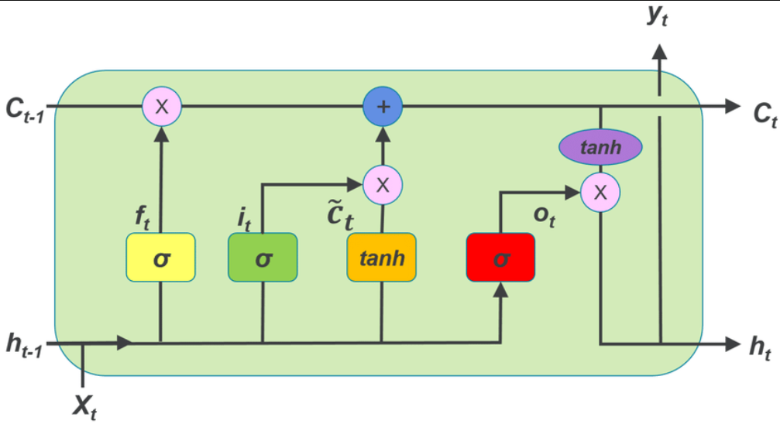
Recurrent Neural Network.
By dedicating my efforts to extensive research on neural networks, I have successfully gained an in-depth understanding of their various types, workings, and benefits.
Then I worked on getting knowledge about the RNN itself and its features and different types like vanilla RNN and Long Short-Term Memory with their pros and cons.

Slide 5
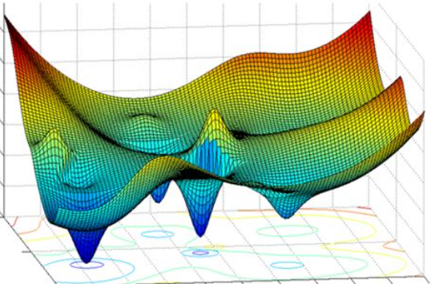
Training Concept.
In our project the RNN must behave in some manner and to do that we should train it properly. My work was about what is the meaning of training a hardware machine how is it done and what is its mathematical background.
After that I started to search for software platforms and libraries that present these services and how to write software code that performs the training.

Slide 6
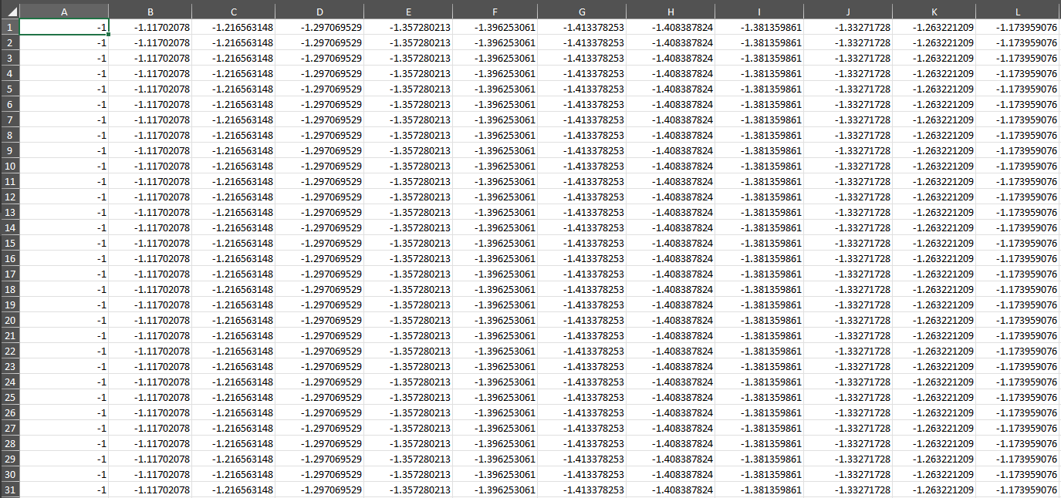
MATLAB Code.
Eventually after deciding the forms of the data that our RNN will deal with, I started to write a MATLAB code that generates the signals which is transmitted by the Zigbee transmitter by the different symbols.

