Slide 1
Smart Home Automation System
Abdullah (FA21-BCE-008)
Mitwas (FA21-BCE-017)

Slide 2
What is Home Automation?
Definition:
The use of technology to control and automate household systems like lighting, heating, and security.
Importance:
Enhances convenience, security, and energy efficiency.
Benefits:
Remote control of devices.
Automation of daily routines.
Improved energy management.

Slide 3
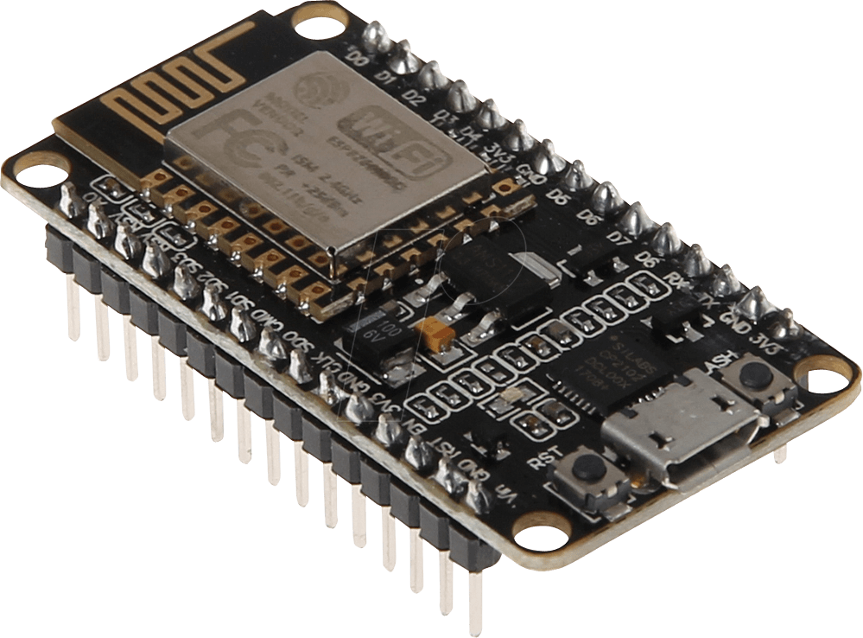
Why Choose ESP8266 and Blynk?
Advantages of ESP8266 and Blynk
ESP8266:
Cost-effective Wi-Fi module.
Easy integration with various sensors and actuators.
Extensive community support and documentation.
Blynk App:
User-friendly interface for controlling IoT devices.
Real-time monitoring and control from anywhere.
Supports both iOS and Android platforms.

Slide 4
Components Required
Following are the components required:
NodeMCU 1.0: Development board with ESP8266
Mobile Phone: To control via the Blynk app
4-channel relay Relay: Solid-state relay for reliability
5V Power Supply: Relay and component power
4 Bulbs: As 4 devices are required
Connecting Wires, Jumper Wires, Heat Shrinks, Screwdrivers, and Basic Tools

Slide 5
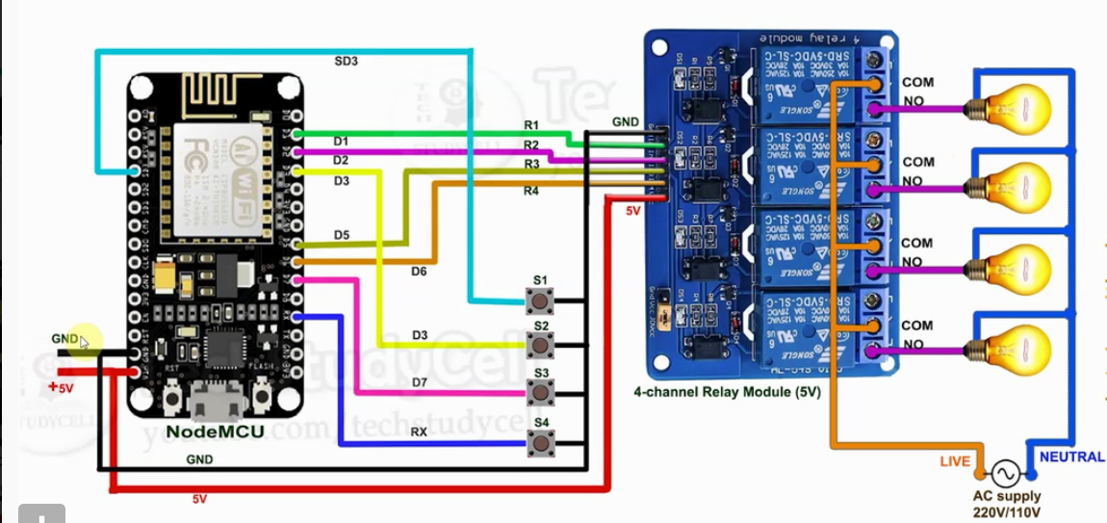
Circuit Diagram

Slide 6
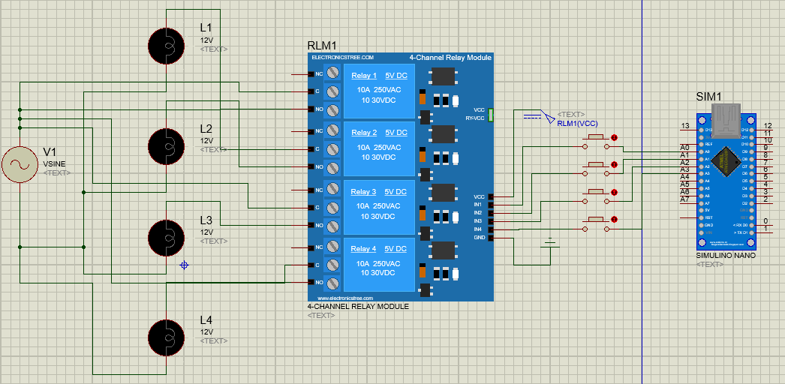
Proteus Simulation

Slide 7
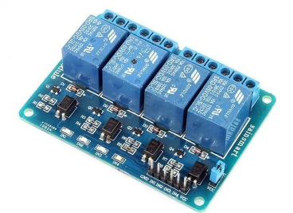
Why Use a 4-Channel Relay
Advantages and Applications
Control Multiple Devices:
Simultaneous Control:
A 4-channel relay module allows you to control up to four devices independently.
Ideal for home automation projects where multiple appliances need to be managed.
Versatility:
Can be used to control lights, fans, heaters, and other electrical devices.
Ease of Integration:
Direct Connection:
Easily interfaces with microcontrollers like NodeMCU, Arduino, and Raspberry Pi.
Simple wiring with control pins connected to the GPIO pins of the NodeMCU.
Cost-Effective:
Economical Solution:
Provides a cost-effective way to control multiple devices with a single module.
Reduces the need for multiple single-channel relays, saving space and money.

Slide 8
Project Benefits:
Advantages of Using ESP8266 and Blynk App
Cost-Effective:
Affordable Components:
ESP8266 and related components are inexpensive, making it a budget-friendly project.
Free Blynk Cloud:
The Blynk app offers a free cloud plan, reducing ongoing costs.
Ease of Use:
User-Friendly Interface:
The Blynk app provides an Simple interface for controlling devices.
Simple Setup:
Easy to configure and set up using Arduino IDE and the Blynk app.
Remote Accessibility:
Control from Anywhere:
Manage home appliances from anywhere in the world using the Blynk app.
Multiple Device Control:
Use multiple smartphones to control the system via a single Blynk account.

Slide 9
Limitations
Reliance on Wi-Fi Connectivity:
Connectivity Issues:
The system heavily depends on a stable Wi-Fi connection.
Any interruption can result in the inability to control devices remotely.
Range Limitations:
Wi-Fi signals may not cover all areas of a large house, leading to connectivity issues in certain zones.
Security Concerns:
Vulnerability to Hacking:
Since the system is connected to the internet, it is potentially vulnerable to hacking and unauthorized access if not properly secured.
Data Privacy:
Data transmitted over the internet, including device status and control commands, could be intercepted if not encrypted properly.

Slide 10
Future Enhancements:
Smart Home Integration:
Connect with other smart home platforms like Google Home, Alexa, or Apple HomeKit.
Use voice commands for control.
Automation Routines:
Implement complex automation scenarios (e.g., morning routines, security checks).
Use Blynk’s eventor feature to create conditional triggers and actions.
Using Sensors to make different systems automatic.

Slide 11
Thanks For Your Time

