Slide 1
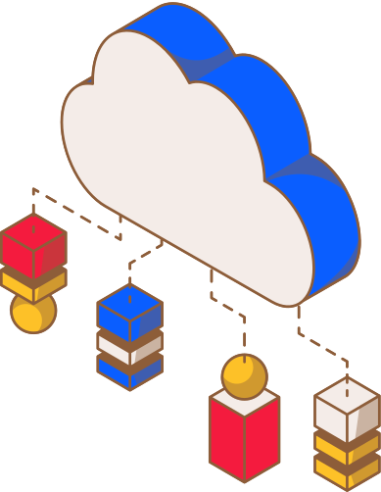

Parallel and Distributed Computing
Cloud Storage and Cloud Computing Architecture
Department of Computer Science
Presented by
Rafia Akbar sp23/bscs/007
Aemaan Ahmed sp23/bscs/053
Azka Noor sp23/bscs/150
Lahore Garrison University LGU

Slide 2
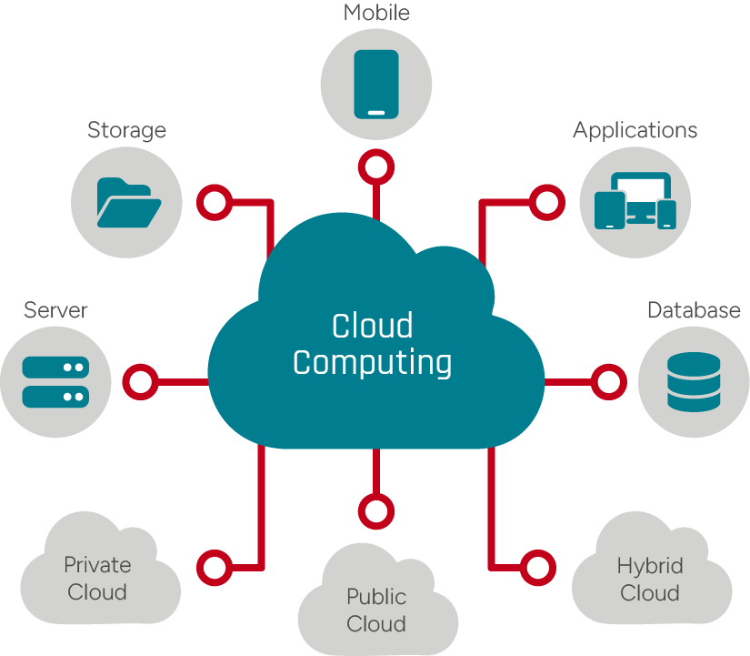

Parallel and Distributed Computing
What is Cloud Storage?
Cloud storage is a method to save data on the internet instead of your computer or hard drive — using remote servers managed by cloud providers, accessible anytime from anywhere.
Internet-Based: Files live on remote servers, not your local device
Any File Type: Documents, photos, videos, backups & more
Redundancy: Multiple server copies keep your data safe from loss
Department of Computer Science

Slide 3
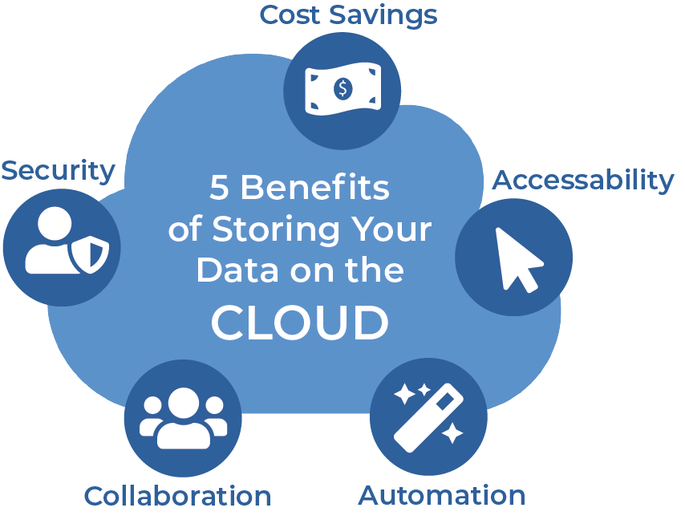
Parallel and Distributed Computing
Why Use Cloud Storage?
  No hardware to buy
Don't buy expensive servers
  Unlimited space
Click the button if you need more space.
  Access anywhere
Internet is all you need to access the storage.
  Automatic backup
Provider copies your data for you so it remains available and reliable.
  Pay for what you use
0.01perGB,not10,000 upfront
Department of Computer Science

Slide 4

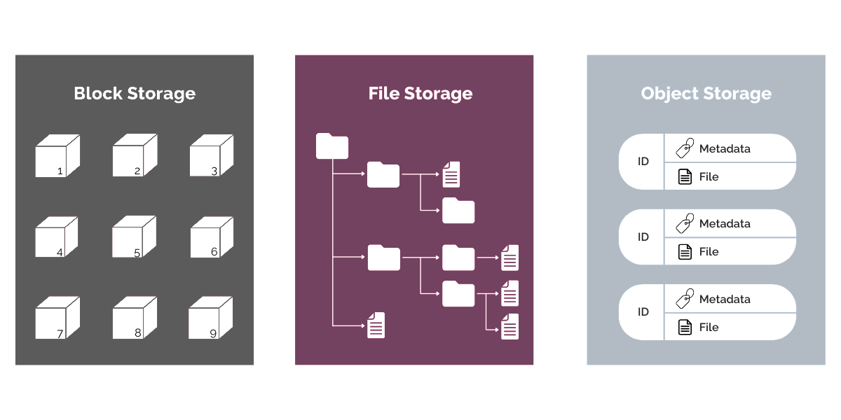
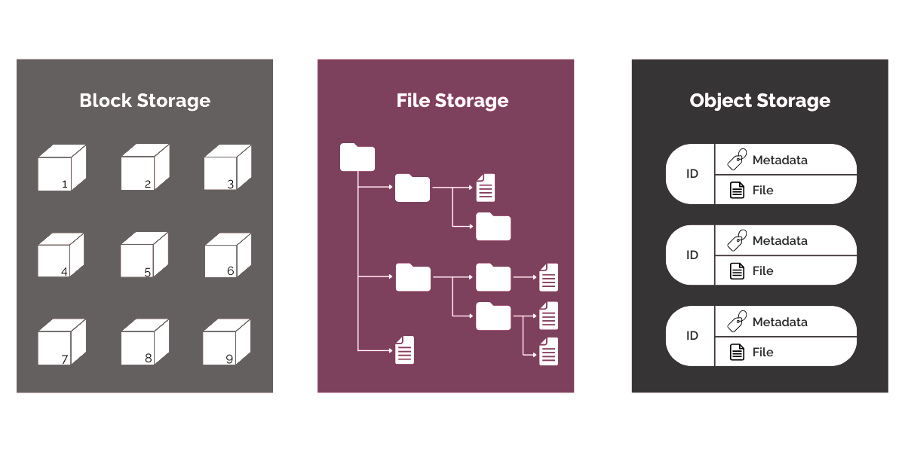
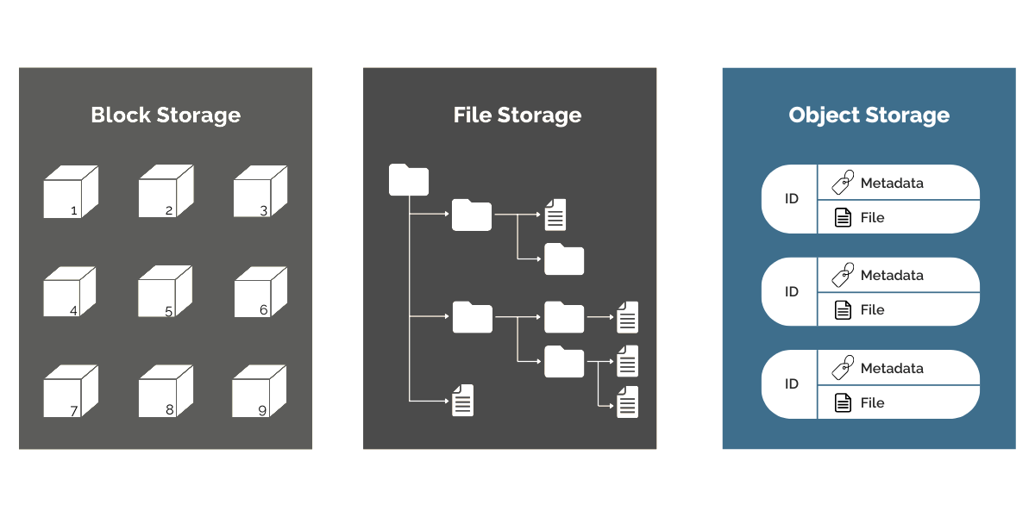
Parallel and Distributed Computing
Types of Cloud Storage – Overview
Object Storage
Block Storage
File Storage
Department of Computer Science

Slide 5
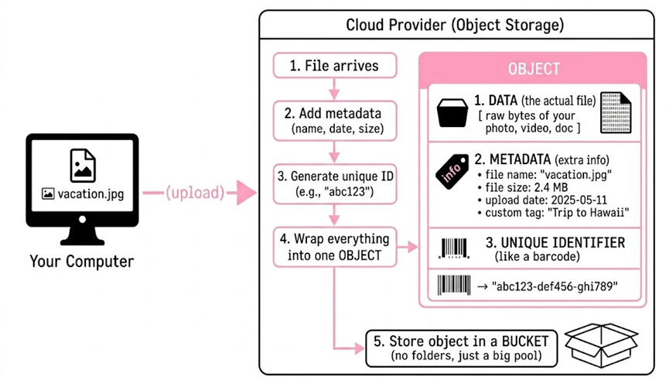
Parallel and Distributed Computing
Type 1 – Object Storage
  Files are stored as individual objects (not in folders).
  Each object has data, metadata, and a unique ID.
  Accessed via HTTP/REST APIs (GET, PUT, POST, DELETE).
Department of Computer Science

Slide 6
Parallel and Distributed Computing
Type 1 – Object Storage
Example
When to use:
Advantages
Disadvantages
  Amazon S3
  Google Cloud Storage
  personal services like Google Drive
  Photos
  videos
  audio file
  backups
  log files
  static website hosting.
  Extremely scalable
  Cheap for large amounts of data, rich metadata.
  Slower than block storage
  cannot modify a small part of a file
  Not suitable for fast transactional systems e.g databases
Department of Computer Science

Slide 7
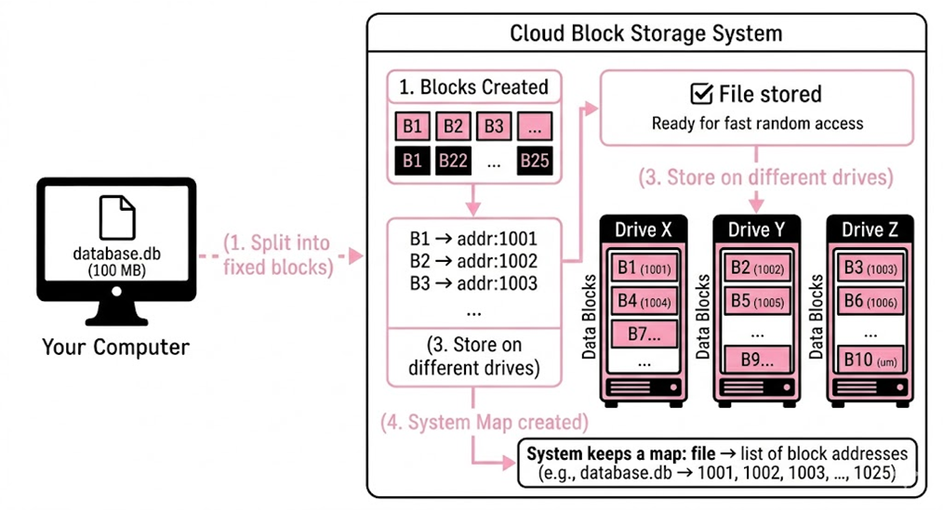
Parallel and Distributed Computing
Type 2 – Block Storage
  Block storage takes your file and cuts it into small, fixed-sized blocks.
  Each block has its own address.
  These blocks can be stored on different physical drives.
Department of Computer Science

Slide 8
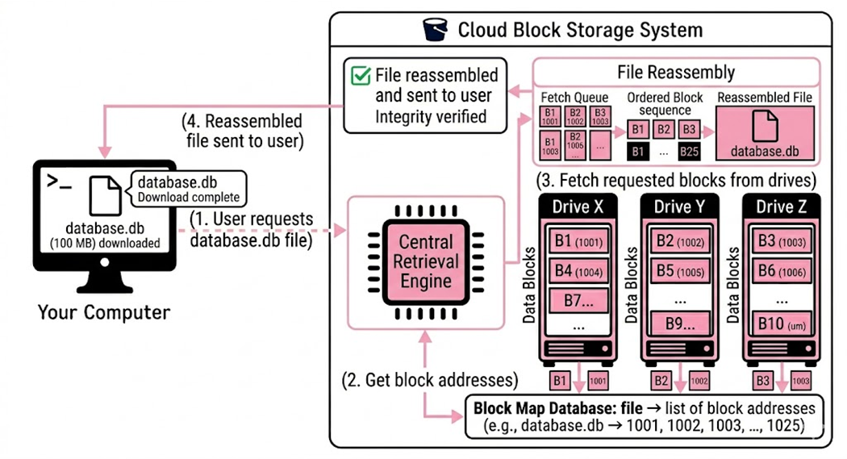
Parallel and Distributed Computing
Type 2 - Block Storage
When you need the file, the system fetches all the blocks and reassembles them.
Department of Computer Science

Slide 9
Parallel and Distributed Computing
Type 2 – Block Storage
Example
Best For
Advantages
Disadvantages
  Amazon EBS
  Azure Disk Storage.
  Databases
  VMs
  high-speed apps
  Fast read/write.
  Can modify a single block without touching the whole file
  Expensive
  Harder to manage
Department of Computer Science

Slide 10
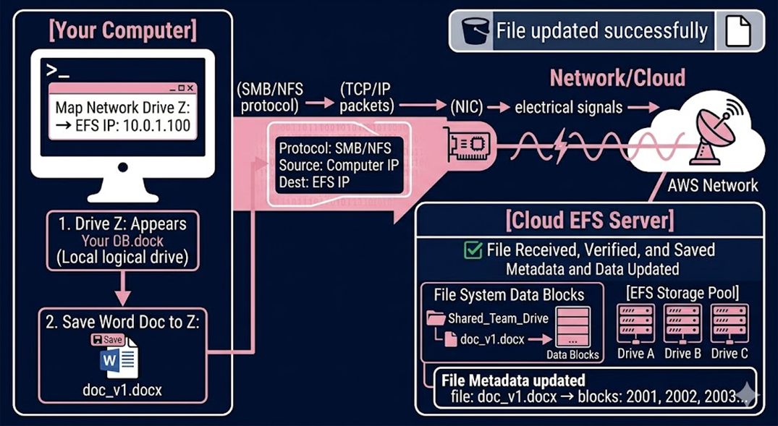
Parallel and Distributed Computing
Type 3 - File Storage
Works like a shared network drive. Connects via NIC over a network to a NAS (Network-Attached Storage) server. Pre-formatted — no partitioning needed. OS sees it as a mapped drive letter.
Department of Computer Science

Slide 11
Parallel and Distributed Computing
Type 3 – File Storage
Example
Best For
Advantages
Disadvantages
  Amazon EFS
  Azure Files
  Google Filestore
  Shared drives
  collaborative file access
  Files organized in folders, familiar structure, easy to use .
  No need to partition
  Limited scalability.
  Handling metadata is limited
Department of Computer Science

Slide 12


Parallel and Distributed Computing
How to Choose the Right Type
01
Criteria
Object Storage
Block Storage
File Storage
02
Best For
Media, backups, logs
Databases, VMs
Shared network drives
03
Performance
Moderate
High
Moderate
04
Scalability
Excellent
Limited
Good
05
Use When
Storing large files
Speed matters most
Team file sharing
Department of Computer Science

Slide 13
Parallel and Distributed Computing
Storage Tiers (Hot → Cold → Archive)
The less you access data, the less you pay.
Storage tiers categorize data by access frequency and value to optimize cost and performance, generally splitting data into hot (active), warm (infrequent), and cold (archival) categories
Hot
Cool
Cold Tier
Archive
Optimized for data being accessed or modified frequently.
Access daily (today's photos)
Cost: Highest
Optimized for data that is accessed occasionally but still needs quick availability.
Access monthly (backup files)
Cost: Medium
Optimized for data that is rarely accessed and stored mainly for long-term backup or compliance purposes.
Access yearly (old company records)
Cost: Low
Optimized for data that is almost never accessed and kept only for preservation or legal requirements.
Access only when needed in emergencies
Cost: Lowest storage cost.
Department of Computer Science

Slide 14
Parallel and Distributed Computing
Security in Cloud Storage
Data Encryption
Security Audits
Files encrypted at rest and in transit unreadable to intruders
  01
  04
Regular third-party audits + GDPR & HIPAA compliance
Multi-Factor Auth (MFA)
Secure File Sharing
  02
  05
Password-protect links with auto-expiry dates
Extra login layer — password + phone code required
Security
Role-Based Access (RBAC)
Redundancy & Backup
Control who can view, edit, or share specific files
  03
  06
Data replicated across multiple data centers worldwide
Department of Computer Science

Slide 15
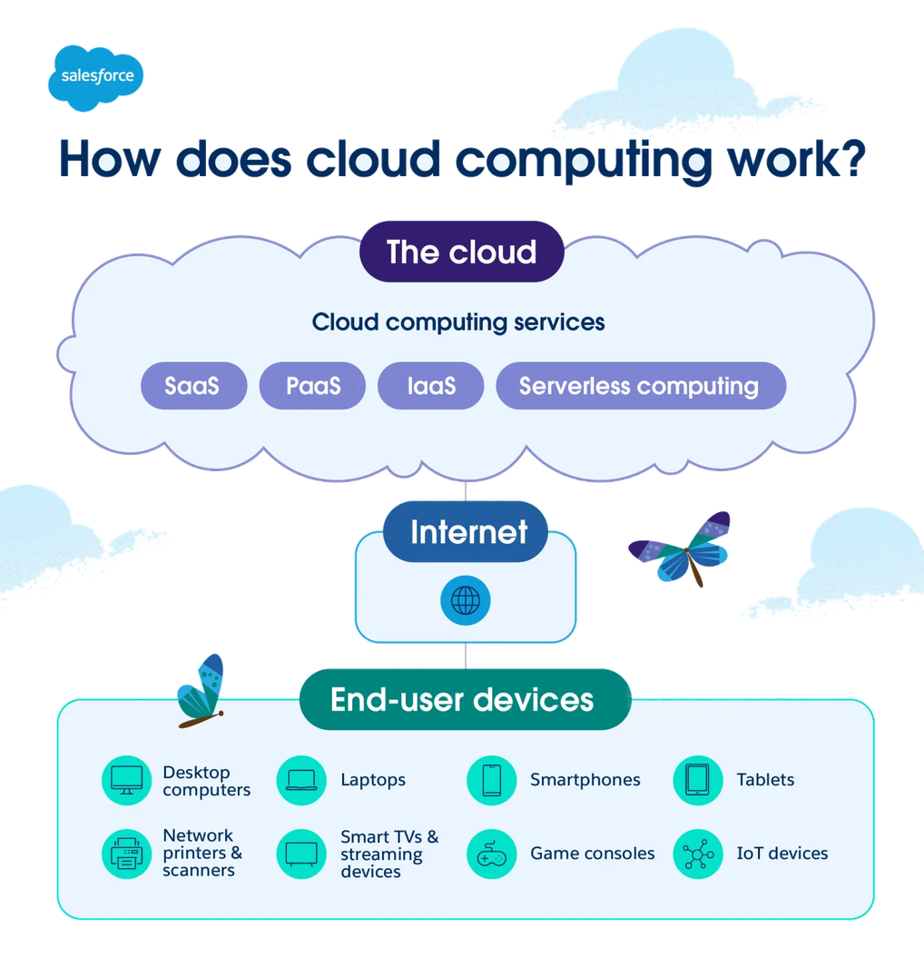
Parallel and Distributed Computing
What is Cloud Architecture
  The blueprint that shows how all cloud pieces (servers, databases, networks, storage) connect and work together.
  Cloud architecture is the conceptual blueprint and structural design of how technology components such as servers, storage, databases, and networking are combined and managed to create cloud computing environments
  It defines how these resources interact over the internet to deliver scalable, flexible, and cost-effective services
Department of Computer Science

Slide 16
Parallel and Distributed Computing
The Problem Architecture Solves
The problem: A single server will crash or get overloaded.
Many servers share the load
  01
1 server handles everything
  01
One server dies → Others take over
  02
  02
Server crashes → App dies
With
Architecture
Without Architecture
More users → Add more servers
  03
Too many users → Slow
  03
Multiple locations → Backup works
  04
Data center floods → Data lost
  04
Department of Computer Science

Slide 17



Parallel and Distributed Computing
Cloud Architecture – Overview
FRONTEND
BACKEND
NETWORK
CONTROL LAYER
What user sees (browser, app)
Where work happens (servers, database, storage)
Connects everything (internet, routers)
Management, security, provisioning
Department of Computer Science

Slide 18
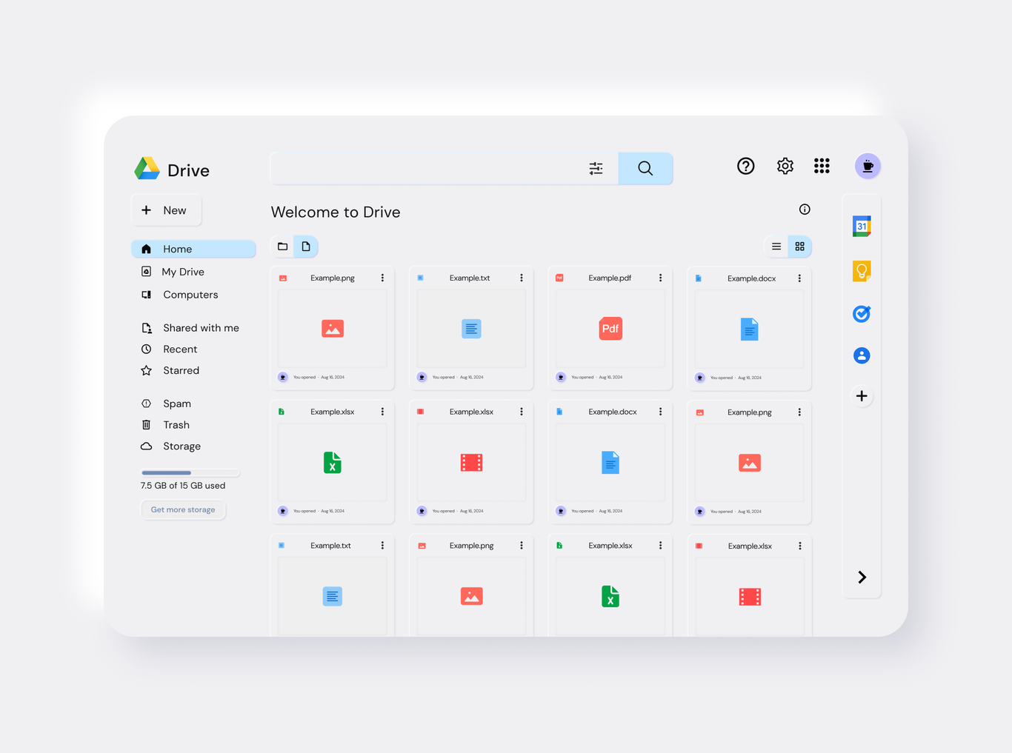
Parallel and Distributed Computing
Layer 1: Front-end layer
The front-end layer is the user-facing side of cloud computing, acting as the entry point that allows users to interact with and access services.
Examples of Front-End
  Google Drive website
  AWS dashboard
  Google Colab interface
  Web browsers
Components of Front-End
  User Interface (UI)
  Client-Side Logic
  API Calls
  State Management
Department of Computer Science

Slide 19
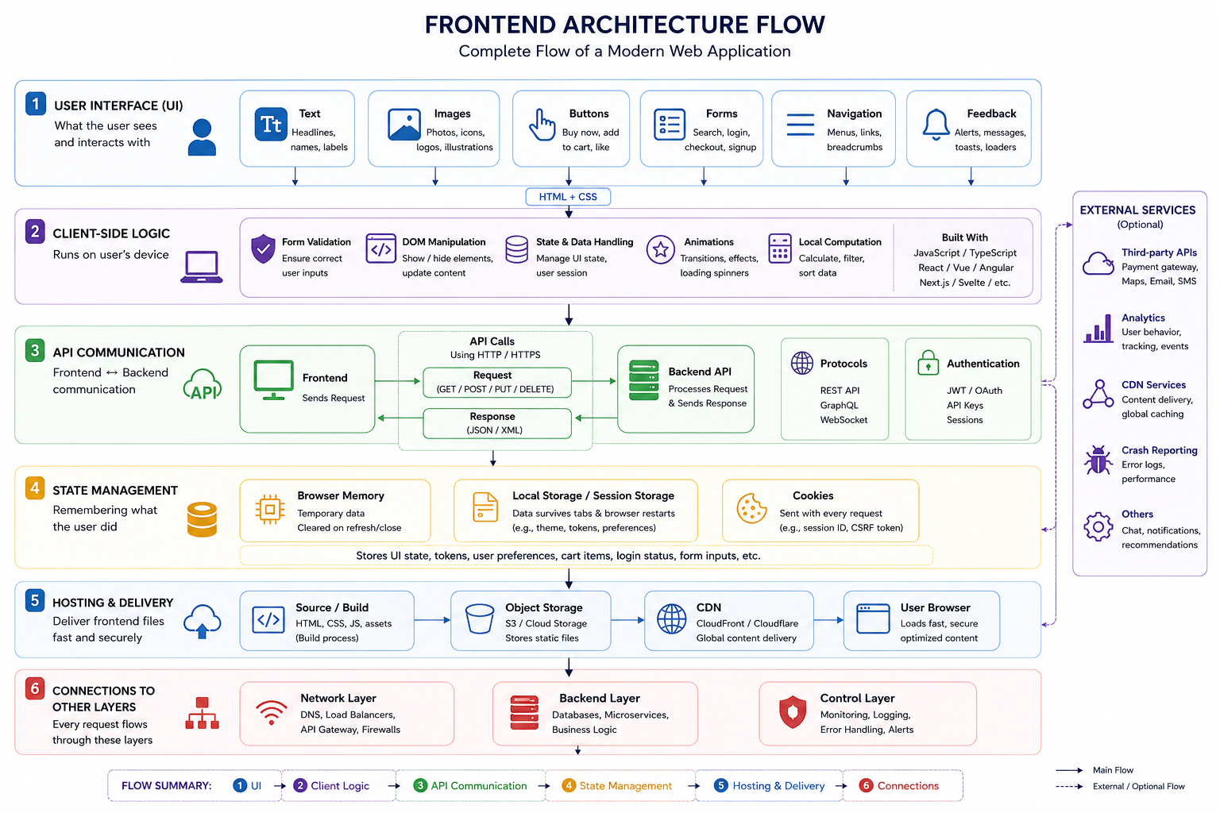
Parallel and Distributed Computing
How Front-End Works
Department of Computer Science

Slide 20
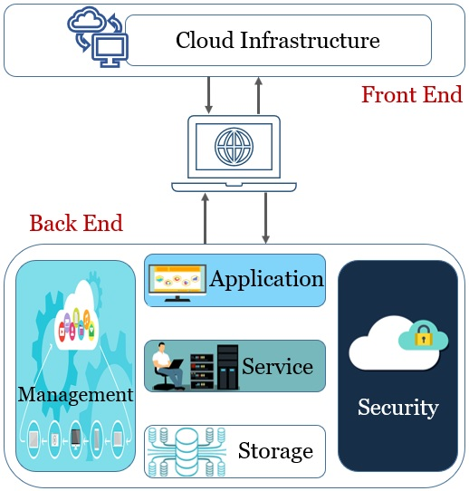
Parallel and Distributed Computing
Layer 2: Back-end layer
The backend layer of cloud architecture is the "engine room". It comprises the server-side infrastructure, databases, and application logic that process requests, store data, and execute business rules.
Core Components of the Backend Layer:
  Compute : Runs application code, processes requests
  Database: Stores structured data (users, orders, products)
  Storage: Stores files (images, videos, documents, backups)
  Cache: Remembers frequent answers for speed
  Queue: Handles slow tasks in background
Department of Computer Science

Slide 21
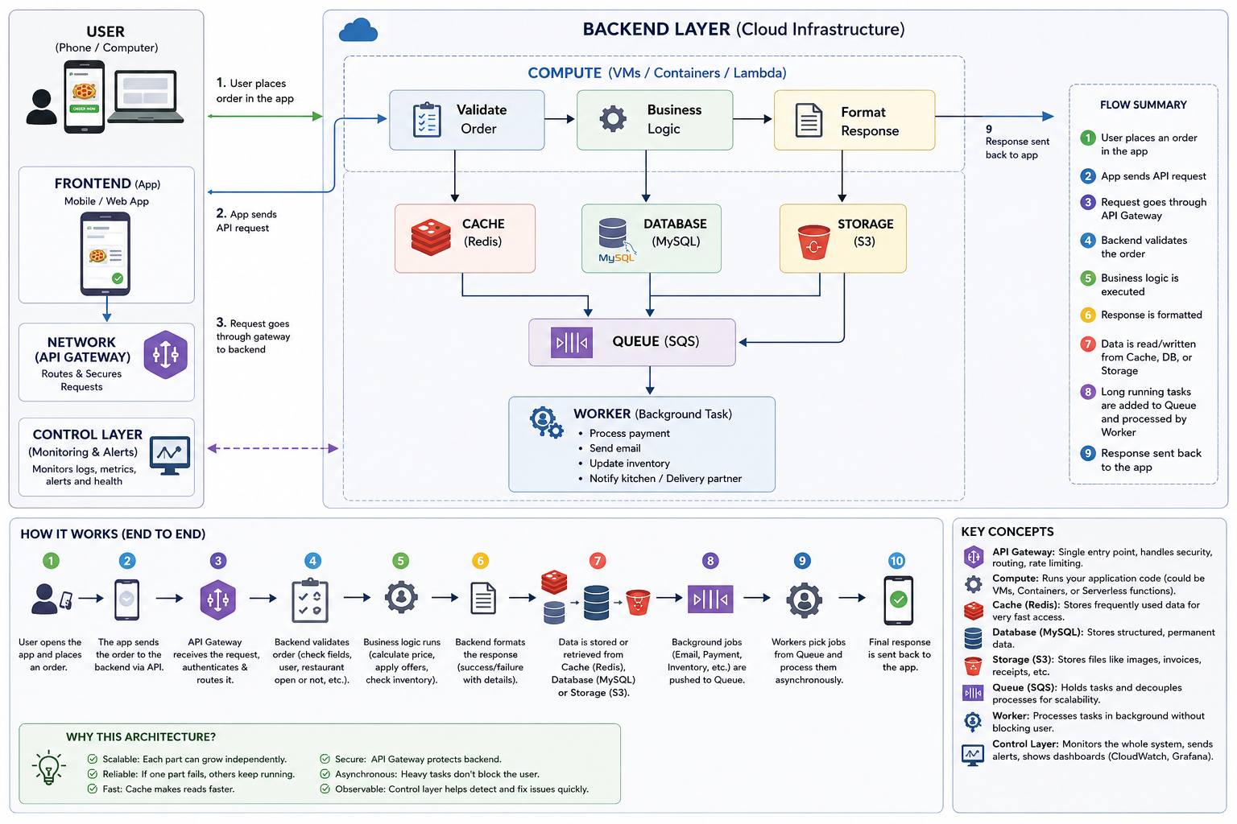
Parallel and Distributed Computing
How Back-End Works
Department of Computer Science

Slide 22
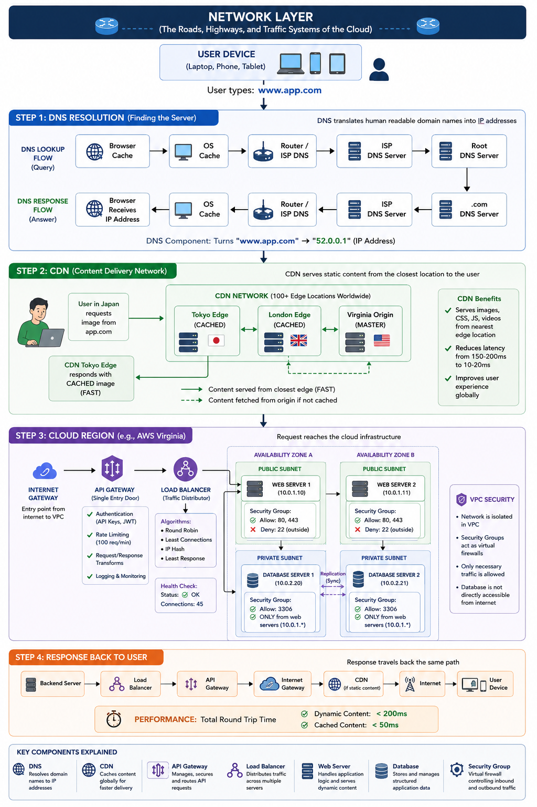
Parallel and Distributed Computing
Layer 3: Network Layer
The network layer in cloud architecture acts as the digital highway that connects end-users to cloud resources and facilitates seamless communication between microservices, storage systems, and servers
Core Components of the Network Layer:
  DNS: Turns domain names (google.com) into IP addresses (142.250.190.46)
  Load Balancer: Distributes incoming requests across multiple servers
  API Gateway: Single entry point for all API calls
  CDN: Stores copies of content near users for speed
  Firewall/Security Groups: Controls what traffic is allowed in/out
Department of Computer Science

Slide 23
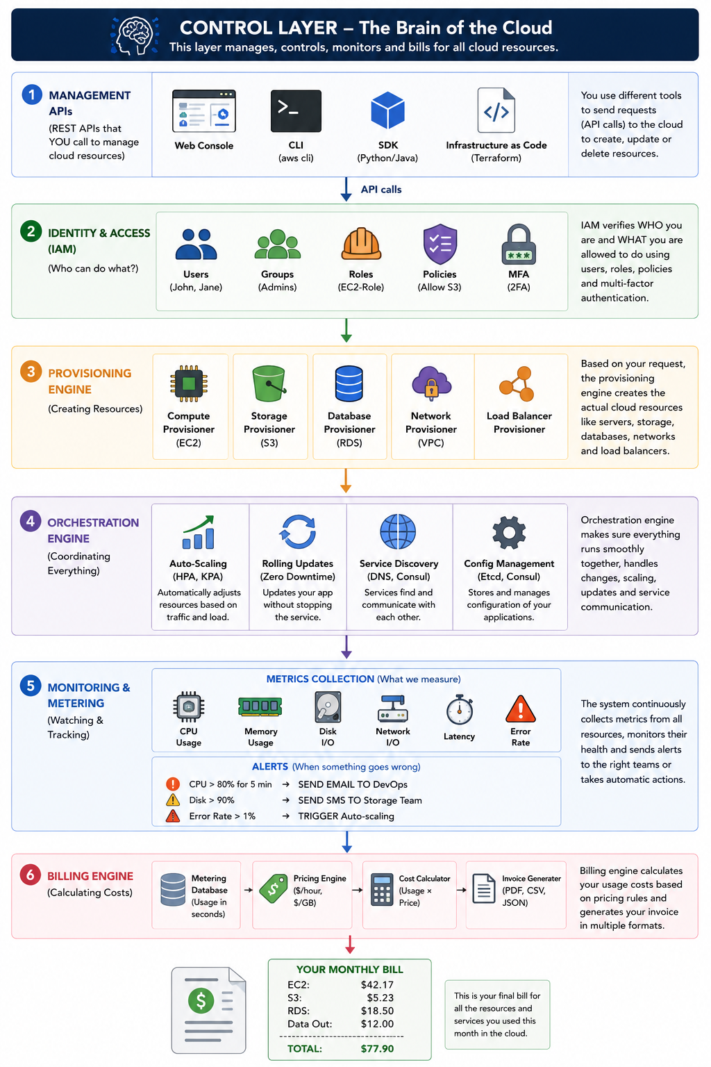
Parallel and Distributed Computing
Layer 4: Control Layer
The control layer (or control plane) in cloud architecture acts as the operational brain of the system. It manages, automates, and orchestrates cloud resources
Core Functions of the Control Layer
  Provisioning: Provisioning is the automated process of creating, configuring, and delivering cloud resources.
  Monitoring: Monitoring is the continuous collection, analysis, and alerting of metrics about cloud resources.
  Orchestration: Orchestration is the automated coordination and management of multiple cloud resources to work together as a single system.
  Metering & Billing: Metering tracks exactly how much of each cloud resource you use. Billing calculates your cost based on that usage.
  Security and IAM (Identity and Access Management) controls who can access what cloud resources and what actions they can perform.
Department of Computer Science

Slide 24
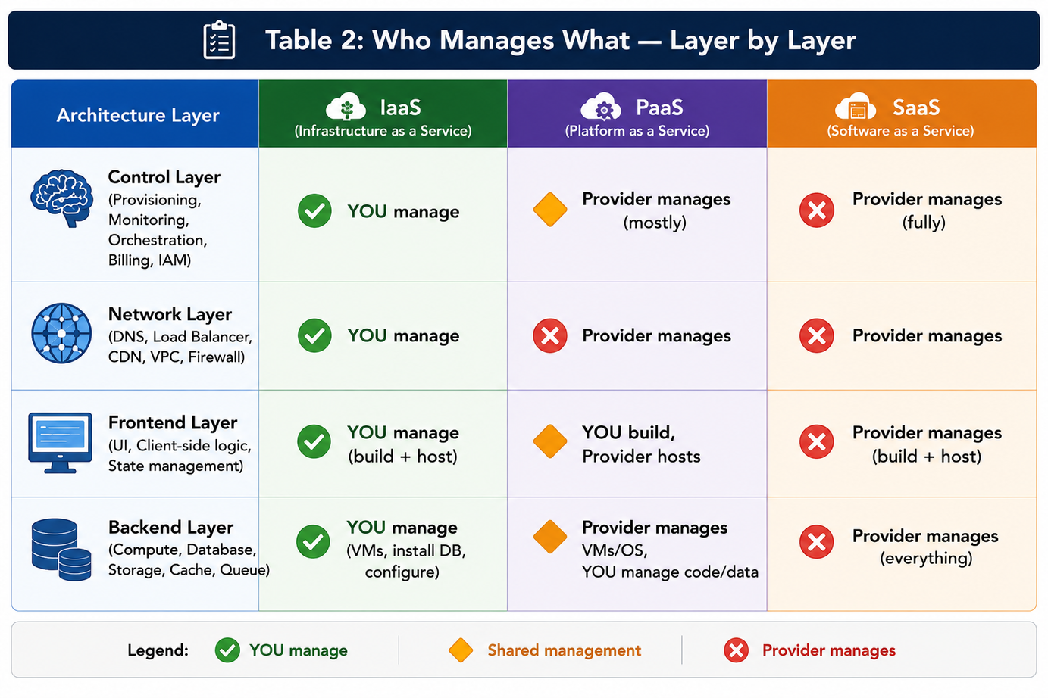
Parallel and Distributed Computing
How Service Models Affect Architecture
Service models dictate how applications are structured, deployed, and scaled, directly influencing the complexity, performance, and operational constraints of the software architecture.
Department of Computer Science

Slide 25
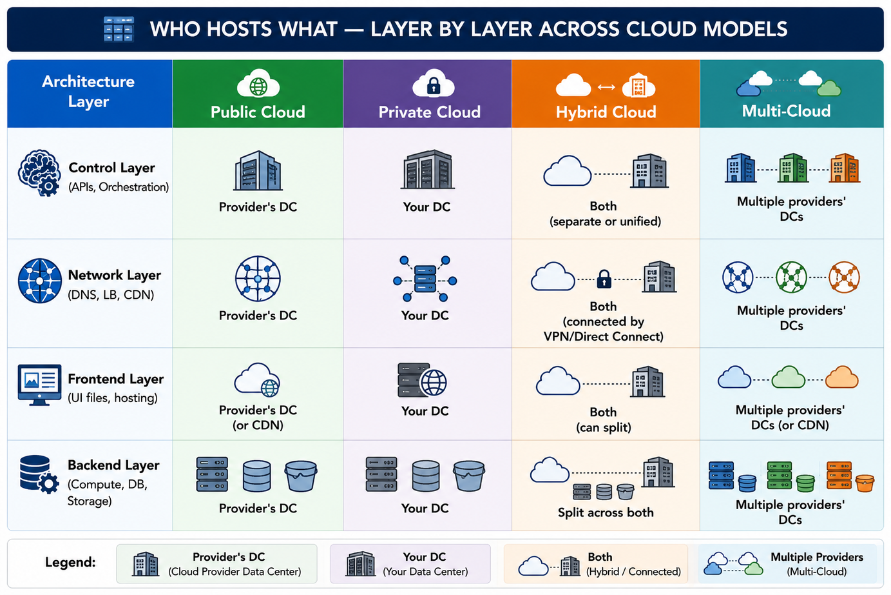

Parallel and Distributed Computing
Parallel and Distributed Computing
How Deployment Models Affect Architecture
Deployment models define where your software runs, who controls it, and how resources are organized, directly dictating key aspects of your system's architecture, including scalability, security, cost, and latency.
Department of Computer Science

Slide 26
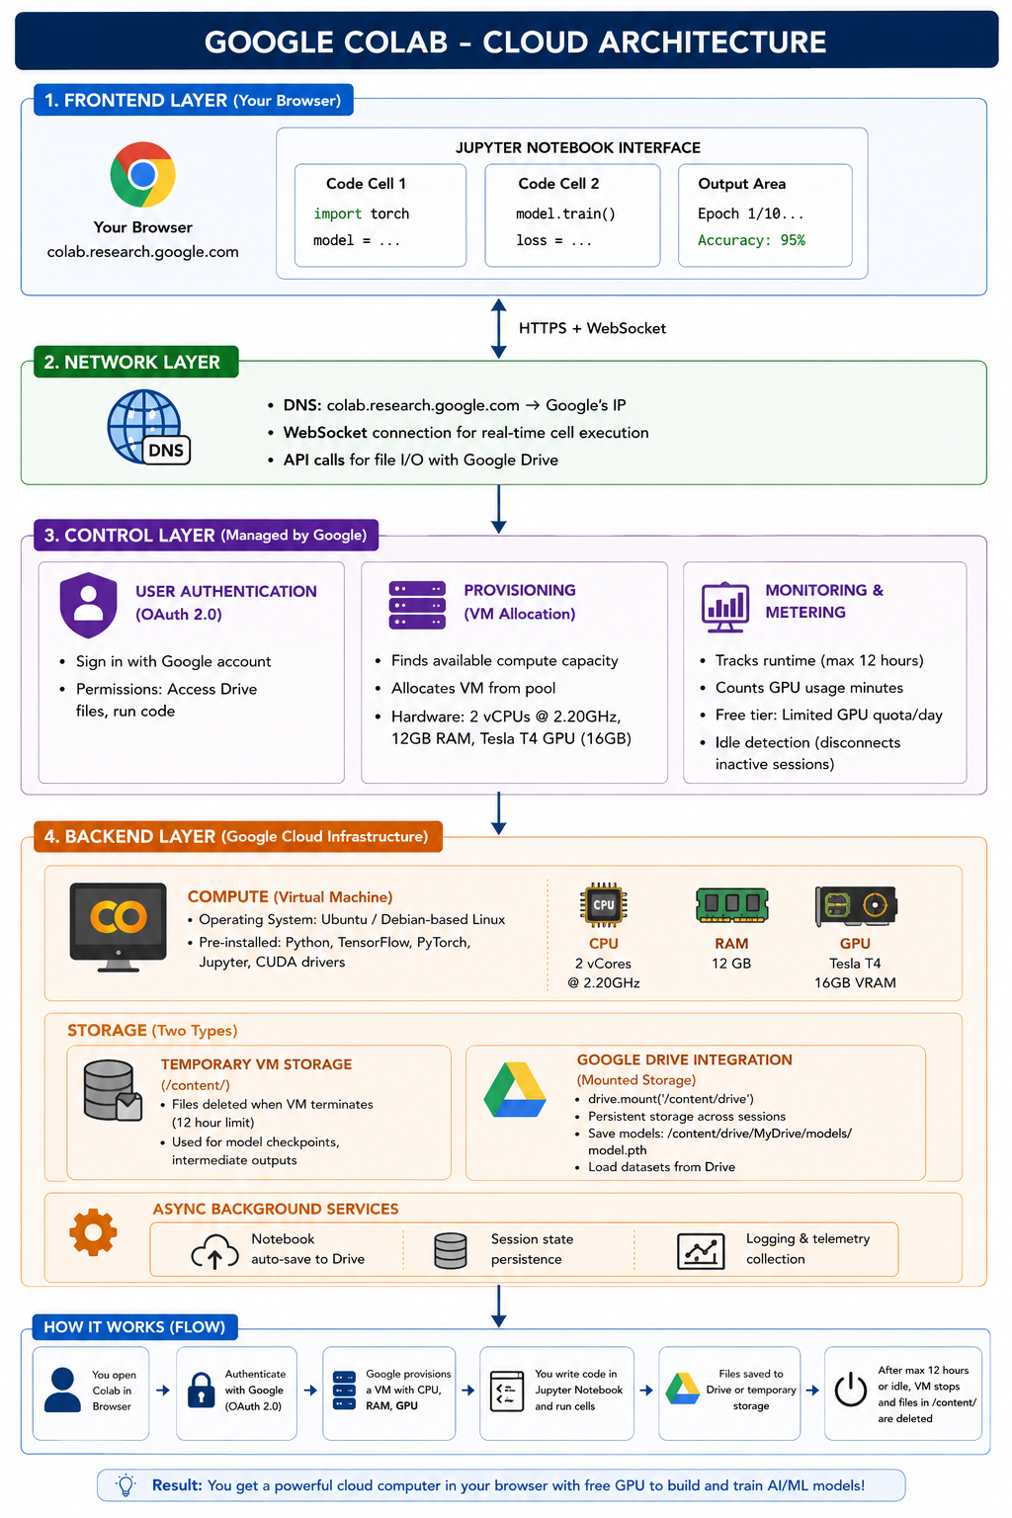
Parallel and Distributed Computing
Real World Example
Google Colab is a cloud-based Jupyter notebook environment that lets you write and run Python code in your browser, with free GPU access.
Department of Computer Science

Slide 27
Parallel and Distributed Computing
Thank You!
Department of Computer Science

