Slide 1
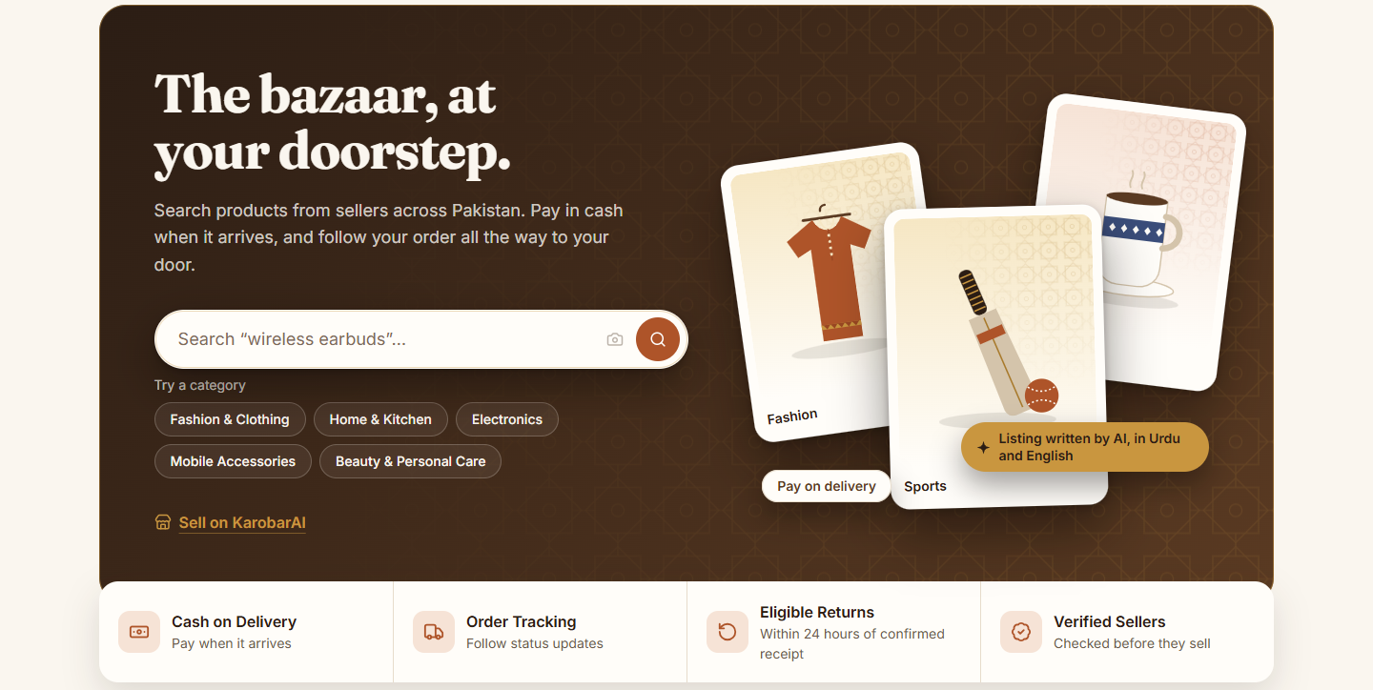
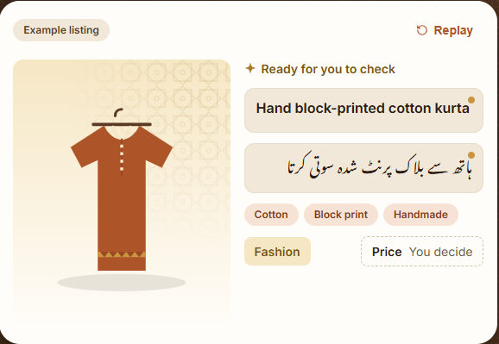
FINAL YEAR PROJECT 2026 · DEPARTMENT OF COMPUTER SCIENCE
KarobarAI
کاروبار، اب AI کے ساتھ
An AI-powered e-commerce platform that lets small Pakistani sellers run an online store from one product photo
Live demo after this deck
Presented by Rafia Akbar · Abdullah Afzal
Supervisor [Supervisor Name]
Lahore Garrison University
Notes:
HOOK: Start with a question before showing anything: 'How many of you have bought something from an Instagram or WhatsApp shop?' Ask for a show of hands. Then: 'Behind every one of those shops is a seller doing everything by hand. Today we show how KarobarAI changes that.' Introduce the team and supervisor.

Slide 2





A day in the life of Ayesha, a home-based seller
MEET OUR USER
9:00 AM
11:00 AM
2:00 PM
5:00 PM
8:00 PM
40+ WhatsApp DMs asking 'price?'
Writes captions in Urdu and English by hand
Calls 3 couriers to compare rates
Buyer asks 'where is my parcel?'
A used item comes back as a 'return'
No time to grow, no trust from new buyers, money lost on fake returns. Ayesha is not alone.
Notes:
STORYTELLING: Walk through Ayesha's day card by card, as if telling a story. Pause on the last card and ask: 'Which of these problems would you fix first?' Let one or two people answer. Transition: 'Ayesha is not alone. Look at the numbers.'

Slide 3

Pakistan's small sellers are stuck offline
PROBLEM STATEMENT
90%+
~15%
~90%
of businesses in Pakistan are SMEs, giving about 40% of GDP
of small businesses actually sell online
of e-commerce transactions are Cash on Delivery
Arab News / SMEDA, 2025
Mobilink MicroInsights 2025 (Karandaz)
State Bank of Pakistan, FY2018
Problem: Small sellers have no affordable, Urdu-friendly tool that writes listings, books local couriers, tracks orders and protects them from fake returns, so they stay on WhatsApp and lose time, trust and money.
Notes:
GUESS BEFORE REVEAL: Cover the numbers (or say them as questions first): 'What percentage of small businesses in Pakistan do you think sell online?' Take guesses, then reveal 15%. Then read the one-line problem statement slowly.

Slide 4




Who KarobarAI is built for
TARGET COMMUNITY
Home-based sellers
Small shop owners
Women and families selling clothes, food and crafts from home
Local shops that want online orders without a website
Social media sellers
Buyers
Instagram, Facebook and WhatsApp stores that manage everything by hand
People who want trusted shops, COD and live tracking
Common need: no technical skill, Urdu or English, low cost, Cash on Delivery
Notes:
RELATE: Ask: 'Do you know someone in your family who sells something from home?' Most people will. That person is our user. Keep it short and personal.

Slide 5


Many apps sell online, but each misses something
COMPETITORS
Daraz
Shopify
Social media
WooCommerce
Marketplace with COD and own delivery
Own online store with apps
Free and familiar to everyone
Free store plugin
High commission, no help writing listings, seller has no own store
Paid in USD, English-first, local couriers and COD need extra apps
No cart, tracking, returns or analytics; all manual
Needs hosting and technical skill to set up and run
Notes:
Go left to right quickly: one strength, one weakness each. Ask: 'Which of these would Ayesha choose?' The honest answer is usually WhatsApp, because the others are costly or complex. That is the gap.

Slide 6
The gap: nobody combines all of it
GAP ANALYSIS
Feature | Daraz | Shopify | WhatsApp | WooCommerce | KarobarAI
AI listing from one photo, Urdu + English | ✗ | ◐ | ✗ | ✗ | ✓
Automatic local courier selection | ✗ | ◐ | ✗ | ◐ | ✓
Live order tracking for buyers | ✓ | ✓ | ✗ | ◐ | ✓
AI check on return photos | ✗ | ✗ | ✗ | ✗ | ✓
Plain-language sales assistant | ✗ | ◐ | ✗ | ✗ | ✓
Free to start, no technical skill | ◐ | ✗ | ✓ | ✗ | ✓
✓ available ◐ partial or through paid add-ons ✗ missing
Notes:
Point at the KarobarAI column last. Say: 'Every other column has red. Ours is the only one that is fully orange.' The AI return check row is empty for everyone else; that is our strongest differentiator.

Slide 7






Every gap has a KarobarAI answer
HOW WE FILL THE GAPS
Writing listings takes hours
AI Store Builder: one photo becomes an Urdu + English listing
Comparing couriers by phone
Smart Logistics: scores TCS, Leopards, Trax and books in one click
Buyers don't trust new shops
Live Tracking + COD: real-time timeline and a public tracking link
Fake and used returns
ReturnsAI: compares return photos with dispatch photos (DINOv2)
Sellers can't read reports
AI assistants: ask about sales and stock in Urdu or English
Notes:
Read only the left side aloud as questions ('How do sellers write listings?') and answer each with the right side. This problem-answer rhythm keeps the audience following.

Slide 8




From one photo to a delivered order
HOW IT WORKS
1. Snap
Seller uploads one product photo
2. AI writes
Title, description, tags in Urdu + English
3. Ship
Best courier booked, buyer tracks live
4. Protect
Real AI listing from KarobarAI
Returns checked by AI, earnings settled
Notes:
TEASER: 'In a minute we will do this live: one photo, and you will watch the listing appear in Urdu and English.' This builds anticipation for the demo.

Slide 9






Basic architecture
SYSTEM ARCHITECTURE
Python AI Service
Gemini, Qwen, DINOv2
Users
Buyer, Seller, Admin
Node.js Backend
REST API, Socket.IO, business rules
React Web App
Storefront, Seller Center, Admin
Data
PostgreSQL, Redis, MinIO
External
Stripe, couriers, SMS
Everything runs in Docker containers; the AI service is never exposed to the internet.
Notes:
Keep it to 30 seconds: users use one web app, the backend holds all the rules, AI runs in a separate Python service, and data stays in PostgreSQL. Details are in the report.

Slide 10
RESULTS AND IMPACT
Ayesha's day, now
15/15
10/10
3
2
use cases passed testing
AI assistant grounding checks
couriers compared in one click
languages from one photo
Before: hours of DMs, captions and courier calls. Now: one photo, one click, and the platform does the rest.
Let's see it live
Questions?
Notes:
CALLBACK: Bring back the opening story: 'Remember Ayesha's day? Here is her day now.' Read the four numbers. Then: 'Instead of telling you more, let us show you.' Switch to the live system for the demo, then take questions.

