Slide 1
A short presentation on weather app
An app to know your weather forecast

Slide 2
Team introduction
aBdUllah bin habib, roll - 1607002
Md. Tasnimul khair tousif, roll - 1607015
Md. Mahmud rayhan, roll - 1607026

Slide 3
What is a weather app?
As the name suggests, it shows user the weather forecast of that day and ahead.

Slide 4
How does a weather app work
It gets data from local weather stations (or state-level meteorological departments) and displays the most recent forecasts to the user.

Slide 5
introduction
why do you need this app?

Slide 6
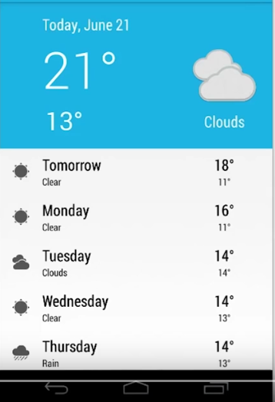
A sample weather app (launching)

Slide 7
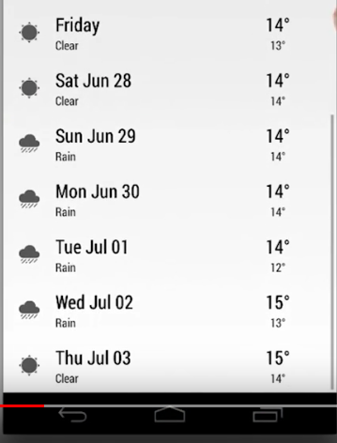
A sample weather app (scrolling)

Slide 8
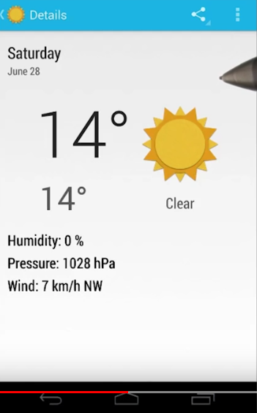
A sample weather app (Details)

Slide 9
challenges
1. Low processing power,
2. limited ram
3. impact on battery life
4. limited data cost
5. cloud storage
6. location service
7. simple ui design

Slide 10
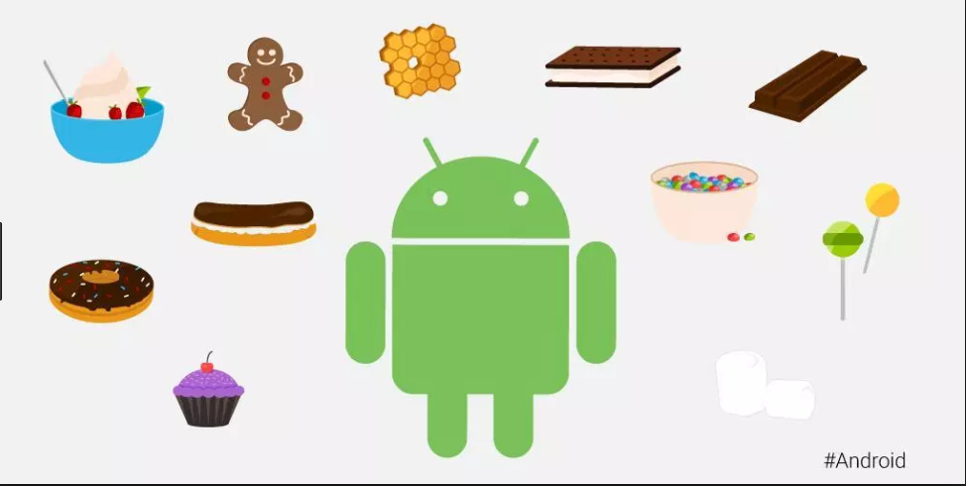

Platform and ide

Slide 11

end

