Slide 1
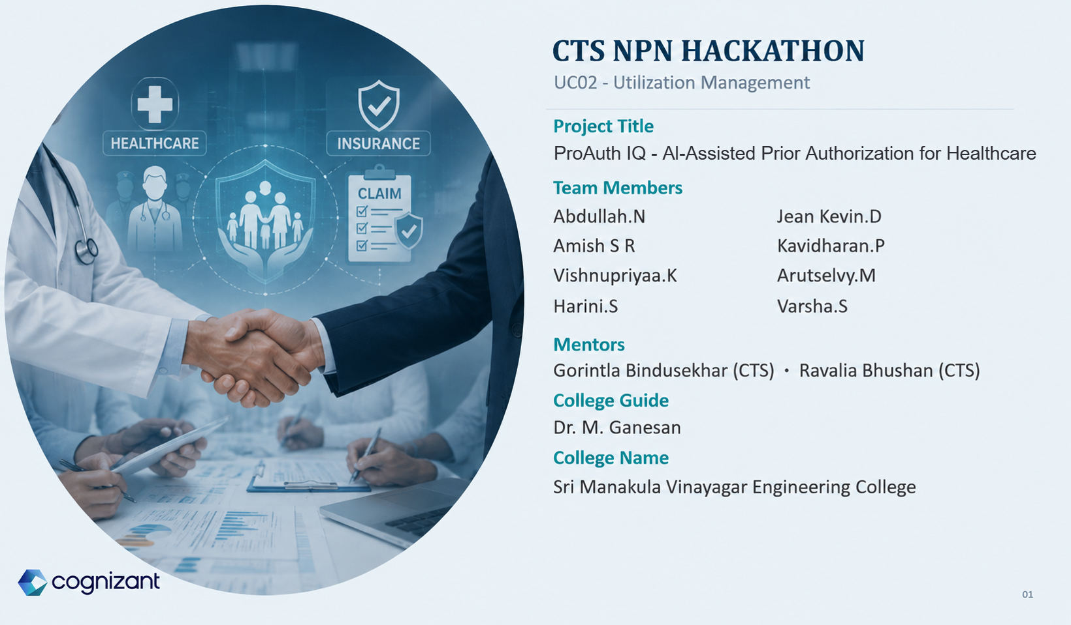

Slide 2

Problem Statement
Prior authorization is the approval a health insurer requires before certain treatments, procedures, or medications are covered — one of the most scrutinized payer processes today, because speed, accuracy, transparency, and provider experience all matter at once.
94%
1
Slow
Requests wait on manual policy and clinical review
of physicians report that prior-authorization delays directly lead to care delays for patients — and 88% call the administrative burden high or extremely high.
2
Inconsistent
Outcomes depend heavily on individual reviewer interpretation
3
Opaque
Providers and patients rarely see which criteria drove a decision
Source: AMA Prior Authorization Physician Survey
4
Evidence-heavy
Reviewers cross-reference policy, records, and documents by hand
What this means for ProAuth IQ
5
Pending cases sit in submission order even as urgency changes
Every stage below exists to remove one specific cause of delay, inconsistency, or opacity — not to replace clinical judgment.
Hard to prioritize
02

Slide 3
THE APPROACH
Solution Overview
ProAuth IQ provides an evidence-grounded prior-authorization pipeline. A doctor submits a request; the system retrieves policy evidence, evaluates clinical and documentation criteria, and produces an explainable recommendation — with a separate model prioritizing whatever still needs a human.
1
2
3
4
5
6
7
Identify
Policy
Retrieve
Evidence
Evaluate
Clinical + Docs
Assemble
Reasoning
ML
Decision
Explain
Prioritize
Applicable coverage policy determined
RAG search over the policy corpus
Criteria and required paperwork checked
Structured evidence + feature vector
Approve / Pend, with confidence
Human-readable reasoning generated
Pending cases ranked for nurses
The goal is not to replace clinical or insurance reviewers — it's to remove repetitive evidence-gathering work and make human review faster, more consistent, and more explainable.
03

Slide 4
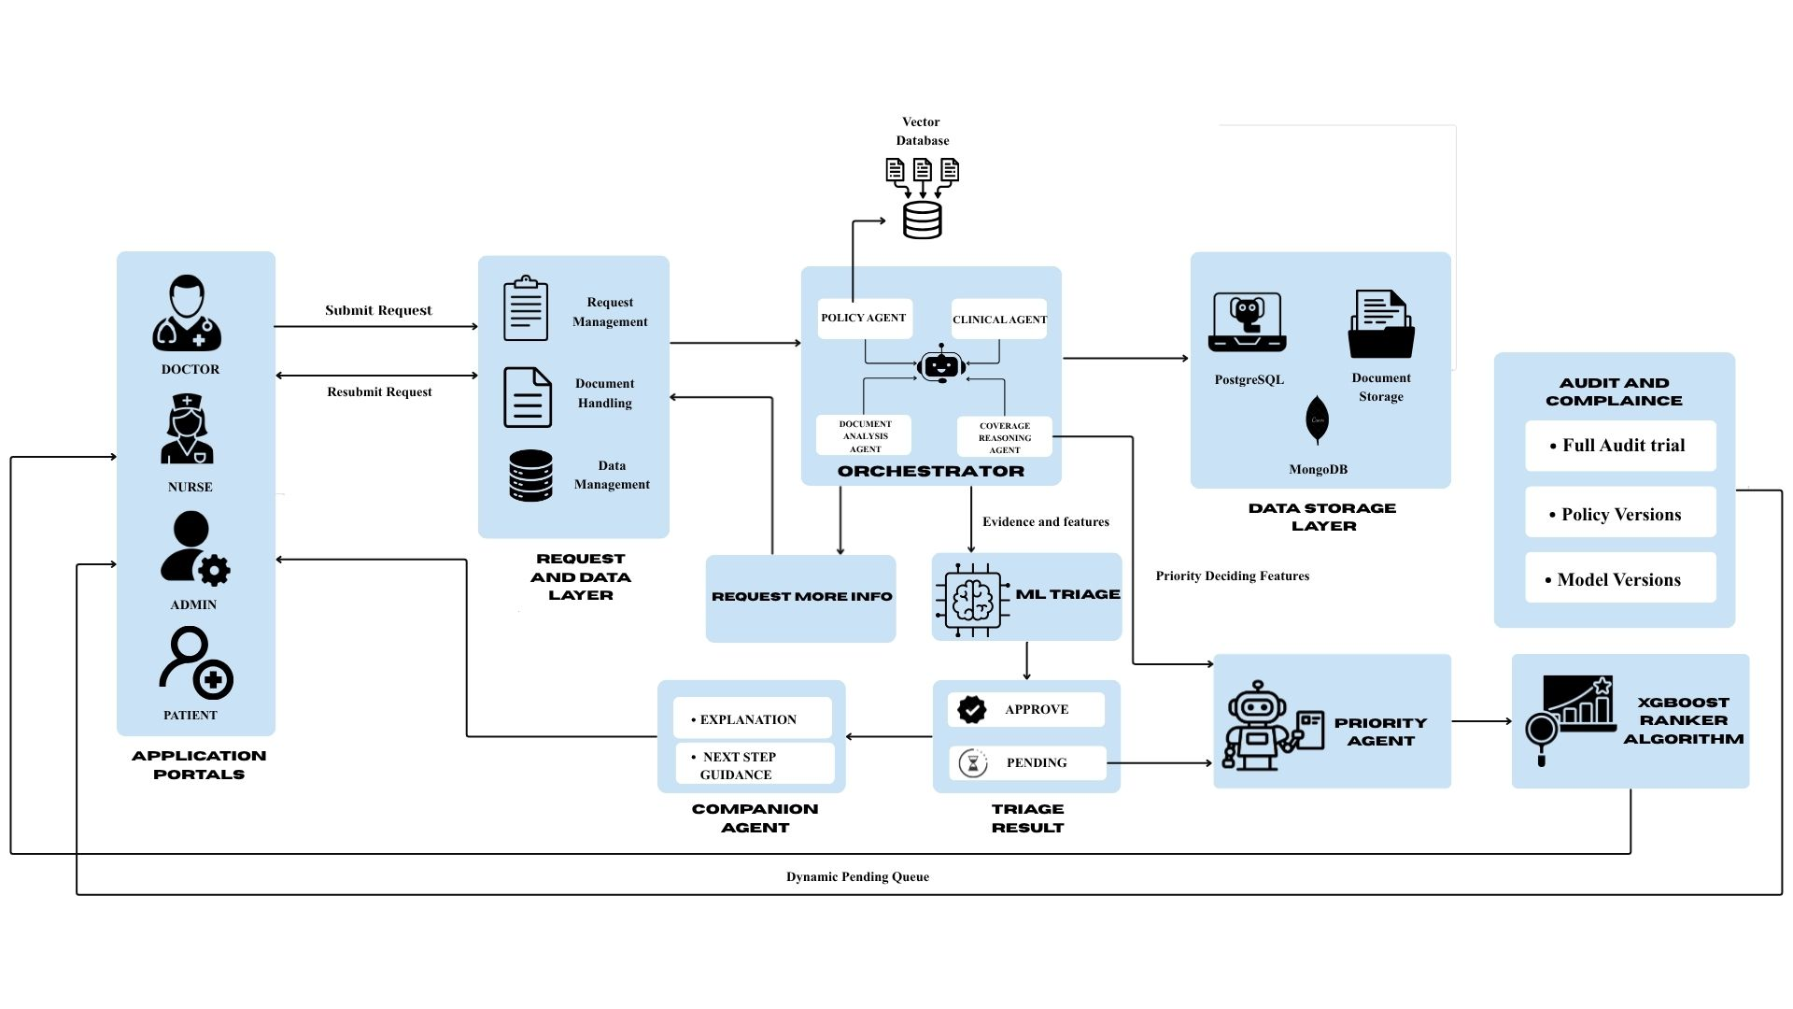
HOW IT WORKS
System Architecture
Requests flow from four role-based portals through an agent-orchestrated triage pipeline into a priority-ranked review queue — with policy versions, model versions, and every decision fully audited.
04

Slide 5
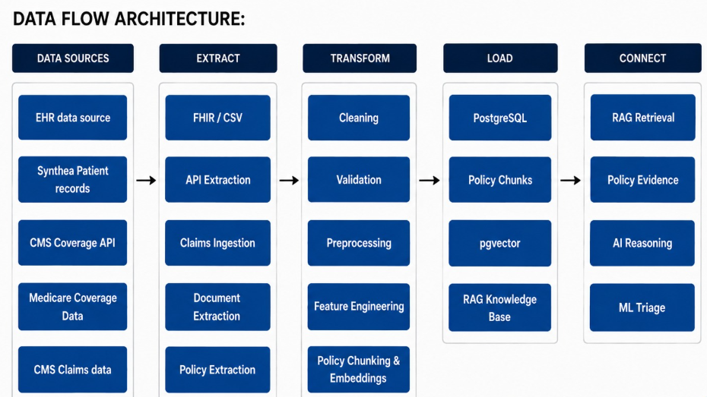

Slide 6
POLICY RETRIEVAL
Grounding Every Decision in Real Policy Text
Retrieved chunks give evidence for policy interpretation rather than relying on an LLM's pretrained memory of coverage rules.
Policy
Document
Text
Chunking
Sentence
Transformer
384-d
Embedding
pgvector
HNSW index
Cosine
Similarity
Top Policy
Chunks
EMBEDDING & STORAGE
TWO-STAGE RETRIEVAL
Vector store
Stage 1 — candidate policies
PostgreSQL 17 + pgvector — the same relational database as the rest of the app, not a separate system
Ranks each policy by its single best-matching chunk, filtered to the patient's payer and jurisdiction; keeps the top 3 within a 0.10 relative margin
Embedding model
Stage 2 — deep retrieval
sentence-transformers/all-MiniLM-L6-v2, 384 dimensions, cosine-normalized
Pulls up to 8 chunks per surviving policy (max 3 per section), returns up to 18 chunks total to the Policy Agent
Chunking
Confidence tiers
List-aware: named criteria become their own chunk; otherwise a 220-word window with 40-word overlap
distance ≤0.35 = HIGH · ≤0.50 = MEDIUM · above = LOW, converted to a continuous relevance score
Index
HNSW index on the embedding column, operator vector_cosine_ops
No matching policy → the request routes straight to PEND before the ML model ever runs.
06

Slide 7
DESIGN PHILOSOPHY
Agentic Design — Why Agents, What Each Does
Agents gather and structure unstructured evidence; a small, auditable ML model makes the actual call. None of the six agents below ever outputs APPROVE, PEND, or MORE INFORMATION.
Unstructured evidence
Explanation needs language
Repeatable decisions
Structural enforcement
Policy text & notes need reading, not raw math
A reviewer needs a reason, not a probability
Coverage calls must be reproducible & testable
Explanation runs only after the decision, never before
LLM AGENT
LLM AGENT
DETERMINISTIC
Policy Evidence Agent
Clinical Evidence Agent
Document Agent
Resolves the applicable policy, calls the RAG tool for real, and returns coverage status, criteria, and required documents.
Extracts clinical facts from the justification, grades each named policy criterion PASS / FAIL / UNKNOWN.
Deterministic keyword/category match of required vs. submitted documents — no LLM, no content understanding.
DETERMINISTIC
LLM AGENT
DETERMINISTIC
Coverage Reasoning Agent
Companion Agent
Priority Agent
Deterministic assembly layer — turns three evidence objects into the feature vector and gate flags the model reads.
Runs strictly after the decision exists; converts evidence into plain language and cannot revise the outcome.
Zero-LLM workflow — validates, computes queue features, and coordinates the XGBoost ranker.
05

Slide 8
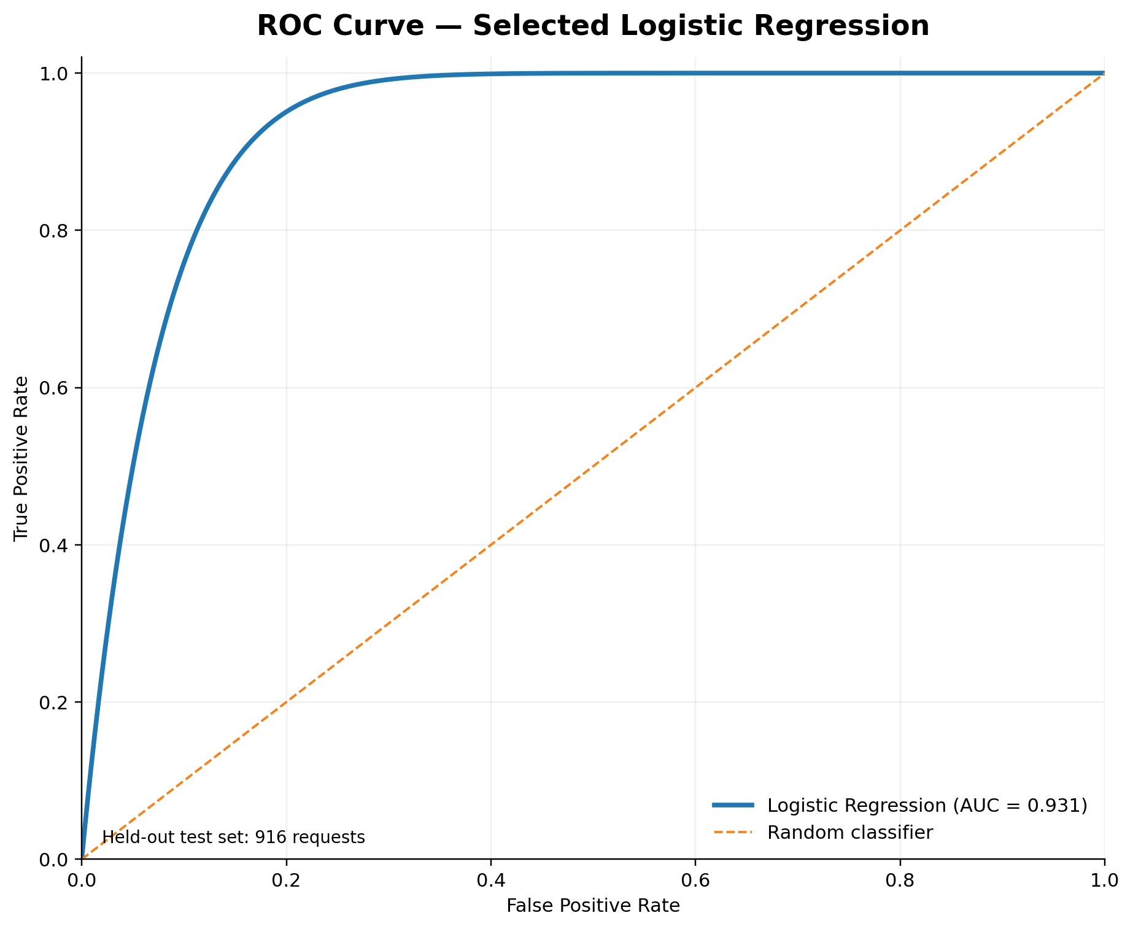
MACHINE LEARNING · MODEL 1 OF 2
Decision Intelligence
Regularized logistic regression (L1) · scikit-learn pipeline (StandardScaler → LogisticRegression) · decides APPROVE vs. PEND only after every safety gate has cleared.
TEST SET · 916 REQUESTS
4-FEATURE VECTOR
Metric | Value
Accuracy | 83.73%
Precision | 90.34%
Recall | 75.55%
F1 Score | 82.28%
ROC-AUC | 93.10%
1 policy_score
How strongly the retrieved policy evidence applies to the request
2 documentation_score
Proportion of required documents present
3 clinical_evidence_score
Proportion of named policy criteria satisfied
4 num_criteria_missing
Whether the diagnosis is policy-supported (zeroed by L1 when uninformative)
Dataset 14,000 requests across 9 Medicare service categories; one full category held out fully unseen. Threshold Tuned to reduce wrongful approvals — treated as 3× more costly than a wrongful pend. Why L1 Regularization zeroes out weak features automatically, keeping the model simple and fully explainable.
07

Slide 9
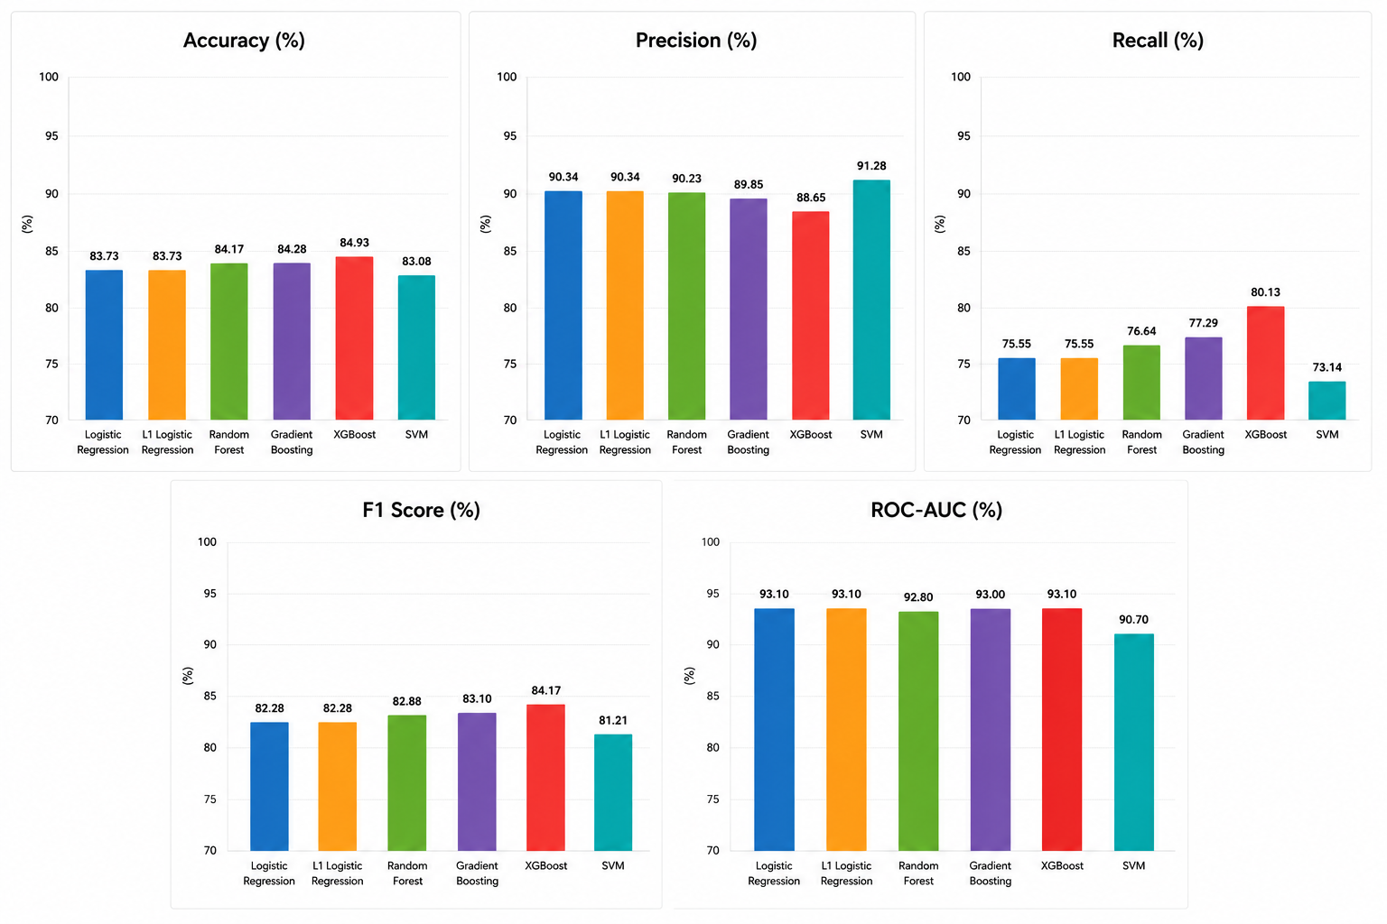
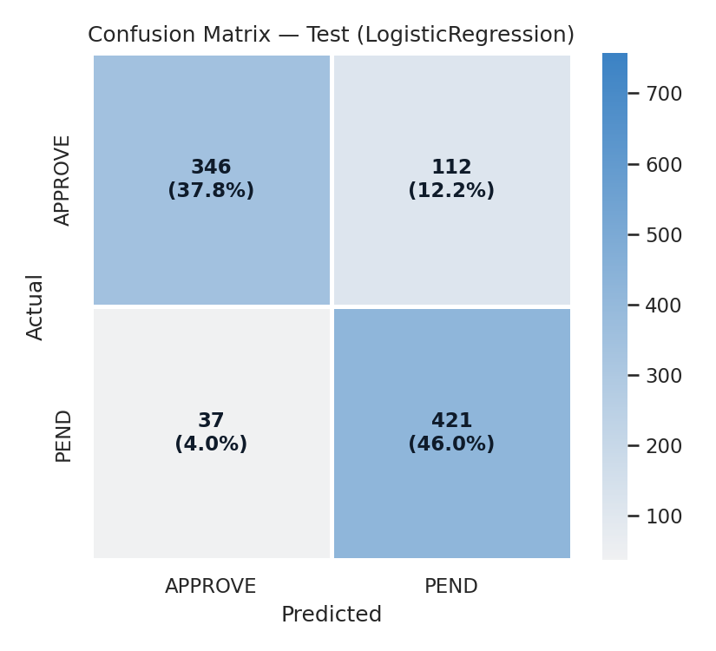
MACHINE LEARNING · MODEL 1 OF 2 · CONTINUED
Model Selection & Validation
Six classifiers were benchmarked head-to-head before selection; the chosen model was then validated on a held-out confusion matrix.
MODEL COMPARISON · 6 CLASSIFIERS EVALUATED
CONFUSION MATRIX · HELD-OUT TEST SET
Why Logistic Regression: it matched the strongest model (XGBoost) on accuracy and ROC-AUC, so the simpler, fully explainable model was chosen for production.
08

Slide 10
MACHINE LEARNING · MODEL 2 OF 2
Priority Intelligence
XGBoost Ranker (rank:ndcg) · re-orders an already-PEND queue only — it makes no medical decision and never touches an APPROVE or MORE INFORMATION case.
PEND
Authorization
Priority Agent
(no LLM)
Validate
Queue Case
Calculate
Queue Features
XGBoost
Ranker
Safety-aware
Priority
Priority Tier
+ Reasons
Nurse
Dashboard
9 QUEUE FEATURES
STATIC — reused from the original triage evaluation
policy_score
documentation_score
clinical_evidence_score
num_criteria_missing
DYNAMIC — recalculated on every queue load (time-sensitive)
hours_pending
sla_pressure
urgency_weight
98.3%
care_setting_weight
clinical_risk_weight
Test NDCG@5 — how well top-ranked cases match the priority rule
Why the split: what the triage pipeline already computed is reused as-is; what changes purely by the clock (queue wait, SLA pressure) must be recalculated every time the queue opens.
Output: a priority score, a queue position, and a short written reason per case. The queue recalculates regularly, so a longer wait moves a case up over time.
09

Slide 11
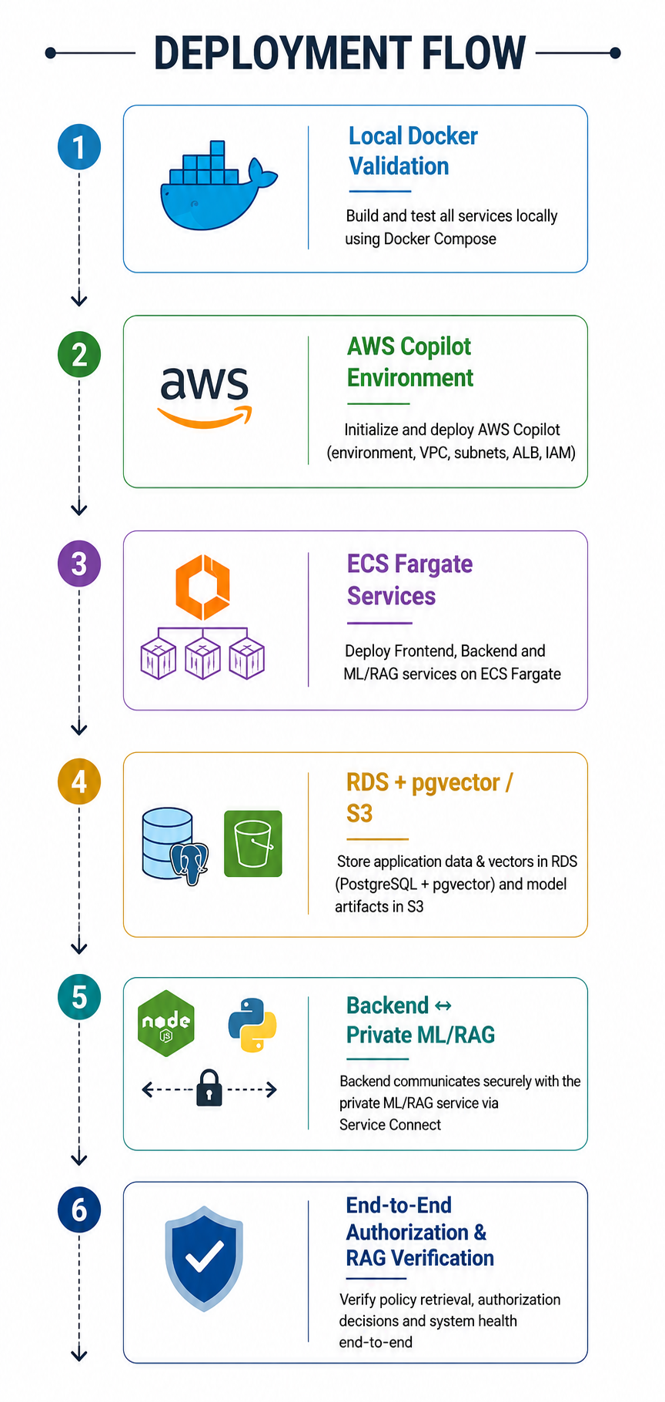
AWS Cloud Architecture
AWS-based Production Architecture:
Application Services:
Frontend: React/Vite → AWS ECS Fargate + Application Load Balancer
Backend: Node.js/Express → AWS ECS Fargate + Application Load Balancer
ML/RAG: Python FastAPI → Private ECS Fargate service
Data & AI Infrastructure:
Amazon RDS PostgreSQL 17 + pgvector → Application data & policy embeddings
Amazon S3 → Triage and XGBoost Ranker model artifacts
MongoDB Atlas → LangGraph agent checkpoint state
Networking & Security:
AWS Copilot → Manages ECS, VPC, networking, ALB and service infrastructure
Service Connect → Secure backend → ML/RAG communication
Private VPC/Subnets → RDS and ML/RAG protected from direct public access
SSM / Secrets Manager → Credentials, API keys and encryption configuration
11

Slide 12
WHAT IT'S BUILT WITH
Technology Stack
Application
AI & Orchestration
• React, Vite · react-three-fiber
• LangGraph workflow orchestration
• Node.js, Express · Sequelize
• Groq · openai/gpt-oss-120b
• Python, FastAPI (Triage API)
• sentence-transformers/all-MiniLM-L6-v2
• JWT + bcrypt authentication
• scikit-learn Logistic Regression
• XGBoost Ranker
Data Layer
Cloud & Infrastructure
• PostgreSQL 17 + pgvector
• AWS ECS Fargate
• MongoDB Atlas (agent state)
• Amazon RDS · Amazon S3
• Vector similarity search (HNSW)
• Application Load Balancer
• AWS Copilot
10

Slide 13
WHY IT MATTERS
Impact
✓
Patients get care faster
Doctors
Nurses
A request that used to sit in a manual review queue for days can be evidence-checked and routed in minutes
Spend less time chasing paperwork, more time with patients
Start every case with the evidence already gathered
✓
Doctors spend less time on paperwork
Physicians already call prior-auth paperwork a major burden — this moves the evidence-gathering work off their desk entirely
Admins
Patients
✓
Reviewers focus on judgment, not searching
A nurse opens a case with the policy, the evidence, and the reasoning already assembled — they decide, they don't dig
See exactly where automation helps and where it doesn't
Know their request is moving, and why a call was made
✓
Insurers reduce cost and compliance risk
Consistent, policy-grounded decisions cut reviewer-to-reviewer variation and the liability that comes with it
✓
Nothing is a black box
Every decision carries its evidence and reasoning — a patient, a doctor, or an auditor can always see why a call was made
12

Slide 14
CURRENT SCOPE
Limitations
Policy Coverage
Workflow & Scale
• Policy corpus is curated manually, not payer-synced
The current platform covers the core PA lifecycle from submission and evidence gathering through triage, prioritization, and review.
Additional authorization scenarios and workflow automations can be progressively added.
• Covers Medicare-style policies only, in English
• No multi-jurisdiction or state-specific rule variants yet
Model Scope
Priority Intelligence Is Limited to Pending Cases
• Decision model deliberately bounded to 4 structured features
XGBoost prioritization operates only after a request enters PEND.
Urgency and clinical risk drive review priority.
Priority intelligence manages queues, not authorization.
• No dedicated model yet for the "Request More Info" branch
13

Slide 15
WHAT'S NEXT
Future Plans
Government Scheme Integration (India)
Model Evolution
• Ayushman Bharat PM-JAY claims & pre-auth API integration
• Dedicated model for the "Request More Information" outcome
• Auto-map requests to Health Benefit Package rates & rules
• Feedback-driven retraining pipeline for both ML models
• ABHA ID verification for instant beneficiary lookup
• Multi-jurisdiction rule support — state & national schemes
Workflow & Automation
Platform & Product Expansion
Expand automated evidence extraction across authorization types
• Mobile app for doctors and nurses
Improve document intelligence for complex submissions
• Multi-language support — Hindi and regional languages
Enhance resubmission and missing-information workflows
• Direct payer/scheme policy feed, replacing manual ingestion
14

Slide 16
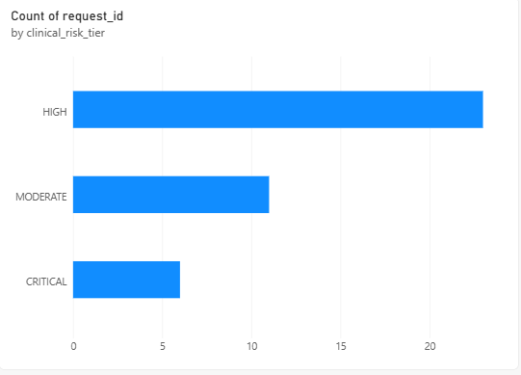
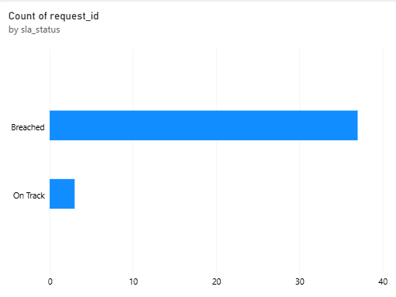
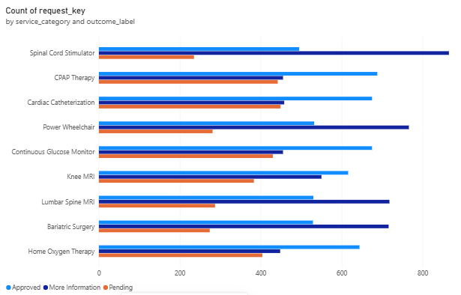
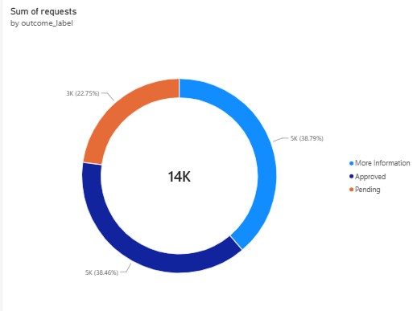
Power BI and Analytics:
14

Slide 17
WHY IT'S DIFFERENT
USP & KPIs
✓
Evidence-grounded, not guesswork
83.7%
81.5%
RAG-retrieved policy passages, not an LLM's memory
Model 1 test accuracy
Accuracy on a fully unseen service category
✓
Two-model separation
Evidence agents gather; small ML models decide and prioritize
✓
Fully explainable
98.3%
0.93
Readable formula + plain-language reasoning for every case
✓
Safety-first by design
Model 1 test ROC-AUC
Model 2 test NDCG@5 (priority ranking)
Deterministic overrides always outrank a learned score
✓
Complete audit trail
Full history across policy versions and model versions
15

Slide 18







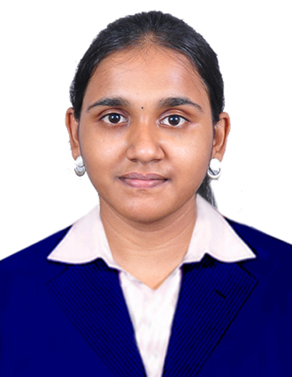
THE TEAM
Team Members
AN
JD
AR
KP
Abdullah .N
Leader, Backend + Agents + Cloud
Jean Kevin.D
Frontend + DB Management
Amish S R
R&D + Backend
Kavidharan.P
UI Designing + Cloud
VK
AM
HS
VS
Vishnupriyaa.K
Machine Learning
Arutselvy.M
Data Engineering + RAG
Harini.S
Frontend + Power-BI
Varsha.S
Research And Development + Presentation
16

Slide 19

Thank You
17

