Slide 1
REAL ESTATE ANALYTICS
Real Estate Price Analysis
Predicting Property Value from Location, Age & Amenities
Muhammad Abdullah
BS Computer Science · University of Chakwal
Python (EDA & Regression) · Tableau (Interactive Dashboards)

Slide 2
Objective
1
Understand Price Drivers
Identify which property and location factors most influence residential price per unit area.
2
Engineer & Transform Features
Extract time features from raw transaction dates and transform skewed variables to better fit a linear model.
3
Build a Predictive Model
Fit a multiple linear regression to estimate price from house age, transit distance, amenities, and location.
4
Communicate Findings Visually
Package the analysis into a reproducible notebook and an interactive Tableau dashboard for non-technical audiences.
Real Estate Price Analysis | 2

Slide 3
Dataset Overview
Residential transactions — Sindian District, New Taipei City
414
6
0
Transactions
Predictive Features
Missing Values
Feature | Description
transaction_date | Date of sale (decimal-year format)
house_age | Age of the property, in years
distance__mrt | Distance to nearest MRT (transit) station, meters
convenience_stores | Number of convenience stores within walking distance
latitude / longitude | Geographic coordinates
house_price_unit_area | Target — price per unit area
Real Estate Price Analysis | 3

Slide 4
Methodology
1
2
3
4
5
6
Clean
Engineer
Explore
Transform
Model
Evaluate
Standardize columns,
check nulls/duplicates
Extract transaction
year & month
Visualize trends &
relationships (EDA)
square(house_age),
log(distance to MRT)
Multiple linear
regression
R², Adj. R²,
RMSE, MAE
Each stage builds on the previous one — every transformation and modeling choice is driven by what the EDA reveals.
Real Estate Price Analysis | 4

Slide 5
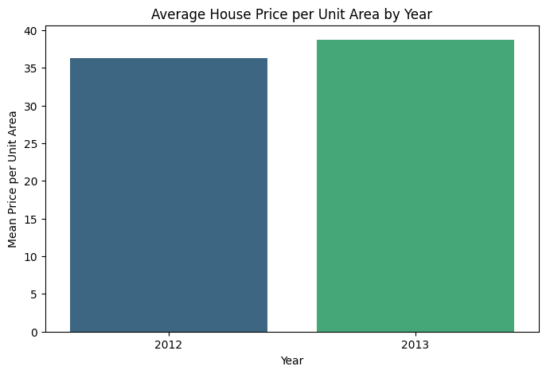
EDA — Yearly Price Trend
Key Insight
Total transaction value per unit area in 2013 was roughly 2× that of 2012.
Average price per unit area also rose year-over-year, suggesting genuine market appreciation rather than just higher sales volume.
Real Estate Price Analysis | 5

Slide 6
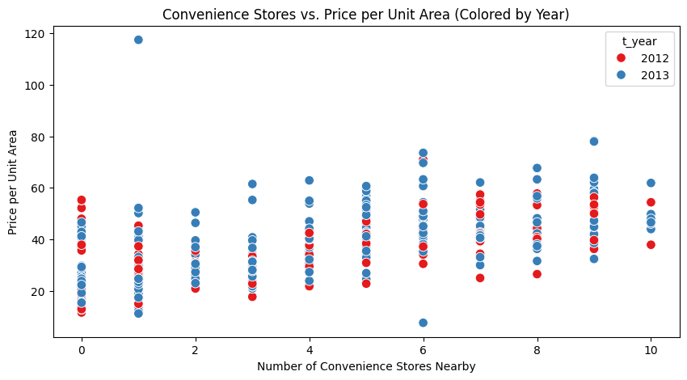
EDA — Amenity Effect
Key Insight
More nearby convenience stores tracks with higher price per unit area.
Walkability and amenity access are consistent value drivers across both 2012 and 2013 transactions.
Real Estate Price Analysis | 6

Slide 7
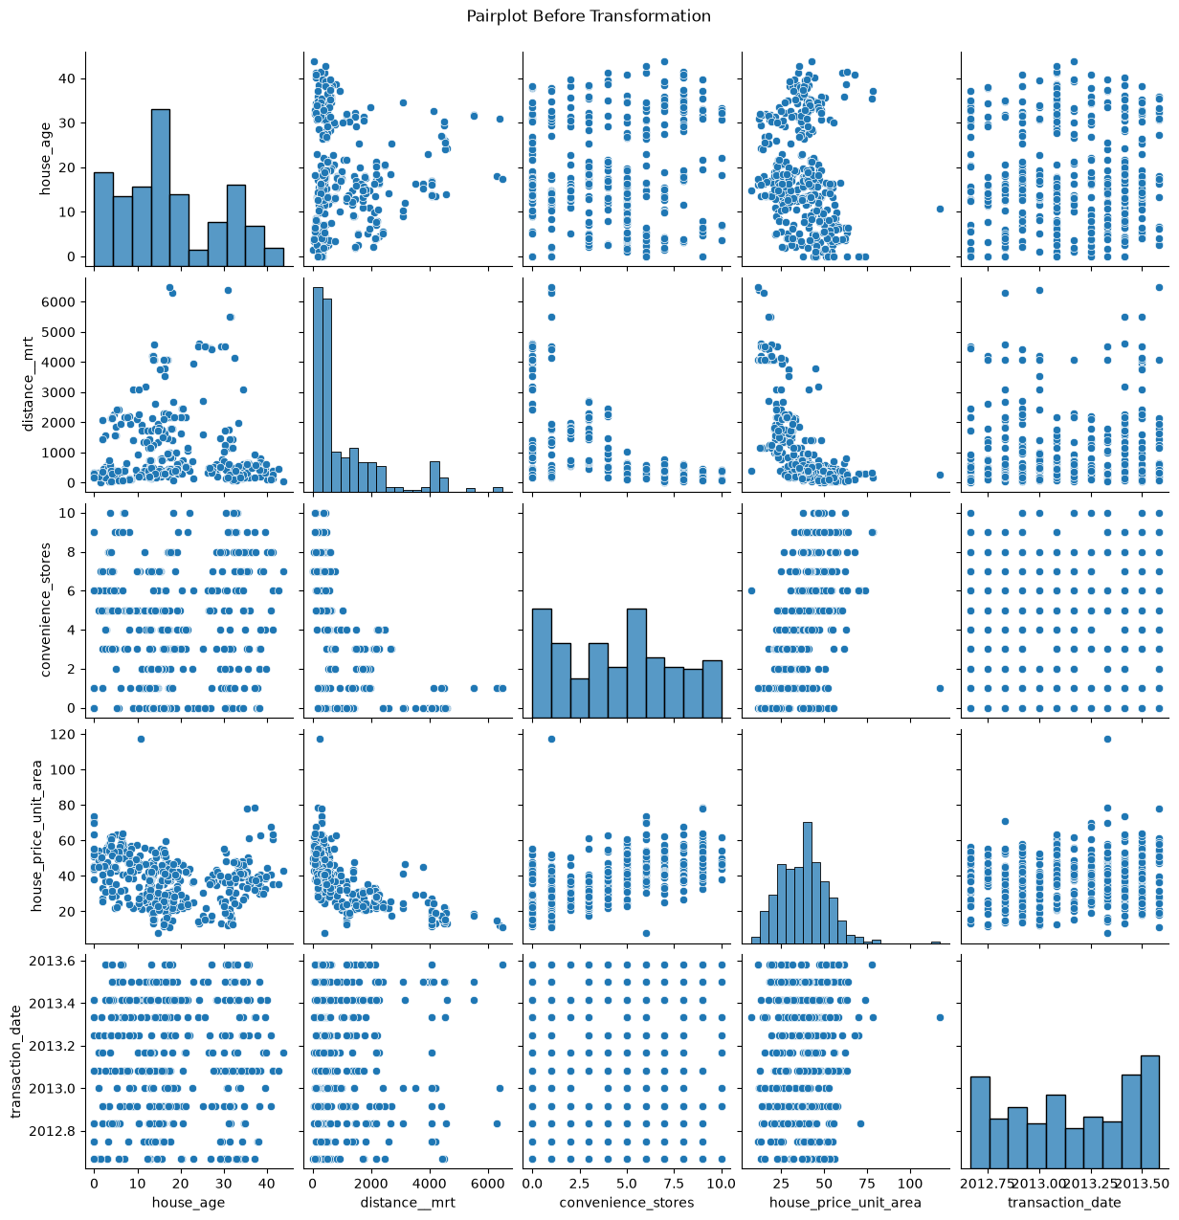
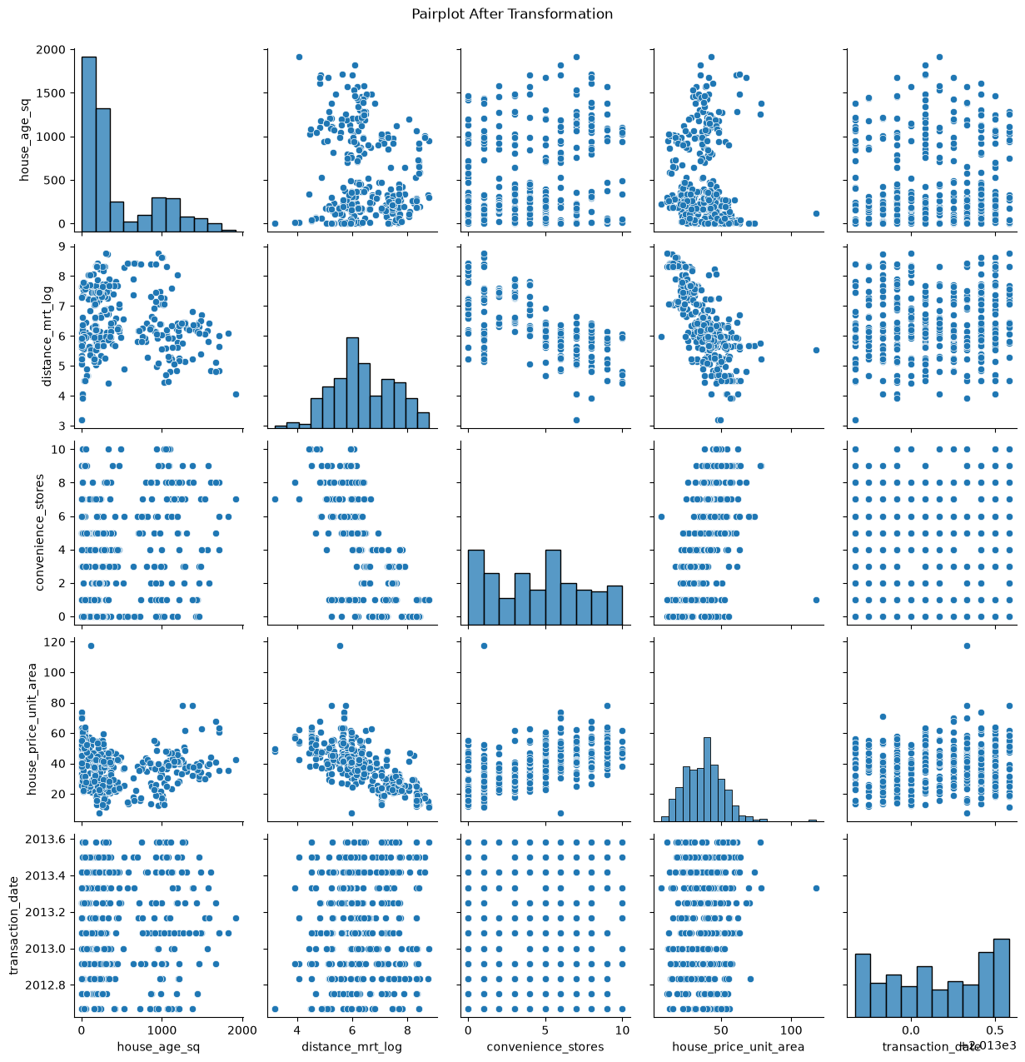
Feature Transformation
Before
After
house_age_sq
= house_age^2
distance_mrt_log
= log(1 + distance to MRT)
Reduces skew and straightens relationships with price before fitting a linear model.
Real Estate Price Analysis | 7

Slide 8
A Note on Location Features
The Limitation
The Decision
Price doesn't vary linearly with latitude/longitude. Two coordinates close together can carry very different prices depending on what surrounds them — a pattern a straight-line model can't represent well.
A tree-based model (Random Forest / Gradient Boosting) would capture this spatial signal better by splitting the region into local pockets.
For this linear regression, latitude and longitude were kept in rather than dropped — excluding them would discard real signal, and their coefficients remain directionally informative.
Real Estate Price Analysis | 8

Slide 9
Model — Multiple Linear Regression
Predictor Features
Target Variable
house_age_sq
house_price_unit_area
distance_mrt_log
Train / Test Split
convenience_stores
80% Train
20%
latitude
Test set held out for unbiased evaluation. random_state=42 for reproducibility.
longitude
transaction_date
sklearn.linear_model.LinearRegression() + statsmodels.OLS() for coefficient significance (p-values)
Real Estate Price Analysis | 9

Slide 10
Model Evaluation
Measured on the held-out 20% test set
0.716
0.693
6.91
4.45
R²
Adjusted R²
RMSE
MAE
Variance in price explained by the model
R² penalized for number of predictors
Typical prediction error, same units as price
Average absolute prediction error
Reading the Result
The model explains ~72% of the variation in price per unit area — solid for a 5-feature linear model on real transaction data. The remaining ~28% likely reflects the non-linear, spatial effects discussed on the previous slide, along with property-level factors (condition, floor, building quality) not captured in this dataset.
Real Estate Price Analysis | 10

Slide 11
Coefficients & Slope Interpretation
Holding all other features constant · from statsmodels OLS on the full dataset
Feature | Coefficient | p-value | Interpretation
house_age_sqrt | −1.928 | <0.001 | Older properties (transformed) sell for less
distance_mrt_log | −5.938 | <0.001 | Farther from transit → notably lower price
convenience_stores | +0.490 | 0.011 | Each nearby store adds modest value
latitude | +295.21 | <0.001 | Strong north-south price gradient
longitude | +24.71 | 0.480 | Not statistically significant in this model
longitude's coefficient isn't statistically significant (p = 0.48) — a reminder that not every included feature earns its keep, and that spatial effects here are dominated by the north-south (latitude) axis rather than east-west.
Real Estate Price Analysis | 11

Slide 12
Interactive Tableau Dashboard
📊
🤖
EDA View
ML Dashboard
Explore price trends by year, month, and amenity count with filterable, interactive charts.
Visualizes model predictions, coefficients, and prediction error against actual sale prices.
https://public.tableau.com/app/profile/muhammad.abdullah6976/viz/RealEstateMaeketAnalysis/EDAView
https://public.tableau.com/shared/5TW74TFJG?:display_count=n&:origin=viz_share_link
Real Estate Price Analysis | 12

Slide 13
Key Takeaways
Transit distance and house age are the strongest, most significant price drivers in the model.
Amenity access (convenience stores) adds modest but statistically significant value.
Location coordinates are better suited to tree-based models — a clear next step for improving accuracy.
The linear model explains ~71% of price variance (R² = 0.708) on unseen data — a solid, interpretable baseline.
Thank you
Muhammad Abdullah · Kaggle & GitHub portfolio
Real Estate Price Analysis | 13

