Slide 1
Superstore Sales & Profitability Analysis
Identify Key Business Insights
Presented by: Muhammad Abdullah
Last Updated: September 9th , 2025

Slide 2
Objective
Analyze Superstore dataset to identify key business insights
Time period: Jan 3, 2014 – Dec 30, 2017
Focus: Balance revenue growth with profitability across segments and ship modes, with supporting cuts by region and category

Slide 3
Data Summary
Data source: Superstore Sample Dataset from Kaggle
Size: ~ 10,000+ rows , 20+ columns
Prepared in R : Using readr , janitor , dplyr , and ggplot2 libraries
Columns used : Revenue , Profit & Profit Ratio , Segments and Ship Mode
Data was cleaned before importing into Tableau for visualization

Slide 4
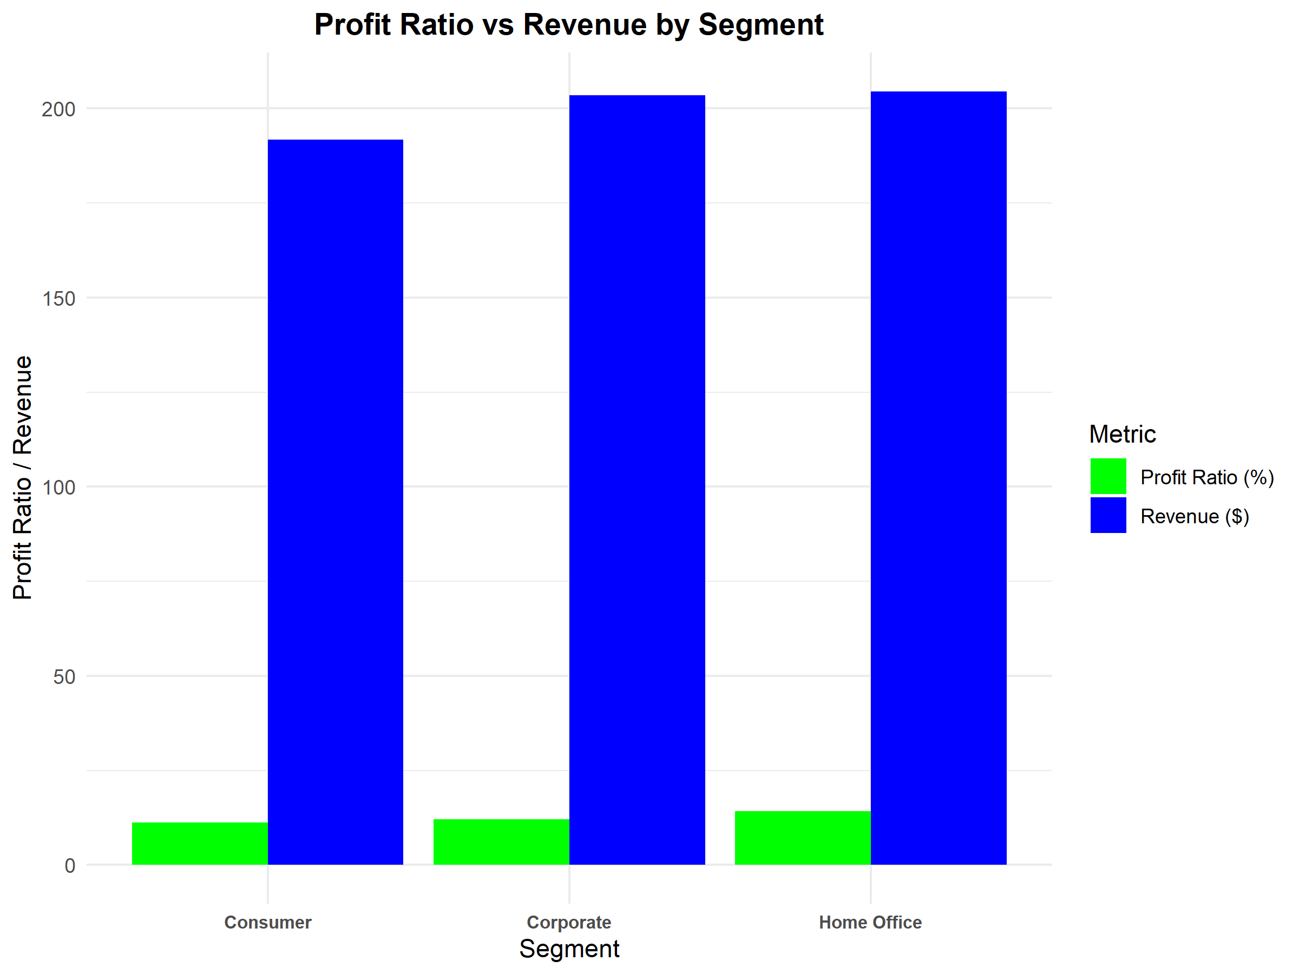
Profit Ratio vs Revenue by Segment
INSIGHTS :
Home Office delivers the highest revenue and
profit ratio, while Consumers shows weaker Revenue.

Slide 5
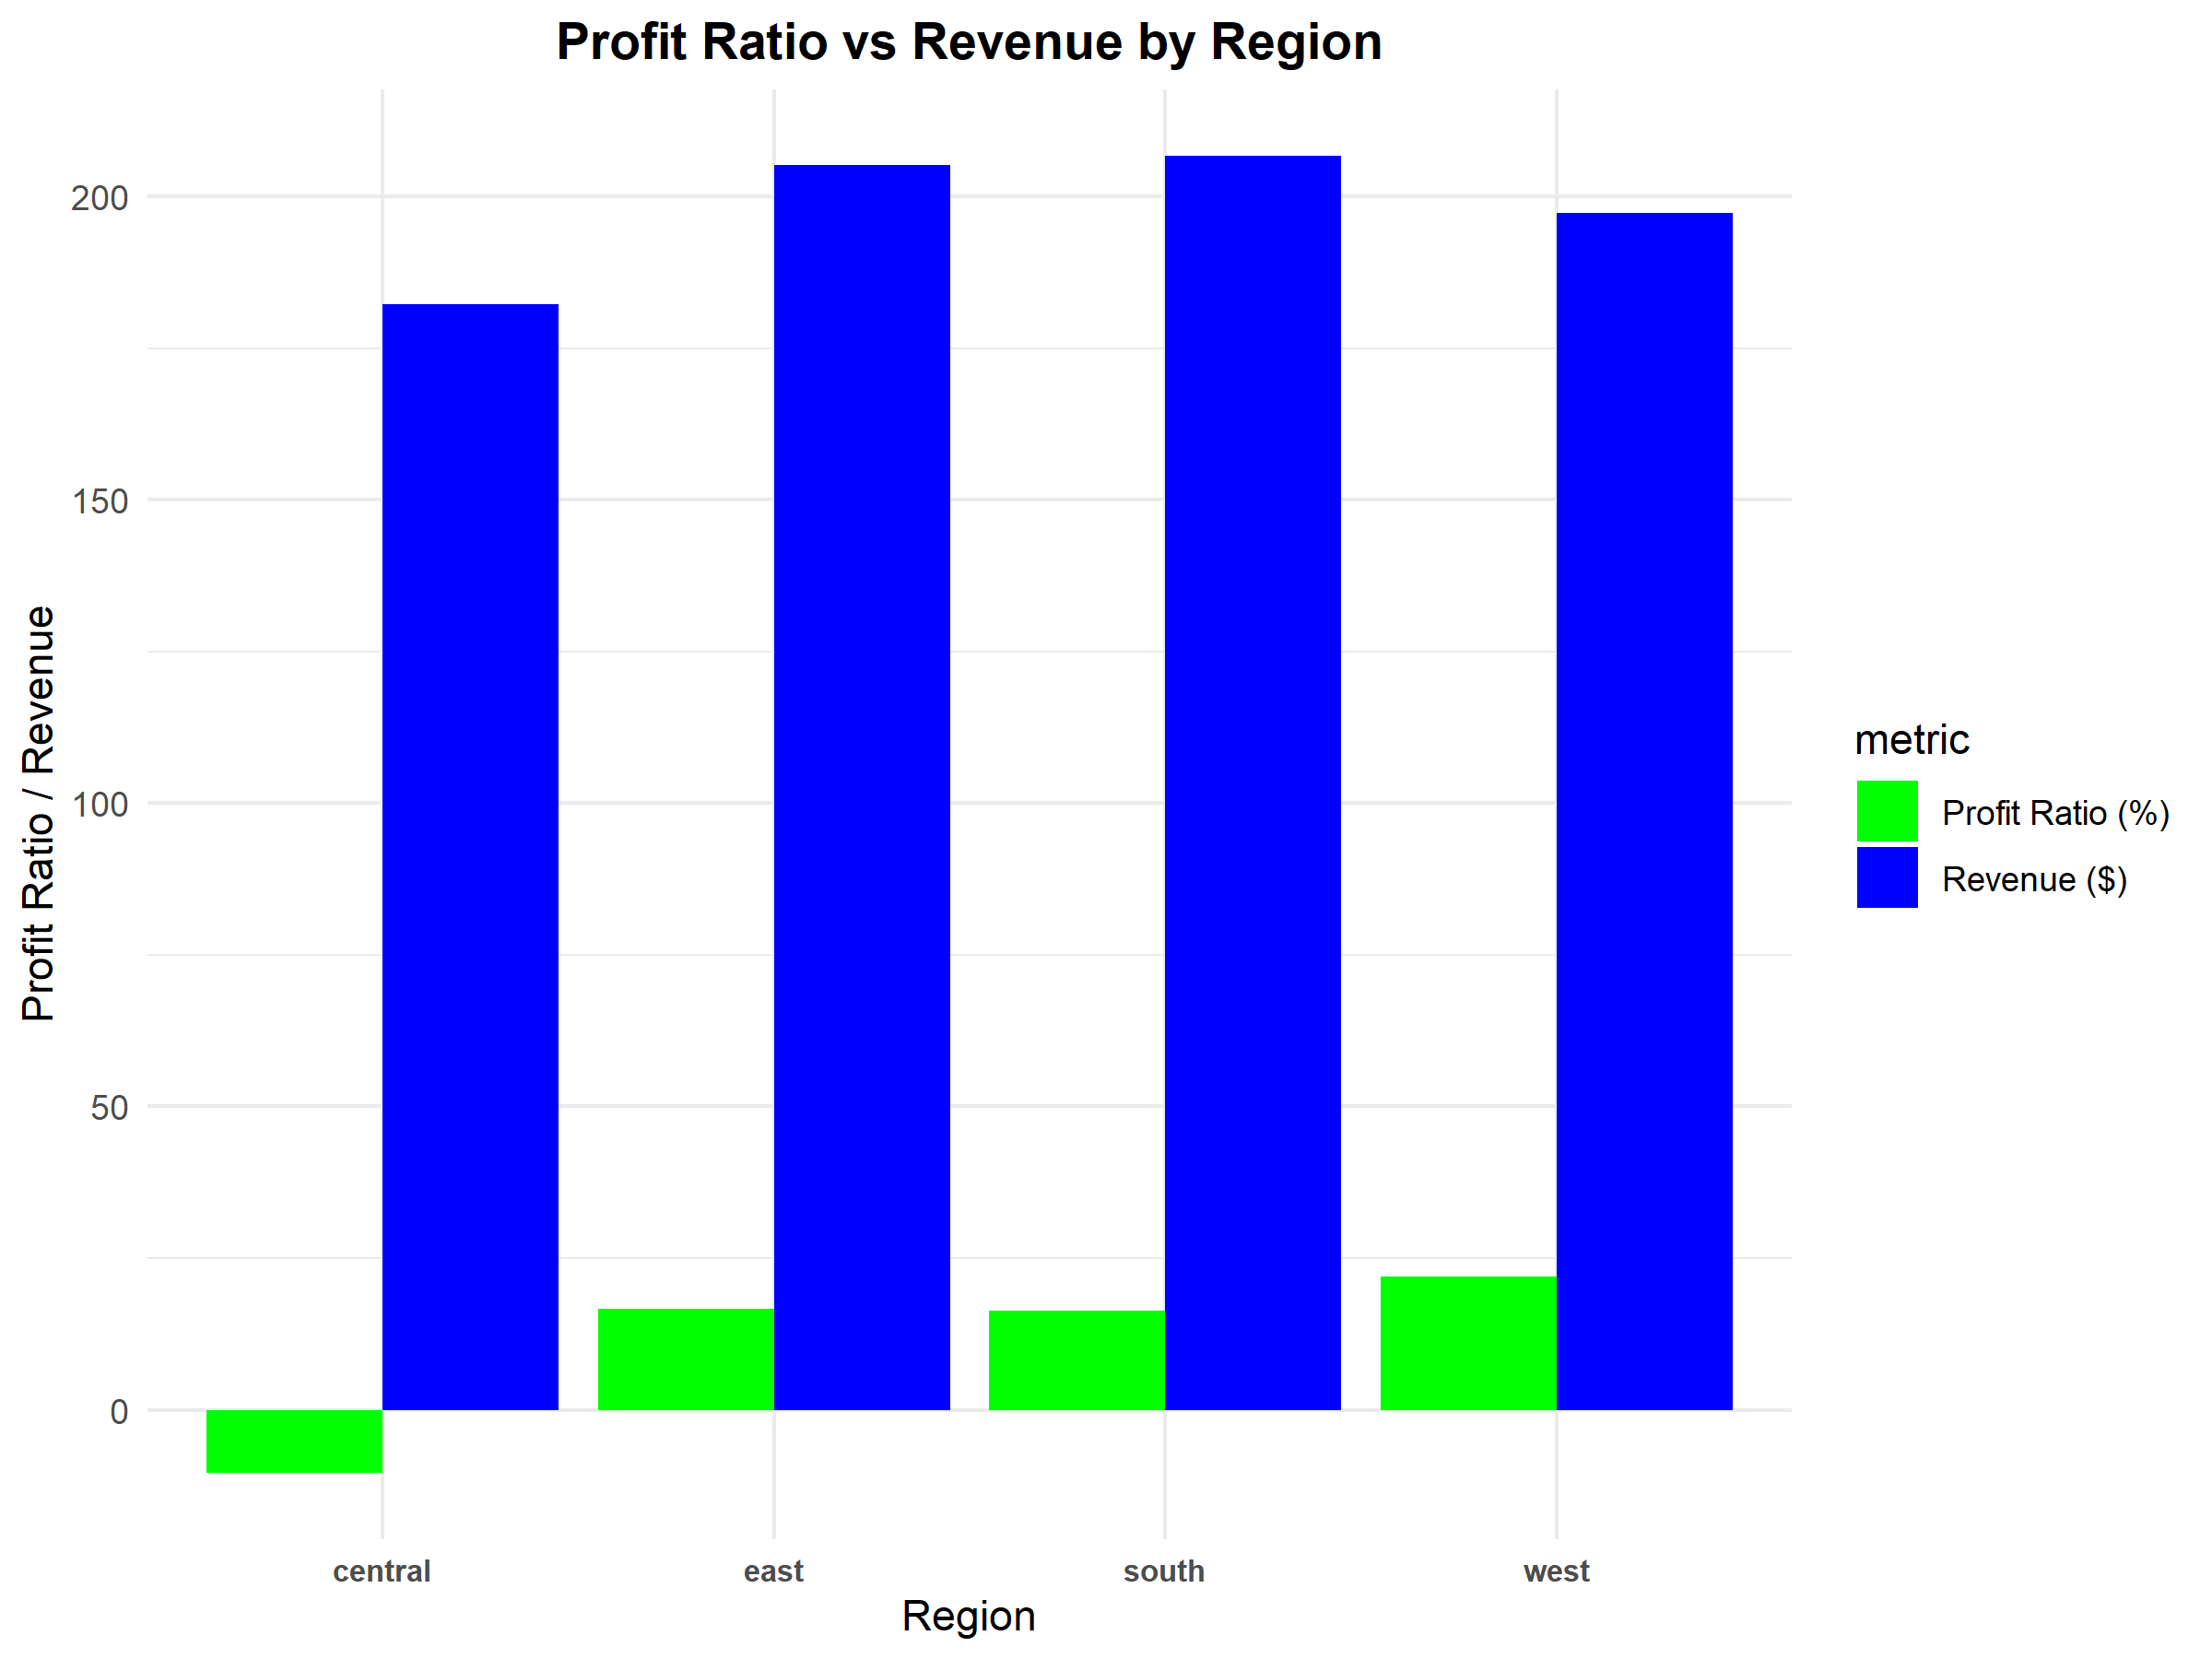
Profit Ratio vs Revenue by Region
INSIGHTS :
The South Region region leads in both Revenue and profitability, whereas the Central Region lags behind with lower margins especially negative profit ratio

Slide 6
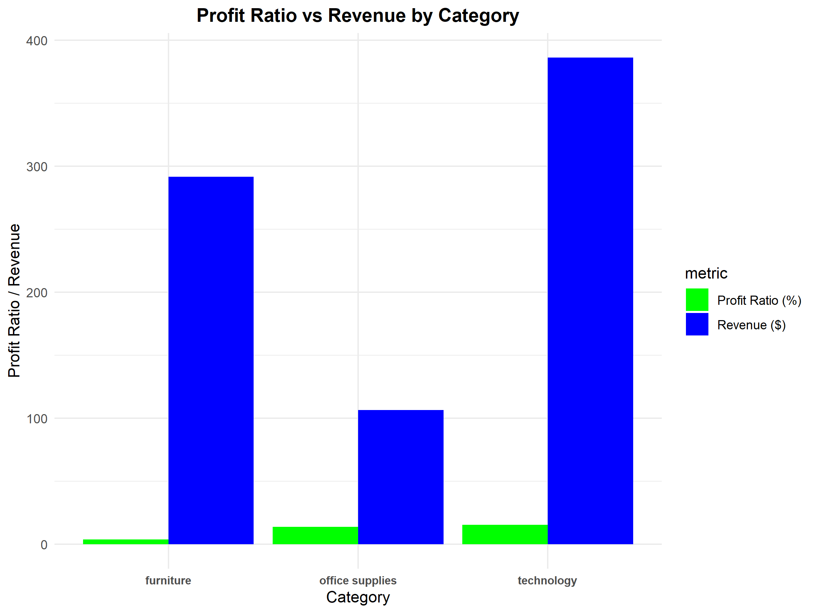
Profit Ratio vs Revenue by Category
INSIGHTS :
Technology and Office Supplies yield higher profit margins, while Office Supplies have least Revenue and Furniture holds very small Profit Ratio

Slide 7
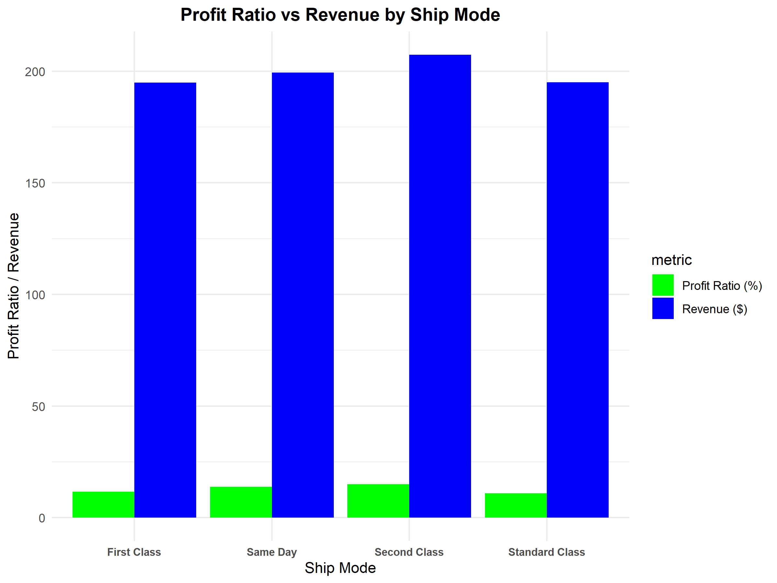
Profit Ratio vs Revenue by Ship Mode
INSIGHTS :
Standard and Same Day shipping are most cost-efficient, while Standard Class and First Class raise costs and also with good proportional gains.

Slide 8
Recommendations
Prioritize Home Office Segment: Enhance loyalty programs & promotions.
Improve Corporate Efficiency: Optimize discounts, reduce shipping costs.
Focus on Profit Ratio Monitoring: Track profitability alongside sales, not just revenue.
Balanced focus on efficiency + customer satisfaction is key.

Slide 9
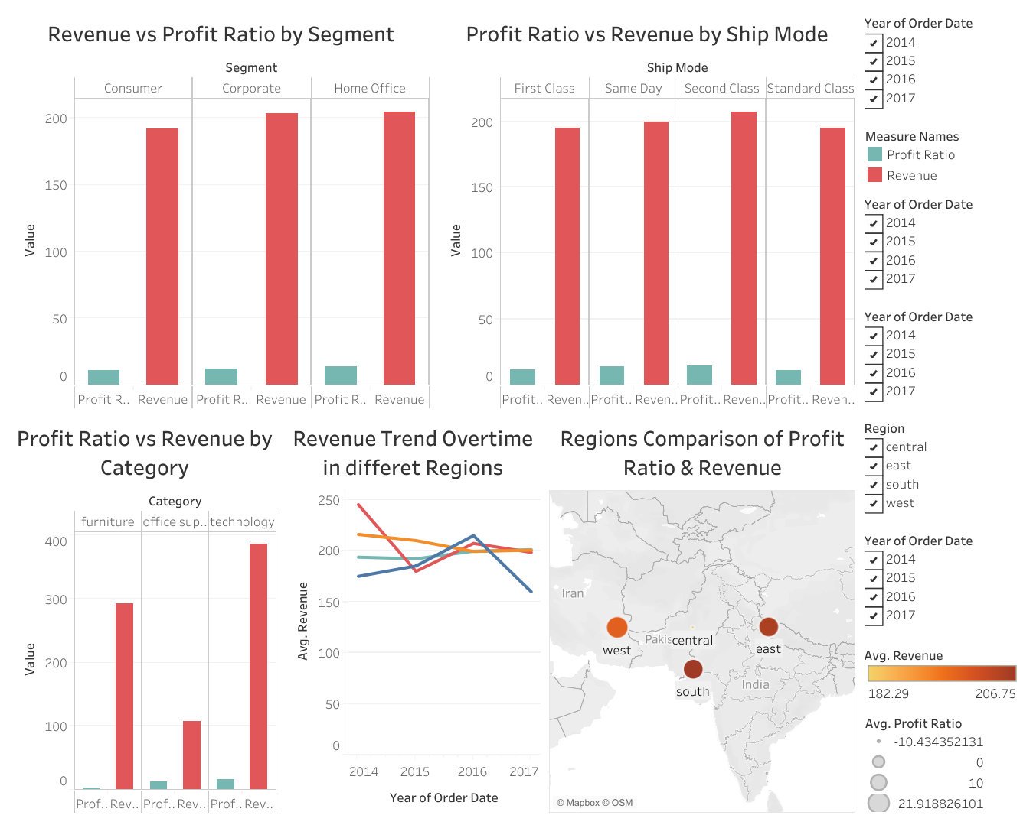
Dashboard

Slide 10
Thank you ..!

